Slide 1
THE 2019 COHORT
M.Ed. In Higher Education Administration

Slide 2
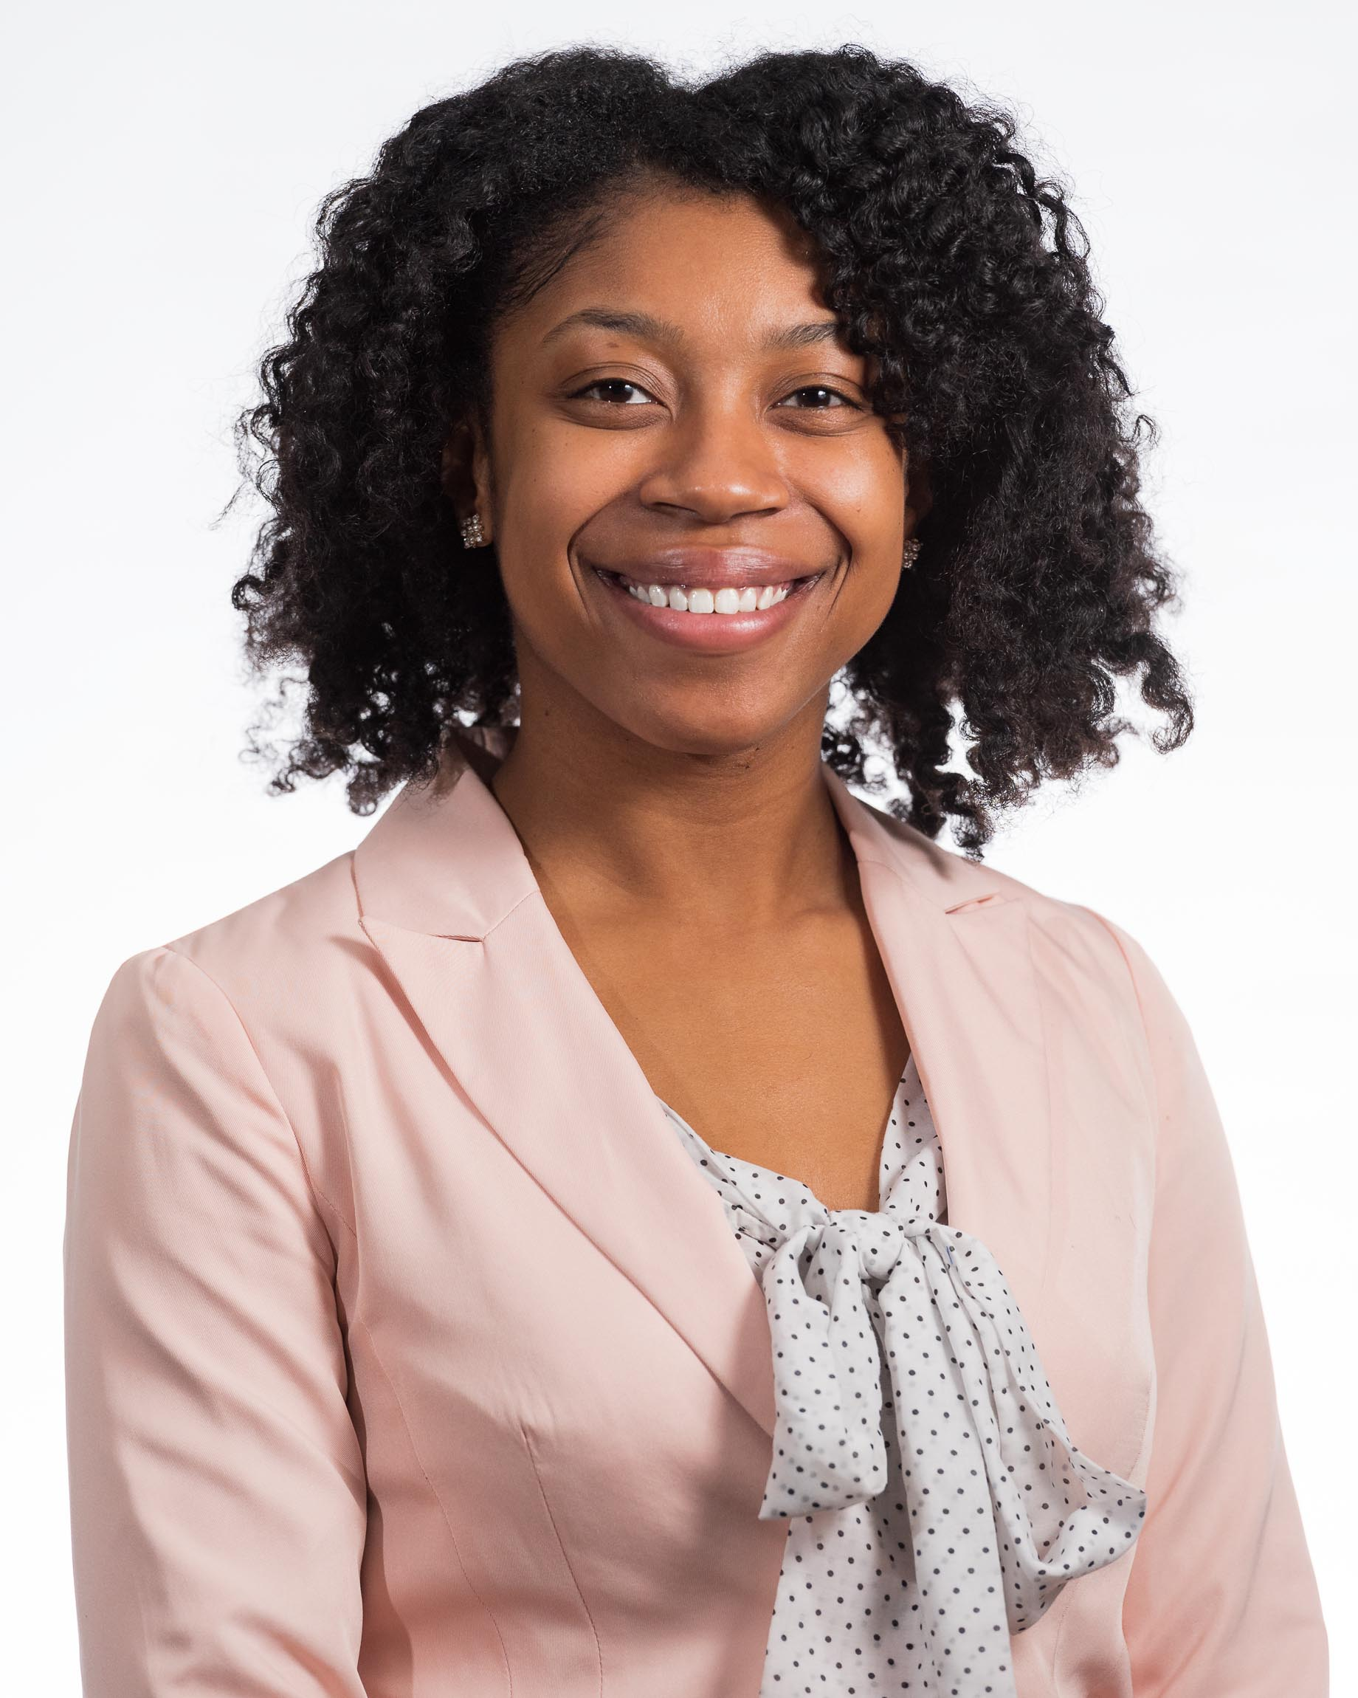
MAKAYLA ALFRED
Hello All, my name is MaKayla Alfred and I am a second year Graduate Student in the Higher Ed Program at the University of Toledo. I am currently working as a Graduate Assistant for the Dean of Students office with a focus in the Camp Adventure Program and in Residence Life as a Residential Intern. In addition to this, I have completed a practicum as an ACUHO-I intern at the University of Miami in Florida as a Residential Life Intern as well. In regards to the future, I am hoping to accept a full time entry level position in Residence Life in hopes to learn and work with other functional areas within the Student Affairs department.

Slide 3
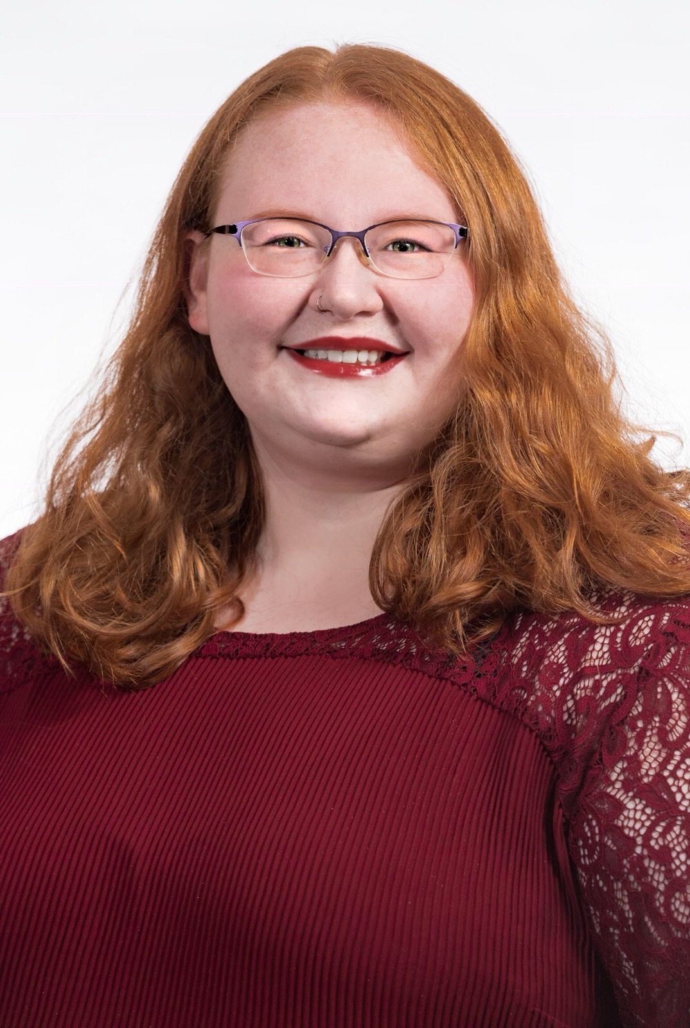
ASHLEY ANDREWS
Through my time at UT, I have been a Graduate Assistant for the Office of Residence Life, working in Carter Hall and International House. I completed my practicum in a facet of residence life, working in Housing Administration and gaining a deeper insight of into the components that make up Housing and Residence Life. Though the future is unclear, I would like to continue working in Residence Life in some capacity, increasing the development of diversity and inclusion efforts throughout the residential communities.

Slide 4
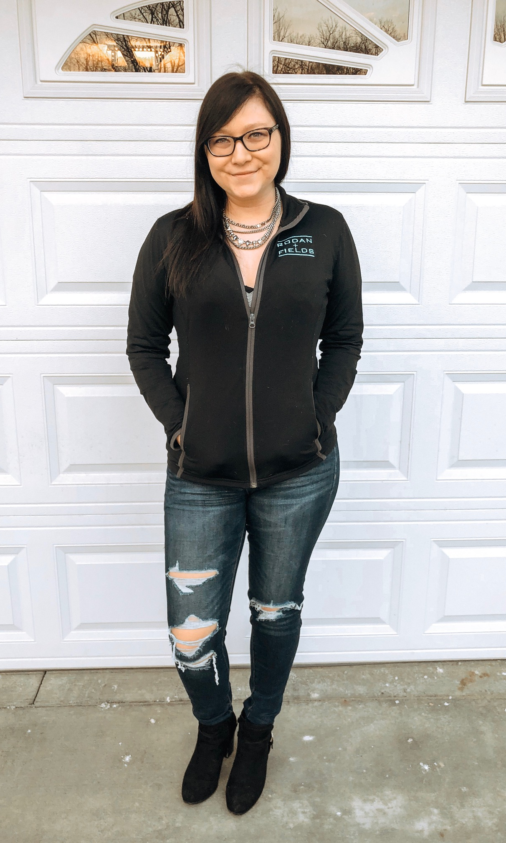
KATIE CARVER
I completed my practicum working in TRIO at UT on the Program Assessment for the Grant renewal. Currently, I work full time with Redwood Living Inc. as a Multi-Site Leasing Professional. Property management is a new realm for me but it is very rewarding, and the company culture is beyond amazing. In addition, in my free time, I am an Independent Consultant for Rodan + Fields and have a large passion for my business. I will be pursuing an MBA in Marketing beginning this summer. Marketing has become a huge passion of mine! Redwood is paying for my degree because they value further education, and encouraged me to apply to the program! 🙂 I do not think I will pursue Higher Ed in the near future. I currently love my company and position. If I do pursue Higher Ed, I would like to go the route of advising or marketing.

Slide 5
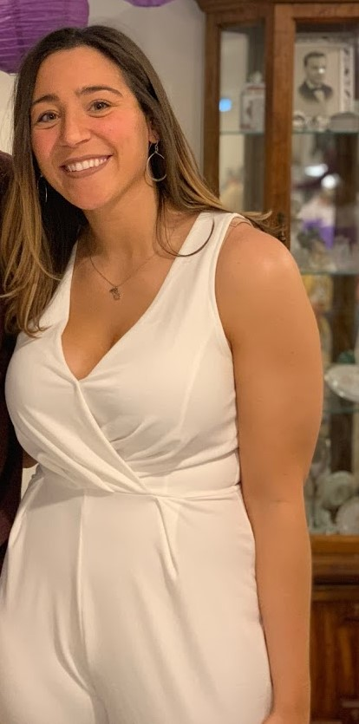
RYAN CRUDDER
I currently work as an Assistant Director in the College of Engineering. My primary responsibility is working with students transferring outside and within the university. My hopes for my future career is to continue to work with students in academic affairs, however I plan on working closely with the Engineering Living Learning Community in the near future.

Slide 6
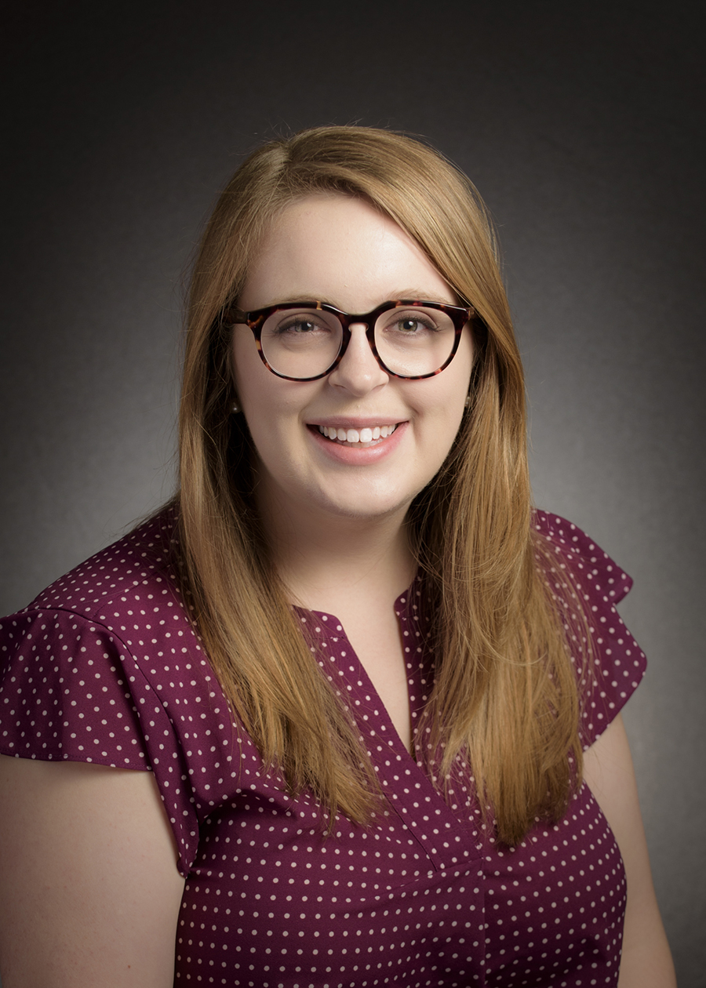
MEREDITH ERRINGTON
I am currently the Technology Services Manager in the Office of Information Technology Services at Lourdes University. I also did my practicum in this office, as a Technology Support Specialist. For the future, I am still deciding if I want to stay in Higher Ed on the IT side of things, or if I want to branch out to another functional area like the Registrar's Office or maybe advising!

Slide 7
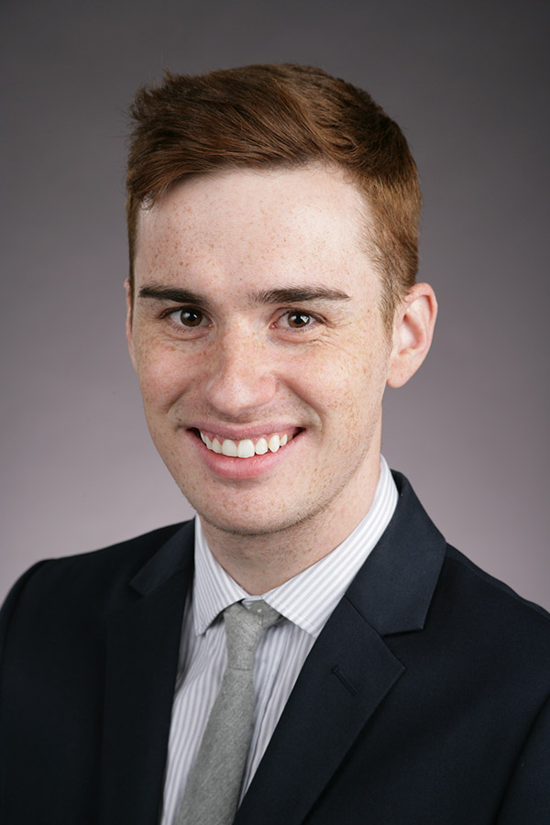
ADAM LEE
I have spent the last four years working in The University of Toledo’s Office of Undergraduate Admission as an Admission Counselor. My time in the Office of Undergraduate Admission has provided me countless opportunities to connect with incoming students that initiated my interest in working in higher education. I have recently accepted a new position in The University of Toledo’s College of Law as the Assistant Director for Law Admission Communication. I look forward to contributing to the future success of UT’s College of Law in my new position.

Slide 8
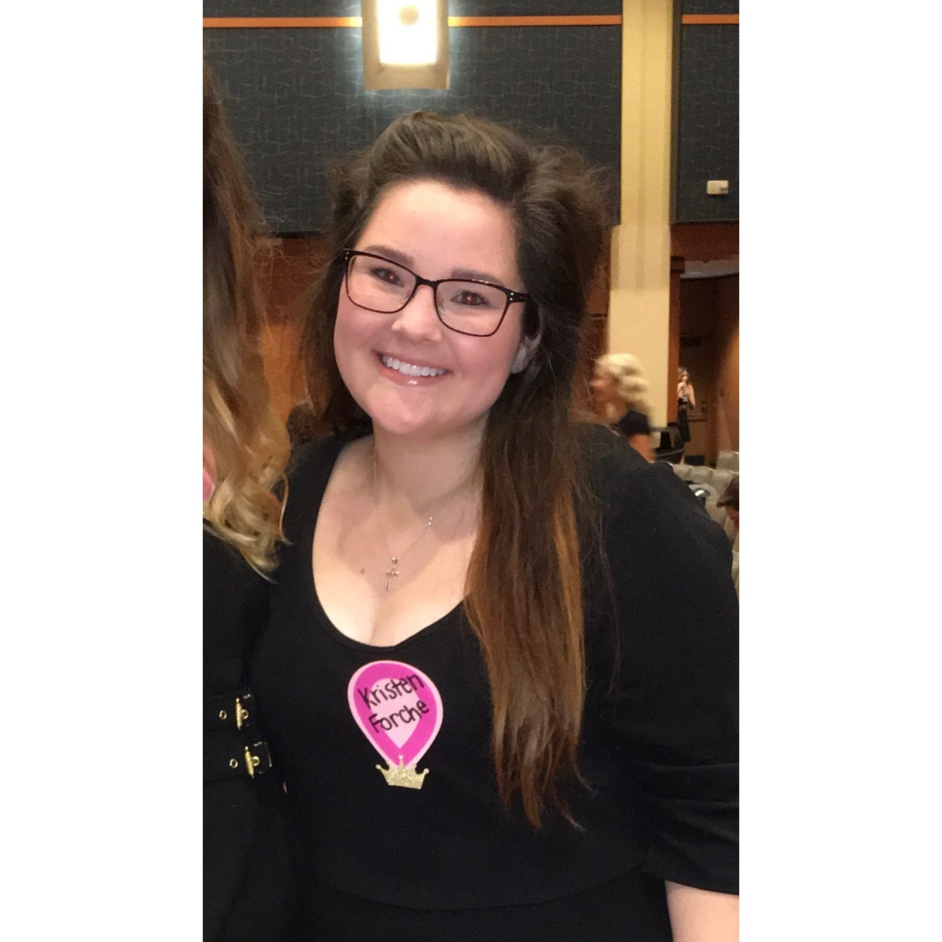
KRISTEN FORCHE
I did my practicum experience at Owens Community College in the Academic Advising Department. From there I was offered an interim Academic Advising position in the School of Business at Owens Community College which later was made a permanent position. I was in that role for just over a year and a half before I decided to accept a job at the Ohio State University as an Academic Advisor 2 in the School of Chemical and Bimolecular Engineering. I’m not entirely sure what my hopes are for my career but I’m happy in my current position and in the choices I've made this far in my career. I do hope to always keep an open mind to different job opportunities!

Slide 9
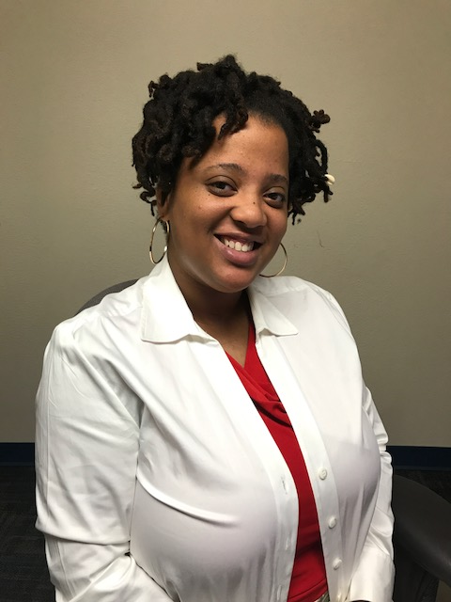
JASMINE JENKINS
I had the pleasure to complete my practicum with the Vice President for Student Affairs Dr. Cockrell and his office. I am also obtaining additional experience working with the TRIO Student Support Service here at UT. I look forward to working in higher education with a particular interest in multicultural programming and advising geared towards the retention of underrepresented and first generation students.

Slide 10
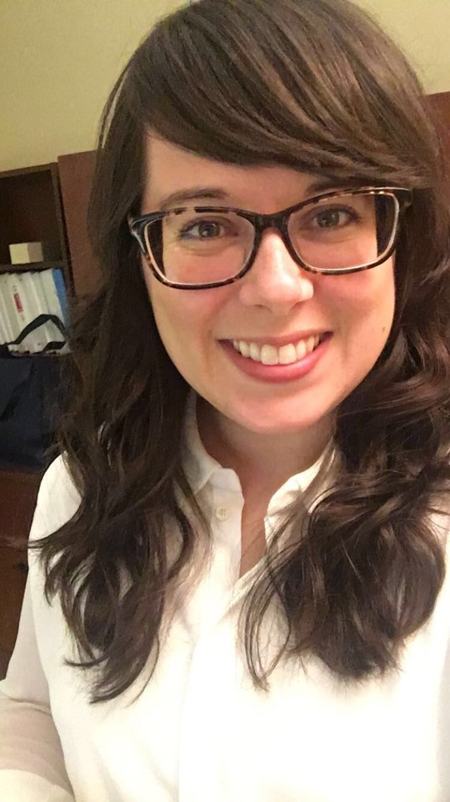
BRITTANY KIM
I have had the pleasure of working as a graduate assistant to our program faculty for the past two years. I completed my practicum last fall in Workforce and Community Services at Owens Community College, where I had the opportunity to coordinate with local business owners in creating personalized training programs for their employees. This experience sparked my interest in higher education’s relationship to the local community and economy. It is my hope that my career will lead me to a position in which I will be able to work within this realm, strengthening partnerships between an institution and its stakeholders and ensuring that the university is best serving both its students and its local community.

Slide 11
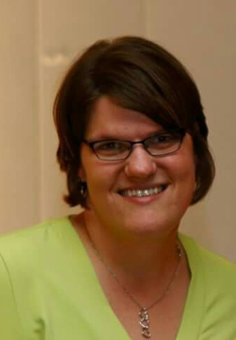
HEATHER NASH
I completed my practicum in the Student Disability Services Office at the University of Toledo. My goal is to obtain employment in higher education in either disability services, advising, or as a success coach.

Slide 12
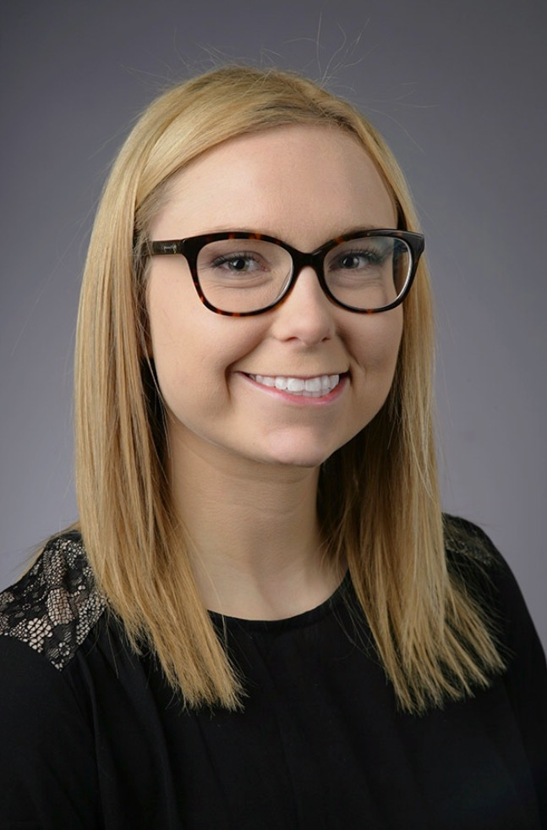
KELSEY O’BRIEN
Graduate Assistant for Student Involvement where I support student organizations and advises Campus Activities & Programming and the Student Allocation Committee. I did my practicum in Commuter Student Services. I hope to obtain a job working in student activities. ~chill vibes~

Slide 13
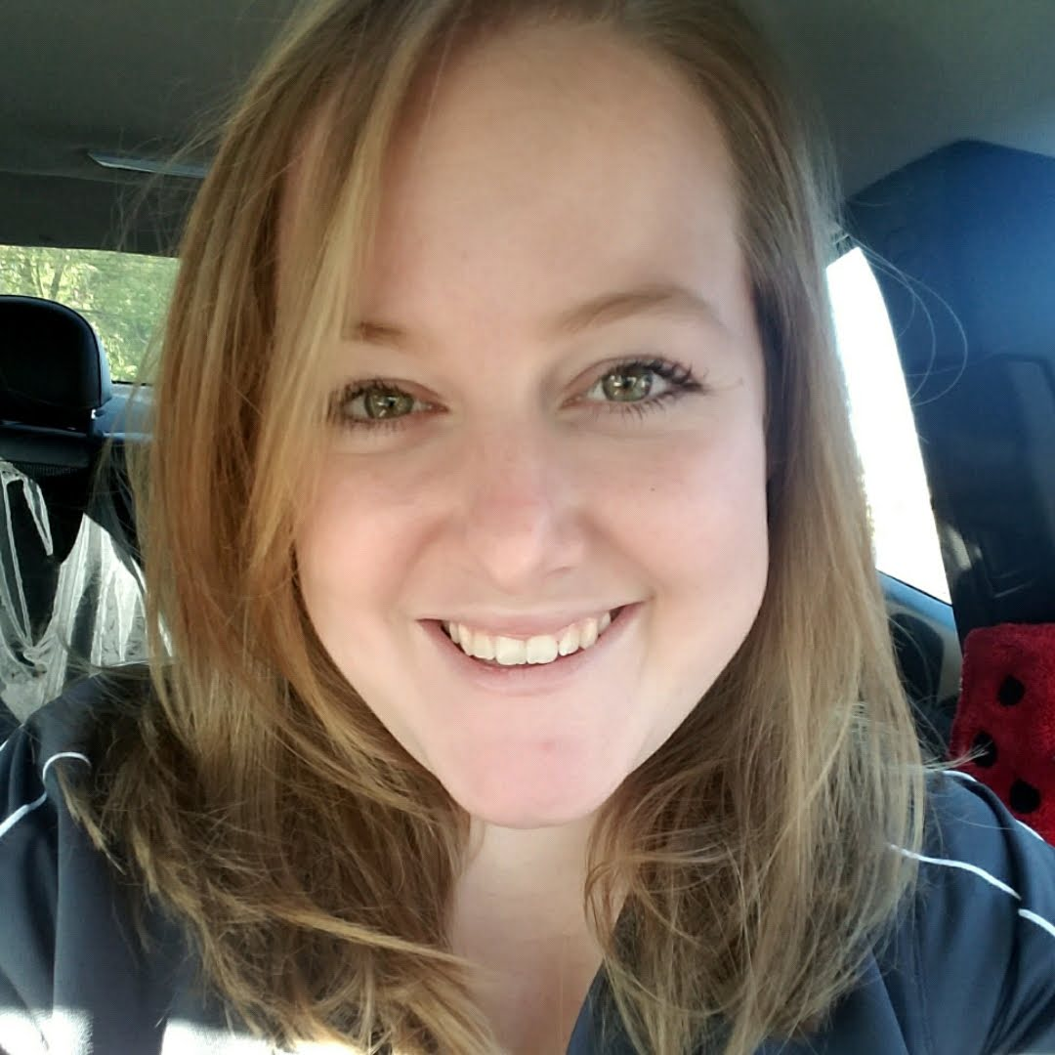
AUGUSTA SCHMIDT
I did my practicum at LSU in Camps and Conferences. I currently work in the Office of Residence Life here at the University of Toledo. I have accepted a position at University of Wisconsin - Stevens Point as a Hall Director.

Slide 14
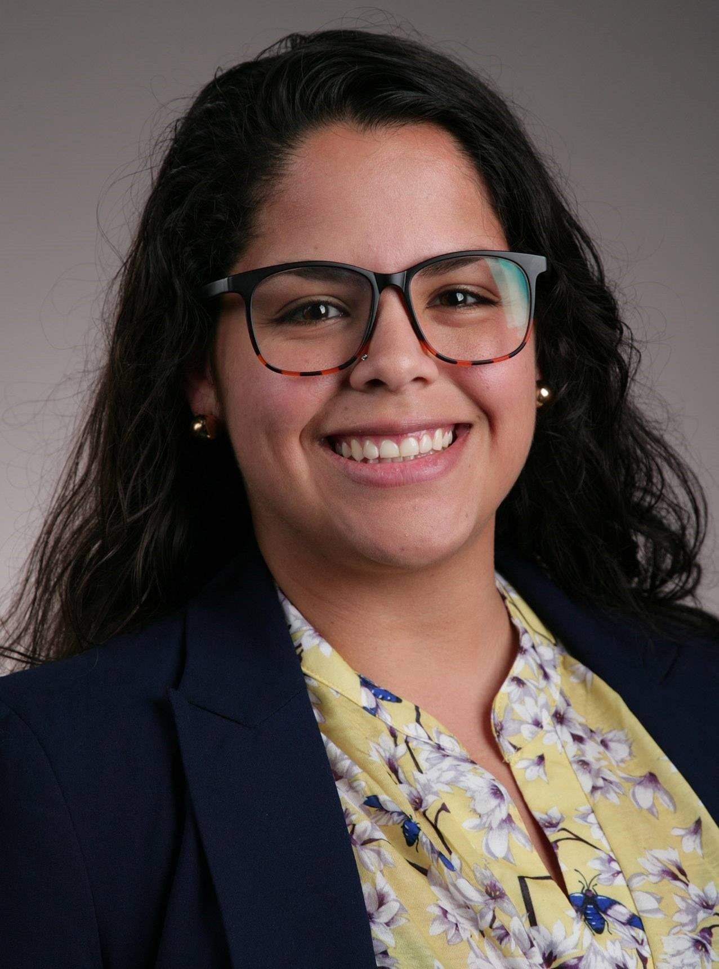
DANIELA SOMAROO
I’m currently serving as a Teaching Assistant for the Office of Graduate Studies and Research in the College of Engineering; I previously served as the Graduate Assistant for the Center for International Studies and Programs, as well as the Office of Student Conduct and Community Standards. I did my first practicum with the Office of Student Conduct and Community Standards, and a second practicum in the College of Engineering. As of right now, I am still on the lookout for opportunities within UToledo, hopefully working in an area related to advising or some place that serves international students.

Slide 15
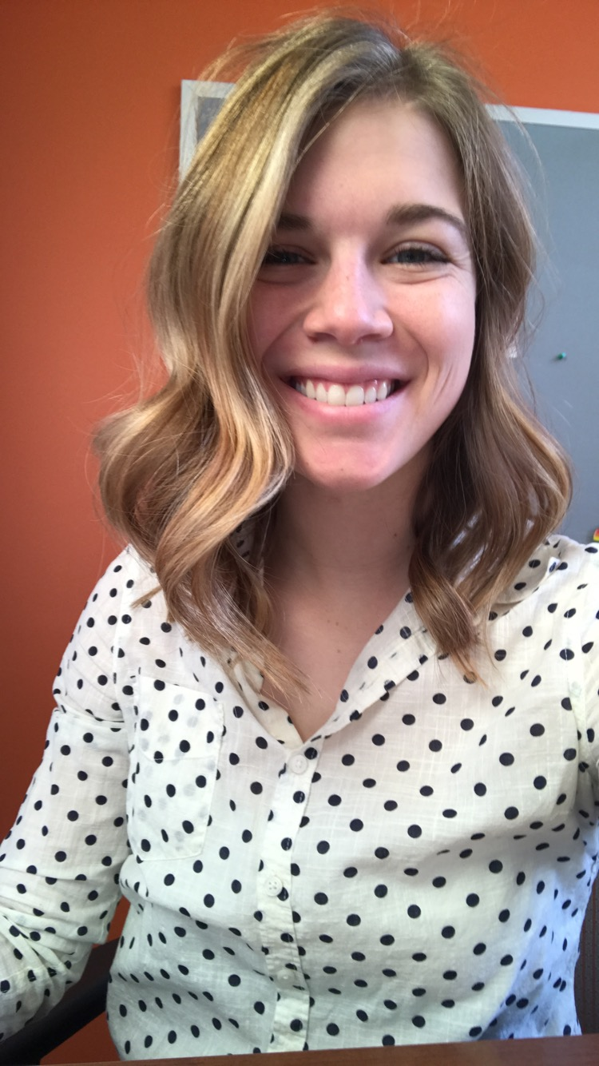
JAMIE WLOSOWICZ
Hello friends, my name is Jamie Wlosowicz. I did my practicum at Kent state in new student orientation. Currently, I work for BGSU in the center for women and gender equity & violence prevention center as the student engagement coordinator. My hopes for my career... probably to return back to school soon and get my MSW.

Slide 16
CONGRATULATIONS!
MaKayla Alfred
University of Pittsburgh: Resident Director
Ryan Crudder
University of Toledo: Assistant Director in College of Engineering
Augusta Schmidt
University of Wisconsin-Steven’s Point: Hall Director

Slide 17
CONGRATULATIONS!
Kristen Forche
The Ohio State University: Academic Advisor 2 in College of Engineering
Adam Lee
University of Toledo: Assistant Director for Law Admission Communication

Slide 18
CONGRATULATIONS!
Brittany Kim
Owens Community College: Career and Transfer Services Advisor
Jamie Wlosowicz
BGSU: Student Engagement Coordinator in
Women and Gender Equity

Slide 19
YOU COULD BE HERE!
Would you like more information on our
On-Campus Master’s program?
Contact Program Director,
Dr. Debra Harmening at
debra.harmening@utoledo.edu

