Slide 1
Faculty Senate Ad Hoc Recruitment and Retention Committee (RRC)
2022 / 2023
October 18, 2022
A Brief Initial Report

Slide 2
UToledo is facing an enrollment crisis
Institutions Making the Right Moves
Fall
Enrollment
(as % of
2015
Numbers)
UToledo
*Data Source: Ohio Department of Higher Education (ODHE) Preliminary Headcount Data
Last Data Point is Based on UToledo’s Fall 2022 Census

Slide 3
Summary of RRC Responsibilities
Review UToledo’s past and present recruitment and retention practices
Benchmark other universities’ student recruitment and retention practices
Identify opportunities to enhance UToledo faculty and staff involvement in the student recruitment and retention process
Define metrics for faculty and staff involvement in student recruitment and retention
Advise UToledo Administrators on ways to collaborate with faculty and staff to increase student recruitment and retention

Slide 4
RRC began meeting and formed subcommittees
September 23: The Recruitment and Retention Committee (RRC) obtained its charge
September 30: Kick-off meeting
October 14: Subcommittees presented their initial plans
October 18: RRC brief report to senate – Today
November 28: RRC preliminary report to senate
Spring end: RRC final report to senate

Slide 5
RRC has 31 members from 9 UToledo Colleges
Committee Co-chairs: Tomer.AvidorReiss@utoledo.edu (NSM, Biology)
Yakov.Lapitsky@utoledo.edu (COE, Chemical Engineering)
Health and Human Services (HHS):
David.Bazettjones@utoledo.edu Faculty engagement Associate Professor Director, Post-Professional Athletic Training Program
Jennifer.Reynolds21@utoledo.edu Retention - Peer universities Human Services Department Chair
Thomas.McLoughlin@UToledo.Edu Associate Professor of Exercise Physiology
Jesup Scott Honors College:
Daniel.Mcinnis@utoledo.edu Recruitment - UToledo’s practices Associate Professor of Humanities
Ashley.Pryor@utoledo.edu UToledo value proposition Associate Professor of Humanities
Arts and Letters:
Andrew.Rhodes@utoledo.edu (Tiger) Recruitment - Peer universities Recruitment followed by Retention
William.Myers@utoledo.edu Recruitment - Peer universities Associate Professor and Department Chair, Department of Communication
Melissa.Gregory@utoledo.edu Interim Dean
Kristen.Keith@utoledo.edu Assoc. Dean
Barbara.Miner@utoledo.edu UToledo value proposition Chair, Department of Art
Ammon.Allred@utoledo.edu Professor of Philosophy
Engineering:
Arunan.Nadarajah@utoledo.edu UToledo value proposition Professor of Bioengineering
Luis.Mata@UToledo.edu Associate Professor and Program Director, The University of Toledo, Construction Engineering Technology
Mohammad.Elahinia@utoledo.edu UToledo value proposition Distinguished University Professor, Chair, Mechanical, Industrial and Manufacturing Engineering
Tamara.Phares@utoledo.edu Recruitment - UToledo’s practices Instructional Laboratory Coordinator, Department of Bioengineering
Alex.Spivak@utoledo.edu Retention - UToledo’s practices Visiting Assistant Professor, Civil & Environmental Engineering
Bryan.Bosch@UToledo.edu Retention - UToledo’s practices Manager of Diversity, Inclusion, and Community Engagement and Part-time Instructor of Engineering
Education:
Jon-Jama.Scott@utoledo.edu Faculty eLisa.Kovach@utoledo.edu Faculty engagement Professor, Educ​ational Psychology
Natural Sciences and Mathematics (NSM):
ngagement Academic Advisor, Upward Bound Classic
Sandra.Robinson@utoledo.edu, Retention - Peer universities Lecturer, Mathematics and Statistics, Natural Sciences and Mathematics
Kevin.Gibbs@utoledo.edu Recommendations for recruitment event organization
Michael.Heben@utoledo.edu Professor of Physics and PVIC Endowed Chair
Aniruddha.Ray@utoledo.edu Recruitment - Peer universities Physics
Pharmacy:
Michelle.Serres@utoledo.edu Senior Lecturer and Associate Dean For Admissions And Enrollment Management
Nursing:
Linda.Lewin@utoledo.edu Recruitment - UToledo’s practices Professor
Tonya.Schmitt@utoledo.edu Faculty engagement Assistant Professor
Medicine and Life Sciences:
Jeffrey.Schneiderman@utoledo.edu Recruitment - UToledo’s practices Program Director, EMS Education
Julie.DeSantis@utoledo.edu, Department of Urology - Division of Transplant)
Thyagarajan.Subramanian@utoledo.edu Associate Dean for Research
Business and Innovation:
Steve.Wallace@utoledo.edu Retention - UToledo’s practices Associate Professor of Information Systems
Karen.Green@utoledo.edu Recruitment - Peer universities Associate Professor of Accounting
Suliman Rajab, UToledo value proposition college of business and innovation
26 members are active in subcommittees
Notes:
I want to thx the senate executive committee for tasking the recruitment and retention committee.
It is critical to understand we are only at the beginning of the process - only 25 days from the inception.
The main point we would like to make in this short report is the urgency of the RRC task and the commitment of the RRC members.

Slide 6
RRC is organized into 7 subcommittees
  UToledo’s recruitment practices – Collect and organize UToledo’s
Recruitment
  Peer university recruitment policies – Collect other universities’ recruitment policies (4 members)
  UToledo’s retention practices – Collect and organize UToledo’s past and current retention practices (4 members)
Retention
  Peer university retention practices – Collect other universities’ retention policies (4 members)
  Faculty engagement – Define the parameters and general ground rules for how faculty involvement in student recruitment and retention will be enhanced, monitored, and governed (4 members)
Dave
Meredith
  UToledo value proposition – Define the value proposition of UToledo as a whole, its colleges, and departments/schools (5 members)
Recruitment day debacle
  Recommendations for recruitment events management and coordination – (Organized by Professor Mike Heben)
Notes:
Recent Dave Meredith's PowerPoint Presentation

Slide 7
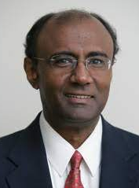
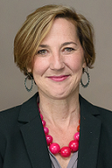
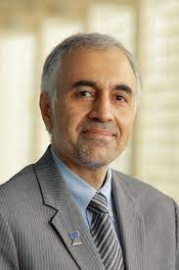
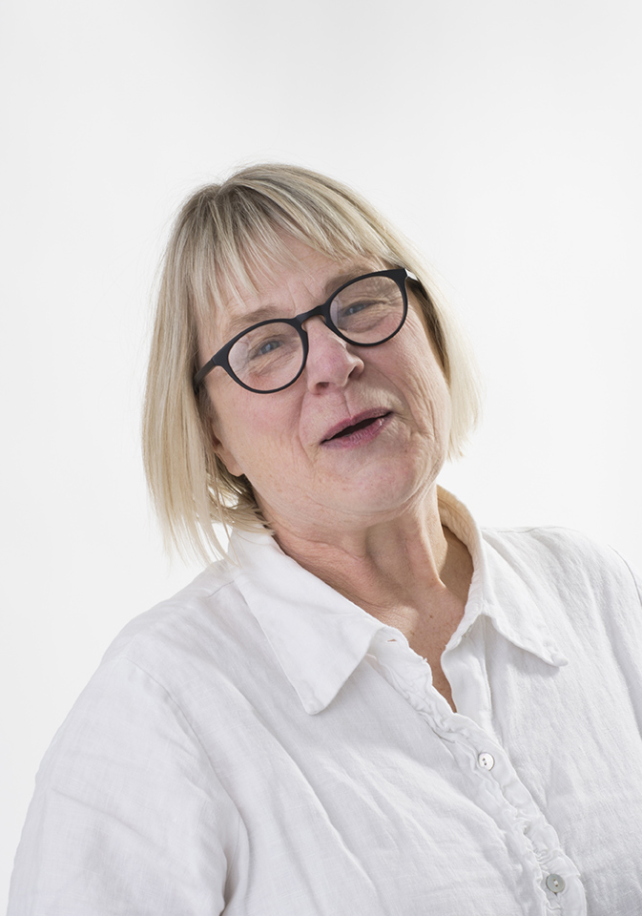
UToledo’s Triple Value Proposition (3VP)
Per Dave Meredith’s
(Vice President for Enrollment Management) suggestion
Practical: We emphasize the practical side of education with a strong emphasis hands-on learning
Partnership: We believe education is a partnership between faculty and students, with strong mentorship and high expectations
Place: We are a part of the fabric of Toledo and northwest Ohio, but also open to the rest of the country and the world
Prof. A. Nadarajah
Bioengineering
Subcommittee
Chair
Prof. A. Prior
Humanities
Prof. M. Elahinia
MIME
Prof. B. Miner
Dept. of Art
Prof. R. Suliman
Business
Notes:
This slide presents only an initial idea, and we will refine it and adapt it to various university units.
It also highlights our commitment to working with Dave Meredith, the Vice President for Enrollment Management.

Slide 8
Summary
RRC’s working hypothesis:
  An urgent and coordinated effort
  by UToledo administration, faculty, and staff
  will reverse UToledo enrolment trend
Fall
Enrollment
(as % of
2015
Numbers)
UToledo
*Data Source: Ohio Department of Higher Education (ODHE) Preliminary Headcount Data
Last Data Point is Based on UToledo’s Fall 2022 Census
Notes:
Hear you can see the RRC working hypothesis at leas as Yakov and I see it
Please email us us any comment to RRC work.

