Slide 1
Faculty Senate Ad Hoc Recruitment and Retention Committee (RRC)
2022 / 2023
November 29, 2022
Preliminary Report

Slide 2
UToledo is facing an existential enrollment crisis
Institutions Making the Right Moves
Fall
Enrollment
(as % of
2015
Numbers)
UToledo
National undergraduate fall enrollment decline slows down
from -3.1% in 2021
to -1.1% in 2022
https://nscresearchcenter.org/stay-informed/
*Data Source: Ohio Department of Higher Education (ODHE) Preliminary Headcount Data
Last Data Point is Based on UToledo’s Fall 2022 Census

Slide 3
Summary of RRC Responsibilities
Review UToledo’s past and present recruitment and retention practices
Benchmark other universities’ student recruitment and retention practices
Identify opportunities to enhance UToledo faculty involvement in the student recruitment and retention process
Define metrics for faculty involvement in student recruitment and retention
Advise University Administrators on the resources needed to enhance collaboration with faculty on recruitment and retention

Slide 4

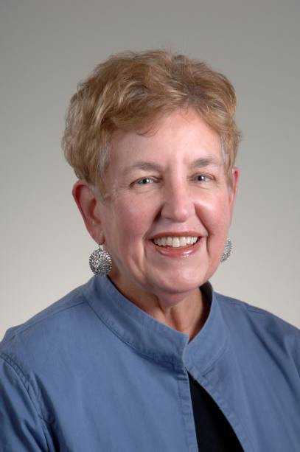
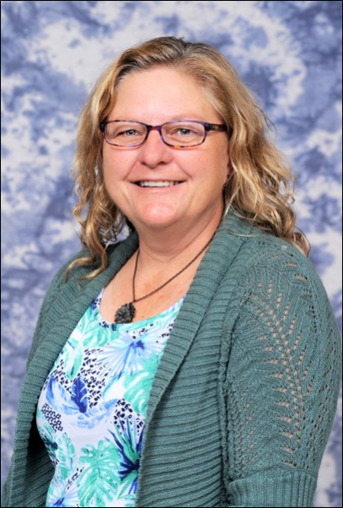
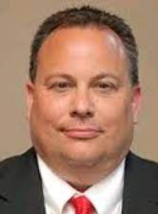
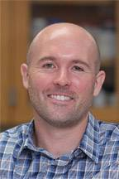
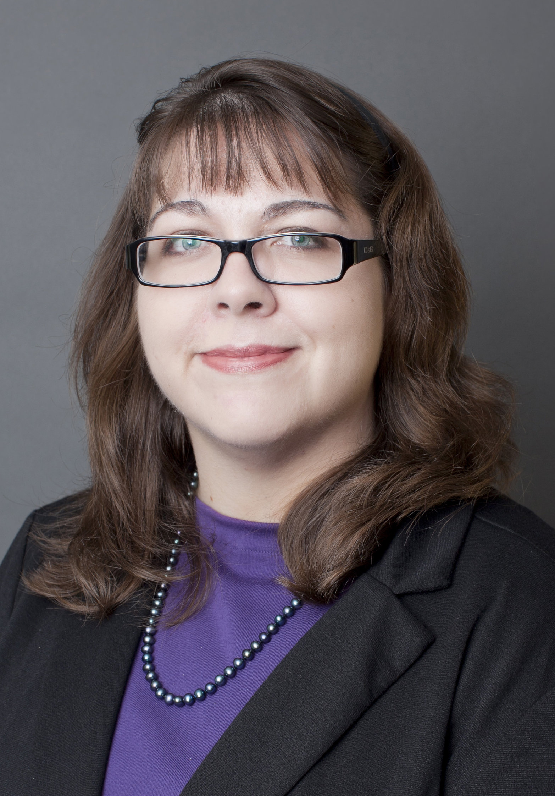
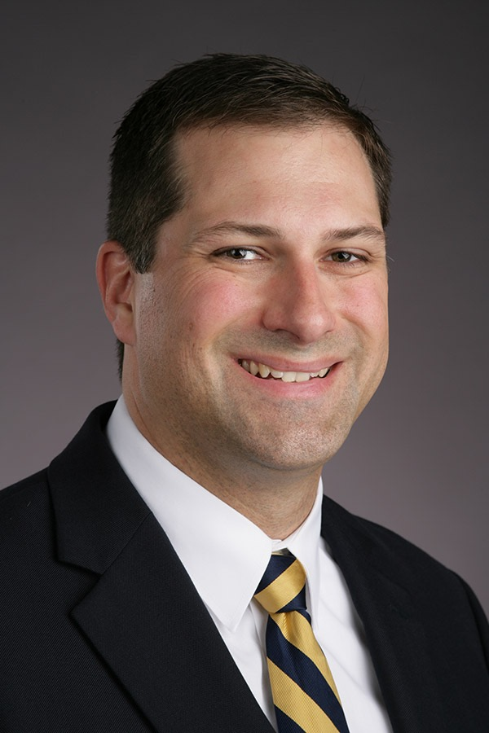
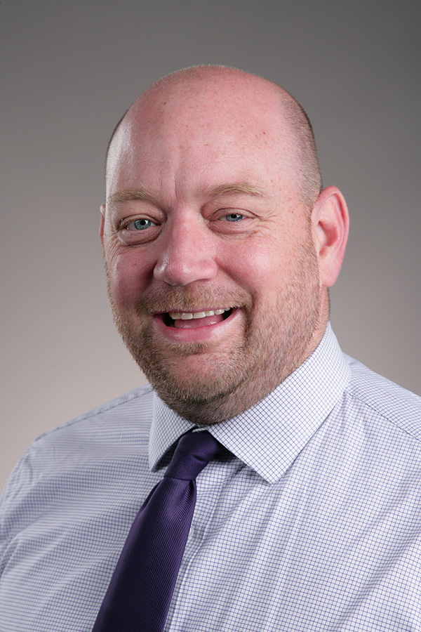
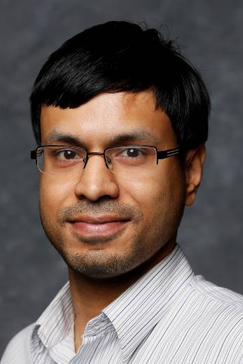
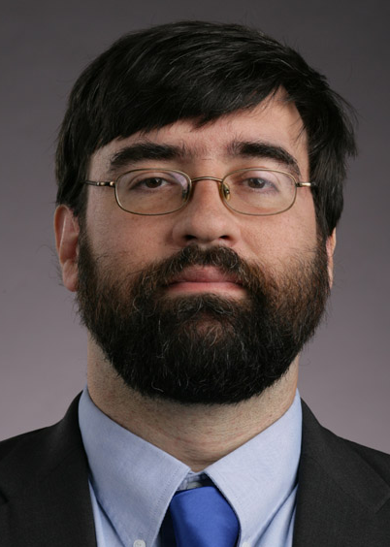

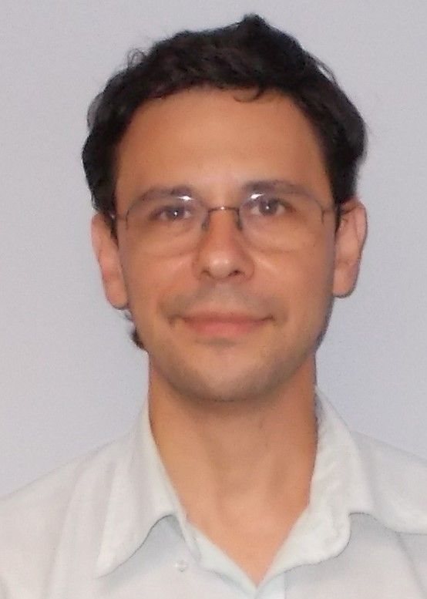
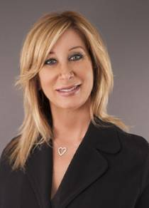
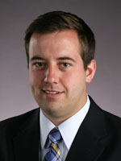
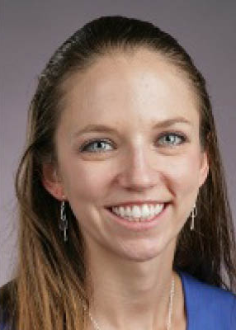
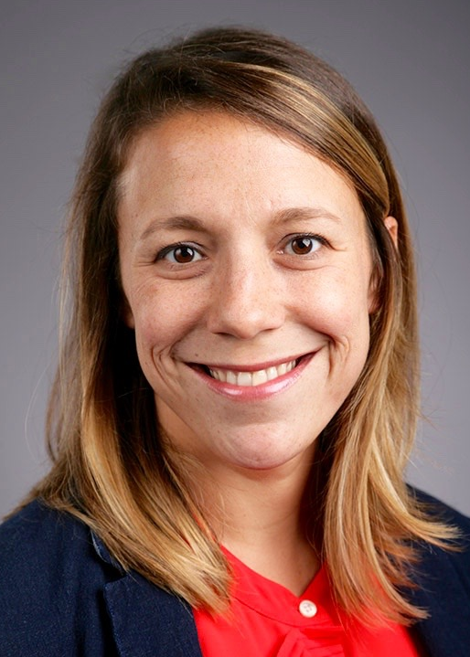

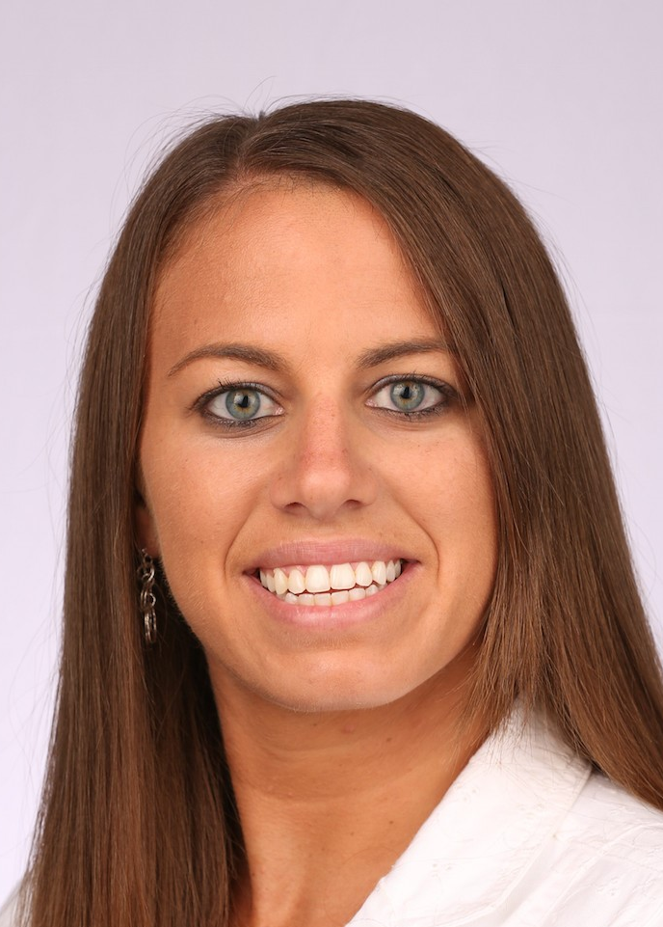

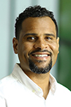
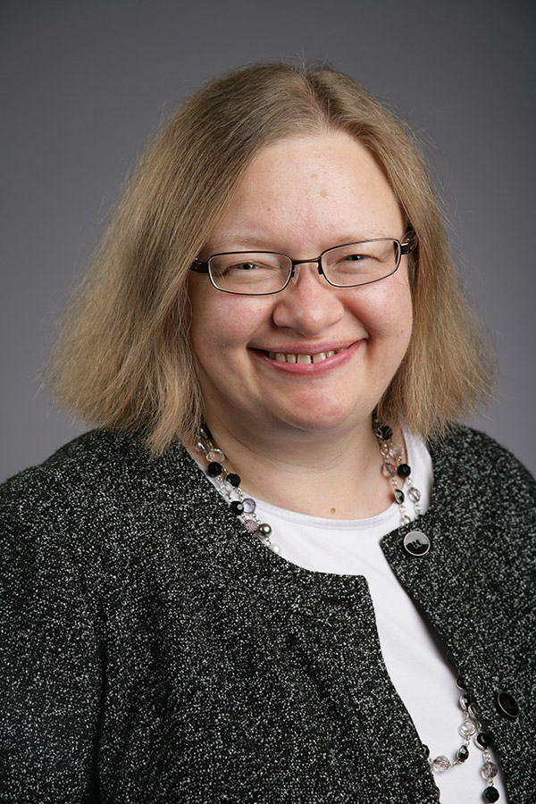
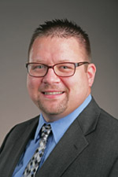
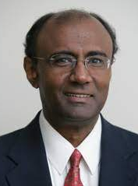
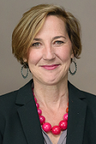
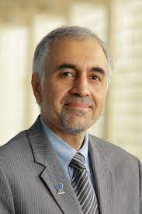

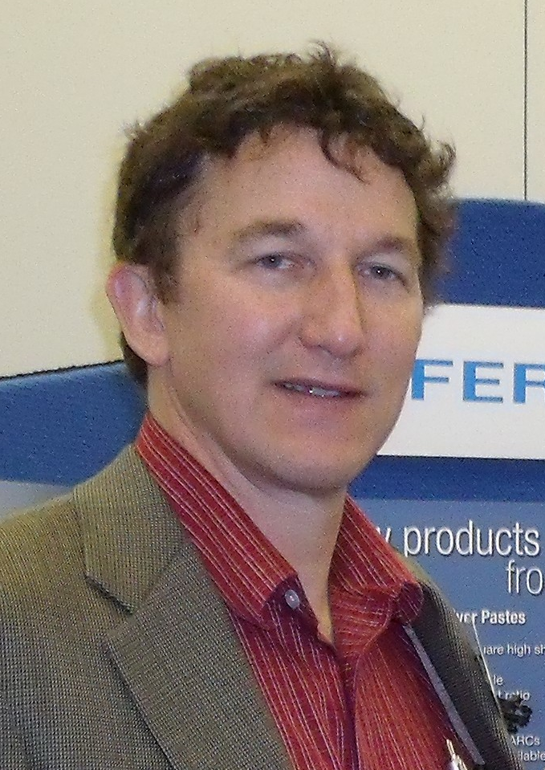
RRC Subcommittee Members
UToledo Recruitment Practices
Peer University Recruitment Practices
Prof. D. McInnis
Humanities
Prof. L. Lewin
Nursing
T. Phares
Bioengineering
J. Schneiderman
EMS Education
Prof. T. McLoughlin
Exercise Science
Prof. K. Green
Accounting
Dr. T. Rhodes
Music
Prof. Ben Myers
Communication
Prof. A. Ray
Physics
UToledo Retention Practices
Peer University Retention Practices
Prof. S. Wallace
Information Systems
Prof. J. Desantis
Urology
Prof. A. Spivak
Civil Engineering
Prof. L. Kovach
Education
B. Bosch
Engineering
Prof. S. Robinson
Mathematics
Prof. J. Reynolds
Human Services
Prof. A. Allred
Philosophy
Prof. M. Seegert
Pharmacy
Faculty Engagement
UToledo Value Proposition
Prof. T. Schmitt
Nursing
J.-J. Scott
Upward Bound
Prof. J. Martin
Libraries
Prof. D. Bazett-Jones
Athletic Training
Prof. A. Nadarajah
Bioengineering
Prof. A. Prior
Humanities
Prof. M. Elahinia
MIME
Prof. B. Miner
Dept. of Art
Prof. R. Suliman
Business
Advisor on
Recruitment Events
Prof. M. Heben
Physics

Slide 5
RRC Timeline
September 23: The Recruitment and Retention Committee (RRC) obtained its charge
September 30: Kick-off meeting
October 14: Subcommittees presented their initial plans
November 1: RRC brief report to senate
November 29: RRC preliminary report to senate – Today
Spring end: RRC final report to senate

Slide 6
Preliminary Findings and Working Hypotheses
The fall RCC report represents the committee's preliminary findings and provides a working hypothesis for our continued studies in the spring semester.
However, due to the situation's urgency, we would like the UToledo administration to start adopting recommendations from this preliminary report immediately.

Slide 7
Three strategic areas that need immediate attention
Increasing yield by significantly improving engagement of prospective students after they have made first contact with UToledo, including by mail, face-to-face outreach, and during visits to UToledo
Dramatic improvement in recruitment-related experience by coordinating across various UToledo units and improving communication between administration, faculty, and staff
Reallocation of financial resources toward critical recruitment efforts, including college-based recruiters, campus tours/experience days, university website improvements, and advertisement

Slide 8
Approach: Break down silos and align responsibility with authority
The UToledo must declare solving the enrollment crisis its top priority
To this end, the RRC recommends appointing a high-level administrator (i.e., a full-time Executive Vice President for Enrollment) to govern all aspects related to this effort
This administrator will direct all offices related to student recruitment and experience (outside of academics and athletics), including Enrollment Management, Marketing and Communication, Parking and Transportation Services, Dining Services, and others, which often work in silos
  The administrator will coordinate with academics and athletics at a high level
To support their efforts, we propose to form a student and faculty advisory board that will aid in the continuous improvement of UToledo’s recruitment and retention efforts

Slide 9
UToledo Recruitment Practices
Key Preliminary Findings:
UToledo is severely underperforming relative to peers
Between 2011 and 2022, there has been a ~40% decline in newly enrolled students
Admitted Students
This decline reflects a drastic downturn in the yield of admitted students, which has dropped from ~37% to ~22%
Enrolled Students
Data Source: Census ODS Data
This reduction in new students has decreased the total student headcount from 22,610 to 15,603 (despite the retention rates increasing from 62% to 75%)
Apparent causes contributing to this decline:
Poor communication between UToledo’s recruitment office and academic units contributing to uncompetitive sales pitches and on-campus recruitment events
Inadequate MarComm support (inconsistent/slow response to requests)
Insufficient communication with students in the enrollment funnel

Slide 10
UToledo Recruitment Practices
Recommendations:
Strengthen communications between Enrollment Services and academic units
Increase faculty/academic unit communication with recruiters to provide them with accurate, up-to-date program information
Employ over-communication/critical redundancies in communication between Enrollment Management and academic programs
Enhance Enrollment Management and MarComm’s responsiveness to inquiries/requests from UToledo’s academic programs/faculty
Increase staffing of UToledo’s recruiting efforts/events
Provide Colleges with dedicated recruiters
Increase incentives for UToledo tour guides and student recruitment event volunteers
Tailor on-campus visits to demonstrate UToledo’s student-centeredness
Schedule tours at times that increase UToledo student and faculty availability
Provide free parking for all admissions-related visits
Enhance academic program marketing to transfer students and adult learners
Leverage remote/hybrid course formats to increase program appeal to adult learners
Broaden opportunities for professional license renewal-focused continued education
Offer micro-courses that can be applied toward degree requirements
Develop additional community college affiliations

Slide 11
Peer University Recruitment Practices
Methods Used:
Analyze/compare peer university/competitor websites (overall appearance and numbers of clicks needed to schedule visits)
Reach out to personal connections at other universities
Be a secret shopper and request information from peer universities/competitors (along with UToledo for comparison)
Survey of UToledo faculty with household members looking at colleges (59 total responses)

Slide 12
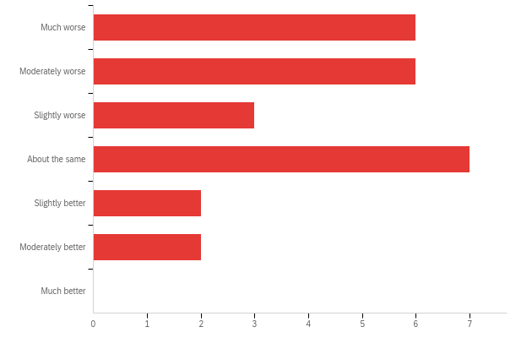
Peer University Recruitment Practices
Key Preliminary Findings:
UToledo’s Campus Tours Compared to Other Universities
UToledo uses many of the same recruiting tactics as peer institutions but executes many of them poorly
Much worse
Moderately worse
Slightly worse
About the same
Specific areas of concern include:
Slightly better
Moderately better
Uncompetitive quality of campus tours
Much better
0 1 2 3 4 5 6 7
Slow and impersonal communication with students in the enrollment funnel
Number of Responses
Relatively few campus visit opportunities
Lackluster website relative to nearby institutions (e.g., BGSU and EMU)
Weak branding of UToledo’s academic programs

Slide 13
Peer University Recruitment Practices
Recommendations:
Increase competitiveness of UToledo’s advertising efforts
Strengthen branding/advertisement of individual UToledo programs
Enhance advertisement of student activities and the overall college experience in the City and University of Toledo
Regularly update marketing materials/stop distributing outdated handouts
Add short videos to UToledo’s website with information on and highlights of campus life
Increase outreach to high school students in Northwest Ohio/Southeast Michigan, including prospective college credit plus (CCP) students
Increase competitiveness of UToledo’s campus visits
Add a greater personal touch to campus visits (e.g., engage visitors one-on-one rather than showing them UToledo commercials)
Ensure that campus tours are staffed with excited personnel who are knowledgeable about dorms, financial aid, etc.
Provide free parking for all admissions-related visits
Improve communication with students in the enrollment funnel
Increase quantity/consistency of communication with prospective and admitted applicants
Implement policies on response times from recruiting-related personnel

Slide 14
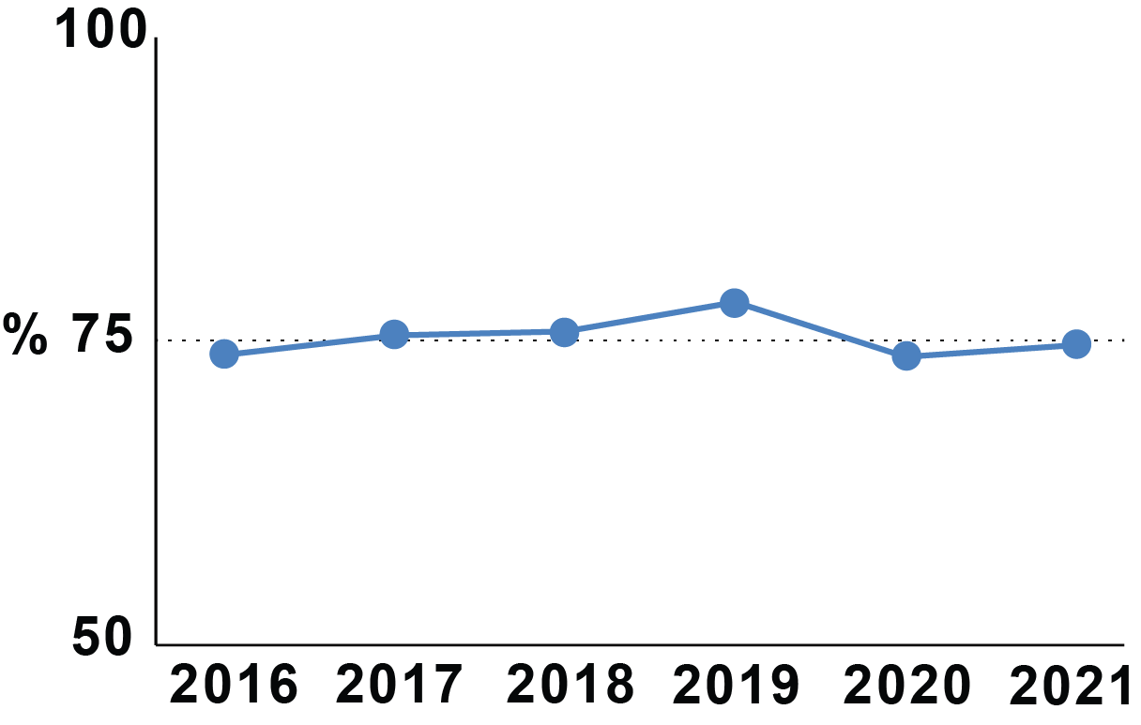
  UToledo’s Retention Practices
Key Preliminary Findings:
Many unretained students are:
  Improperly prepared for STEM gateway classes
  Lack of college-level writing skills
  Unable to continue paying for tuition, fees, or room & board
Inadequate dorm conditions
Limited dining options
Lack of sense of belonging
Insufficient parking
UToledo's first year retention rates for 2016 – 2021
ranges between 73-78%
Plateau
Insufficient Parking: Sample Social Media Posts:
"25 minutes of trying to find a parking spot …looks like I’m skipping today"
"Is it even possible for me to come to class today? Like is there anywhere to park on campus?"

Slide 15
  UToledo’s Retention Practices Continued
Recommendations:
Remediation
Review and update remediation classes and programs
Policies and procedures need to be student-centered
Inform faculty/staff about retention issues
4. Modify placement exams to reflect the student's skills
5. Place students in the proper level-based performance in introductory courses
6. Provide more help and tutoring for select STEM classes
7. Retention issues should be the responsibility of all university stakeholders, not only faculty
Increase student sense of belonging
1. Expand student mentor/ambassador programs (beyond the first year)
2. More success coaches and advisors to handle the high number of at-risk students
3. More student programming, including activities during the weekend to combat isolation
4. More support for student groups to help create much-needed student communities
Dorms, dining, financial needs
1. More oversight on the dorms and fixing dorm issues promptly
2. More dining options. More hours and more places to eat
3. Better assessments for identifying students with financial needs
Parking
1. Provide more information about parking issues
2. Better alternative than towing students’ car (paying $150 to the tow lot)

Slide 16
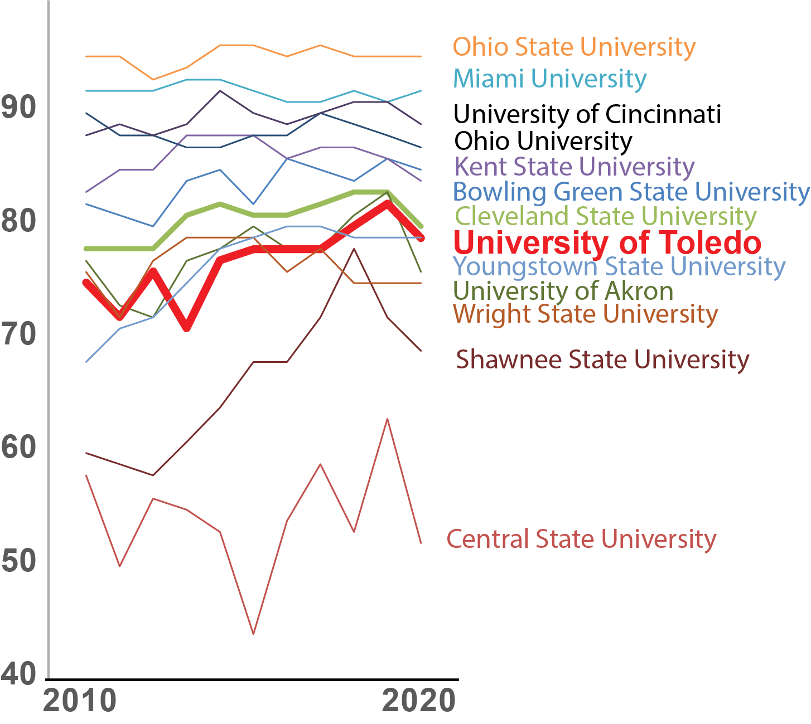
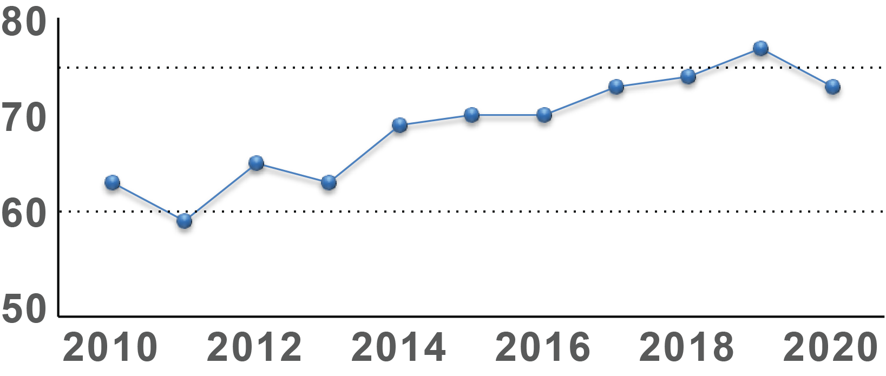
  Peer University Retention Practices
Key Preliminary Findings:
UToledo’s retention rate is:
Comparable to institutions with similar acceptance rates
Below average compared to all 4-year Ohio institutions
Toledo's persistence rates for 2010 – 2020 increased by ~15% (ODHE data)
Plateau
Ohio Department of Higher Education (ODHE) data

Slide 17
  Peer University Retention Practices
Recommendations:
College administration should work with faculty to design faculty-specific, intentional activities to promote retention
Provide each college with retention specialists to work with departments and faculty
UToledo should apply retention efforts across all colleges/campuses with college-specific augmentation after discussions with faculty and staff

Slide 18
Faculty Engagement
Key Preliminary Findings:
There is a need to understand the current levels of, and attitudes toward, faculty engagement in recruitment and retention efforts
Better clarity is needed on whether faculty and staff contributions toward these efforts will be recognized/rewarded by the University
Recommendations:
Administer a survey to study faculty perceptions/attitudes toward their roles in UToledo’s recruitment and retention efforts and how their contributions toward these efforts are recognized by the University
Educating faculty about ways to collaborate with programs serving students from populations with lower rates of degree completion
  e.g., Toledo EXCEL or Office of Multicultural Student Success
Target specific groups of faculty for engagement in recruitment and retention
  e.g., faculty involved in pre-college programs and teaching introductory courses that identify at-risk students
More fully utilize non-tenure-track and adjunct faculty

Slide 19
UToledo’s Value Proposition
Recommendations:
Implementing a hybrid recruitment effort, both University-level and College-specific
Suggest a University-wide and College-specific value proposition named the 3VP Plan, based on three values: Practical, Partnership, and Place
The plan should be distributed to faculty and recruiters for use and continued improvement

Slide 20
UToledo’s Triple Value Proposition (3VP)
Practical: We emphasize the practical side of education with a strong emphasis hands-on learning
Partnership: We believe education is a partnership between faculty and students, with strong mentorship and high expectations
Place: We are a part of the fabric of Toledo and Northwest Ohio, but also open to the rest of the country and the world
Put UToledo’s 3VP front and center
College-specific draft value propositions have been developed by 7 UToledo Colleges

Slide 21
College of Engineering
Triple Value Proposition (3VP)
Practical: Mandatory co-op requirement means that all students need to have practical skills required by industry. Also, teaching students design begins in the freshman year and continues on.
Partnership: Strong advising and faculty mentoring. Student advisory committee that meets every semester to review faculty teaching and make recommendations. Faculty then discuss, implement changes, and report back the next semester.
Place: Use Toledo’s history of industrial design and manufacturing to inform curriculum. Most of the students being placed in companies within a 300-mile radius of Toledo.

Slide 22
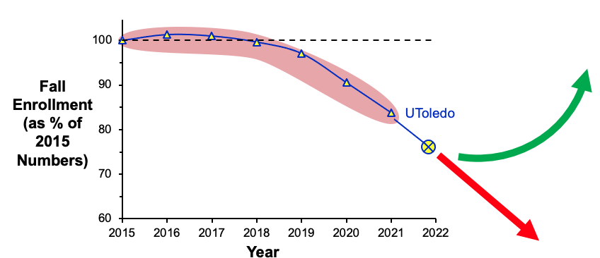
Summary of Preliminary Findings
UToledo’s losses in undergraduate student enrollment are primarily caused by a sharp reduction in yield of enrolling students
UToledo recruitment is underperforming relative to peers; reduction correlates with UToledo’s currently uncompetitive recruitment practices
To reverse these trends, the RRC’s preliminary recommendations are to:
Strengthen communications between Enrollment Services and academic units
Improve staffing of UToledo’s recruiting efforts/events
Tailor on-campus visits to demonstrate UToledo’s student-centeredness
Appoint a
senior administrator
and a student and faculty
advisory board
to oversee these efforts

Slide 23
RRC Subcommittee Members
UToledo Recruitment Practices
Peer University Recruitment Practices
Prof. D. McInnis
Humanities
Prof. L. Lewin
Nursing
T. Phares
Bioengineering
J. Schneiderman
EMS Education
Prof. T. McLoughlin
Exercise Science
Prof. K. Green
Accounting
Dr. T. Rhodes
Music
Prof. Ben Myers
Communication
Prof. A. Ray
Physics
UToledo Retention Practices
Peer University Retention Practices
Prof. S. Wallace
Information Systems
Prof. J. Desantis
Urology
Prof. A. Spivak
Civil Engineering
Prof. L. Kovach
Education
B. Bosch
Engineering
Prof. S. Robinson
Mathematics
Prof. J. Reynolds
Human Services
Prof. A. Allred
Philosophy
Prof. M. Seegert
Pharmacy
Faculty Engagement
UToledo Value Proposition
Prof. T. Schmitt
Nursing
J.-J. Scott
Upward Bound
Prof. J. Martin
Libraries
Prof. D. Bazett-Jones
Athletic Training
Prof. A. Nadarajah
Bioengineering
Prof. A. Prior
Humanities
Prof. M. Elahinia
MIME
Prof. B. Miner
Dept. of Art
Prof. R. Suliman
Business
Advisor on
Recruitment Events
Questions?
Prof. M. Heben
Physics

Slide 24
End

