Slide 1


Bookstore
Updates and Information
Faculty Senate 11/5/24

Slide 2
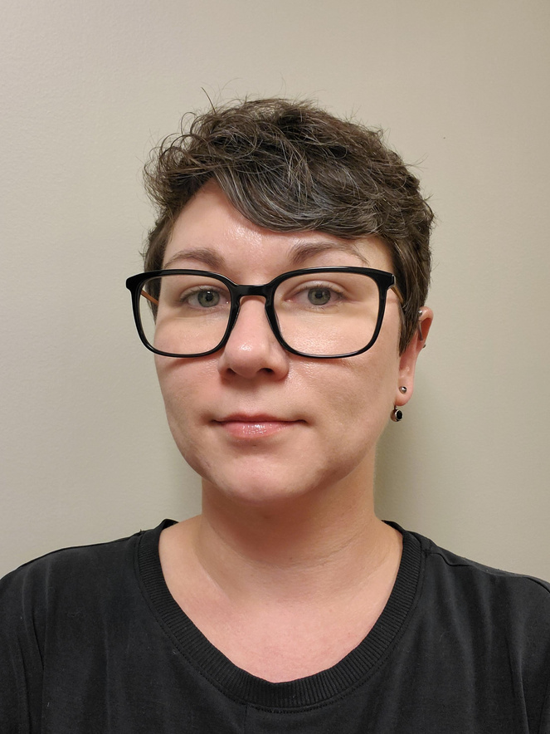
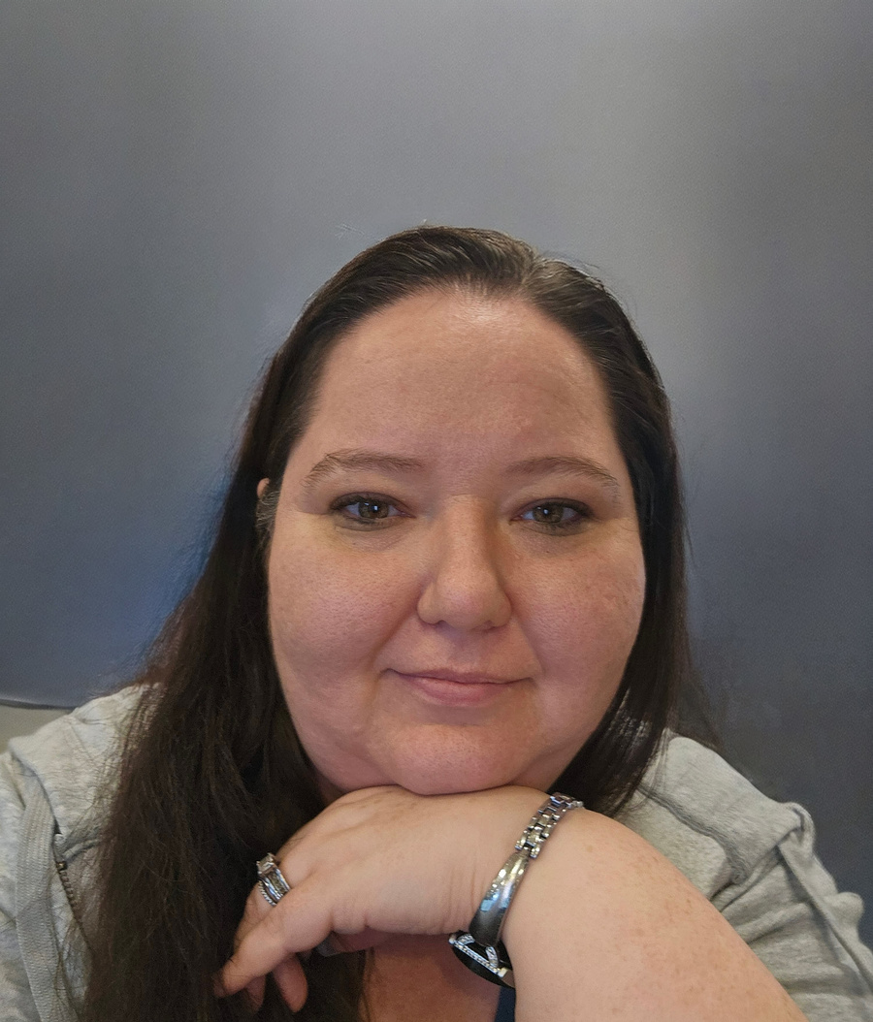
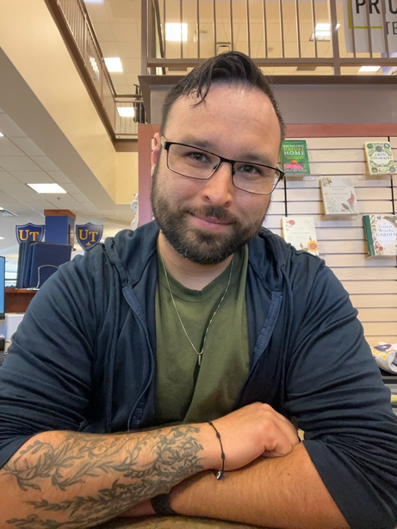
Meet your Bookstore Team
Jay Hall
Rebecca Jones
Justin Colter
Store Manager
Assistant Manager/Course Materials Manager
Rocky’s Locker Manager
jhall@bncollege.com
jcolter@bncollege.com
rjones@bncollege.com
Textbook Contact: books1@utoledo.edu

Slide 3
Introduction
Your Barnes and Noble UToledo bookstore provides course materials, clothing, school supplies, and much more to the University of Toledo community and the public.

Slide 4

Bookstore Glossary
Book/Course Material
Terms are used interchangeably to describe anything a student needs for their course. Might include a textbook, ebook, online access, kit and more
Online Access/Courseware
Sometimes called an Access Code or Media, anything used to access an outside website to complete reading and/or coursework.
Also frequently referred to by their titles - WebAssign, Connect, MyLab, Acheive and more.
Adoption
The process of telling the bookstore what materials are needed for students to be successful in your course

Slide 5

Inclusive Access
Lower Cost
Inclusive Access offers a lower cost to all students in the course
Inclusive Access/First Day
Provides students with required material digitally on or before the first day of the course
All Sections
All sections of a course must agree to use the same material and agree to use Inclusive Access delivery.
Cost included with Tuition
Students don’t need to worry about paying, the charges are on the tuition bill and covered by scholarships/financial aid if available
Deadlines
IA deadlines are 3 weeks prior to registration start.
More Information:
https://www.utoledo.edu/offices/provost/inclusive-access.html

Slide 6



Why UToledo B&N
Student Success
One Stop Shopping
  Our goal is to have all materials your students need to be successful
  We accept Scholarships, Rocket Cards, Veterans funding and CCP students.
  We are a source for student information
Adopt what you want
  Faculty choice is important to us. You adopt what you want to use, we will figure out the rest!
  All materials for all students to be successful
  No waiting for shipping
  Accurate material information

Slide 7
Why UToledo B&N
Courseware/Access
  You can use courseware in any course!
  We can connect you with the publisher’s representatives for setup and assistance
  Most courseware can be integrated to Blackboard for ease of use
What the bookstore does
Adoption
Formats
  Review all adoptions as they are submitted
  Keep you up to date on new editions
  Connect you with publisher reps for questions and/or desk copies
  Ensure the correct format is available
  Add explanatory notes to books/courses
  All books are offered in all available formats, unless otherwise requested
    Print
      New
      Used
      Purchase
      Rent
    Digital
      Multiple Lengths
      Access in as little as 1 hour
Finding a book
  We can recommend books and/or courseware that might be relevant for your course based on our experience and/or what is being used at similar schools

Slide 8

Book Adoption
Spring 2025
  Adoptions are open now
  Spring 25 adoptions were Due 10/14
  89% of adoptions submitted for spring
https://sso.bncollege.com/bes-sp/bessso/saml/utoledoedu/aip/logon
Summer 2025
Login is with UToledo Credentials!
  Adoptions open 1/21/25
  Adoptions are Due 2/16/25
  Faculty and staff can easily manage and submit course material adoptions each term.
  Academic leaders can view real-time adoption rates and submission progress at the institution, campus, or departmental level, and communicate directly with faculty from within the portal.
  Adoption support via Phone or Chat 8am-11pm EST
Fall 2025 and Spring 2026
  Adoptions open 1/21/25
  Adoptions are Due 3/10/25
Updated Adoption schedule aligns with student registration, and increases HEOA compliance
The bookstore also accepts adoptions via email!
Communication is KEY! We can resolve anything and make anything work as long as we are aware.

Slide 9
Book Adoption
Why so early?
Learn more about AIP!
  Time for review/update if needed
  Students can see their material when they register
  Better chance of Used books
    Allows bookstore to source books early and/or keep rentals when they come back
  Student preparation
    Students can be prepared when classes start, not rushing around at the last minute
  Publisher Coordination
    Helps ensure publishers have sufficient quantites of books, and are able to ship
  Shipping time
    Especially in winter, shipping times can be unpredictable.
  Faculty Intro Video: https://vimeo.com/757681164/5cef6f87bb
  Course List Training Video: https://vimeo.com/757686172/0ac184da1e
  Bulk Upload Training Video: https://vimeo.com/757711191/c3bc8c7d8d

Slide 10

What you can do
Follow up with missing adoptions
The bookstore will communicate with department chairs and deans about missing adoptions. Follow up with your faculty about submitting.
Encourage early Adoptions
The sooner the better once adoptions open for a semester. If there are concerns, there is time to address them
Communicate with the bookstore
Have a question? Concern? Need more time? We are always here to help, but we can’t help if we don’t know you need it!
Correct Adoptions are Important
We frequently see mistakes in adoptions. Particularly when access is being used, but is not adopted.
Encourage faculty to communicate with the bookstore if they are unsure about what they are adopting
Streamline material choices
When possible, have a book (or choice of a few books) for courses with many sections, to assist adjunct or new faculty with selection.

Slide 11
What else does the bookstore do?
Clothing/Merch
Your source for your favorite UToledo Gear!
We can do special orders for a group!
Book Signings/Events
Having an event on campus? We may be able to join you with books and/or merch for sale
Graduation Regalia
Faculty and students purchase and/or rent (depending on role) regalia via the bookstore.
Faculty rental is available for each graduation
We can also assist with purchasing your own set of regalia to keep!
Sporting Events
Visit our Rocky’s Locker store in the Student Union, or our kiosks at football and basketball games!

Slide 12
Thank you

