Slide 1
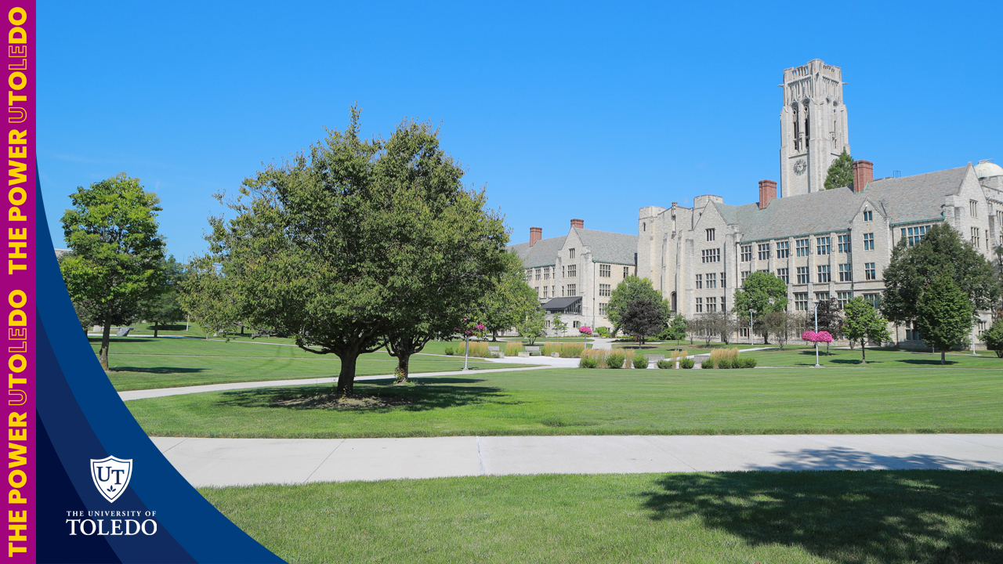
Faculty Senate Committee on Student Affairs, 19 November, 2024
Second SG Issue: Campus Accessibility and ADA Compliance
Dr. Deborah Coulter-Harris, Dr. Karen Green,
Dr. Katherine O’Connell

Slide 2
SG Issue 1: Campus Accessibility
Student Government wrote: “Many prospective students this summer were posting how they ultimately decided not to go to UT since it is not a disability-friendly campus. This is incredibly worrying as we need to ensure that we can pull as many students as possible. We typically carry out a couple of ADA walks to target some specific buildings and see how they can improve, but it is evident that we need to do more for our campus.”

Slide 3
Proposed Resolution:
Meet with Lisa Yost and Kurt Soltman from Office of Accessibility and Disability Services.
Email or call the contacts to gather a report on all buildings, restrooms, and athletic venues that assesses ADA compliancy for locations. Where and how can some locations be improved? Have there been complaints?
First Meeting and Discussion Between FSCSA and Office of Accessibility and Disability Services (10/24/2024)
Attendees: Lisa Yost, Kurt Soltman, Karen Green, Ashley Westgate, Lucas Will, Kate O’Connell, Sarah Aldrich Renner, Deborah Coulter-Harris

Slide 4
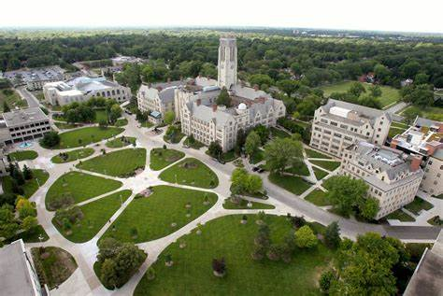
Origin of Concern
Students saw videos/posts online that prospective students loved the university, but felt they couldn’t get around – “I love UT but can’t come here.”
One video from a student that came for 1 year and left because of difficulty navigating campus.
No mention of specific buildings or concerns with faculty.

Slide 5
Requirements for Restrooms
Certain restrooms only have automatic door openers on the 1st floor (example Field House and Student Union).
Each building has to have a “reasonable bathroom nearby” with an automatic opener or have the door <3lbs to pull open.
Balance between spirit of the law, the law and reasonability of finances for all concerns.

Slide 6
Requirements for Entryways/Evaluation of ADA Compliance
At least one accessible entrance required.
All buildings in compliance since the start of Spring ADA walks.
ADA compliance physical and electronic report created annually by Kurt and sent to Auditor/University leadership
Dave Cutrie auditor
AHEAD completes an external audit. Home - AHEAD - Association on Higher Education And Disability
ADA walks with Student Government: Kurt Soltman walks with SG representatives through 1 building each month to assess accessibility.
Goal to get to every building over 2 years.
Kurt will follow-up on the following:
2nd floor bathrooms in Field House.
Discuss concerns/online comments in more detail with Student Government.
Reach out to marketing to discuss opportunities to collaborate and share office success stories.

Slide 7
Survey Students: Determine Accessibility Needs/Perceptions?
Survey could be created for campus in general.
Currently, Office of Accessibility and Disability Services sends out yearly student survey to assess satisfaction of students currently engaged with this office.
How satisfied are students with the services they receive?
What can office do to improve?
General questions with Likert scale and places for comments included.
Limitation: only goes to students currently engaged with the office.

Slide 8
Future Plans for Office
Deborah will add Kurt/Lisa to Faculty Senate schedule to present. (Already asked FS President: Spring date)
Continue to improve perception/awareness of Office of Accessibility and Disability Services:
Consider increasing advertising or email each quarter.
UT news article on office: could include student success story if student willing.
Social media campaign with student success stories (if willing).
Consider adding question to office survey “are you willing to provide a quote about the office or share a success story? If so, email us.”

Slide 9
Future Plans (con’t)
Office of Accessibility and Disability Services to come to certain classes to discuss their role and benefits.
Ex. Undergraduate writing courses
ADA walks to continue with Kurt and Student Government.
Monitor new buildings – works with office as well as facilities to ensure compliance.
Jason Toth (facilities) and Nichole Baden (chief architect)
Please see Appendix 1 in Memorandum for Record for Updates from Office of Accessibility and Disability Services.

