Slide 1
Faculty Senate Committee on Student Affairs:
Student Involvement Subcommittee: 23 April; 2024
Sally Harmych

Slide 2
Issue: Student Involvement
SG says last 2 years student involvement has been low. Many campus events but low turnout.
Students don’t want to leave their comfortable rooms
High turnout for campus organizations in Fall; 2023; however. Need to monitor involvement over the academic year.

Slide 3
Action:
The committee members administered a survey using Qualtrics to help understand which activities may generate the greatest student interest.
To determine items to include in the survey; we asked students to provide suggestions.
Dr. Deborah Coulter-Harris identified the following activity themes for the survey questions: Academic; sports; cultural activities; arts; social events; and entertainment.

Slide 4
Are students interested in participating in campus activities?

Slide 5
Most likely to participate in:
  leadership activities
  trivia night
  AI training

Slide 6
Most likely to participate in:
  Dodgeball tournaments
  Campus campout event

Slide 7
Most likely to participate in:
  International film festival
  Coffee chats

Slide 8
Most likely to participate in:
  Toledo museum of art trip
  On-campus art exhibit

Slide 9
Most likely to participate in:
  Food drives
  Toy drives
  Potluck lunch/dinner

Slide 10
What types of events are most interesting to students?
Students were surveyed on their interest in participating in activities in the following areas:
  Academic; social; athletic; cultural; art-related; entertainment related
Activities students are most interested in:
  Leadership training; trivia nights; AI training; dodge ball tournaments; a campus campout event; coffee chats; an international film festival; visiting the Toledo Museum of Art; on-campus art exhibits; food drives; toy drives; potluck lunch or dinner; comedy nights; on-campus farmers market.

Slide 11
Activities suggested by students:
Movie nights; Cultural holiday activities; Cultural Day; food tours of different ethnicities; international art / music festival; Nightlife culture fair; Cooking classes that focus on different cultural foods; international food days; motivational guest speakers; Travel club; Art fairs or gallery tours; discussions on current issues; Coffee chat but have a speaker; game night; Try new foods from different cultures in Toledo; “Something I can engage in… not a PowerPoint style event” Custom and fashion exhibits; art markets / lectures; dance; poetry making; Sculpting classes; painting contest; night of painting or arts and crafts; photography course; live music; classic movie night; theatre night (e.g.; Shakespeare); Visual Art Club; Contest of the best of art completed in a limited time frame; Art course to learn the basics; Capture the flag; Hide and seek; competitive tag; intramural volleyball; powderpuff football; pickleball; spikeball; 5K; Walking club; Broomball; Dance battles; fishing; activities of lesser-known sports; a field day to try out sports; golf outings; Kayaking club; Career exploration; Book clubs; Networking events; review sessions/study groups; writing contests; jeopardy game night

Slide 12
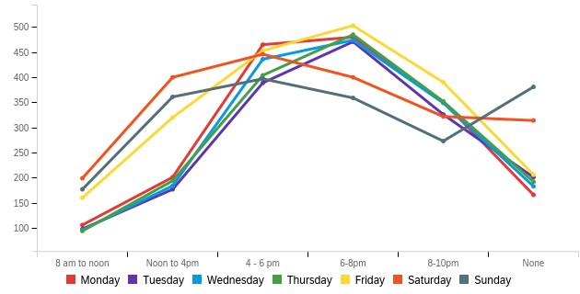
What is the best time to schedule events?
Prefer events later in the evening
Unavailable on weekends
Students living off campus have a preference for events scheduled weekdays 8 a.m.-noon

Slide 13
What prevents students from participating?
Students gave the following reasons for not attending campus events:
  lack of time, work, time of event, commuters don’t want to drive back to campus, on campus students don’t want to leave their room, anxiety about meeting new people
Those that participate in activities indicated they enjoy meeting others.
Students want an active campus life.
Students often don’t hear about events beforehand, so better advertising is needed.
FSCSA Subcommittee on student involvement: 23april,2024

