Slide 1
Course Proposals for Recommendation
DST 3030: (Disability Culture) Updated to reflect the current focus of the course
DST 3700: (Disability and Communication) Updated to reflect the focus of the course as currently taught
DST 4000: (Global Issues in Disability) Updated to reflect how faculty currently teaches the course
DST 4200: (Crip Arts, Crip Culture) Updated course description
EMS 2310: (Paramedic I) Changes
Film 3730: (Directing for Camera Styles and Techniques) Changes in course title to limit student confusion with other similarly named courses.
NSM 1000: (Foundations of Academic Success for Science and Math Majors) Changing the current one semester 2-credit hour orientation course into two 1-credit hour courses, taught in sequence over a year (Fall and Spring semesters).
PHPR 2040: (Introduction to Cosmetic Science) This course is currently only offered in the Fall semester. In CIM it is listed as a Spring semester offering.
THR 3150: (Theatre History-Ancient to Contemporary-WAC) Change in the course description from “performance” to all areas of theatre production to allow students to apply theatre history to their specific role in production.

Slide 2
DST 3030:
DST 3030: Syllabus Course Description
CATALOG/COURSE DESCRIPTION
An interdisciplinary exploration of the history and culture of disability, including the issues of stigmatizing and stereotyping, communication barriers and breakthroughs, educational segregation and mainstreaming and the experience of "passing."

Slide 3
DST 3700: Proposal
DST 3700: Syllabus Course Description
In this course we will explore several key communication aspects of disability in society. We will examine the rhetoric of disability, including the ways disability is conceptualized and talked about as well as the growth of disability movements; communication technology and disability; mass media and disability, including the ways the media portray people with disabilities and disability-related issues; and a number of other topics, including interpersonal communication issues around disability.

Slide 4
DST 4000: Proposal
DST 4000:Syllabus

Slide 5
DST 4200: Proposal
What evidence of student learning or need prompted this curricular change?
The only change proposed is an update to the course description.
DST 4200: Syllabus
Catalog/Course Description: This course explores disability art across media and considers its relationships both with disability culture and with the culture-at-large.

Slide 6
ESM 2310: Proposal
ITAG: Industry Recognized Credential Transfer Assurance Guides

Slide 7
Film 3730: Proposal
Revised Course Title: Directing For Camera: Styles and Techniques

Slide 8
NSM 1000: Proposal
NSM 1000: Syllabus
CATALOG/COURSE DESCRIPTION
Course will introduce new students to the University and college, help them develop skills to successfully transition from high school to college, provide them with information about their discipline and degree requirements, connect them to academic and campus resources, create a sense of belonging, and help students successfully navigate the first year of their academic journey.

Slide 9
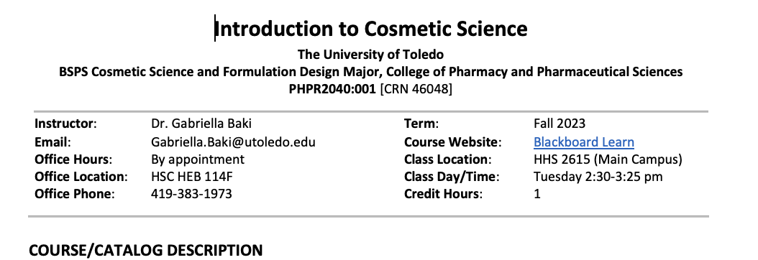
PHPR 2040: Proposal
PHPR 2040: Syllabus

Slide 10
THR 3150: Proposal
THR 3150: Syllabus
CATALOG/COURSE DESCRIPTION
This course explores major developments and trends in theatrical production, theory, and playwriting from ancient times to the Present. In this course, students use the knowledge of theatre history that they attain to develop innovative approaches to all areas of theatrical production in thoroughly-researched and properly-cited papers.
STUDENT LEARNING OUTCOMES*
Class SLOs
In this course, we will focus on following departmental student learning outcomes:
Identify a wide range of major developments and trends in theatrical production, theory, and playwriting from ancient times to the Present.
Write and speak analytically about characteristics of traditional and experimental modes of theatrical production in a variety of cultures and historical time periods.
Apply knowledge of the above to the development of original theatrical writing, design, or performance.

