Slide 1
FSCSA Report on
UTSG Issue 3: Student-Faculty Communications
From: Deborah C-H, Lucy Duhon, Sally Harmych, Suzanne Smith
11 February, 2025

Slide 2
I. History of SG Topic #3 (Not a New Issue)
Officially, the Faculty Senate Committee on Student Affairs is charged with the following: “The Senate Committee on Student Affairs shall act as a liaison between the Faculty, the Student Government, and the Administration on matters of common interest that fall within the jurisdiction of the Faculty Senate, and shall study and make recommendations on such matters.”
History of SG Topic #3 (Not a new issue: read pdf’s below.)
(Faculty – Student Communication) “Student Government would love to work with Faculty Senate to improve communication between students and faculty this year. Students have had issues with professors not replying in a timely manner or communicating in ways that are not easily accessible.” (From First Meeting of FSCSA for 2024-2025: Thursday, 19 September, 2024)
Please read Faculty Senate Minutes from 15 November, 2022, here:
https://www.utoledo.edu/facsenate/docs/minutes/approved-faculty-senate-minutes-november-15-2022.pdf
Please read FSCSA Memorandum Report from 15 November 2022 here:
https://www.utoledo.edu/facsenate/docs/final-%20fscsa-subcommittee-on-faculty-student-email-communcations-
    report-for-fs-11-15-22.pdf

Slide 3
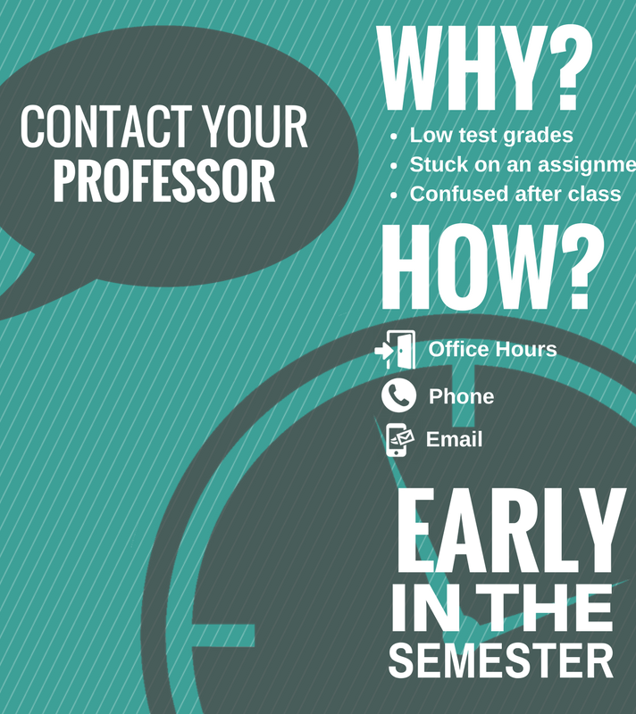
  Items Discussed at FSCSA’s 19 September, 2024, first meeting:
  A. The subcommittee remarked on the fact that this very issue had been addressed before (Fall 2022 and reported on at the 11/15/2022 Faculty Senate meeting) with solutions proposed on both the student side and the faculty side.
  As a recap, in November 2022, our then subcommittee suggested three approaches to improve faculty-student email communications:
  1. On student side- Academic Support Services include resource to Writing Center website to promote guidance and training on email etiquette;
  2. On faculty side - Dr. Jeanne Kusina recommended faculty develop their own email policy in class and/or address the issue on their syllabi.
  3. Make email etiquette training an incentivized part of FYE or orientation

Slide 4
Items Discussed at FSCSA’s 19 September, 2024, first meeting:
B. The subcommittee confirmed: not enough time to conduct formal survey of students and/or faculty during Spring semester 2025.
C. Subcommittee conducted search for existing institutional policies/documents that refer to expectations for faculty and/or students regarding their email communications.
  We confirmed Smith’s and Coulter-Harris’ findings that there were none extant, except for this document: Student Guidelines for the Use of Official Student Email Addresses. Supporting DCH’s findings also, the subcommittee found that although this document still links to a 2003 “policy” on email usage, that policy apparently no longer exists.

Slide 5
Items Discussed at FSCSA’s 19 September, 2024, first meeting:
D. Subcommittee discussed functionality of Course Messages sent through Blackboard.
  Question raised: in addition to notifications sent to users’ Outlook email, could Blackboard Ultra be configured to send notifications to students’ phones (i.e., text message alerts to check their emails or BB messages)?
  Is there a one-way mechanism like this that students could opt into? This may be something to look into to increase their engagement.

Slide 6
II. Action Items Planned after First FSCSA Meeting:
A. Sally will follow up with Dr. Jeanne Kusina, Director of CETL, on whether there’s an email policy template faculty can use for their syllabi, including any suggested links.
B. Sally will poll her students on their general satisfaction re: email communications with their professors. Results: A survey of 119 students was done to assess their satisfaction with professor response times to email. The results show that:
  Most students are either very satisfied or satisfied with professor response times: 48.7%; satisfied and 30.3% very satisfied. (See Appendix 1)

Slide 7
II. Action Items Planned after First FSCSA Meeting:
C. Lucy will follow up with Tia Tucker, Director Of Academic Support Services, for possible data on students taking advantage of training since the Writing Center’s web page (https://www.utoledo.edu/success/writingcenter/ )was created in March 2023. Results: No data for training on emails vailable.
D. Other subcommittee members were invited to submit feedback from their own students. Suzanne Smith forwarded poll results from her students during mid-week of February 7, 2025. (See Appendix 2)

Slide 8
Appendix 1.
Total of 119 students responded:
Most students either very satisfied or satisfied with professor response times (48.7%; satisfied and 30.3% very satisfied).
When asked how long does it take for your professors to respond to your emails:
  29.4% of students indicated it takes less than 12 hours,
  48.7% indicated it takes 12-24 hours,
  20.2% 1-2 days
  remaining students indicated it takes 3 days or more or that do not receive a response.
The majority of students indicated that they prefer responses from professors within 24 hours. The final question asked students to make suggestions on how to improve communication. These comments are at the end of the document (Please refer to Memorandum for Comments under Appendix 1).

Slide 9
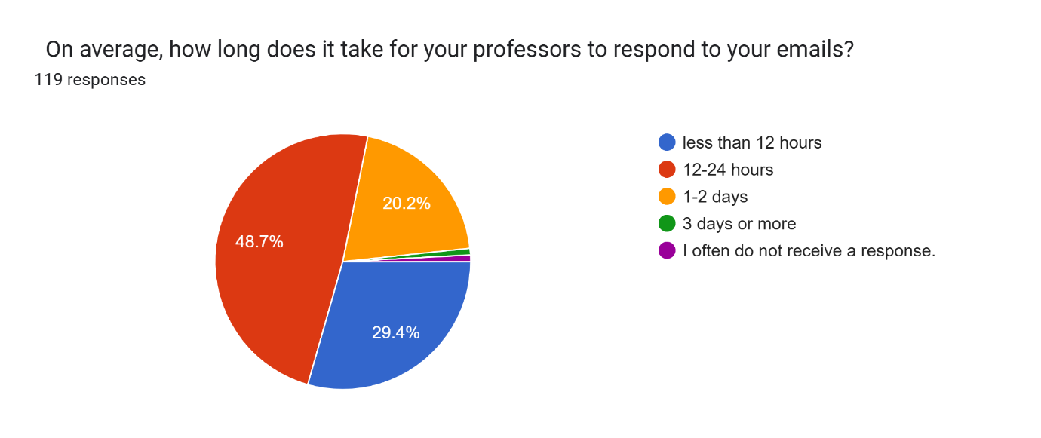
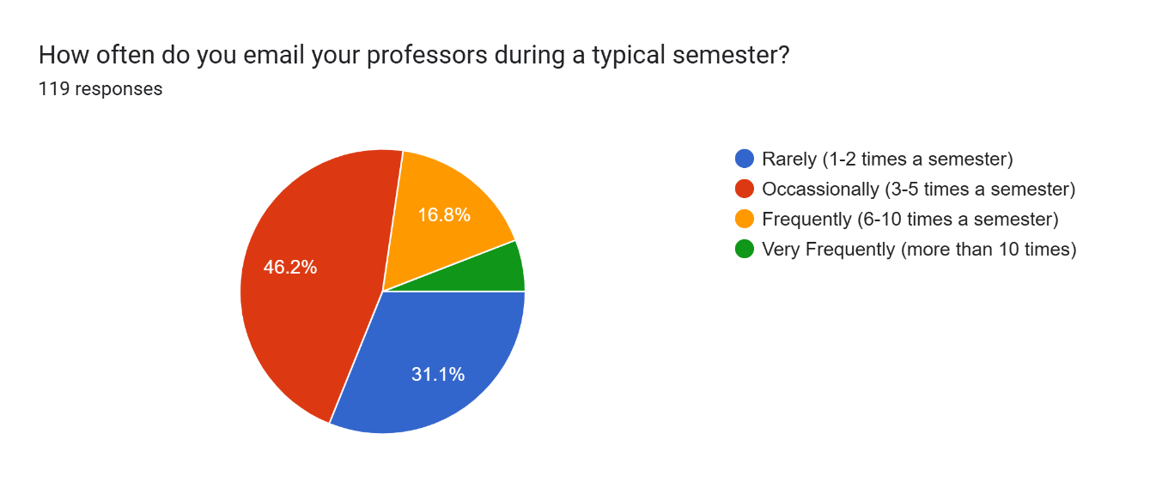
Appendix 1. Questions 1 and 2

Slide 10
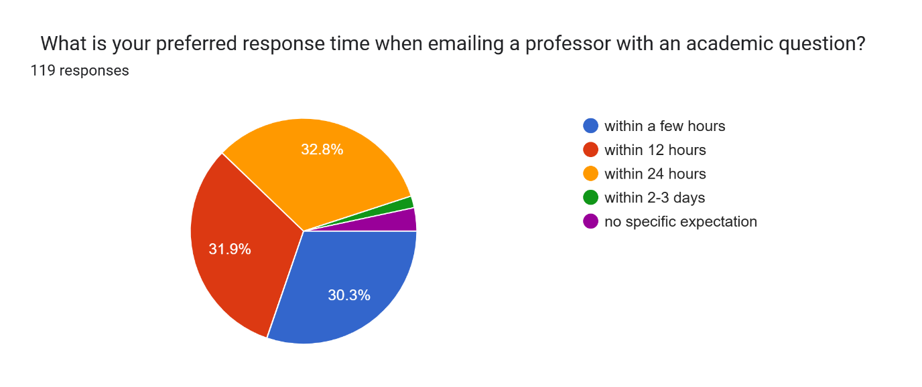
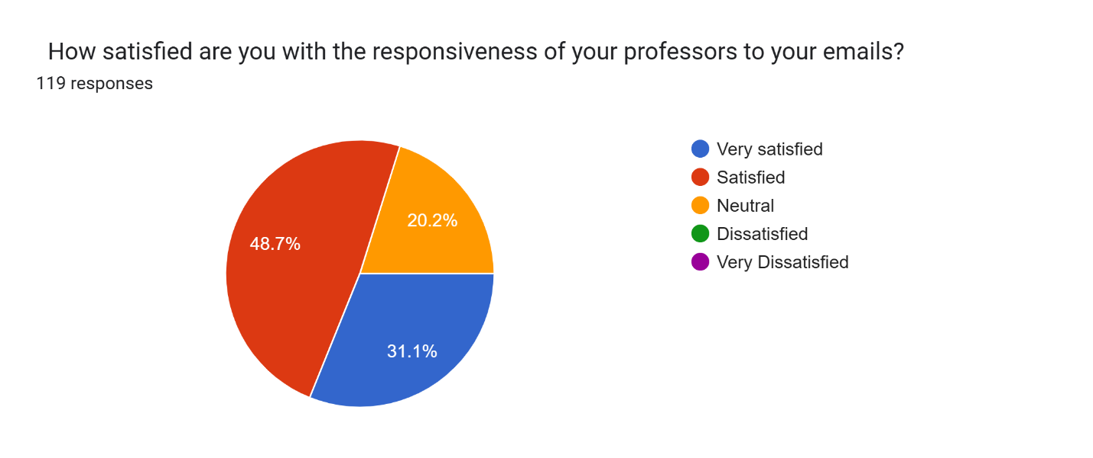
Appendix 1. Questions 3 and 4

Slide 11
Appendix 1. Question 5 (Just a Sampling- Refer to Memorandum for List of Answers.)
What suggestions do you have for improving communication between students and professors via email?
“There needs to be an email back between 12-24 hours. There cannot be an expectation for us to be prompt and professors not.”
“Students should not reach out so late, so professors can respond right away.”
“I feel like some professors don’t respond; sometimes you have to email them twice. I feel like some professor should look at their email more frequently because I once had to email a professor 3 times and she didn’t answer; it took 3 weeks for her to respond.”

Slide 12
Appendix 2. See Memorandum for Other Responses
“I’ve had a few times where communication with professors could’ve been better. One time, I emailed a professor about an assignment deadline, and it took over a week to get a response. That made it hard to plan and stay on top of things. I do check my UT email regularly, but with so many messages from different professors, it can get overwhelming. It’s not always clear which emails are urgent or how quickly I should expect a reply. There are also times when I’m unsure if it’s better to email, message on Blackboard, or just go to office hours. It would help if professors set clear expectations about communication so I know the best way to reach out.”

