Slide 1
Course Proposals
Comm 2600: (Public Presentations) This course is being submitted for approval into the Arts and Humanities core curriculum. It is in compliance with Ohio Transfer 36 and has already been approved by the state.
EECS 4750: (Machine Learning) Changed the prerequisites for the course to meet the needs of students from different degree programs.
Film 4220: (Cinema and Popular Culture Studies) Course changes are to distinguish this course from offerings in the Media and Communication degree program
GEPL 1010: (People, Places, and Society) Update Student Learning Objectives to meet the requirements of OT36
GEPL 2020: (Introduction to Geospatial Science) This is a new course that will be an elective in a BA in Geography and required for the BS in Geospatial Science
GEPL 4300: (GIS Programming) A new course proposal that is offered as a slash course (GEPL 5300), and required for the BS in Geospatial Science
RDON 1010: (Introduction to Radiation Therapy) Updated Syllabus to include a research and writing intensive component.
RDON 3100: (Radiation Therapy Physics I) Updated to be in line with the American Association of Radiologic Technologists. Adoption is required by fall 2025

Slide 2
COMM 2600 (Public Presentations)
Course Proposal

Slide 3
EECS 4750 (Machine Learning)
Course Proposal

Slide 4
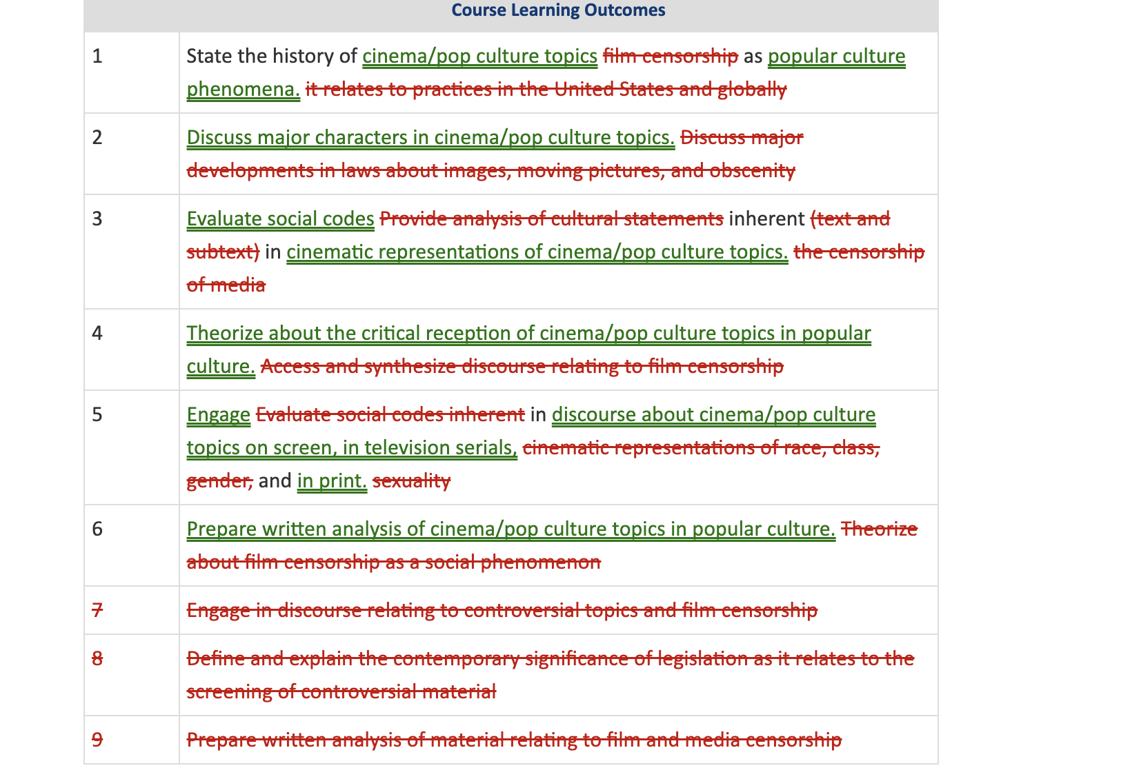
Film 4220 (Cinema and Popular Culture Studies
Course Proposal

Slide 5
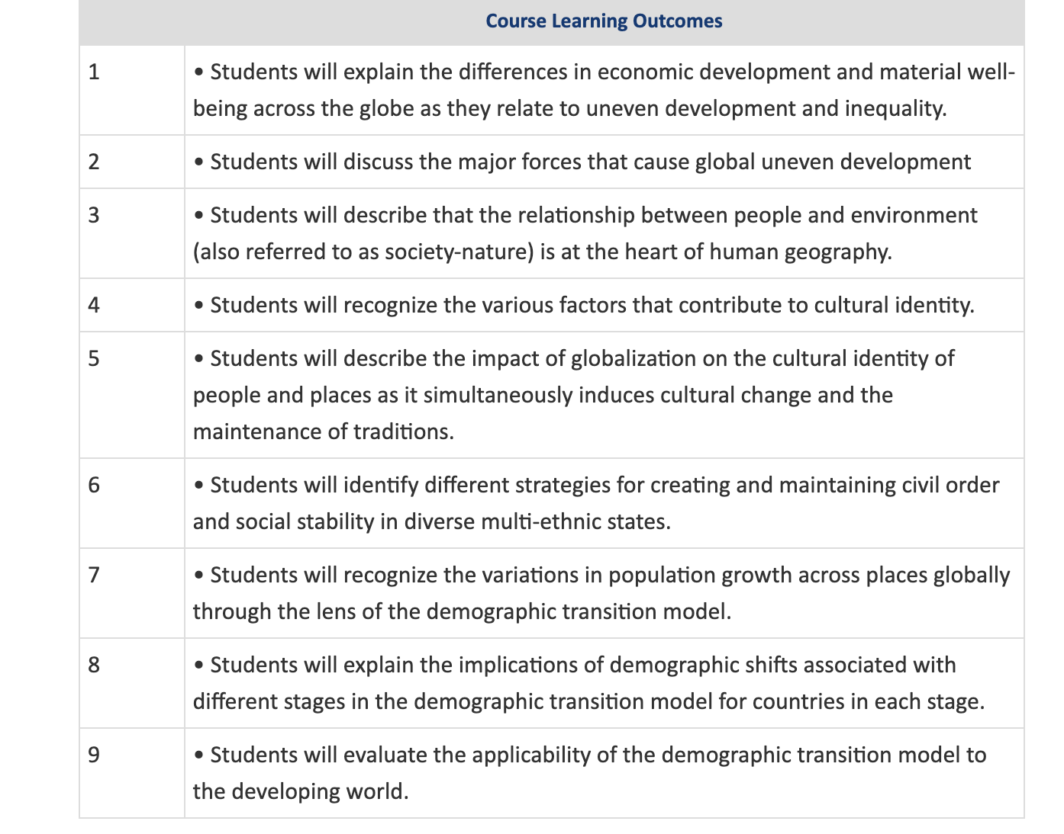
GEPL 1010 (People, Places, and Society
Course Proposal

Slide 6
GEPL 2020 (Introduction to Geospatial Science)
Course Proposal

Slide 7
GEPL 4300 GIS Programming
Course Proposal

Slide 8
RDON 1010 (Introduction to Radiation Therapy)
Course Syllabus
Updated Syllabus

Slide 9
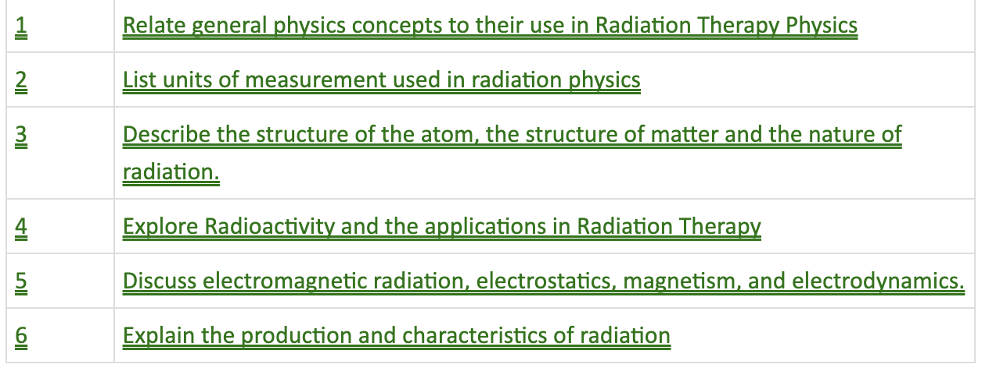
RDON 3100 (Radiation Therapy Physics I

