Slide 1
Undergraduate Curriculum Committee (2/25)
CIEC 3380 (Practicum I) Changing grading from a letter grade to satisfactory/unsatisfactory
CIEC 4480 (Practicum II) Changing grading from a letter grade to satisfactory/unsatisfactory
CIEC 4770 (Practicum III) Changing grading from a letter grade to satisfactory/unsatisfactory
CIEC 4930 (Internship/Student Teaching in Primary Education) Changing grading from a letter grade to satisfactory/unsatisfactory
EECS 4750 (Machine Learning) Changed prerequisites to include equivalent courses in math.
EMS 3320 (Paramedic II) Conforms to the state-wide industry recognized transfer of credits
EMS 4330 (Paramedic III) Conforms to the state-wide industry recognized transfer of credits
ENGL 4340 (Modern and Contemporary Drama) Increases the curriculum choices for students to study contemporary works
ENGL 4900 (English Honors Seminar) Changing the ENGL 4900 and ENGL 4960 courses from 2 and 4 credit hours to 3 credit hours each, which will make it easier to staff the Honors Seminar
ENGL 4960 (English Honors Thesis) Changing the ENGL 4900 and ENGL 4960 courses from 2 and 4 credit hours to 3 credit hours each
FILM 4220 (Cinema and Popular Culture Studies) To differentiate cinema studies from media studies
GEPL 4400 (GeoAI and Machine Learning) This course keeps pace with changes in methods and technologies in the intersections between geography and planning, machine learning and AI
GEPL 4520 (Analytical and Computer Cartography) A reactivated course that will be included in the newly proposed BS in Geospatial Science
GEPL 4800 (Geospatial Science Research) Included in the newly proposed BS in Geospatial Science
IDS 3050 New Course (Professional Development in Interdisciplinary Fields) Addresses the need in interdisciplinary studies to engage in and understand “interdisciplinarity”

Slide 2
Proposals Continued
NSM 2000 (Professional Career Preparation in Math and Science) To provide career advising for second year students
RDON 1010 (Introduction to Radiation Therapy) Conform to the updated curriculum of the American Society of Radiologic Technologists
RDON 3100 (Radiation Therapy Physics I) Conform to the updated curriculum of the American Society of Radiologic Technologists. The Joint Review Committee on Education in Radiologic Technology requires adoption of new standards by Fall 2025
RDON 3120 (Patient Care Management) Conform to the updated curriculum of the American Society of Radiologic Technologists. The Joint Review Committee on Education in Radiologic Technology requires adoption of new standards by Fall 2025
RDON 3130 (Principles and Practice of Radiation Therapy I) Conform to the updated curriculum of the American Society of Radiologic Technologists
RDON 3200 (Radiation Therapy Physics II) Conform to the updated curriculum of the American Society of Radiologic Technologists. The Joint Review Committee on Education in Radiologic Technology requires adoption of new standards by Fall 2025
RDON 3210 (Introduction to Clinical Practicum) Conform to the updated curriculum of the American Society of Radiologic Technologists
RDON 3230 (Principles and Practice of Radiation Therapy II) Conform to the updated curriculum of the American Society of Radiologic Technologists
SPED 3670 (American Sign Language I) Changing the course description to reflect course activities. For example, currently there is no lab requirement
SPED 3680 (American Sign Language II) Make prerequisites consistent with SPED 3690 and SPED 3700. Also the catalog description of this course is incorrect and states ASL 2 teaches interpretive skills
SPED 3690 (American Sign Language III) Make prerequisites consistent with SPED 3680 and SPED 3700. Also the catalog description of this course is incorrect and misleading
SPED 3700 (American Sign Language IV) Make prerequisites consistent with SPED 3680, 3690 and SPED 3700. Also the catalog description of this course is incorrect and misleading
ECON 3980 (Current Economic Issues) To meet the changes in job market preparedness for students

Slide 3
Courses to be Considered, not for Approval
CLT 2000 (The American Constitutional Tradition) To be included in CLT curriculum
CLT 3020 (Liberalism and Conservatism in America) To be included in CLT curriculum
CLT 3030 (Model US Senate) To be included in CLT curriculum
CLT 3040 (Constitutional Democracy and Democratic Citizenship) To be included in CLT curriculum
CLT 3750 (The Empire of Modern Science) To be included in CLT curriculum

Slide 4
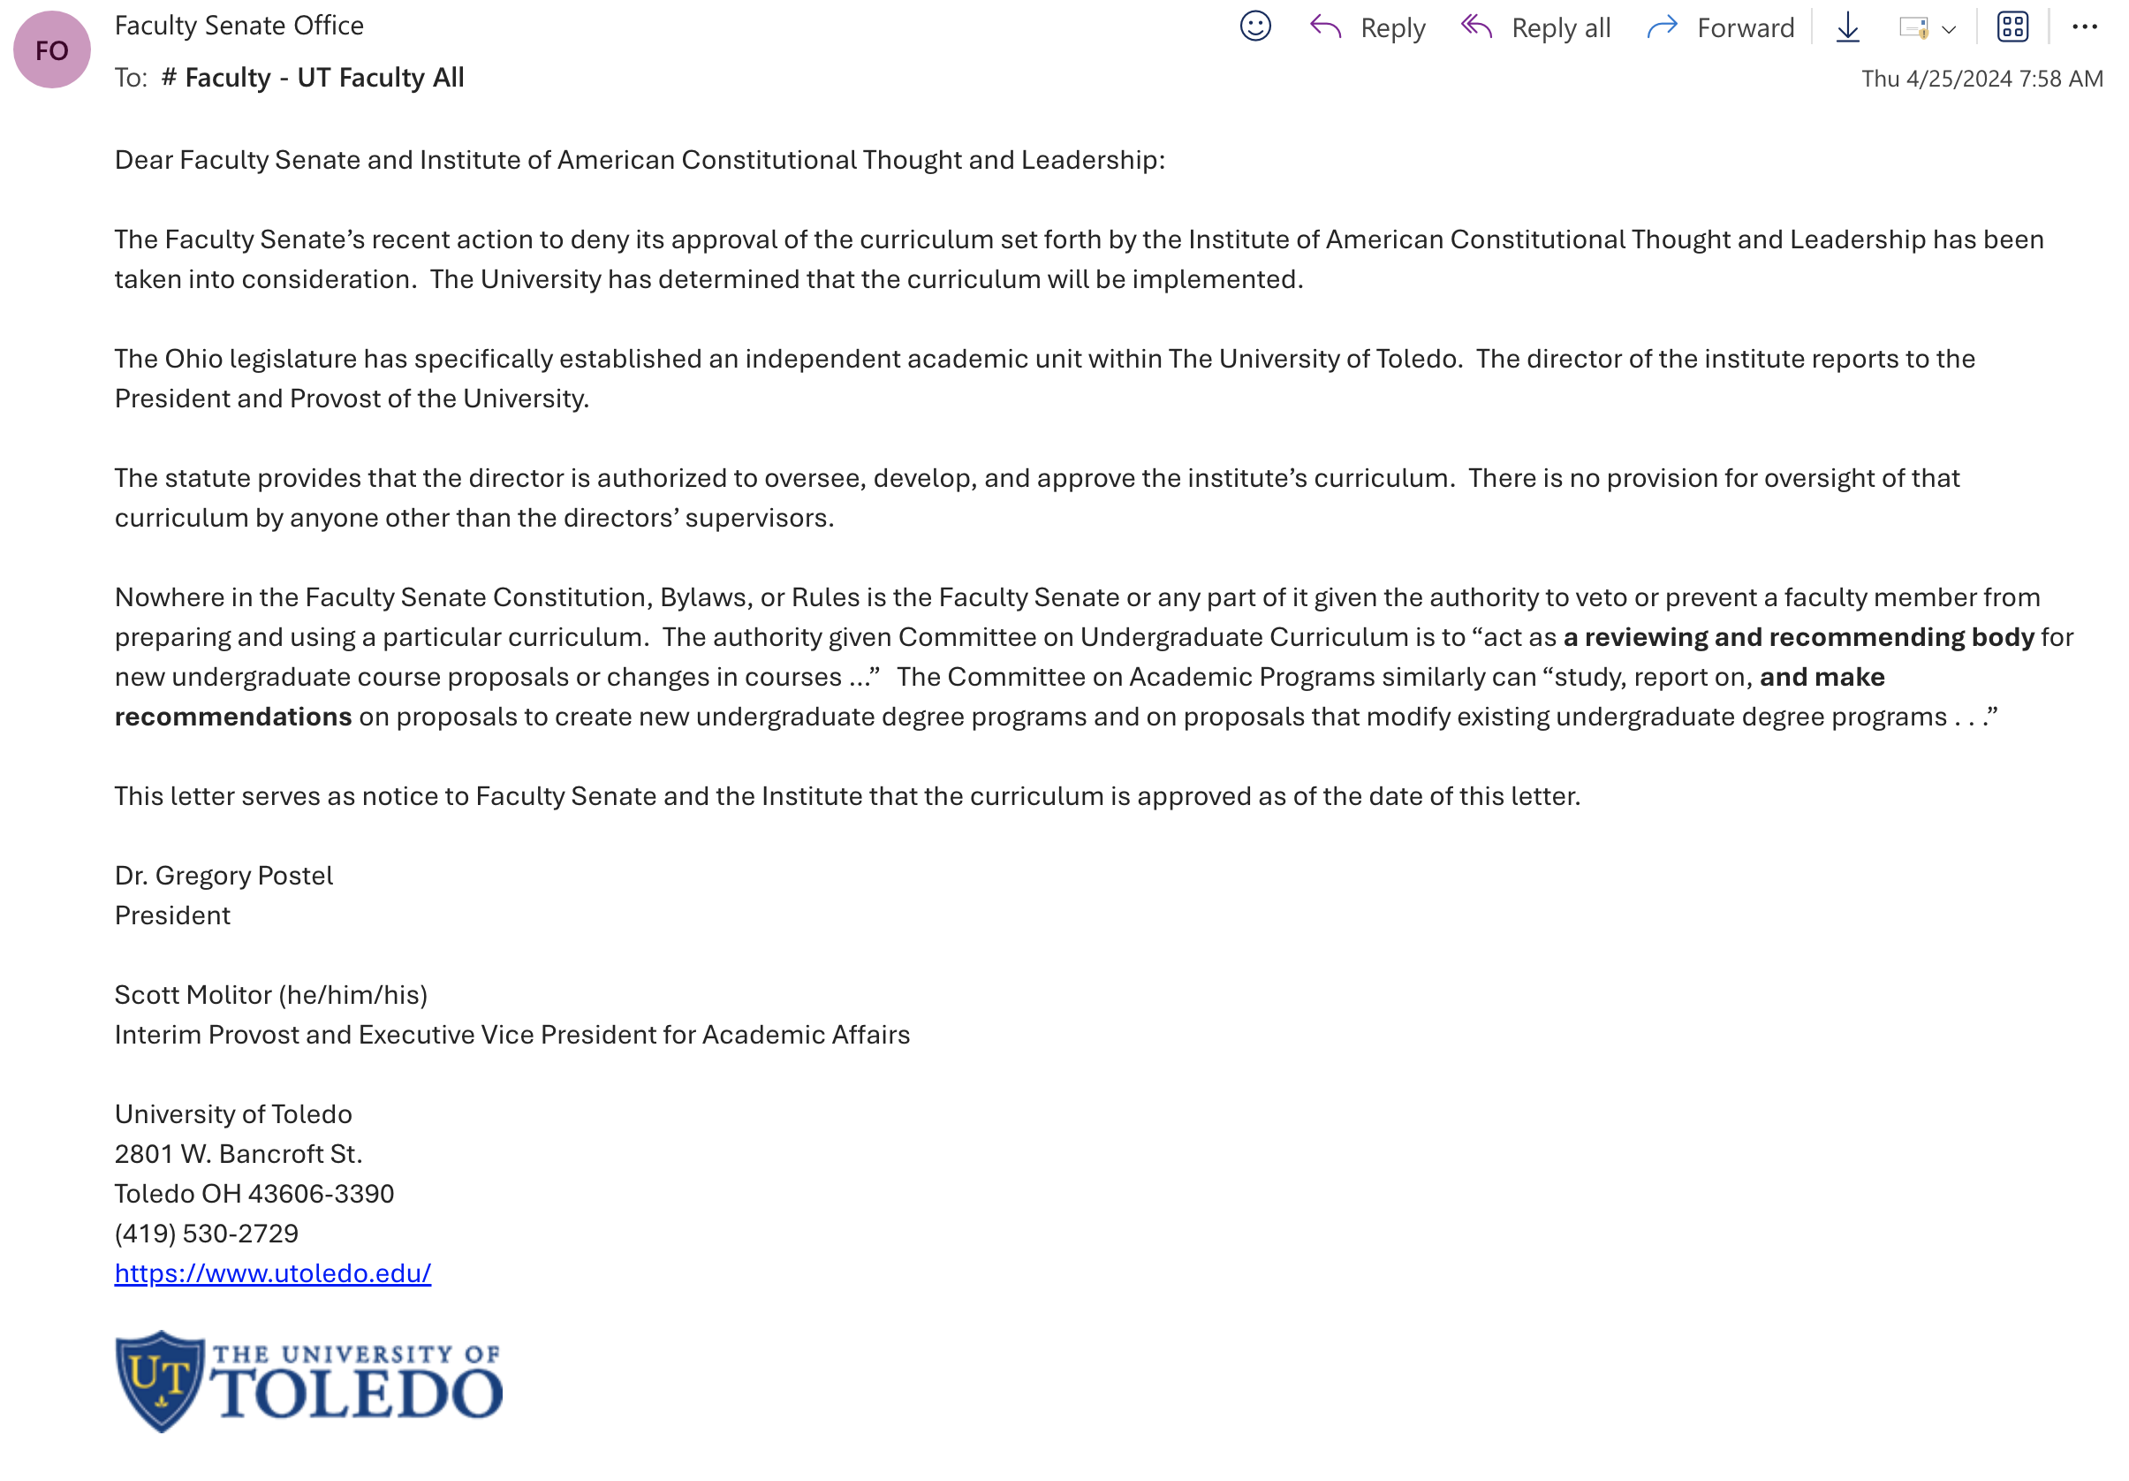
April 25, 2024 email from President Postel to Faculty Senate

