Slide 1
FY25 Financial Performance
January
J. Lee Johnson, Ph.D., CPA
Executive Vice President for Finance and Administration & CFO

Slide 3
UToledo Statements of Revenue, Expenses, and changes in net position (Income Statement)

Slide 4
THE UNIVERSITY OF TOLEDO
Statements of Revenues, Expenses
and Changes in Net Position – Consolidated
As of January 31, 2025

Slide 5
UToledo cash forecast

Slide 6
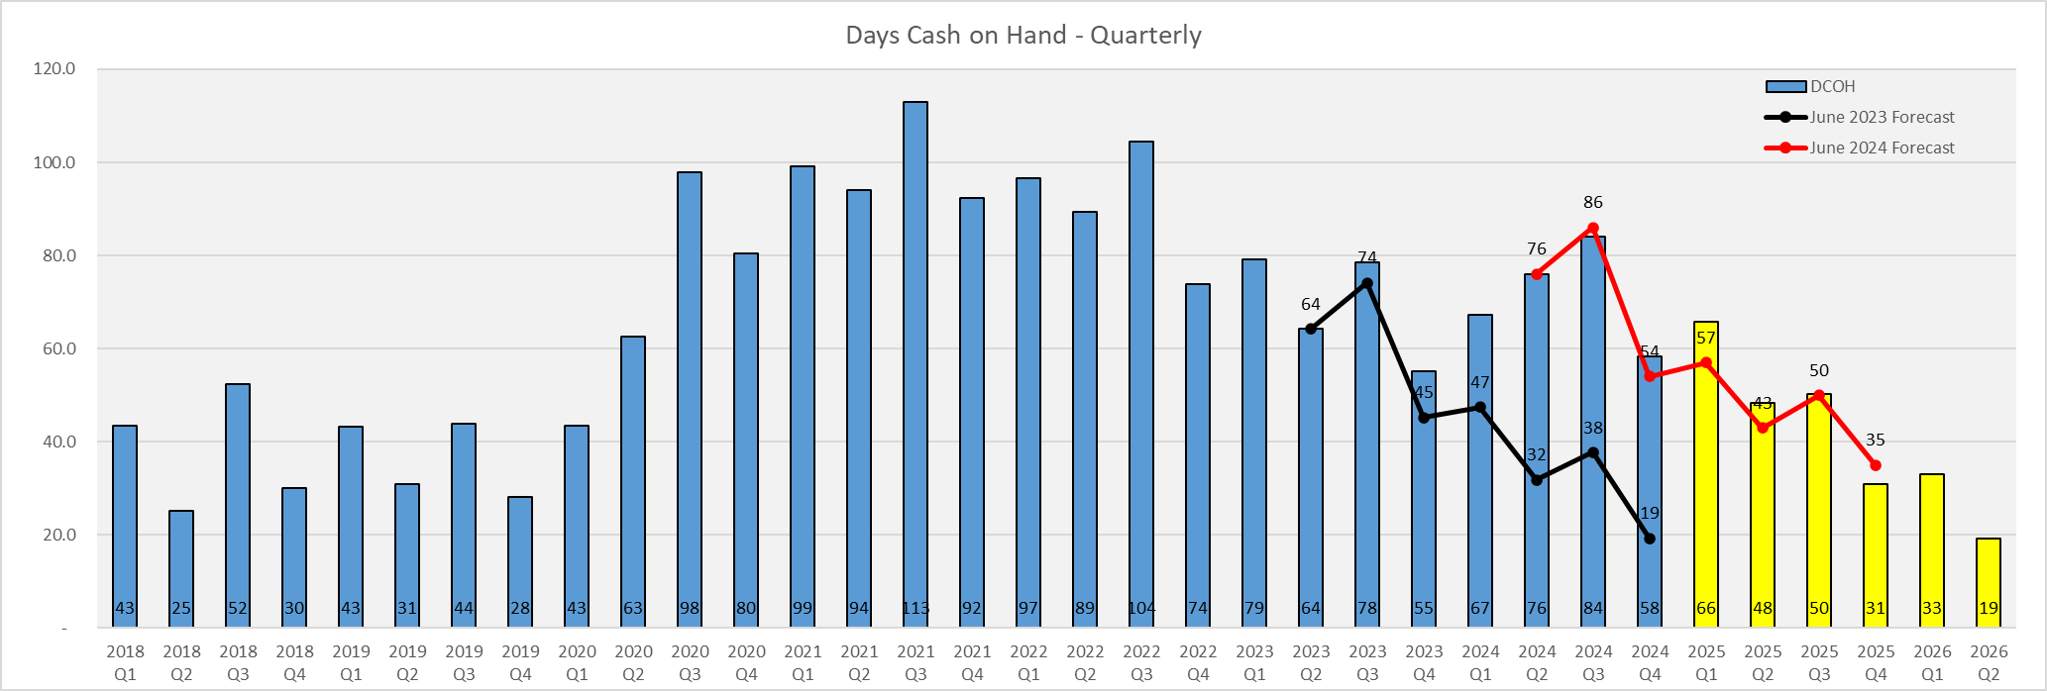
Days cash on hand – working capital
This forecast is business as usual and does not include any FY26 budget assumptions.
This forecast does not include investment income or gains/losses.

