Slide 1
Telling the UToledo Story
Meghan Cunningham
Vice President for Marketing and Communications
Nov. 4, 2025

Slide 2
Office of University Marketing and Communications
What we do:
Marketing Strategy – paid advertising, promotional materials, trademark licensing, etc.
Communications - media relations, internal comms (UToledo News), executive comms
Web - web strategy, user experience, accessibility
Design and photography – creative development and brand standards
Digital Media – social media and video

Slide 3
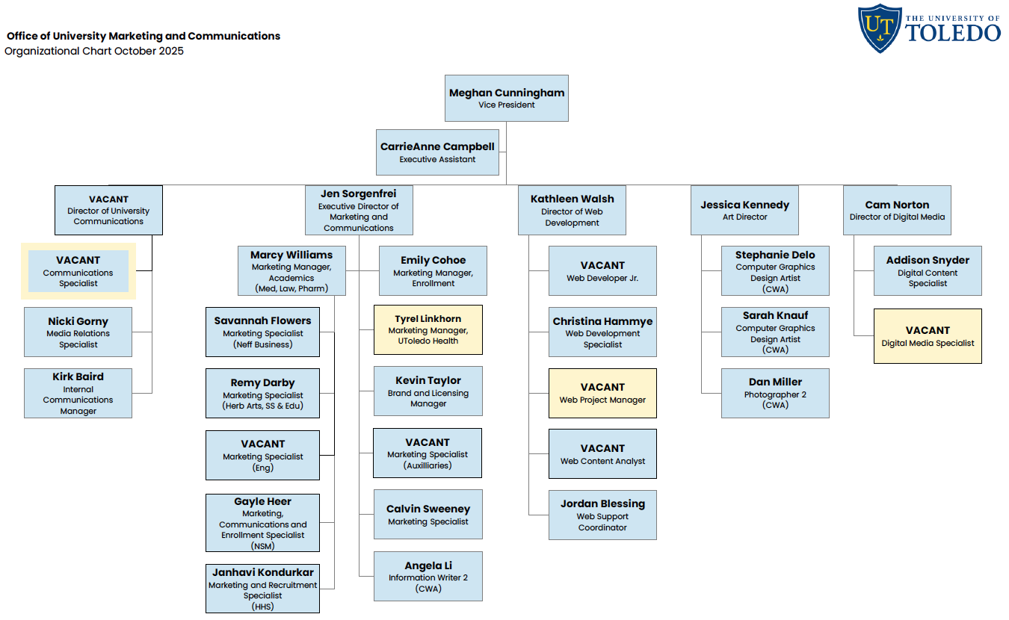

Slide 4
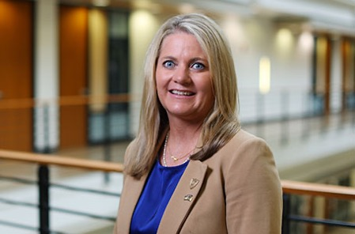
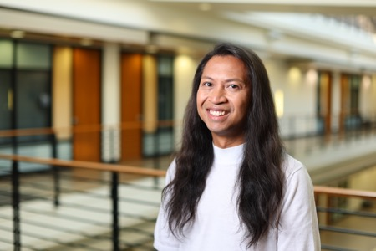
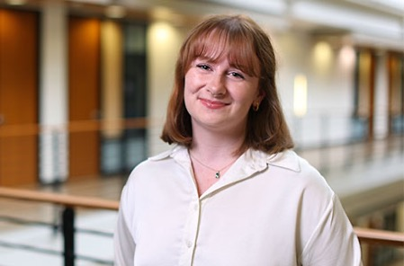
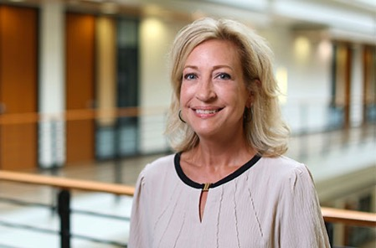
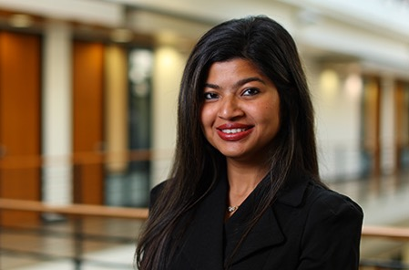
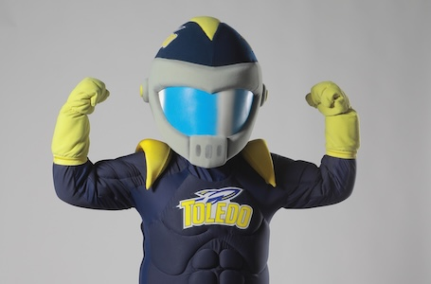
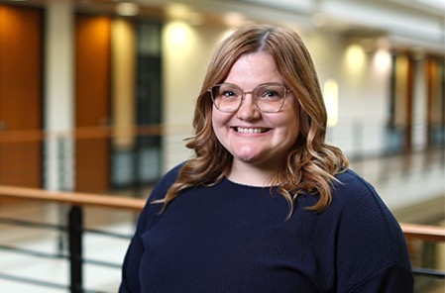
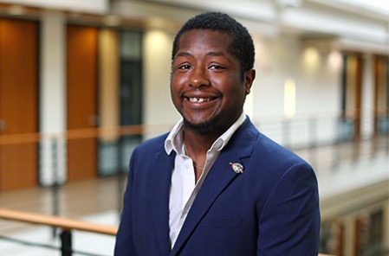
Contact Your Marketing Strategist!
Marcy Williams
Medicine, Law & Pharmacy
Remy Darby
Arts, Social Sciences and Education
Savannah Flowers
Business and Innovation
Gayle Heer
Natural Sciences and Mathematics
Janhavi Kondurkar
Health and Human Services
VACANT
Engineering
Emily Cohoe
Enrollment
Calvin Sweeney
Student Affairs and Admin

Slide 5
Advertising

Slide 6
Advertising
Launched The Power To Do brand in July/August 2024 with the goal of increasing brand awareness
UToledo
Goals: Drive preference and enrollment actions
Audiences: Ohio Public, Prospective Students and Parents and Internal
UToledo Health
Goals: Enhance perception and drive service line volume
Audiences: Toledo Public, Patients, Referring Physicians, Internal and Medicaid

Slide 7
UToledo Advertising Reach 2024-25
Digital - 121.2 million impressions
692,104 clicks
23,020 conversions (RFI submissions, apply clicks or schedule a visit clicks)
550,009 website sessions
18.2 million video/audio completes
Traditional – 53.8 million impressions
TV 6.6 million
Outdoor 46.8 million
Print 426,382

Slide 8
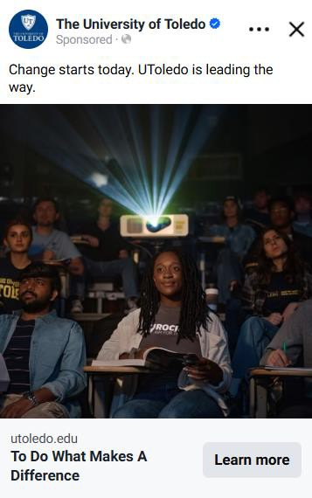
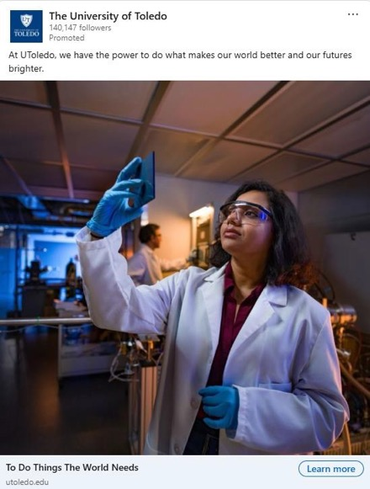
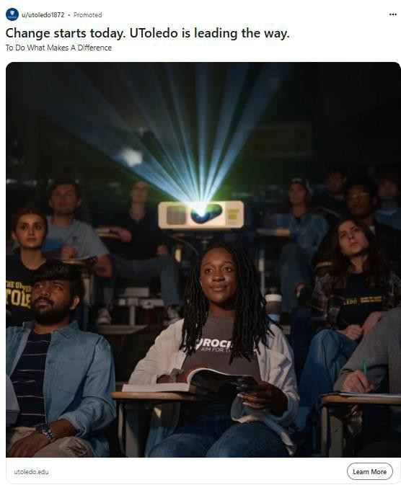
Ohio Public – Social Top Performers
Meta
LinkedIn
Reddit
"Makes A Difference" Static
2.6MM impressions,
7.9k clicks
"World Needs" Static
311k impressions,
3.2k clicks
"Makes A Difference" Static
360k impressions, 1.2k clicks

Slide 9
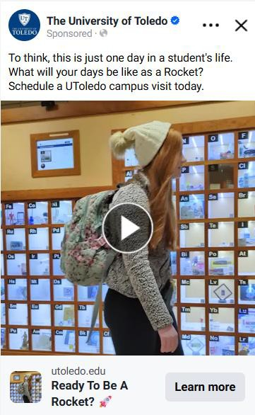
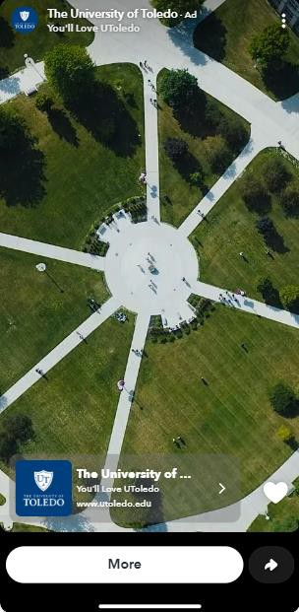
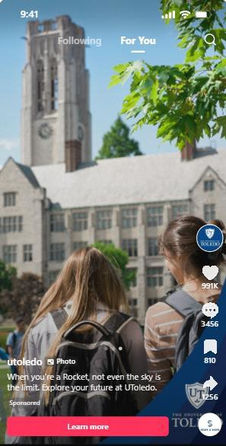
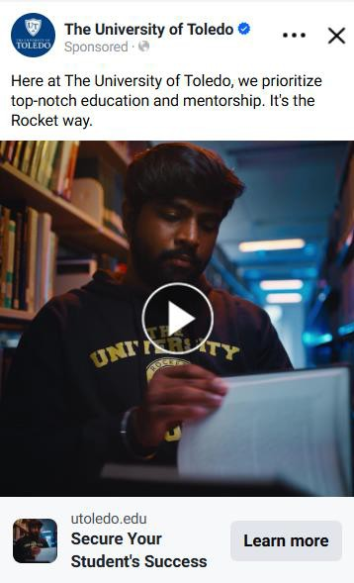
Admissions – Social Top Performers – Lead Gen
Prospects
Parents
Meta
Snapchat
TikTok
Meta
DITL Linnea Video
18k impressions,
203 clicks
Enrollment :30 Video
134k impressions, 5.3k clicks
"Something You Were Made For" Prospects Carousel 1 354k impressions, 21k clicks
Parents :15 Video
822k impressions, 4.2k clicks

Slide 10
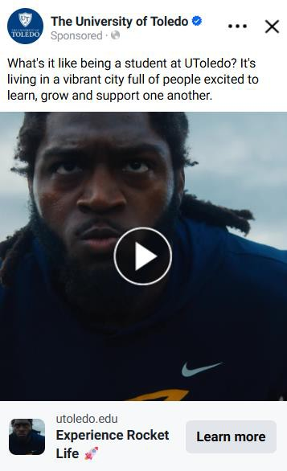
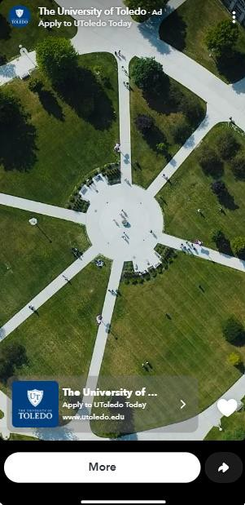
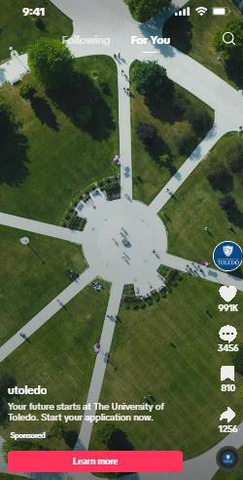
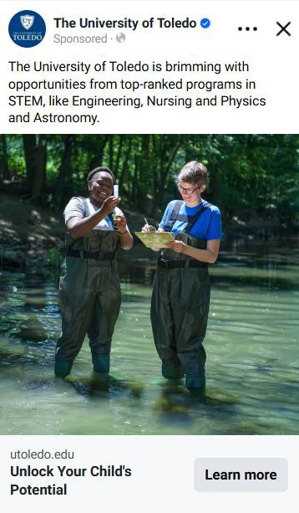
Admissions – Social Top Performers – Application
Prospects
Parents
Meta
Snapchat
TikTok
Meta
"Power in Motion" (Motion 2)
140k impressions, 6.7k clicks
"Ready to Rise" (Motion 4)
598k impressions, 22k clicks
"Ready to Rise" (Motion 4)
931k impressions, 23k clicks
"Water Quality" (Static 2)
670k impressions, 10k clicks

Slide 11
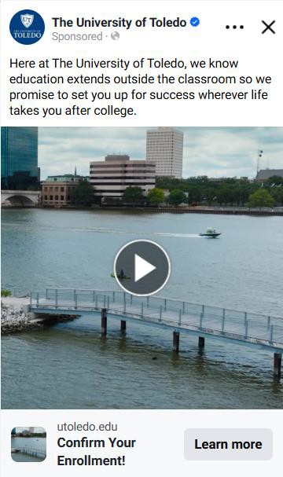
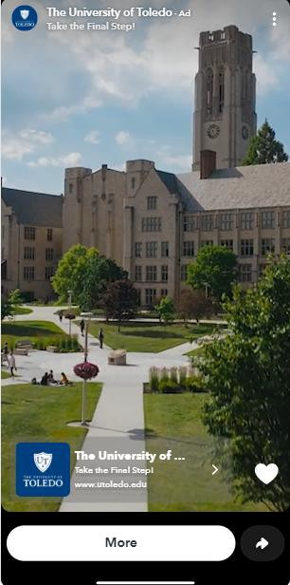
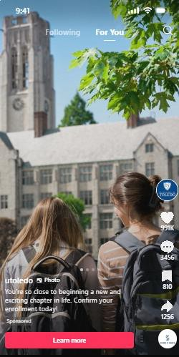
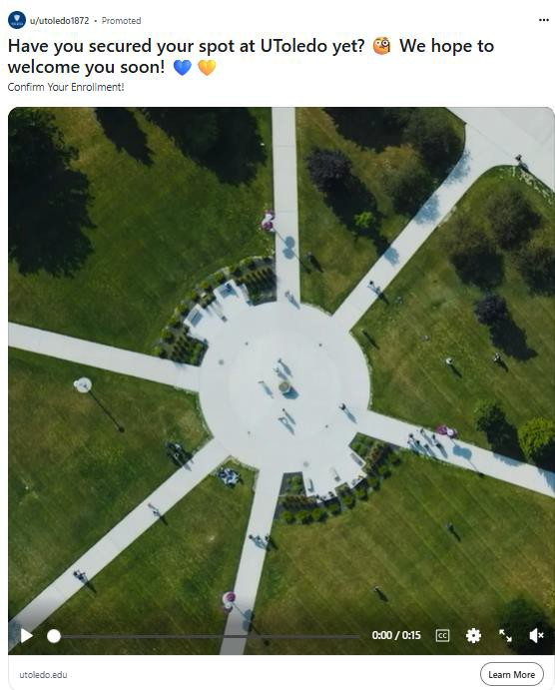
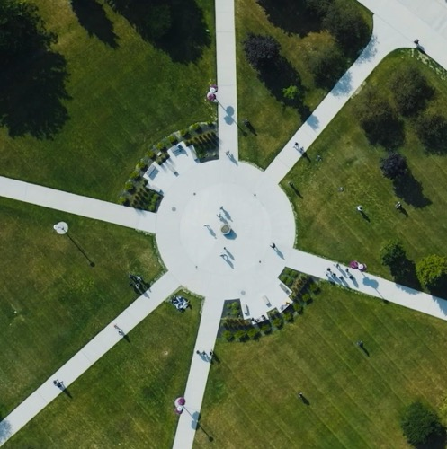
Admissions – Social Top Performers – Yield - Students
Meta
Snapchat
TikTok
Reddit
"Next Starts Now" (Motion 5) 154k impressions, 1.1k clicks
Education Brand :15
150k impressions, 4k clicks,
"Next Chapter" Prospects Carousel 3
25k impressions, 227 clicks
"Ready to Rise" (Motion 4)
11k impressions, 64 clicks

Slide 12
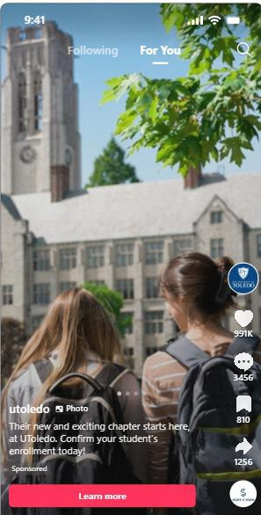
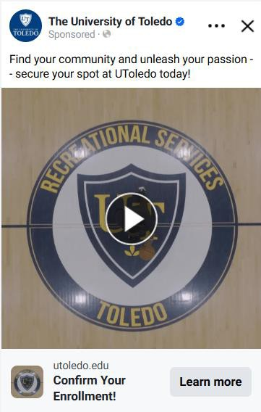
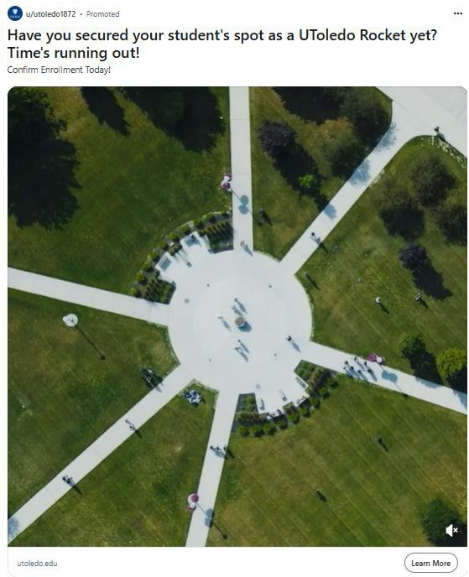
Admissions – Social Top Performers – Yield- Parents
Meta
TikTok
Reddit
Hype :15
48k impressions, 448 clicks
"You're Almost There" Parents Carousel 3
3.2k impressions, 13 clicks
"Ready to Rise" (Motion 4)
1.3k impressions, 12 clicks

Slide 13
New for 2025-26
New geographic targeting strategy aligned with Enrollment Management recruitment strategy.
New creative specific to Engineering, Health Care and Business academic programs
New creative and targeting for online and transfer student populations.
New creative and targeting for the Michigan in-state tuition scholarship initiative.

Slide 14
UToledo Health Advertising Reach 2024-25
Digital – 30.4 million impressions
415,263 clicks
6.2 million video completes
1,081 social media shares and 12,030 reactions
Traditional – 19.8 million impressions
TV 5.7 million
Outdoor 12.5 million
Print 1.6 million

Slide 15
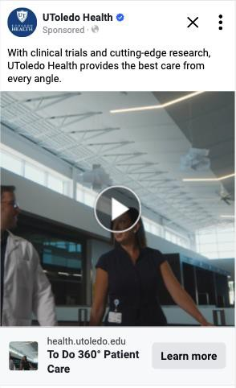
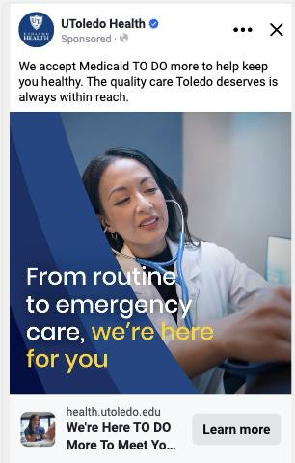
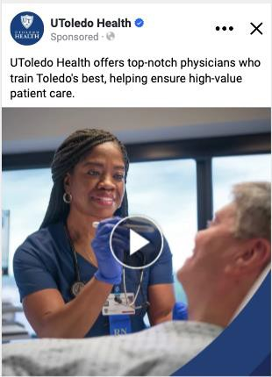
Top Performing Brand Creative
Meta Brand Traffic Campaign
Meta Brand Medicaid Campaign
Meta Brand Awareness Campaign
“Cutting Edge :15 Brand” Video
1,250,336 Impressions,
32,226 Clicks
“Wellness to Emergency” Motion
Graphic 53,086 Impressions,
1,076 Clicks
“Takes The Best” Motion Graphic
326,956 Impressions, 233,351 ThruPlays

Slide 16
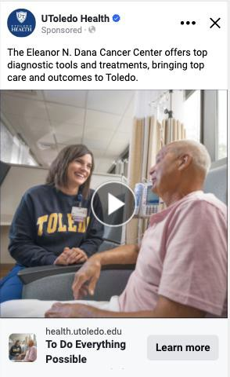
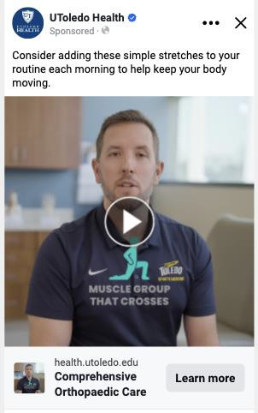
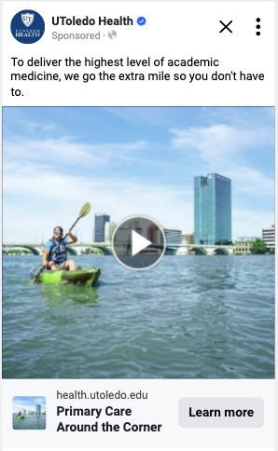
Top Performing Service Line Creative
Oncology
Ortho
Primary Care
“Relentless Excellence” Motion Graphic
325,475 Impressions, 11,042 Clicks
“Miller Stretches To Do" :53 Sec Video 235,552 Impressions, 5,200 Clicks
“Make Life Easier” Motion Graphic
255,614 Impressions, 10,191 Clicks

Slide 17
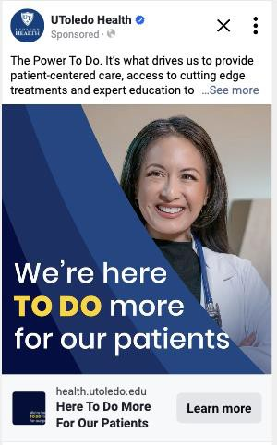
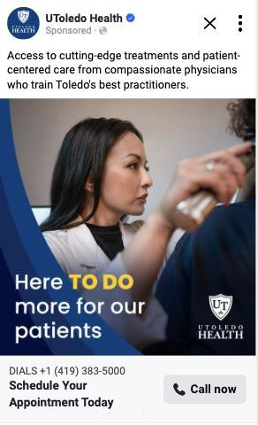
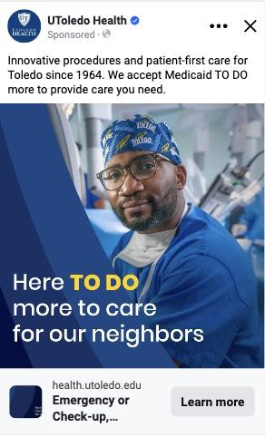
Meta Service Line Creative
Referring Physicians and Internal
Primary Care – Click to Call
Medicaid
“We’re Here To Do” Motion Graphic
122,631 Impressions, 6,531 Clicks
“More For Our Patients” Static
800,074 Impressions, 43 20-second Calls
“Emergency or Check Up” Motion Graphic
123,434 Impressions, 3,019 Clicks

Slide 18
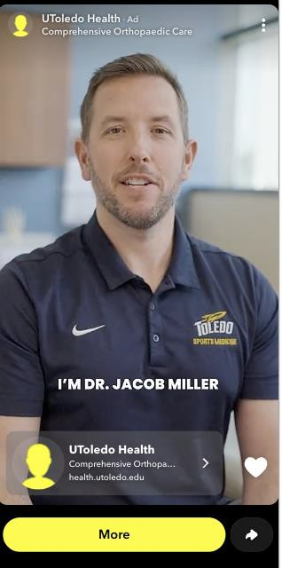
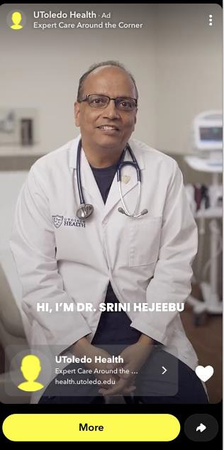
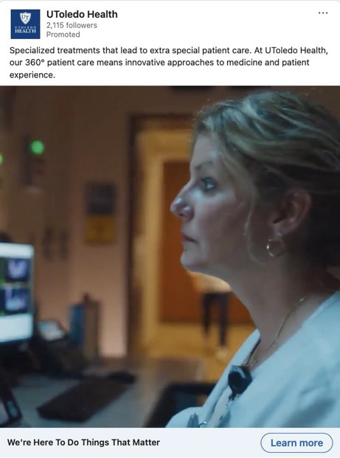
Social Creative
Snapchat
LinkedIn
Ortho
Primary Care
Referring Physicians and Internal
“Miller Stretches To Do"
53 Sec Video
21,754 Impressions, 1,784 Clicks
“Hejeebu MD Q&A How Often To See"
44 Sec Video
16,645 Impressions, 1,871 Clicks
“Specialized Care” :30 Sec Video
35,760 Impressions, 233 Clicks

Slide 19
New for 2025-26
Continued focus on identified service lines of cancer, ortho and primary care.
Year-round targeting for Medicaid patient populations.
Highlighting physician expertise through Blade partnership and first-person videos.

Slide 20
Communications

Slide 21
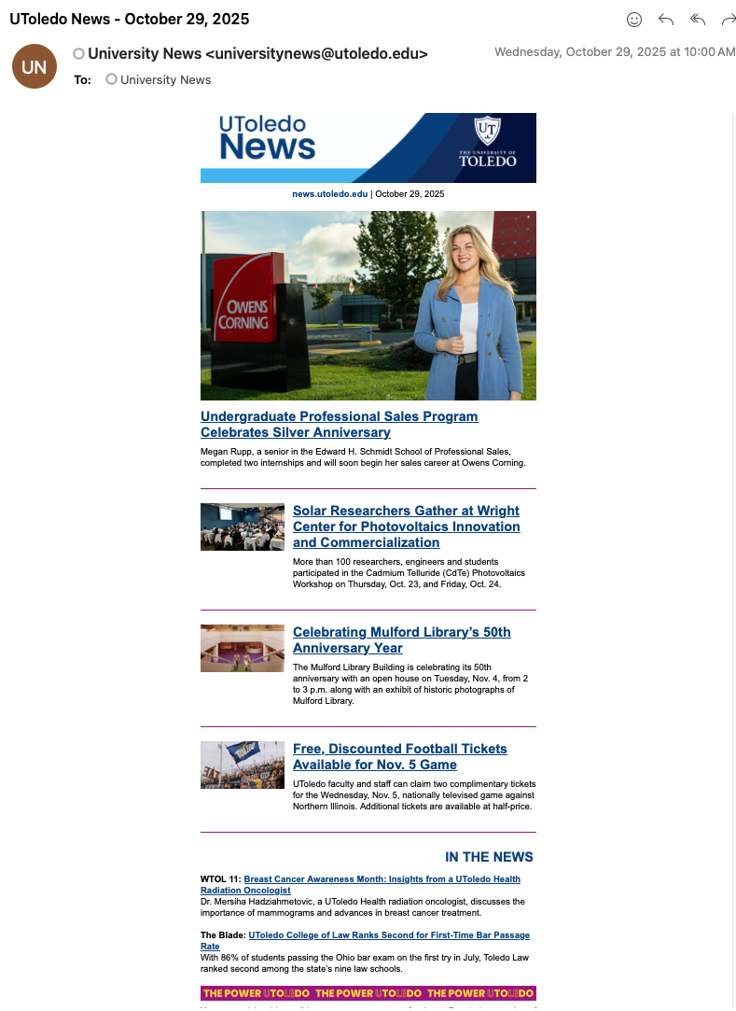
University News
University News email is sent daily during the academic year and twice weekly during the summer.
Stories and their dedicated links are available at news.utoledo.edu.
789 stories shared in FY25

Slide 22
Media Relations
Meaningful media mentions for 2024-25 topped 2,000 news stories about UToledo in local, regional and national news outlets
2,008 Stories
5.2 billion Audience Reach
$50.6 million Ad Value

Slide 23
Types of News Stories
News
Large research award
Noteworthy research publication
Unique or high-profile events on campus
New initiatives, programs, etc.
Feature
Student, faculty or staff achievement
Alumni success
Human interest
Opinion
First-person column on area of expertise

Slide 24
What is Newsworthy?
Timely – Immediate, current information. News is new.
Proximity – Affects the community and region. ”Close to home” or local angle to national story.
Human Interest – Unique stories of accomplishment or overcoming obstacles.
Impact – Measurable significance – grant award amount, publication reach, people affected, etc.
Conflict or Controversy – Attracts attention with argument over actions, events, ideas, policies, etc.

Slide 25




Media Highlights
University of Toledo researchers looking into how Lake Erie affects air quality and you can help
Steven Haller and David Kennedy, Associate Professors, Medicine
June 25, 2025
You Might Actually Be Better Off Wearing SPF For Kids — Here’s Why Gabriella Baki, Associate Professor, Pharmaceutics, and Director, Cosmetic Science and Formulation Design Program
June 12, 2025
Lab mice will try to revive their knocked-out friends, study reveals
James Burkett, Assistant Professor, Neuroscience Feb. 20, 2025
New school at UT expected to help with demand for data scientists
Marc Seigar, Dean, College of Natural Sciences and Mathematics, and Bill Kalies, Professor, Math, and Director of the Data Science Program Feb. 14, 2025

Slide 26




Media Highlights
This is the Fascinating Origin of Baby New Year — and it Goes Back Much Further Than You Probably Think Daniel Compora, Professor, English Language and Literature
Dec. 13, 2024
How Exercise Really Affects Your Testosterone, According to Doctors Dr. Ahmed El-Zawahry, UToledo Health Urologist
Dec. 6, 2024
Road salt may hurt vital link in freshwater food chain, study says
William Hintz, Associate Professor, Environmental Sciences Aug. 17, 2024
The Long, Discriminatory History of ‘Sex Verification’ at the Olympics
Jami Taylor, Professor, Political Science and Public Administration
Aug. 6, 2024

Slide 27
Social Media

Slide 28
Social Media
Total impressions for 2024-25 reached 13.9 million, a 45% increase year over year, while engagements hit 574,870, up 68% from FY24.
Instagram: Led all platforms with 5.7 million impressions and 347,571 engagements, fueled by strong student-centered storytelling and real-time coverage of campus life.
Facebook: Ranked second with 4.0 million impressions and 97,084 engagements, remaining a core channel for parents, alumni and community audiences.

Slide 29
Social Media
TikTok: In its first full year of use for UToledo, delivered 833,427 impressions and 47,687 engagements, proving an effective new channel for reaching prospective and current students.
LinkedIn: A valuable resource for our University staff and alumni saw 2.6 million impressions and 59,790 engagements.
X (formerly Twitter): Continued a downward slide attributed to a shift in platform use year-over-year. Impressions sat at 833,427 with 47,687 engagements.

Slide 30
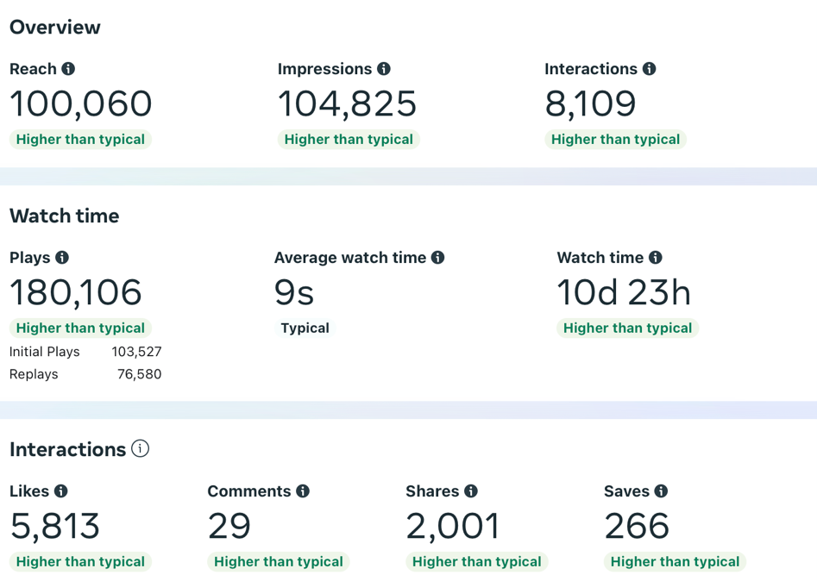
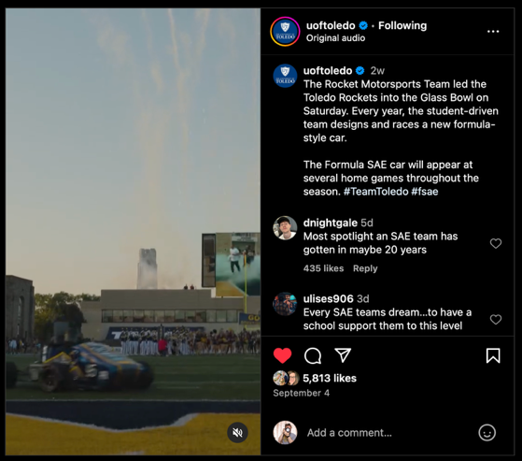
Rocket Motorsports
September 2024

Slide 31
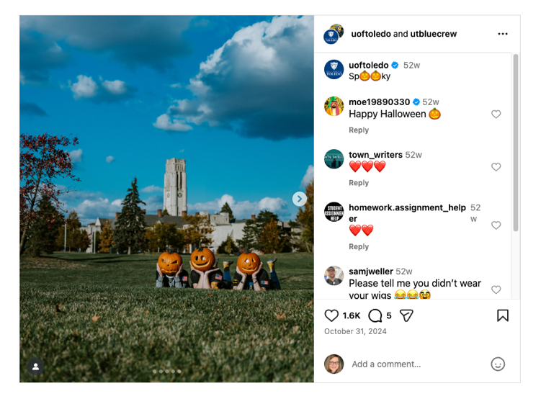
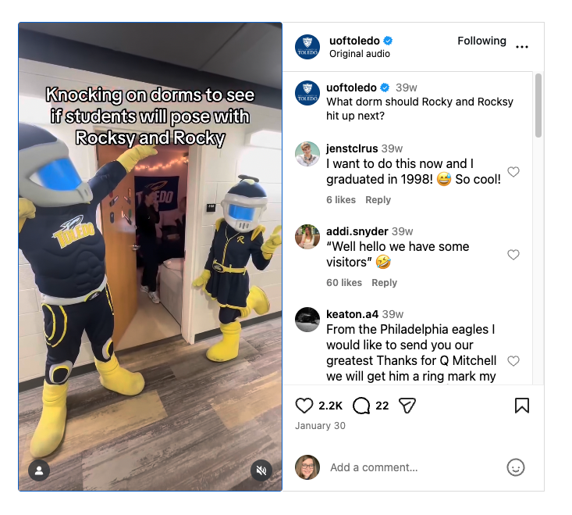
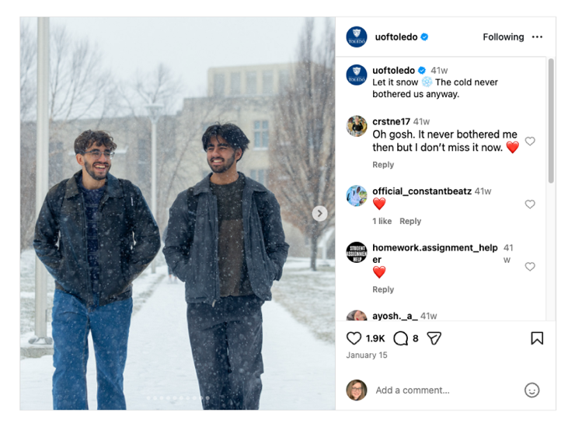
Top Performing Instagrams

Slide 32
Telling UToledo’s Story

Slide 33
Telling Our Story
Advertising: 225.2 million impressions
UToledo: 175 million
UToledo Health: 50.2 million
Media Relations: 5.2 billion audience reach
Social Media: 13.9 million impressions

Slide 34
How You Can Help
Differentiating messaging!
Unique areas of expertise to enter the local, regional and national conversations
Interesting classroom activities or campus events to capture with photos or videos
Meet deadlines - Reporters usually need sources the same day, requiring a response within hours and sometimes minutes!
Follow FERPA, HIPPA, Minors on Campus, media photo releases and other policies and procedures

Slide 35
When in doubt – contact your marketing strategist
Brand Guide and Toolkit
utoledo.edu/offices/marketing/brand-guide
utoledo.edu/offices/marketing/toolkit
Submit story ideas
utoledo.edu/offices/marketing/toolkit/webforms/news-ideas.html
Submit events to calendars
utoledo.edu/events
Request photos
utoledo.edu/offices/marketing/expertise/photography
Web tickets
utoledo.edu/offices/marketing/toolkit/web/support

Slide 36
Thank you

