Slide 1
Faculty Senate Presentation
UToledo BOT Meeting
September 22, 2025

Slide 2
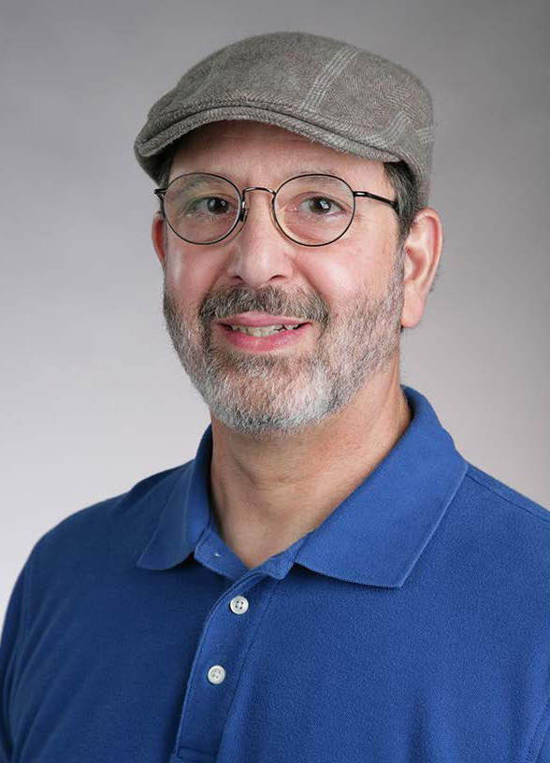
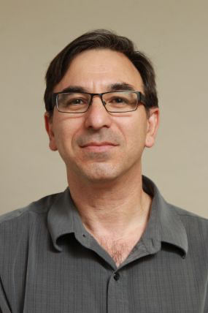
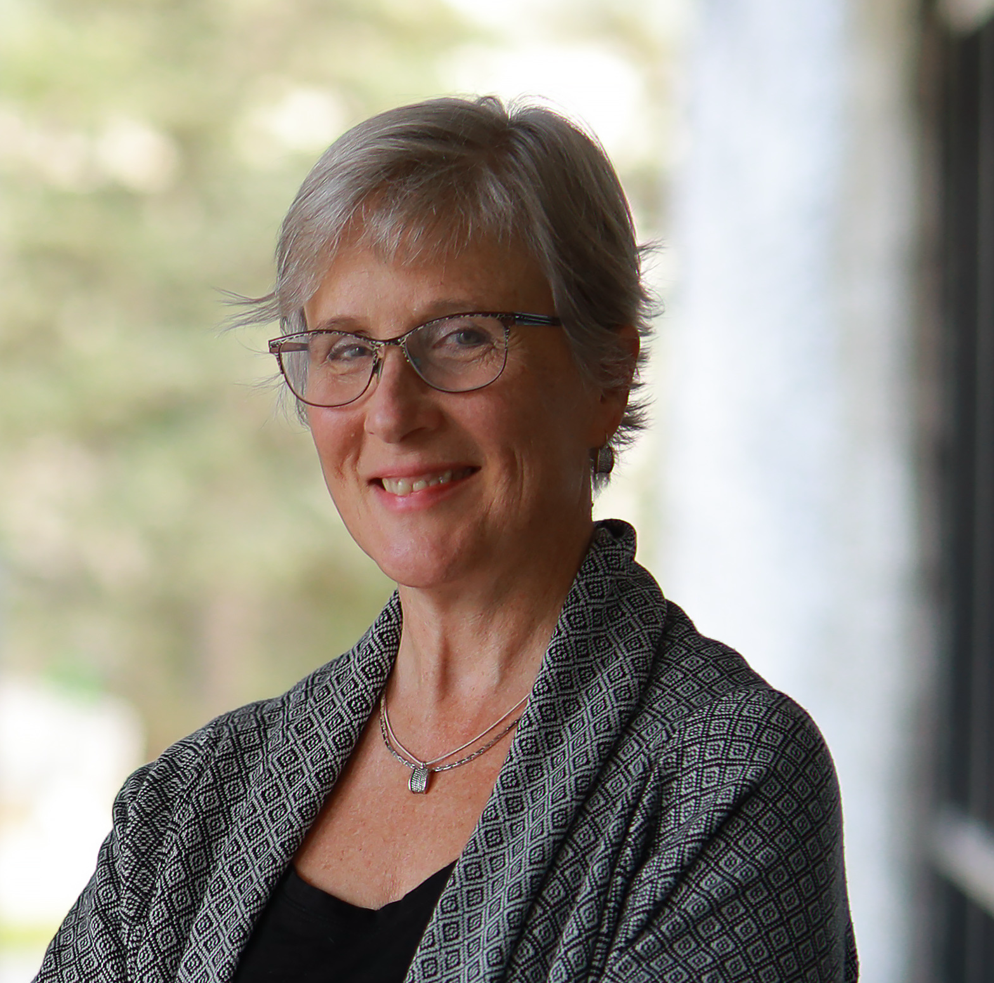
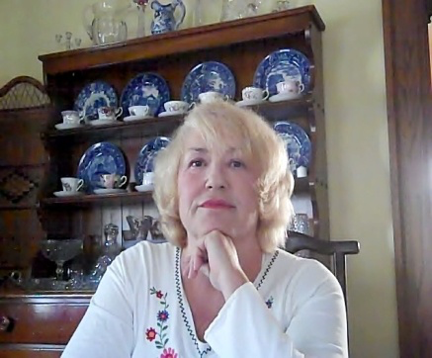
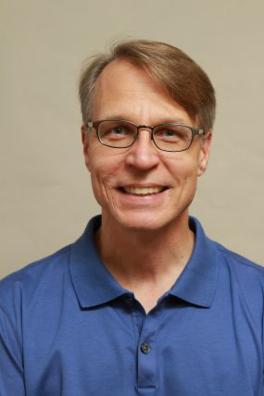
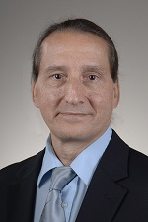
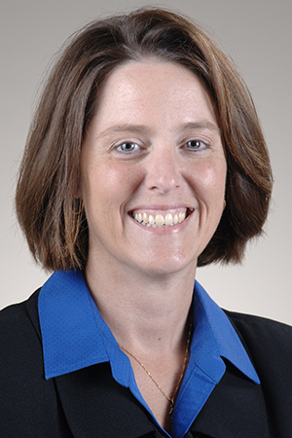
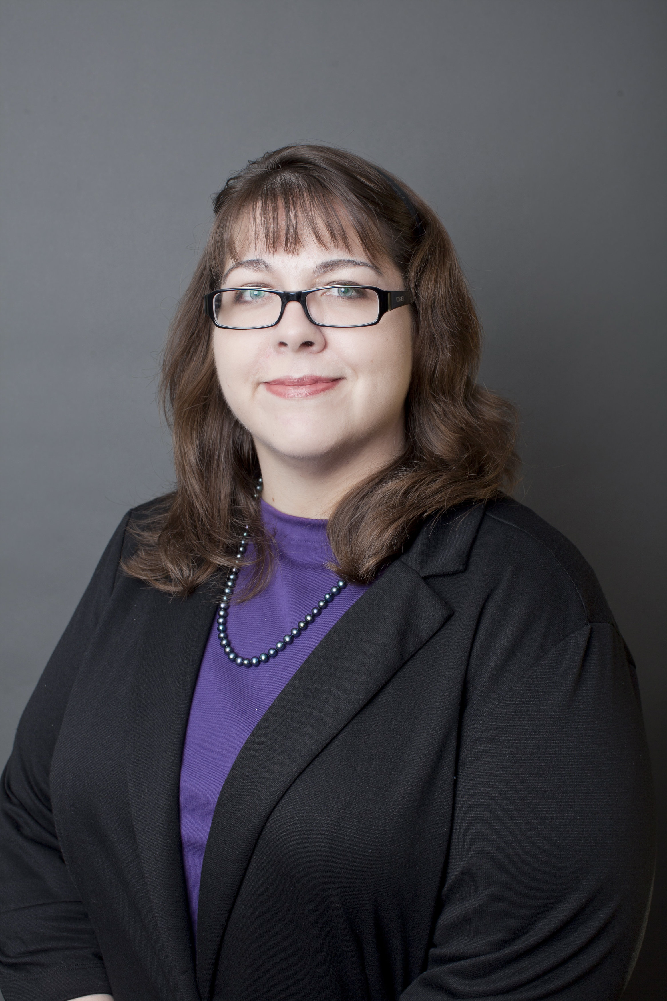
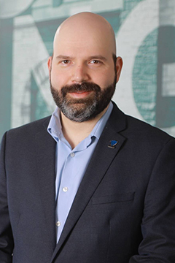
Faculty Senate Executive Committee
Jerry
Van Hoy
Past-
President
Tomer
Avidor-Reiss
President
Renee
Heberle
President
-Elect
Deborah
Coulter-Harris
Executive Secretary
Robert
Steven
Ohio Faculty Council
Representative
David
Giovannucci
Andrea
Kalinoski
Karen
Green
Yakov
Lapitsky
Health Science Campus
Representatives
Main Campus
Representatives
Notes:
Thank you for the opportunity to be here.
It is a great pleasure to provide UToledo BOT with the Faculty Senate report.
Since the start of the academic year, the Faculty Senate Executive Committee and the Faculty Senate have each met twice.
The Faculty Senate Executive Committee also met 6 times during the summer.
The Faculty Senate’s 11 committees have started to work, though we have difficulty fully populating them due to the decrease in faculty numbers and increase in service loads.

Slide 3
Meetings with the President and Provost
We had meetings with the president and provost and are excited about their priorities:
- Enrollment: We want UToledo to become a larger university.
- Research: “Need to grow our research impact.”
- Community: “We exist to serve the region.”
We are looking forward to a formal statement about the vision for UToledo, which will be unveiled on October 16 at the inauguration.
We are also pleased that Provost McKinney plans to visit each department over the coming year, and we anticipate positive outcomes from these discussions.

Slide 4
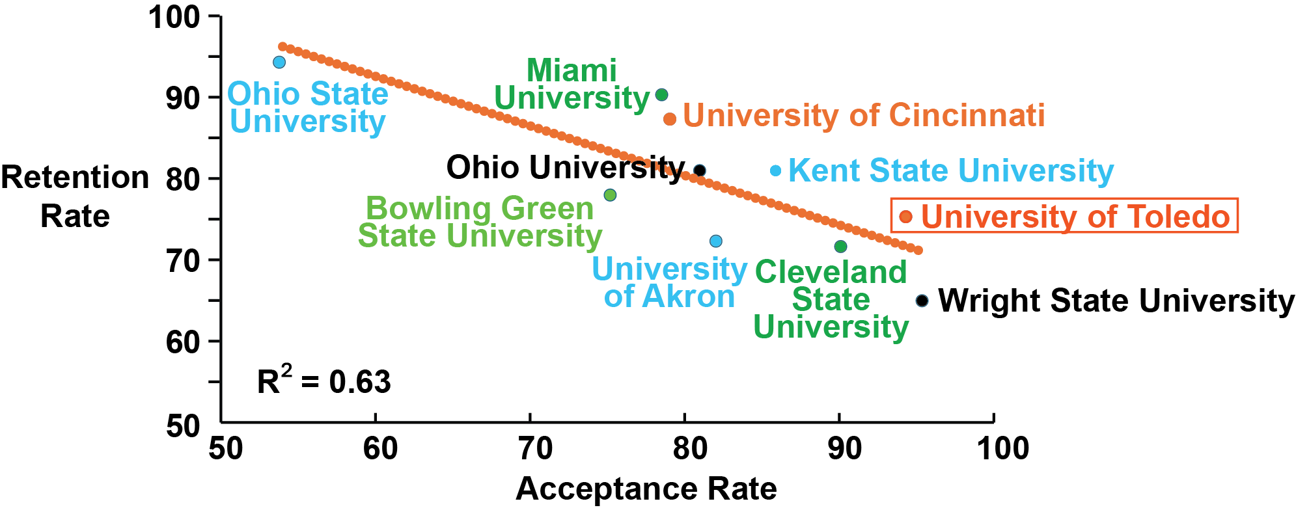
Enrollment Crisis: Retention Is Not the Culprit
UToledo is doing well with retention.
The 10-year retention average of Ohio public universities (first year retention rates) correlates with the acceptance rate
We are encouraged that UToledo’s data point in the plot is above the trendline.

Slide 5
Enrollment Crisis: Faculty Involvement in Recruitment Activities
We are satisfied with our collaborations with the Vice President for Strategic Enrollment Management, Tony Bourne.
We aim to enhance faculty involvement by hosting 1:15 meetings with students and their parents, alongside participation in campus events.

Slide 6
Enrollment Crisis: Improving Coordination Between UToledo Units
However, we remain very concerned about the university's marketing efforts, particularly the lack of a clear focus on recruitment marketing.
This lack of clearly organized collaboration, between enrollment management, marketing, and communication is one example of the lack of systematic coordination between UToledo units, as we focus on resolving the enrollment crises and building our presence in the Northwest region.

Slide 7
Enrollment Crisis: Regaining Control Over Outsourced Operations
The terms of the contract with ParkUToledo block our community from access to events and harm student engagement.
Similarly, the terms of the contract with Chartwell Catering make it far too expensive to serve refreshments at events and activities.
Event planning on campus among faculty and departments has become impossible under the current contracts with Chartwell catering and UPark Toledo. The Senate will be looking into those contracts and requesting changes.”
Notes:
Besides being expensive, our catering company
(1) serves food that is less desirable than what we can get from outside vendors, and
(2) creates administrative hurdles for ordering food that students and stakeholders would actually enjoy.
There is no budget for that.
To add to our repository of ParkUToledo horror stories, after we ran our Engineering Summer Camp this July, we learned that some camper families (despite us buying parking permits for campers leaving their cars on campus) got ticketed.

