Slide 1
Research Update
F. Scott Hall
Interim VP for Research
Office of Research & Sponsored
Programs (ORSP)
November 18, 2025

Slide 2
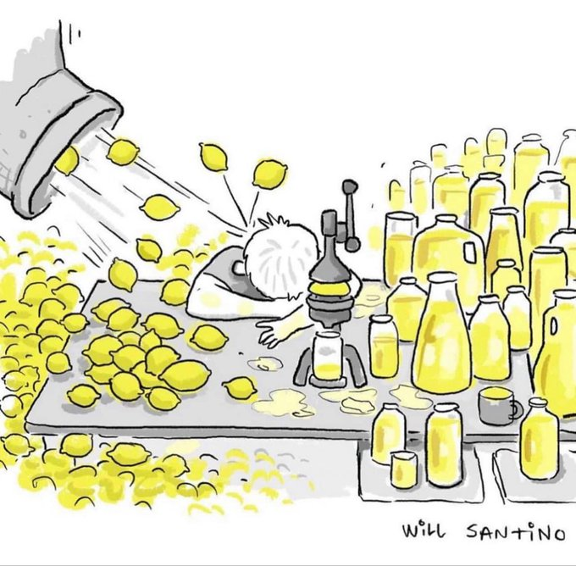
It has been a challenging year . . .
Federal Executive Orders
Threatened cuts to federal funding
Threatened cuts to indirect cost recovery
Grant review and funding delays
Longest federal government shutdown in US history
Changing grant requirements
Increased regulatory requirements

Slide 3
FY2024 Funding Sources

Slide 4
Federal funding is consistently the majority of our research funding

Slide 5
Challenges:
Threatened cuts to Federal Funding
Threatened cuts (from debate around Big Beautiful Bill):
  NSF - 57%
  NIH – 40% (and reorganization of institutes to just 8)
  NASA – 47%
  DOE OS - 14%
  NIST 28%
Did not materialize in budget bills
However, what happens Jan 30?
Numbers from: Trump's budget proposal slashes science funding, threatening the US research enterprise | American Physical Society

Slide 6
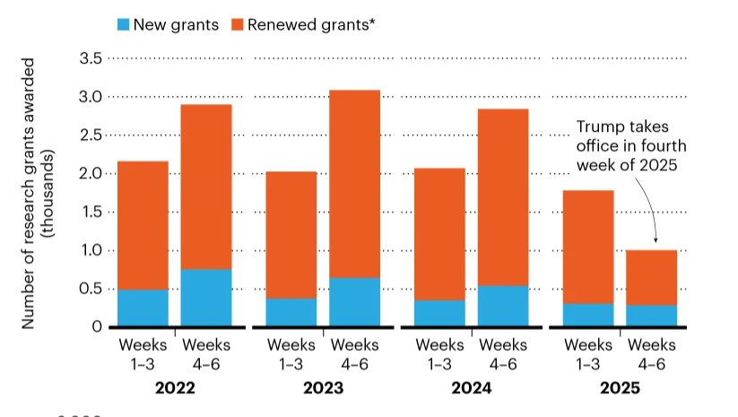
Challenges:
Funding Delays due to Executive Orders
Grants Reviewed to see if they matched Administration “priorities”
  “Diversity, Equity, and Inclusion”
  Green Energy
Nature, Revealed: NIH research grants still frozen despite lawsuits challenging Trump order, Feb 20, 2025

Slide 7
Challenges:
Grant Cancellations
Only 4 grants at UToledo cancelled
NIH T32 training grant
Appealed to NIH
Grounds: According to NIH rules, grants can only be cancelled under two conditions
  Violations of terms/conditions
  No longer meet agency priorities
Appeal comes from IO (VPR) since grants officially awarded to the University
Appeal denied

Slide 8
Challenges:
Indirect Rate Caps
Funding agencies announcing 15% Rate Caps:
NIH/HHS: TRO, PI, hearings ongoing
DOE: TRO, PI, hearings ongoing (stay during shutdown
NSF: Permanently Vacated
DOD: Vacated, appeal due Dec 15
Potential Legislation (FAIR model):
Joint Associations Group
Elements:
  PI costs
  Essential Research Support (IDC moved into direct costs)
  General Research Operations (IDC)
Consequences:
  Reduced overall IDC
  Reduced research money

Slide 9
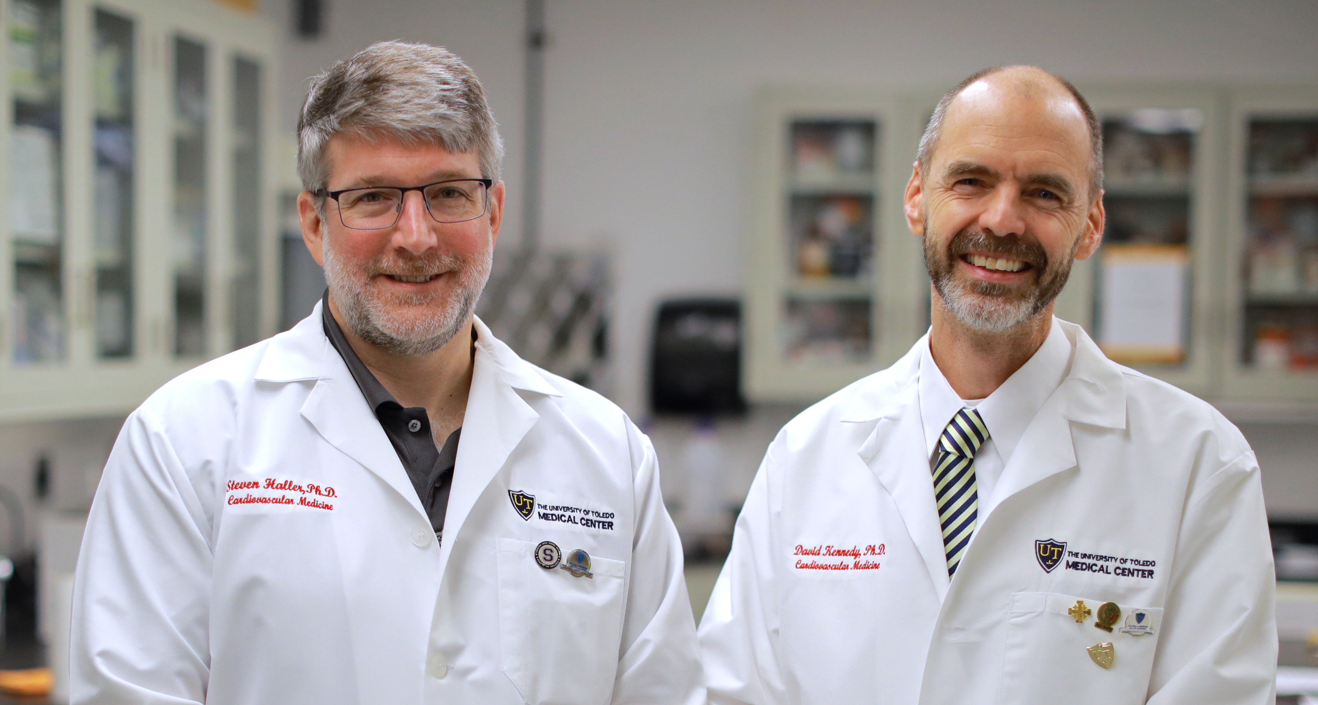
Federal Limit of 15% F&A Impacts
UToledo current rates—52.5% main campus and 56% HSC
  Not applied to equipment purchases, most subcontracts, and participant costs
  UToledo Total F&A reimbursed FY 24 -- $10,943,321
  Estimate reimbursement @ 15% F&A -- $3,551,232
  Estimated FY24 F&A total loss -- $7,392,089
If F&A 15% UToledo would need to reconsider support to research projects
Joint Association Group (led by
former OSTP director) proposed
new F&A models

Slide 10
Challenges:
H1B Executive Order
Applies to H-1B holders currently outside of the U.S. Entry restricted unless sponsoring employer pays $100,000
Effective : September 21, 2025
Clarification, fee does not apply to:
Recent international college graduates on F-1 status changing to H-1B
Current H-1B holders seeking amendments, extensions, or change of status
Current H-1B holders traveling internationally and returning to US
Exceptions: no US worker available; or in National Interest
  A consequence of this appears to be that graduating from a US Institution of Higher Education is a path to H-1B status that avoids the fee

Slide 11
Challenges:
Federal Government Shutdown
Dates: Oct 1 to Nov 12 (longest in US History)
Financial Consequences to UToledo: few immediate impacts
Delays in Grant Reviews and other sponsoring agency actions
Ongoing Consequences: May take agencies some time to return to normal operations
Is this really over? Not really
  Most federal agencies only funded until Jan 30
  Dept Agriculture, FDA funded for year

Slide 12
Challenges:
Federal Government Shutdown residual effects
Ongoing effects: Agencies recovering from furloughs
Backlog: Backlog of actions, delays in study sections
Layoffs: some agencies experiences RIFs, although part of deal was rehiring employees
Ongoing Consequences: May be similar to chaos of spring:

Slide 13
Challenges: New Grant Award Terms and Conditions
Situation: Changes in Federal policies are leading to new grant terms and conditions
Examples:
  Approval of media statements by sponsor (including social media)
  Additional security requirements
  Additional export control requirements
  Travel and foreign collaboration limitations
  Limitations (or prior approval) on use of agency logos
Action: All senior (and non-senior) personnel need to read the grant terms and conditions and contracts to make sure that they are abiding by any new terms or conditions

Slide 14
Challenges:
AI in grant applications
AI generated grants: NIH found single PI had submitted more than 40 unique submissions in a single round using AI
Policy released in response: NOT-OD-25-132: Supporting Fairness and Originality in NIH Research Applications
  No AI use in grant submissions: NIH will use AI detection software
  Limit of 6 submissions as PI per year
  Violations could result in severe punitive actions: “If the detection of AI is identified post award, NIH may refer the matter to the Office of Research Integrity to determine whether there is research misconduct while simultaneously taking enforcement actions including but not limited to disallowing costs, withholding future awards, wholly or in part suspending the grant, and possible termination.” (emphasis added)

Slide 15
Challenges:
New and increased Requirements
Other Support Disclosure Training: covered by research security training
Research Security Training: All funding agencies moving to require this, so will be required of all researchers
Export Control: Increased scrutiny, UToledo just hired an Export Control Officer
Responsible Conduct of Research: more agencies requiring “in-person” training

Slide 16
Research Numbers

Slide 17
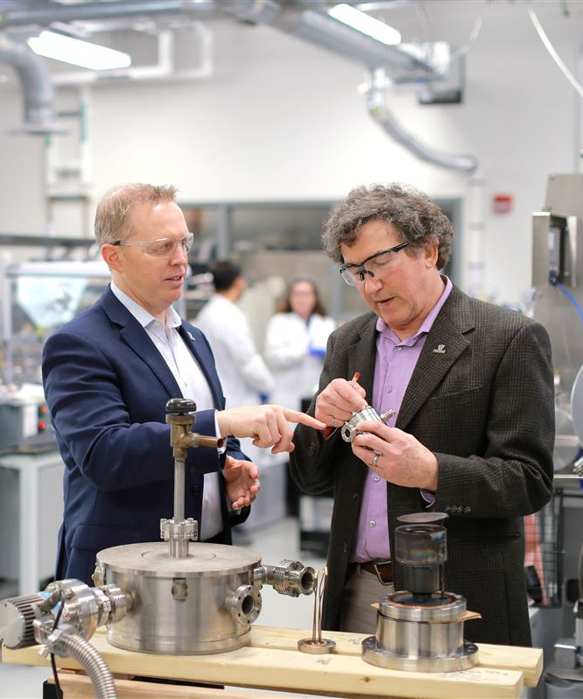
University of Toledo achieves R1 Status !!!
Newly designated as R1 in February 2025
Based on FY2021 – FY2023 numbers
Average 3-year annual research expenditures >$50M threshold @ $61,826
Average 3-year doctoral research degrees awarded >70 @ 116
Next classification in 2028
Photo from Toledo Blade, April 9, 2025
Notes:
Research expenditures are from NSF HERD data and include both sponsored research (i.e from NIH, DOE, DOD, state agencies, industry) and internal UToledo support (varies between X and Y). Internal support over all institutions ~25% - about ½ is federal (need to check this)

Slide 18
Research Expenditures and doctoral degrees
(Key metrics of Carnegie R1 classification)
Research & Development Expenditures
Doctoral Research Degrees Granted
3-Year Average = $61.8M
3-Year Average=116
Threshold > $50M
Threshold > 70
Newly designated as R1 in Feb 2025; achieving Metric 6 of 5-yr plan 3 years early
Next classification in 2028 based on FY24, FY25, & FY26
Expenditures: External & Internal Grant Expenditures + Cost Share + Unrecovered IDC
FY25 Expenditures will not be available until the end of February
Notes:
Related Strategies:
Strategy 2: Invest in and support research and innovation.
Action Steps:
Explore faculty development and internal grant review programs that will enhance funding of science, sustainability, and engineering projects.
Increase the funding of non-science and non-engineering University Research Funding Opportunity (URFO) research projects.
Increase funding for new faculty hires and graduate assistantships in the humanities and social sciences to grow enrollment of those doctoral research students.
Continue to invest in nationally recognized areas of research excellence (e.g., Astronomy and Astrophysics, Solar Energy, Water Quality and Sustainable Technologies, and Cell Architecture and Dynamics).
Leverage university discoveries into technology transfer licenses, startup companies, and multi-institutional collaborations with transformative impacts for the region, nation, and world.
Strategy 3: Continue upward trajectory in national rankings.
Action Steps:
Develop program-specific strategies, based on best practices, to increase rankings, as a part of college/unit plans.
Coordinate ranking survey participation to ensure data accuracy, consistency, and completeness.
Ensure that all eligible programs participate in national ranking surveys.

Slide 19
New research awards and NEW PhD student numbers
(Key indicators of future research output)
New Research Awards
Total Number of PhD Students
Award Dollars were reduced by 50% in Q3 and Q4 of FY2025 vs FY2024
$31M in Q1 and Q2 of 2025
Notes:
Related Strategies:
Strategy 2: Invest in and support research and innovation.
Action Steps:
Explore faculty development and internal grant review programs that will enhance funding of science, sustainability, and engineering projects.
Increase the funding of non-science and non-engineering University Research Funding Opportunity (URFO) research projects.
Increase funding for new faculty hires and graduate assistantships in the humanities and social sciences to grow enrollment of those doctoral research students.
Continue to invest in nationally recognized areas of research excellence (e.g., Astronomy and Astrophysics, Solar Energy, Water Quality and Sustainable Technologies, and Cell Architecture and Dynamics).
Leverage university discoveries into technology transfer licenses, startup companies, and multi-institutional collaborations with transformative impacts for the region, nation, and world.
Strategy 3: Continue upward trajectory in national rankings.
Action Steps:
Develop program-specific strategies, based on best practices, to increase rankings, as a part of college/unit plans.
Coordinate ranking survey participation to ensure data accuracy, consistency, and completeness.
Ensure that all eligible programs participate in national ranking surveys.

Slide 20
New Research Awards by FTTT
Awards
FTTT

Slide 21
RESEARCH NUMBERS Year-to-Date Comparison: FY 2025 vs FY 2026
 | FY 26 | FY 25
Award Dollars | $19,597,041 | $29,142,470
Submissions | 166 | 190

Slide 22
awards – total FY 2023, FY 2024, FY 2025, and FY2026 YTD

Slide 23
May I draw your attention to . . .

Slide 24
Grant Submissions: Leave extra time
Situation: The current uncertainty with federal funding seems to be leading to increased numbers of submissions, including increased submissions to non-federal sources
Normal Deadlines:
No Sub-Awards: Final Budget and Endorsement steps must be completed 5 business days prior to submission date.
With Sub-Awards: Final Budget and Endorsement steps must be completed 10 business days prior to submission date.
New circumstances that may require more time:
New sponsor
New mechanism
Limited Submission: Contact ORSP as soon as possible, limited submissions must be opened to all investigators per policy

Slide 25
Limited Submission Proposals
Problem: ORSP has recently received requests for limited submissions at the last minute
Limited Submission Procedure: announcement sent to PIs requesting proposals, the proposals are reviewed, and one is chosen
Well-known grant mechanisms: announcements are sent for major grant mechanisms or grants that have been commonly applied for in the past
New (or new to us) grant mechanisms: We receive dozens of funding announcements every day, so we cannot send out announcements for all of them
Request: for new limited submission mechanisms, please give us more lead time so we can follow the standard process
  We need to investigate the rules and the process – sometimes we can submit to if one can come from each campus

Slide 26
Grant Submissions: Leave extra time
Situation: The current uncertainty with federal funding seems to be leading to increased numbers of submissions, including increased submissions to non-federal sources
Normal Deadlines:
  No Sub-Awards: Final Budget and Endorsement steps must be completed 5 business days prior to submission date.
  With Sub-Awards: Final Budget and Endorsement steps must be completed 10 business days prior to submission date.
New circumstances that may require more time:
  New sponsor
  New mechanism

Slide 27
Read the Terms and Conditions of Grants and Contracts
Situation: Changes in Federal policies are leading to new grant terms and conditions
Examples:
  Approval of media statements by sponsor (including social media)
  Additional security requirements
  Additional export control requirements
  Travel and foreign collaboration limitations
  Limitations (or prior approval) on use of agency logos
Action: All senior (and non-senior) personnel need to read the actual grant terms and conditions, and any contracts to make sure that they are abiding by any new terms or conditions

Slide 28
Search Update: Director of Sponsored Programs

Slide 29
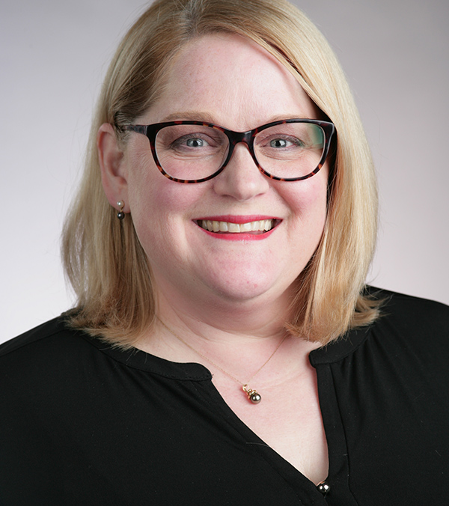
New Director of Sponsored Programs:
Michelle Shipman-Stolar

Slide 30
ORSP Announcements

Slide 31
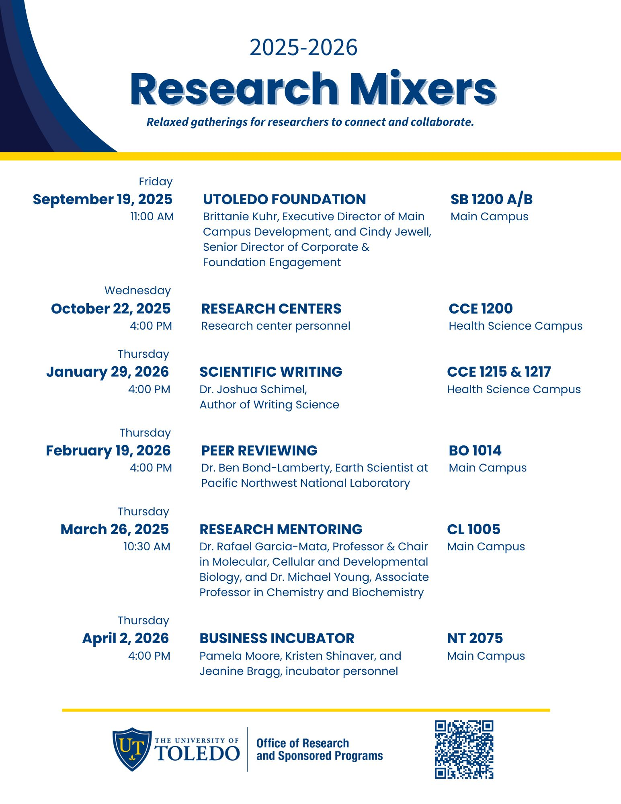
ORSP Research Mixers

Slide 32

Next ORSP Research Mixer is on January

Slide 33
How should UToledo research move forward?

Slide 34
Growing the Research Program
Challenges:
  Declining number of faculty (particularly tenure track faculty)
  Support for Core Instrumentation Facilities and other centers
  Maintaining or increasing the numbers of PhD students
Moving to a higher level:
  Training Grants
  Center and Project Grants
  Industry supported centers and increased relationship to industry
  Increased clinical research
Faculty Demands:
  Faculty need time for research and scholarship
  Administrative support for research – streamlining processes

Slide 35
Questions?

