Slide 1
SEM Update
August 26, 2025

Slide 2
SEM Update Overview
First-year Observations
Core Relevant History – Data and Prep for 2026 Plan
Key Changes in EM Strategy and Operations
Opportunities for Faculty

Slide 3
Observations
Positives
  Funnel conversions
    Increase app completion rate (97% fall 2025 / average 89%)
    Increase in withdrawal communication (up 880 students)
  Visits up – Campus Crawl record
Concerns
  High urgency for Enrollment problem to be fixed
    (by others)
  Low urgency for change in culture and mission
  Work to do coalescing around strategy, messaging and goals
    Not just enrollment goals (reputation, perception, students)

Slide 4
Observations
Need to Define:
  Who are we?
    What is “The Power To Do”?
  How and Where do we say it?
    Channels
    Wording
  How do we make students feel it and believe it?

Slide 5
History
Market Share
  Decline across all markets and demographics
Low Predictability of Outcomes
  Type of inquiry / inconsistency in operations
Jumping from strategy to strategy
  EM operations not large factor in forecast

Slide 6
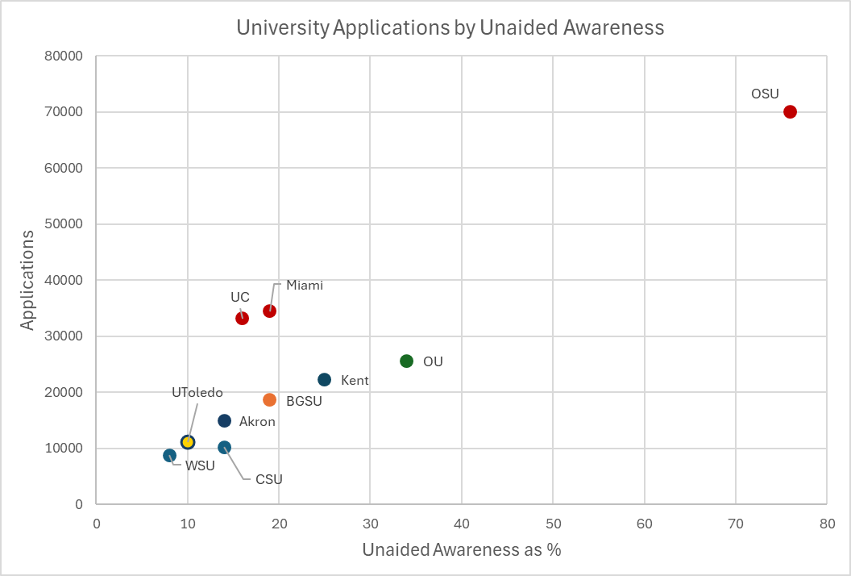
Applications by % Response Unaided Awareness – fall 2024 Entering DHS
History

Slide 7

WSJ Rankings – 10 Ranked Ohio Publics

Slide 8
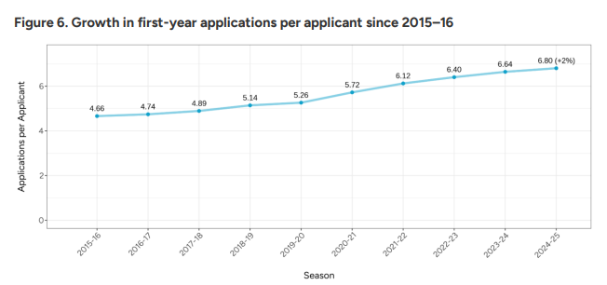
Average Growth in First-Year Apps (National)
History

Slide 9
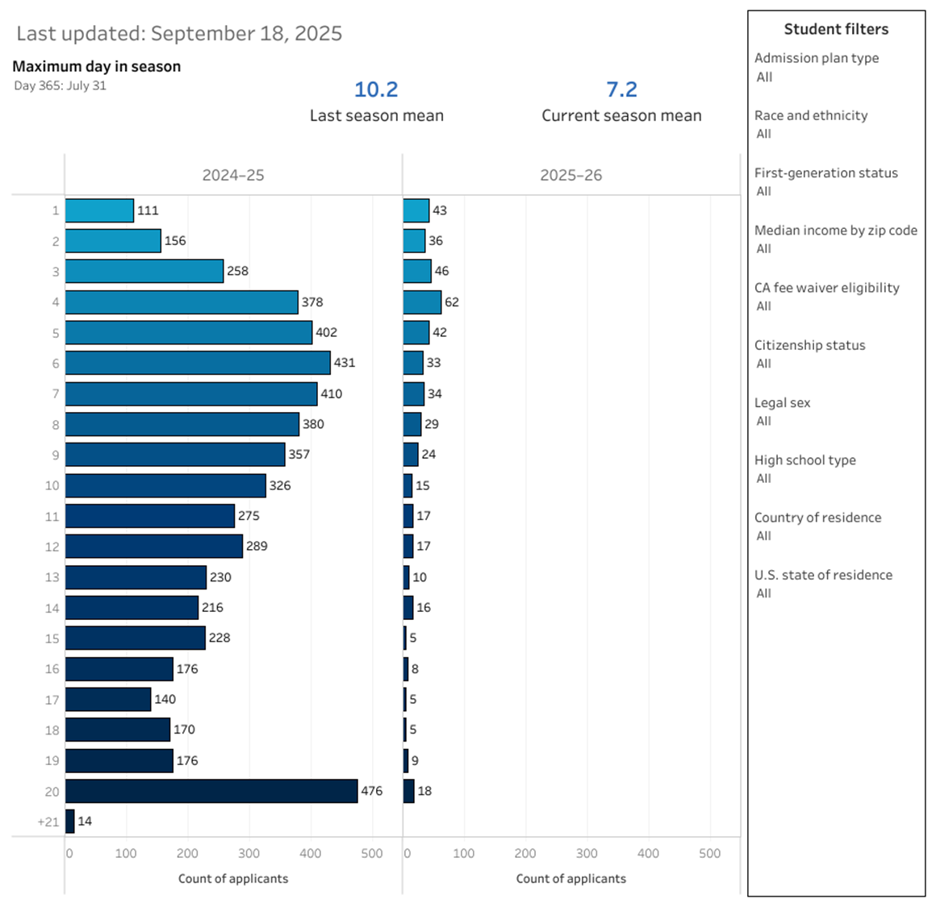
App Per Student Distribution (UToledo)
History

Slide 10
September Apps ’24 v. ‘25
History

Slide 11
Key Changes
Operational Efficacy
  Data acquisition and reliability – ROI / Budget / Forecast
  Focus on impacting funnel metrics
  Overcoming barriers across campus
Consistent Strategy / Partnerships / Investments
  Onboarding Technology Partners - Capture / EAB
  Market Share – Marketing and ROI
  College project managers
Awareness / Reputation
  Athletics Partnership
  Campus Visits – (Investment)
  Classification and Market Segmentation
  Camps

Slide 12
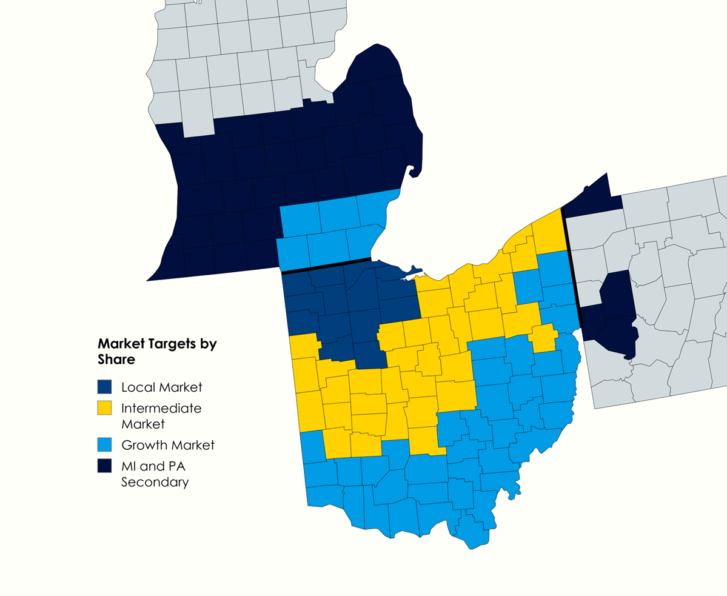
Market Share Target Areas

Slide 13
Early DHS Numbers:
 | Prospects | Inquiries
2026 | 116,264 | 17,240
2025 | 133,543 | 14,264
2024 | 196,058 | 20,379
 | Submitted Apps | Completed Apps | Admits
2026 | 1389 | 746 | 583
2025 | 1220 | 761 | 639

Slide 14
How Can Faculty Help
Aid in the student experience / Perceptions
Assist in defining qualities (who we are)
Help articulate pragmatic impacts / real outcomes
Expand access to 1:15 appointments
Continue to help make events destinations
Help in onboarding of Project Managers
Coalesce around messages / goals / strategies

