Slide 1
Ottawa East Dining Issues: SG Issue #4
Faculty Senate Committee on Student Affairs (FSCSA)
Dr. Coulter-Harris and Dr. Sally Harmych:
Other Subcommittee Members are Dr. Barry Scheuermann and
Dr. Karen Green
11 March, 2025

Slide 2
Introduction
Introduction
Officially, the Faculty Senate Committee on Student Affairs is charged with the following: “The Senate Committee on Student Affairs shall act as a liaison between the Faculty, the Student Government, and the Administration on matters of common interest that fall within the jurisdiction of the Faculty Senate, and shall study and make recommendations on such matters.”

Slide 3
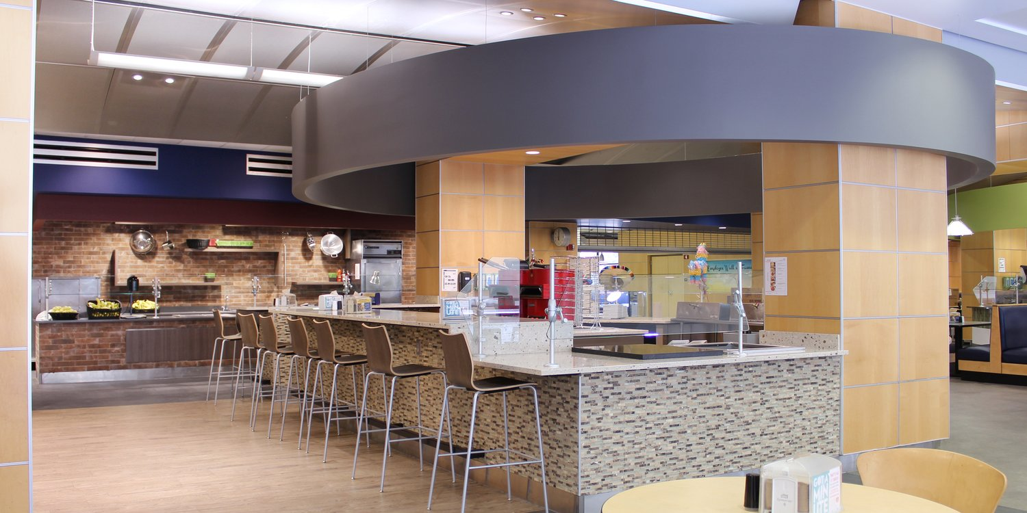
Introduction (Con’t)
From SG Issue #4: “Multiple students have come forward complaining about the food in the dining hall. We have noticed great improvements at the Eatery in the Union, but have heard that Ottawa East has had some issues. Food quality has not been too much of a complaint this year. One claim is that the utensils may be used in multiple foods without being washed. Students are also still worried that allergens are not being properly labeled. One suggestion was the creation of an allergen-free station like the one at the Union. Dining is definitely improving, but the dining hall at Ottawa East is slow to catch up.”

Slide 4
Response from Dining Officials during FSCSA Meeting on 26 February, 2025
1. Utensils may be used in multiple foods without being washed.
  Dining services has some self-serve stations where this could be an issue. Most likely, according to Mr. Bargo, this was done by a student who grabbed some food with a serving utensil and then used the same utensil to serve another food without putting it back.
  Have converted some self-serve areas like the salad bar, so that a member of the dining services staff will serve the food. This should cut down on the chances of this happening in the future.

Slide 5
Response from Dining Officials
2. Students are worried that allergens are not being properly labeled. One suggestion was the creation of an allergen-free station like the one at the Union.
  There is already an allergen-free station, called “Delicious Without,” available that is clearly marked. This is a separate counter with designated storage, prep, cooking and serving areas to avoid cross-contamination.
  There is also plenty of signage at other each food service areas with information about possible allergens as well as bar codes students can scan to get nutrition information.
  Students can access any nutritional and allergen information in the dining app or online (https://dineoncampus.com/utoledo)

Slide 6
New Student Dining Committee
3. Since we spoke with dining services in 2022 to discuss student issues a Student Dining Committee has been established to create an open dialogue on matters pertaining to Rocket Dining. This committee includes representatives from Rocket Dining and Student Government.
  The regular feedback they get from Student Government has allowed them to act on issues more quickly and has greatly reduced the number of complaints.
  Rocket Dining also provides students with many opportunities to provide feedback about their experiences through the website and on the app.

Slide 7
Follow Up to Original Report: 7 November, 2023
4. Follow up on report to Faculty Senate given November 7, 2023, on the hours of operation. Students were upset with the change in hours of operation that were instituted for the 2023/2024 school year. Hours of operation for The Eatery and Food Hall as well as all other dining locations can be found on the app or online (https://dineoncampus.com/utoledo/hours-of-operation)
  Students seem to be accustomed now to the new hours, and things are running more smoothly.
For FSCSA ‘s previous detailed report on dining hall issues and planned hours of operations, please refer to: https://www.utoledo.edu/facsenate/docs/minutes/2023-2024/approved-faculty-senate-minutes-november-07-2023.pdf

Slide 8
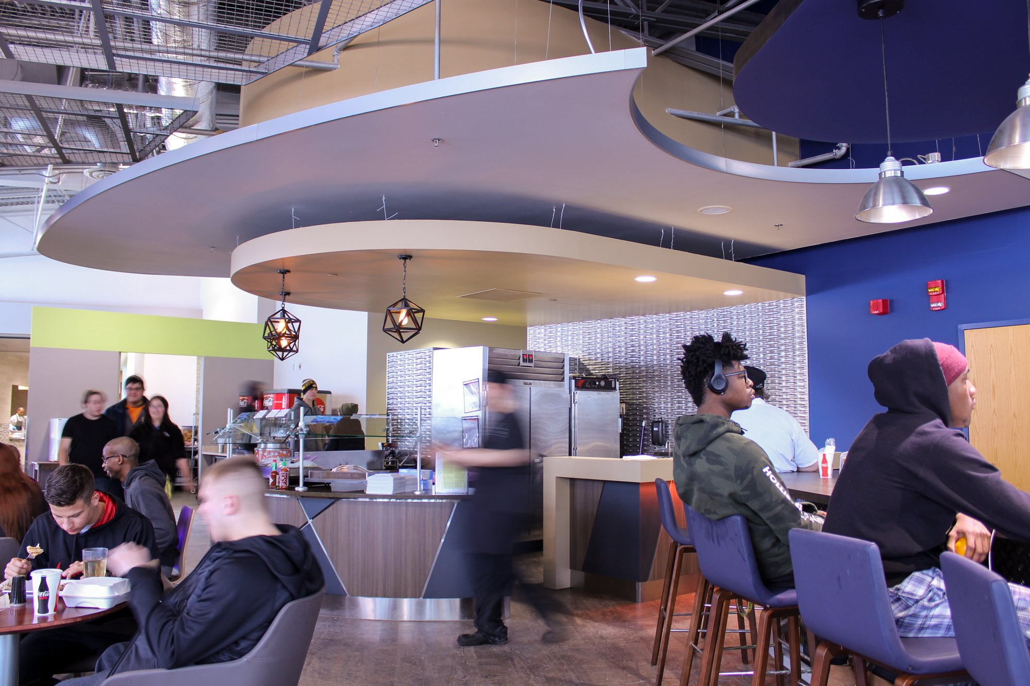
Meal Plan Changes
  Changes to the meal plans also seem to have helped, as the new plans include more dining dollars, giving students more flexibility to use their plan at other dining locations.
  On occasion, there are times when the Food Hall is so busy there is not enough seating. Students have the option at these times to take their meal to go, or come back at a later time.
  Fin

