Slide 1
FSCSA: Issue #5 Summer Classes
By Dr. Deborah Coulter-Harris and Professor Suzanne Smith
8 April, 2025

Slide 2
Introduction and Purpose
Professor Smith and I have been in discussions regarding summer course offerings for several years:
chances of our unit teaching summer courses;
number of summer courses offered in other departments/ colleges in comparison to our own department;
whether budgetary issues affected administration’s ability to schedule
summer classes; etc.
Purpose of our report today: in light of recent developments regarding call for summer course proposals and other factors, we decided simply to report on student responses to our poll questions regarding summer offerings.

Slide 3
Issue #5: Reasons--FSCSA Issue on Behalf of Students
Decrease in summer offerings posing problems for students, especially those on a timed/directed course path to graduation.
Students going to BGSU, Owens, etc.: become a Recruitment and Retention problem, and has implications for scholarships.
We wanted to know if our propositions were correct, so I will begin with my results of the polling questions. This will be followed by Professor Suzanne Smith’s and other faculty’s polling responses.

Slide 4
Questions polled to Students by DC-H: (20 Respondents)
1. Are you planning to enroll in classes at UT this summer? If so, what class(es) do you want to take?
25% (5) say yes, but 75% (15) say no.
Student Comments on Courses: Calculus for Life Sciences II; Chemistry 2; Maybe Math class; Life of Development Psychology, Maybe Spanish

Slide 5
Questions polled to Students by DC-H: (20 Respondents)
2. Is the course that you want to take available to you to enroll in?
4 (20%) yes, available to enroll in
16 (80%) not enrolling
Student Comments: Will enroll at Terra State to save $$; Yes, Course is posted; cannot find the Spanish class I want to take.

Slide 6
Questions polled to Students by DC-H: (20 Respondents)
3. If your preferred class is not available, could you please identify it – either by a specific course name or just a department name?
78% (15.6) Not available
4% (.8 or 1) Can’t find
18% (3.6) Easy find
Student comments: I cannot find the Spanish classes I want: SPAN 1110, 1120, 2140.
I did not see the classes I wanted to take, but I will not go to a different university.

Slide 7
Questions polled to Students by DC-H: (20 Respondents)
4. A. Do you plan to see if another University is offering the class you want this summer? (e.g., BGSU, Owens, or a school near your hometown). B. Would you consider taking the class at another university this summer if it were offered there and not at UT?
A. 80% (16 will not go to another university)
B. 20% (4 will or might go to another university)
Student Comments: I plan to look at Terra Community College to save money and get some credit hours out of the way.

Slide 8
Questions polled to Students by DC-H: (20 Respondents)
5. A. Have you previously enrolled in summer classes at UT?
B. or, have you ever taken a college-level summer class at another University, college, or community college since you have been enrolled at UT? Why did you take that class at another school and not UT?
10 % (2 have previously taken summer courses at UT)
15 % (3 have taken SC at other universities)
75 % (15 have never taken a summer course at UT)
Student Comments: I am enrolled at a community college where my mother works, so the class is free.

Slide 9
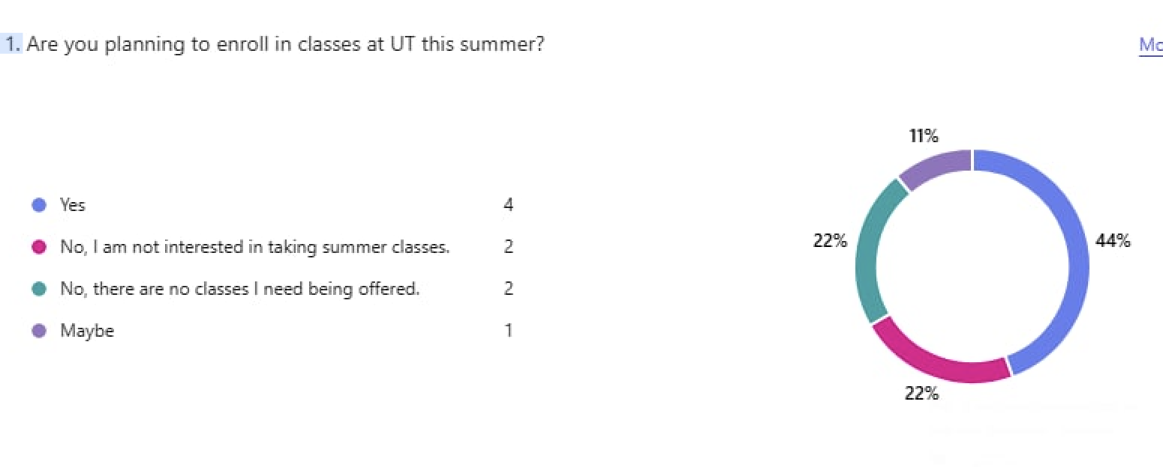
Further Findings from Faculty
Graph shows 44% of students want to take summer classes.
22% of students polled say they are not finding the classes they want.
Notes:
Sample represents approximately 120 students in 6 Composition I and II classes in Spring 2025.

Slide 10
Reasons students give for taking a summer class
Make up credits they lost from transfer/failing a class
Graduate on time
Get classes “out of the way” (electives) that interfere w/major classes
To take a prerequisite so they can move on to classes in their major
Lighten class load during regular semesters
Take extra Math class to prepare for Calculus II
Begin to learn foreign language (Spanish/ASL)
To read “author-focused" English studies

Slide 11
Why take a summer class?

Slide 12
A few specific needs. . .
“If don’t take Gen Chemistry in the summer, I will be overwhelmed with classes and labs in my next semester. Also, I was told if I want a scribe job, I need to have this course completed over the summer and then I plan on applying for the job once I take the course.”
From an Engineering student who said he was frustrated with the summer class offerings: “I would like to take SciTech Writing this summer, so I can focus on mostly engineering-related classes in the fall, but nothing is offered.”

Slide 13
Specific case: Composition Program
A specific focus of FSCSA sub-committee was elimination of summer Composition classes in the English Department. Freshman and sophomore students have filled these summer writing classes in previous years:
To re-take a course if they did not pass their first writing class
To complete their two-semester required writing courses, so they can move on to classes in their major
To finish their required “professional writing class” (e.g. ENGL 2950) because courses in their regular semesters are prescribed as part of their program.

Slide 14
Specific interest in a writing course:

Slide 15
CCP only
2-3 summer Composition classes offered last summer and again this summer, but enrollment is restricted to CCP students only.
Result: the majority of UT students in our survey are not eligible to enroll in these classes even if they want them.
We may not be serving UT students’ needs by not offering summer writing classes

Slide 16
Analysis of Findings
Students have practical reasons for wanting a summer class
They are planning and thinking ahead—and are disappointed when a class is not offered.
They prefer not to “shop” elsewhere for that class.
One student said, “I would like to complete all of my courses through UT.”
We might want to do all we can to ensure that they can.

Slide 17
Final Analysis
We hope that students’ voices are being listened to and that their very practical needs for summer classes are acknowledged and being met as UT moves forward with summer course offerings.
See Appendix 1: Questions Posed to Students in Memorandum
The sub-committee wishes to thank our UT students for their participation and comments in this survey. Thanks also to members of the Composition faculty for contributing data and student comments: Michelle Davidson, Teresa Boyer, Linda Panzner.

