Slide 1
Presentation to
Faculty Senate
Board of Trustees Review and Evaluation of the UToledo Core
Dean Melissa Valiska Gregory, Judith Herb College of Arts, Social Sciences, and Education
Dean Barbara Riter, John B. and Lillian E. Neff College of Business and Innovation
October 15, 2026

Slide 2
HB 96 Mandate
Review and revise the general education curriculum to support Ohio’s goals for educational attainment and workforce development.

Slide 3
Deadlines
December 31, 2026 – Board of Trustees (BOT) submits an initial resolution to the State acknowledging the review process is underway.
March 31, 2027 - BOT formally completes the Gen Ed evaluation, including proposed changes and modifications to the Core.
June 30, 2027 - BOT submits a final resolution to the Chancellor of Higher Education summarizing the specific curriculum changes made.

Slide 4
Purpose of This Faculty Senate Presentation
Today, we are sharing an overview with Faculty Senate of the current UToledo general education Core and the review process that will inform the Board’s December review.
We will share with the BOT:
  Core background
  Core components
  Updated academic program review guidelines
  Summary of the faculty process of Core review
  Overview of emerging priorities in the revision of the Core

Slide 5
UToledo Core Background
Provides a shared educational foundation from a range of disciplines for all undergraduates, all majors
Consistent with Higher Learning Commission (HLC) expectations
Follows requirements set by the Ohio Dept of Higher Education (ODHE)
Ohio Transfer 36 (OT36)
  Requires each Ohio public university to maintain an approved set of 36 credit hours of coursework guaranteed to transfer among Ohio public institutions
Limited flexibility: State-mandated subjects, credits, and course approval leave little room for University-specific additions

Slide 6
UToledo Core Components
ODHE’s Ohio Transfer 36 framework establishes these skill/distribution areas & their minimum credit requirements:
English Composition: 6 credit hours
Mathematics, Statistics, and Logic: 3-5 credit hours
Natural Sciences: 6 credit hours
Social and Behavioral Sciences: 6 credit hours
Arts and Humanities: 6 credit hours
Electives in Math, Arts/Hum, Social or Natural Sciences: 9 credit hours
Additional UToledo requirements that may also count toward above areas:
  Diversity of U.S. Culture: 3 credit hours
  Non-U.S. Diversity: 3 credit hours
  American Civic Literacy: 3 credit hours

Slide 7
Updated ODHE Gen Ed Guidelines
Continuity
  General Education remains prioritized and required
  OT36 distribution areas and credits remain the same
Updated knowledge and capabilities
  Knowledge of the physical and natural world;
  Inquiry, analysis, critical and creative thinking, and oral and written communication;
  Quantitative, Artificial Intelligence, STEM, computational, and information literacy;
  Teamwork, problem-solving, and workforce readiness;
  Ethical reasoning and action;
  Civic and cultural understanding, intercultural competence, and lifelong learning;
  Entrepreneurship and innovation.

Slide 8
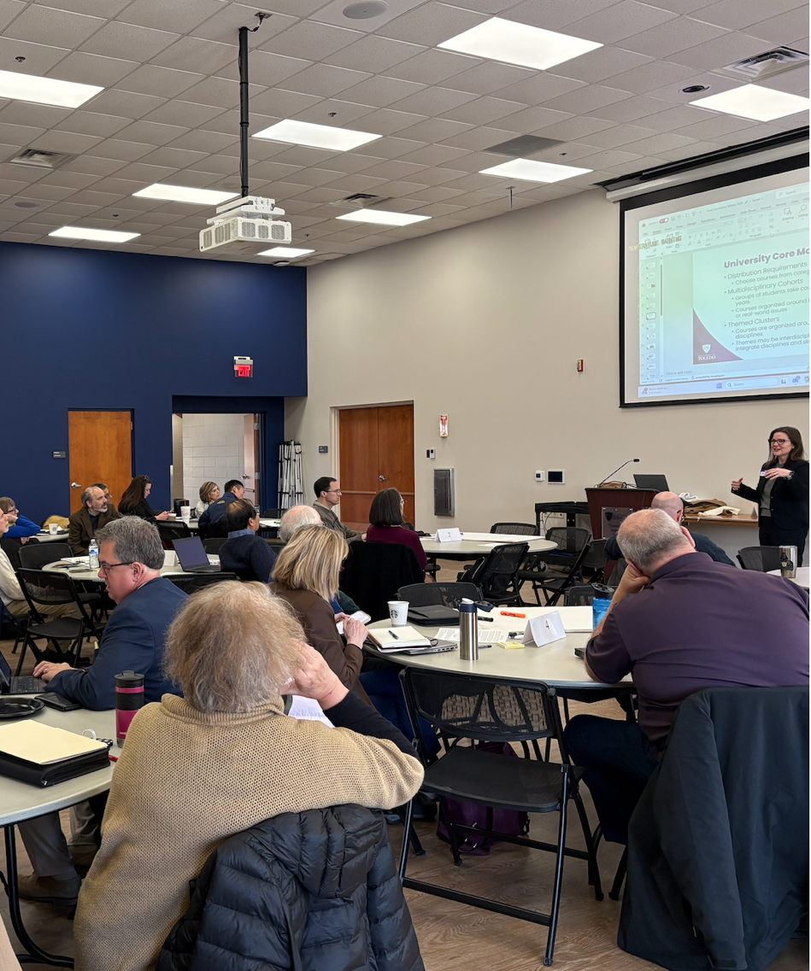
Core Review and Evaluation (Spring 2026)
Regular meetings of the Faculty Senate Core Curriculum Committee
Student and faculty surveys
University-wide retreat with 40 faculty members and academic leaders
Coordination with University initiatives:
  first-year experience
  artificial intelligence
  applied learning, and
  student success
Faculty and staff town halls
Additional opportunities for University-wide feedback

Slide 9
Emerging Priorities
Clarify our educational promise
  Explore a shared framework connecting Core and University learning outcomes to expectations for every graduate.
  Strengthen our first-year experience.
Connect learning with application
  Consider how ASCEND Toledo could connect learning in each major with opportunities to apply it beyond the classroom.
Integrate updated State expectations
  Incorporation of AI, entrepreneurship, and workforce readiness (civic literacy added Fall 2025).
Preserve flexibility and protect student progress
  Examine how emerging priorities can fit within existing degree requirements without adding complexity, which typically increases time to degree completion and thus cost.

Slide 10
Presentation to Board of Trustees
Ongoing work of stakeholder feedback and revision proposals
December 31, 2026
BOT submits an initial resolution to the State acknowledging the review process is underway.
March 31, 2027
BOT formally completes the Gen Ed evaluation, including proposed changes and modifications to the Core.
June 30, 2027
BOT submits a final resolution to the Chancellor of Higher Education summarizing the specific curriculum changes made.
Next Steps

Slide 11
Thank you! Questions?

