Slide 1
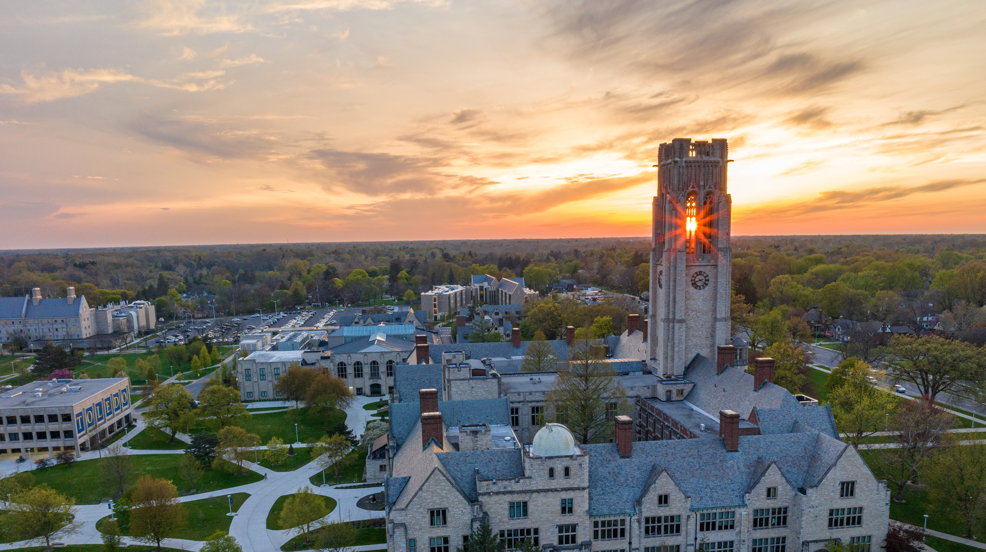


Research and Innovation
Advancing Discovery. Driving Growth. Creating Impact.
Faculty Senate Meeting
October 27, 2026

Slide 2
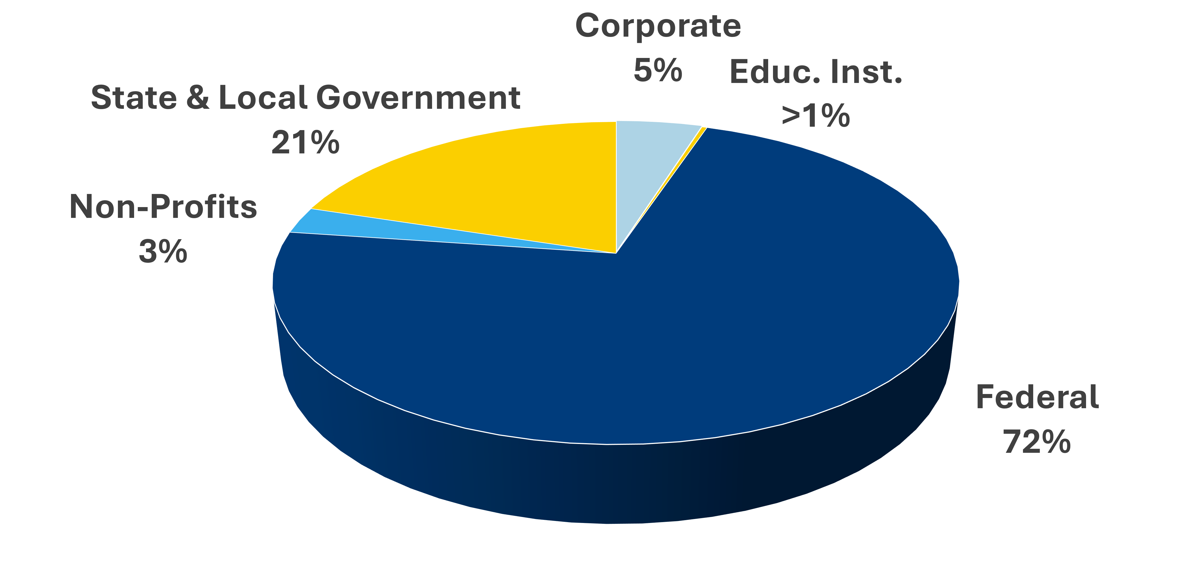
Research by the Numbers*
Competitive External Award Dollars
FY26 Awards by Source
 | FY25 | FY26*
Award Dollars | $54.7M | $50.7M
Submissions | 538 | 516
20%
*As of 10/22/26
HERD Reportable Research Expenditures
Federal Awards by Agency

Slide 3
Growing For Toledo
Drive Research and Innovation Target Goals
Reportable Research Expenditures
(HERD)
Metrics
FY31 $100M in HERD Expenditures
FY31 $75.6M in Competitive External Awards
A stronger pipeline of research doctoral graduates

Slide 4
FY2027-FY2031 Research and Innovation Strategy
Research Without Boundaries
Grow Research Scale and Competitiveness
Build National
Distinction
Enable Faculty and Student Research Success
Grow sponsored research
and major awards
Invest in recognized
areas of strength
Expand research opportunities
and engagement
Expand Partnership
and Innovation
Translate Research into Regional and National Impact
Research
Infrastructure
Strengthen collaborations and commercialization pathways
Deliver measurable societal
and economic benefits
Modernize facilities, resources,
and data capabilities
Notes:
Pillar 2: Drive Research and Innovation
Grow Researc

Slide 5

Rocket Research Acceleration Program
Research without Boundaries in Action
Purpose
Catalyze bold interdisciplinary research
Position UToledo teams for major external funding
Strengthen the university’s research competitiveness
Expected Institutional Outcomes
Growth in major research awards and funding
Expanded industry and federal partnerships
Strengthened national research reputation
Orbit
Strategic Research Initiatives
Enable major research initiatives
Pursue large collaborative funding opportunities
Trajectory
Proposal Development
Advance interdisciplinary research teams
Develop competitive external proposals
Ignition
Early Discovery
Explore new research ideas
Generate preliminary data
Launch new interdisciplinary collaborations
Developing a Structured Research Growth Model

Slide 6


Powering Rocket Research Forward
Dr. Grace Bochenek
Vice President for Research and Innovation
419.530.3809
Grace.Bochenek@UToledo.edu

