Slide 1
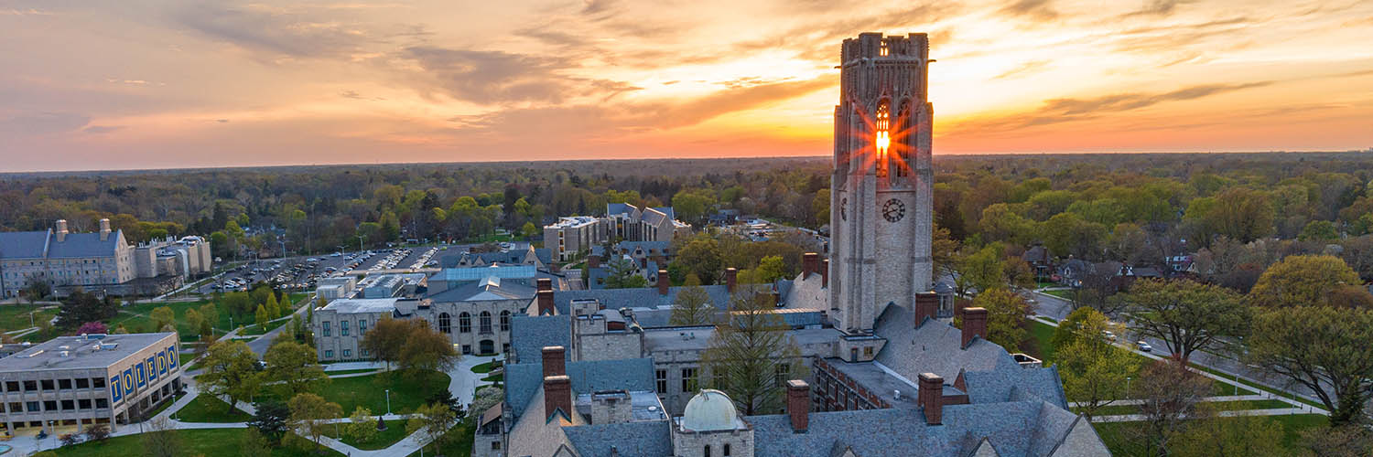
THE UNIVERSITY OF TOLEDO
Growing
for Toledo
A five-year growth agenda for education, research, health, and regional impact
Faculty Senate | September 1, 2026
Notes:
Opening: purposeful growth rooted in academic mission and regional responsibility.
[Sources]
- Growing for Toledo: UToledo Strategic Plan FY2027–FY2031, Draft Version 5, August 12, 2026.
- Photograph supplied by The University of Toledo.

Slide 2
THE CASE FOR ACTION
Why this plan, why now?
Move from managing pressures to building a durable path for mission-driven growth.
Enrollment
Research
Health care
Regional need
Demographic pressure and changing expectations
Funding instability and competition
Rapid change in delivery and economics
Talent, innovation, health, and prosperity
MISSION-DRIVEN GROWTH
GROWING FOR TOLEDO | FY2027–FY2031
Notes:
Growth is a means to serve more learners, create more knowledge, care for more patients, and increase regional value.
[Sources]
- Growing for Toledo: UToledo Strategic Plan FY2027–FY2031, Draft Version 5, August 12, 2026.

Slide 3
THE DESTINATION
What we intend to see by 2032
Stronger, larger, more visible, and more consequential to the people and region we serve.
16,000
$100M
140,000+
100%
fall enrollment
HERD expenditures
attributed lives
experiential learning
Improved brand presence and reputation
Expanded regional presence of health care delivery
Campus experience and athletics visibility promote growth
Business operations support enrollment, research, and health care
GROWTH WITH PURPOSE
More learners prepared to contribute
More knowledge and innovation created
More patients served and healthier communities
More regional prosperity, culture, and pride
GROWING FOR TOLEDO | FY2027–FY2031
Notes:
Distinguish broad vision outcomes from annual operating metrics.
[Sources]
- Growing for Toledo: UToledo Strategic Plan FY2027–FY2031, Draft Version 5, August 12, 2026.

Slide 4
THE STRATEGIC ARCHITECTURE
One plan. Five mutually reinforcing pillars.
The first four advance mission growth. The fifth builds the capacity that enables them.
1
2
3
4
5
Realize the UToledo Advantage
Drive Research & Innovation
Build for a Healthy Toledo
Engage Our Partners
Optimize Institutional Systems
The pillars are linked and designed to self-generate the recurring resources to implement the effort.
GROWING FOR TOLEDO | FY2027–FY2031
Notes:
Emphasize the interdependence of all five pillars.
[Sources]
- Growing for Toledo: UToledo Strategic Plan FY2027–FY2031, Draft Version 5, August 12, 2026.

Slide 5
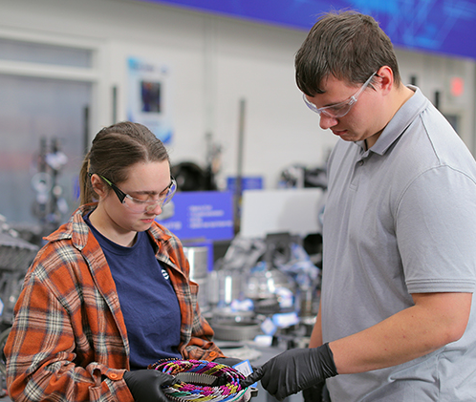
PILLAR 1
Realize the UToledo Advantage
Make experience-based education a defining feature of a UToledo degree.
Ensure every undergraduate participates in experiential learning
Transform Core Curriculum for intellectual growth, civic responsibility, and career pathways
Grow programs aligned with demand, mission, and regional need
Strengthen advising, retention, and student life
Optimize recruiting systems
16,000
84%
73%
FACULTY LEADERSHIP: curriculum • pedagogy • mentoring •
program innovation
fall census
retention
persistence
GROWING FOR TOLEDO | FY2027–FY2031
Notes:
Faculty leadership is essential to implementation and quality.
[Sources]
- Growing for Toledo: UToledo Strategic Plan FY2027–FY2031, Draft Version 5, August 12, 2026.
- Photograph supplied by The University of Toledo.

Slide 6
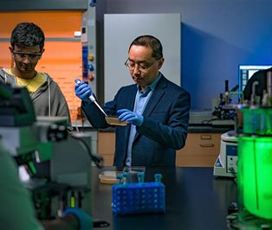
PILLAR 2
Drive Research & Innovation
Strengthen R1 performance and translate discovery into impact.
Complete Research without Boundaries plan
Accelerate proposal development, interdisciplinary teams, and sponsor engagement
Hire strategically in areas of strength
Improve research infrastructure and research administration
Expand industry, defense, commercialization, and innovation partnerships
$100M
$74M
+6%
FACULTY LEADERSHIP: discovery • collaboration •
doctoral education • impact
HERD
awards
doctorates
GROWING FOR TOLEDO | FY2027–FY2031
Notes:
Faculty leadership is essential to implementation and quality.
[Sources]
- Growing for Toledo: UToledo Strategic Plan FY2027–FY2031, Draft Version 5, August 12, 2026.
- Photograph supplied by The University of Toledo.

Slide 7
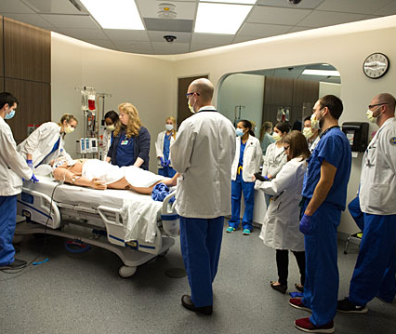
PILLAR 3
Build for a Healthy Toledo
Advance care, health education, clinical research, and regional health.
Pursue performance excellence and stronger service lines
Expand health education opportunities and affiliations
Grow capacity of health research and clinical trials
Extend services through community locations and partnerships
5%
7%
140K+
FACULTY LEADERSHIP: health education • clinical research •
quality • regional health
inpatient
outpatient
lives
GROWING FOR TOLEDO | FY2027–FY2031
Notes:
Faculty leadership is essential to implementation and quality.
[Sources]
- Growing for Toledo: UToledo Strategic Plan FY2027–FY2031, Draft Version 5, August 12, 2026.
- Photograph supplied by The University of Toledo.

Slide 8
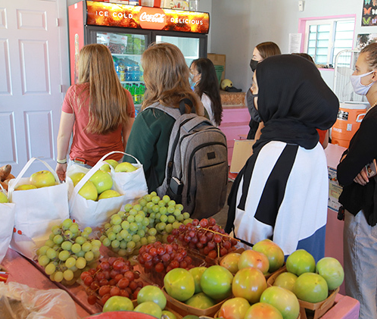
PILLAR 4
Engage Our Partners
Extend UToledo expertise beyond campus and become the preferred regional partner.
Strengthen K–12, transfer, and educational partnerships
Extend expertise through camps, workshops, public programs, and events
Use athletics and campus activity as community connectors
Grow alumni engagement and philanthropic capacity
K–12
REGION
CAMPAIGN
FACULTY LEADERSHIP: outreach • partnerships •
public scholarship • trust
pathways
partnerships
philanthropy
THE UNIVERSITY OF TOLEDO
GROWING FOR TOLEDO | FY2027–FY2031
Notes:
Faculty leadership is essential to implementation and quality.
[Sources]
- Growing for Toledo: UToledo Strategic Plan FY2027–FY2031, Draft Version 5, August 12, 2026.
- Photograph supplied by The University of Toledo.

Slide 9
PILLAR 5
Optimize Our Institutional Systems
Build the financial, physical, operational, and cultural capacity required for mission growth.
PEOPLE
RESOURCES
PLACES
Review staff compensation philosophy
Strengthen recognition
Build a culture of success
Improve budget transparency
Use incentive models selectively
Align indirect costs with research growth
Prioritize housing, STEM, research, health, and student life
Sequence by mission impact
Continue repair and renewal
DISCIPLINED, PHASED INVESTMENT • GROWTH FUNDS THE NEXT PHASE
GROWING FOR TOLEDO | FY2027–FY2031
Notes:
This pillar enables the other four through people, resources, places, and systems.
[Sources]
- Growing for Toledo: UToledo Strategic Plan FY2027–FY2031, Draft Version 5, August 12, 2026.

Slide 10
OUR FOUNDATION
Proposed Mission Statement
A concise statement of what UToledo does, for whom, and from where.
The University of Toledo, proudly rooted in northwest Ohio, prepares students for personal and professional success, expands human knowledge and capability, and delivers exceptional, advanced care for patients.
PREPARES
EXPANDS
DELIVERS
Students for personal and professional success
Human knowledge and capability
Exceptional, advanced care for patients
PLACE
Proudly rooted in northwest Ohio
GROWING FOR TOLEDO | FY2027–FY2031
Notes:
Suggested framing: The proposed mission is intentionally brief and active. It identifies three core functions: student success, knowledge creation, and advanced patient care. It also names the University’s place and regional identity without limiting the reach of its work.
Discussion prompt: Does this statement capture the enduring academic and public purpose of UToledo?
[Sources]
- Growing for Toledo: UToledo Strategic Plan FY2027–FY2031, Draft Version 5, August 12, 2026.
- Main Campus photograph supplied by The University of Toledo.

Slide 11
SHARED OWNERSHIP
Faculty leadership in Growing for Toledo
Success requires faculty action to provide a valuable education, research, and health care environment.
SHAPE
Curriculum, programs, research priorities, and standards
LEAD
Experiential learning, scholarship, mentoring, and engagement
ADVISE
Investments, implementation choices, and corrections
ASSESS
Outcomes, educational quality, impact, and unintended consequences
SUCCESS IS NOT ASSURED, BUT WE MUST BEGIN, AND WE MUST ACT WITH AMBITION
Feedback: utpresident@utoledo.edu
GROWING FOR TOLEDO | FY2027–FY2031
Notes:
Invite substantive faculty feedback rather than simple endorsement.
[Sources]
- Growing for Toledo: UToledo Strategic Plan FY2027–FY2031, Draft Version 5, August 12, 2026.

