Slide 1
Division of Student Affairs (DSA)

Slide 2
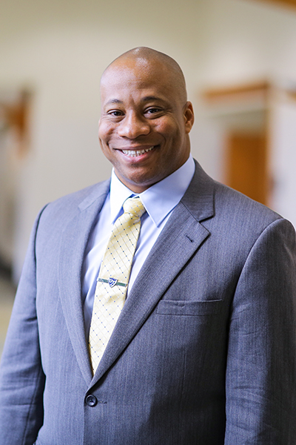
WELCOME HOME!!!
The Division of Student Affairs is very excited to partner with you.
Sammy J. Spann, Ph.D.
Vice Provost & Dean of Students
Division of Student Affairs

Slide 3
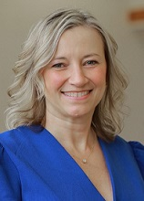
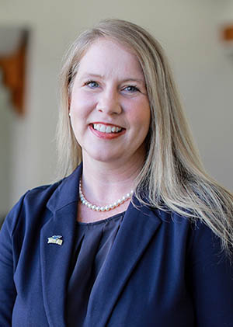
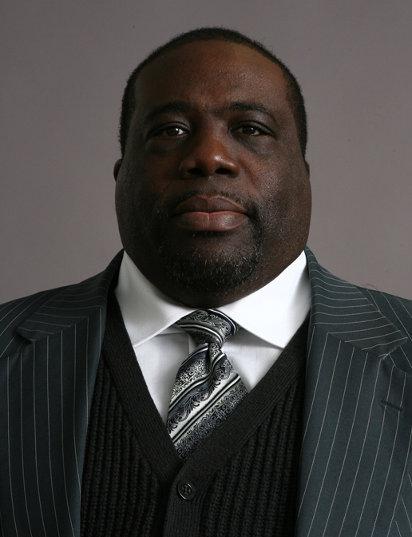
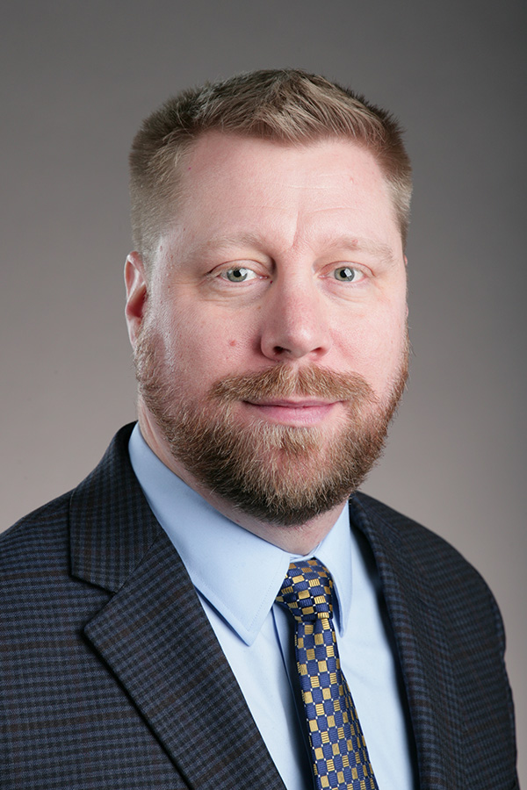
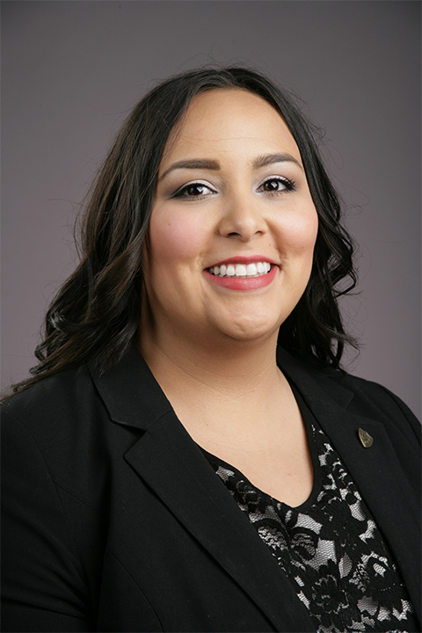
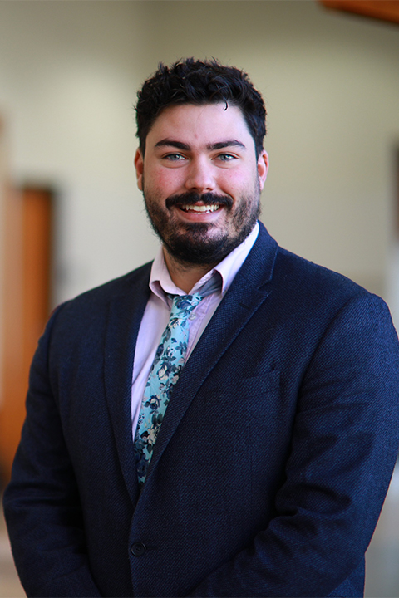
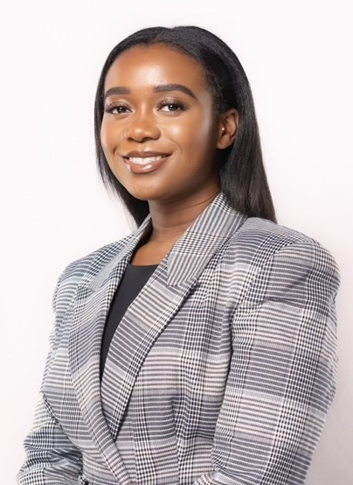
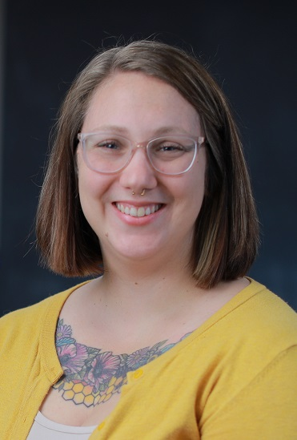
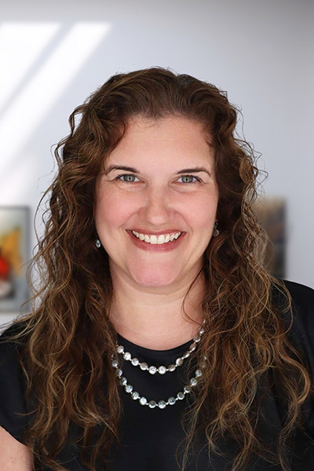
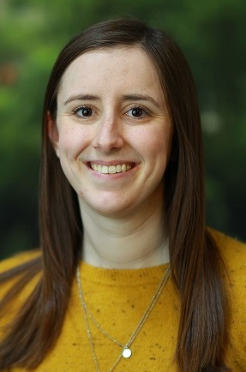
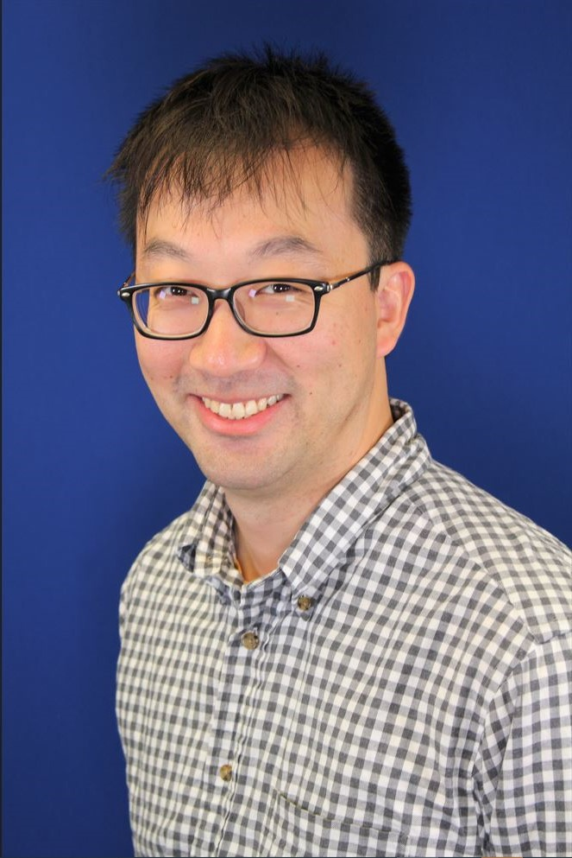
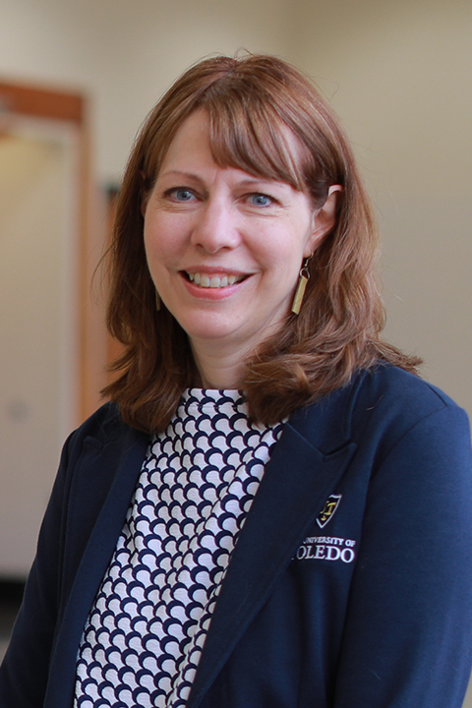
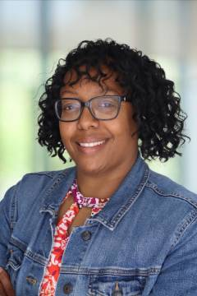
Meet The Student Affairs Leadership Team
Sammy Spann, Ph.D.
Vice Provost of Student Affairs & Dean of Students
Julie Fischer-Kinney, Ph.D.
(Dr. JFK)
Executive Director,
Student Experience
Sara Clark
Executive Director,
Student Experience
and Connections
David Young
Executive Director,
Student Success
Toledo Excel
Eric Buetikofer
Director,
Military and Veteran
Affairs
Aleiah Jones
Director,
Office of Student Engagement and Connections
Alex Zernechel
Director,
Office of Student Engagement and Connections
Jewel Mundoe
Executive Assistant II
Office of the VP and
Dean of Students
Danielle Lutman, Ph.D.
Associate Director,
Eberly Center for Student Experience
Meredith Blaine
Director,
Student Conduct and Community Standards
Emily Skibski
Director,
New Student Orientation Programs
Xinren Yu
Director,
Center for International Studies and Programs
Shelly Drouillard
Director,
Rocket Career Center
Alisha Durham
Director,
Upward Bound & Upward Bound Math Science

Slide 4
Areas in DSA
Center for Advocacy and Student Experience (CASE)
  Student Conduct & Community Standards
  New Student Orientation Programs
  Eberly Center for Student Experience
  Rocket Fuel Food Pantry
Center for International Studies and Programs (CISP)
  Office of International Student Scholar Services
  American Language Institute
  Study Abroad
Military Service Center
Office of Student Engagement and Connections (OSEC)
Rocket Career Center (RC2)
Rocket Kids
Toledo Excel
Upward Bound

Slide 5
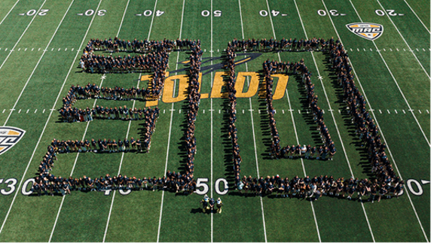
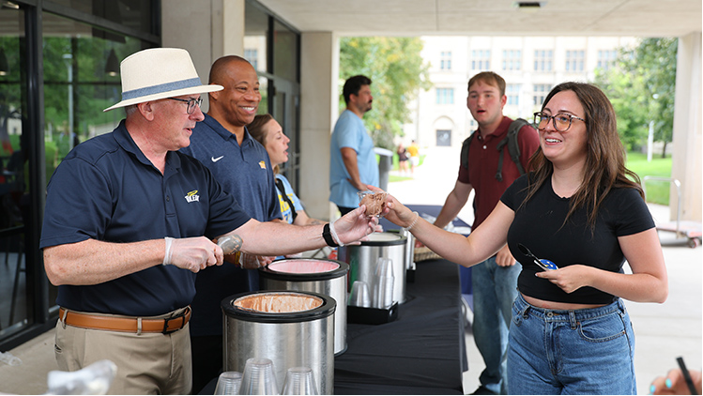
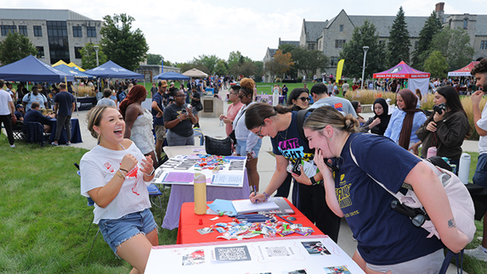
Welcome Weeks Recap
Convocation
Donuts with the Dean of Students – 160
CAP Carnival – 850
Flick in the Field – 323
Sundae on a Monday - 626
Welcome Stations - 922
Campus Involvement Fair - 1200
Fraternity and Sorority Life 101 - 250
Welcome Weeks (August 28th – October 10th) –activities, traditions,
and opportunities for students to meet new people, explore the
university and discover what makes campus feel like home.
List of events can be found here Welcome Weeks

Slide 6

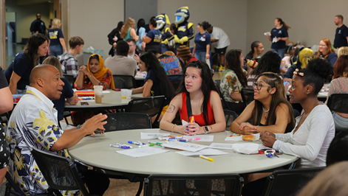
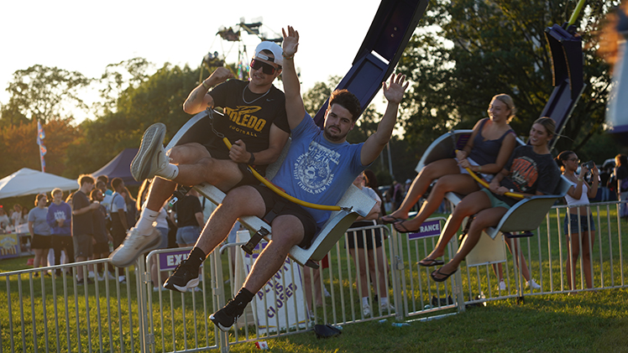


Rocket Welcome Weekend Schedule
  Friday, August 28th
    Donuts with the Dean
      9-10am, SU Ingman
    Academic Adventure
      Various locations
    Class of 2030 Lunch
      12-1pm, Flatlands
    Rocky's Welcome (convocation)
      2-3pm, SU Auditorium
    CAP Carnival
      7-9pm, Carter Hall Field
      Saturday, August 29th
  Saturday, August 29th
    Walmart & Target Runs
      10am-2pm
    Rocky's Mud Volleyball Tournament
      10am – 2pm, Flatlands
    Flicks on the Field
      8-10pm, Glass Bowl
  Sunday, August 30th
    Sunrise and Yoga
      6-9am, Glass Bowl
    NPHC Jam Session
      6-pm, Centennial
15

Slide 7
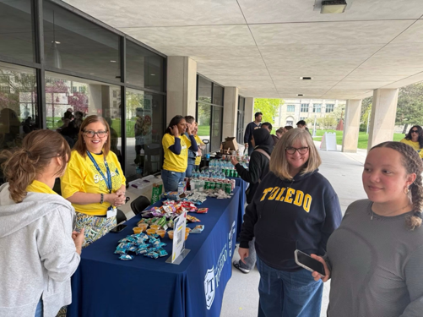
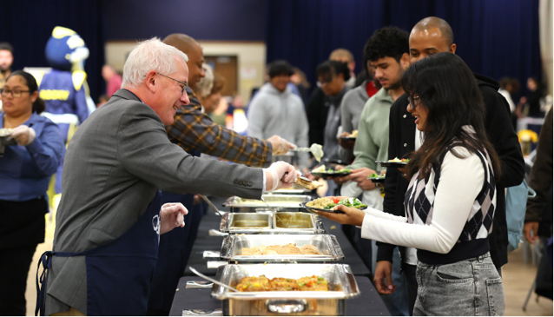
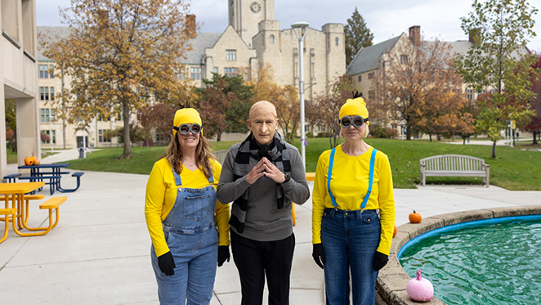
Upcoming Events
Floats and Votes – September 15th
JCPenney Rocket Suit-Up – September 25th
Rocket Family Weekend - September 25th – 27th
Homecoming Week:
  Olympus Unleashed: Rockets Reign – October 5th – 10th
Halloway’s Haunted Halloween Week – October 26th – 30th
BOO-sting Your Career Week – October 26th – 29th
Rocket Thrift Shop – November 4th
President’s Thanksgiving Lunch – November 9th
Mom’s Weekend – November 13th -15th
International Education Week – November 16th -20th

Slide 8
Some New Initiatives
CVS wellness bags
September 8: Fraternity & Sorority Life 101
September 22: Vintage Market on Centennial Mall
October 24: Islamic Food Bank Service Trip
October 27: Don't Ghost Your Vote
October 31: Trick or Canning
Rocky's 60th Birthday will be celebrated during Homecoming week!
House Calls: Intentional check-ins with first-year, residential students in Parks Tower.

Slide 9
Some New Initiatives
Meal Recovery: Partnership with Chartwells
Rockets Feeding Rockets (Meal Swipe Donations)
Upgrades to the online orientation platform
VALOR: Peer Advising – to support military connected students
Collaborating with the Office of the Provost’s new ASCEND program
Launching the new Science, Data & Health Career Fair

Slide 10
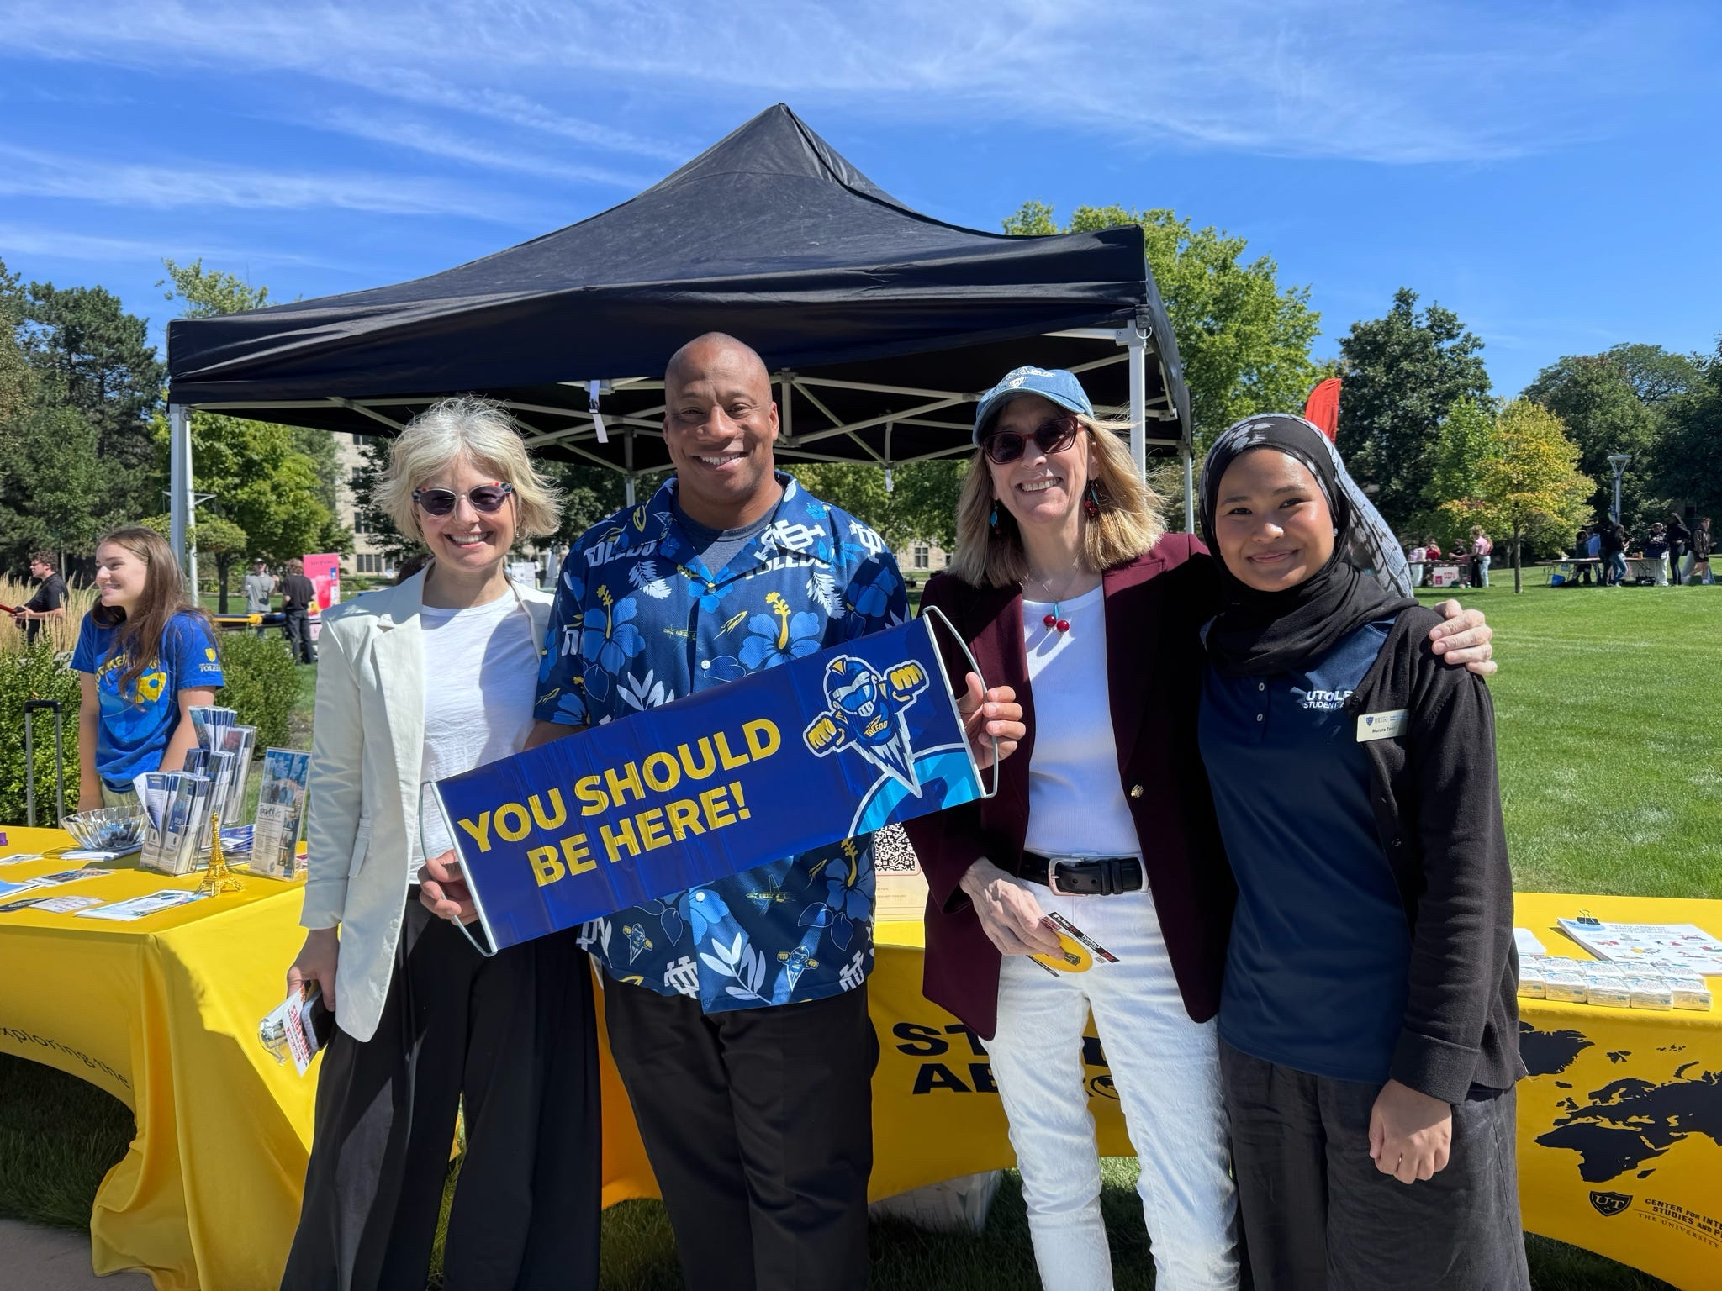
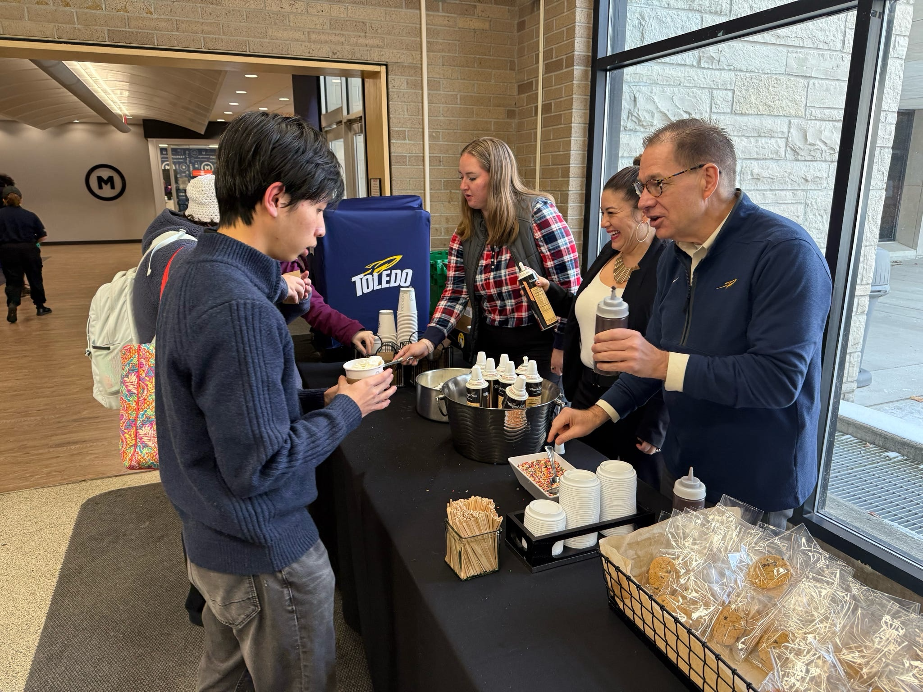
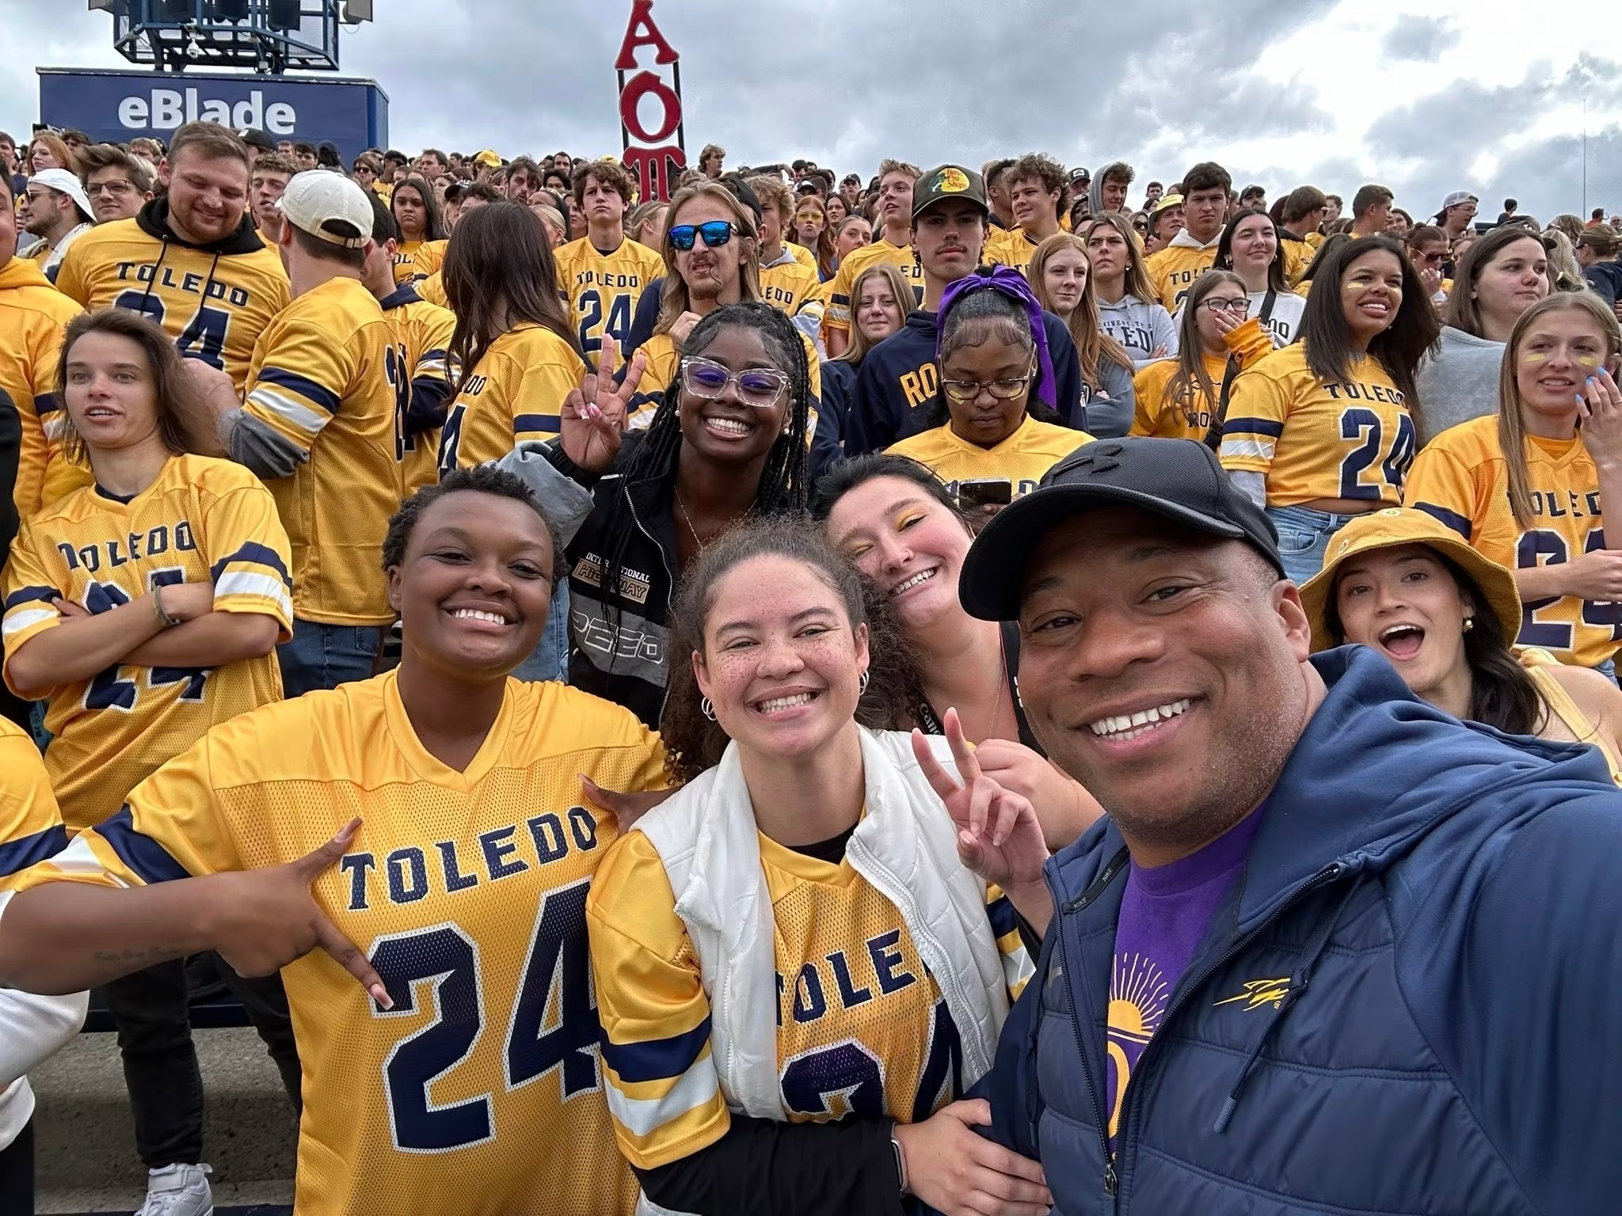
How You Can Help
Support students outside of the classroom
Provide extra credit to students for attending events
Sign up to volunteer
Visit Invonet to learn about student organizations and events
Encourage students to get involved and take advantage of campus resources
Report a concern

Slide 11
How to Report a Concern
In Person, E-Mail, or Telephone
2518 Thompson Student Union
CASE@UTOLEDO.EDU OR 419-530-HELP
DSA 24/7 On-call: 419-343-9946
Report a Concern: Bottom of every UToledo Website
Sexual Misconduct, Title IX (Title IX/Student Conduct)
Discrimination/Harassment (HR)
Student Conduct (CASE)
Concern for a Student (CASE)
Anonymous Reporting Line (Compliance)

Slide 12
Thank you and Go Rockets
Sammy J. Spann, Ph.D.,
Vice Provost & Dean of Students
Division of Student Affairs
University Hall 3630
Sammy.Spann@utoledo.edu
419.530.7963
Instagram: @DocSpann
DSA Instagram: @utoledostudentaffairs

