Slide 1
UToledo
Teaching and Learning Center
Faculty Senate Meeting, September 1, 2026
Dr. Jeanne Kusina, Director

Slide 2
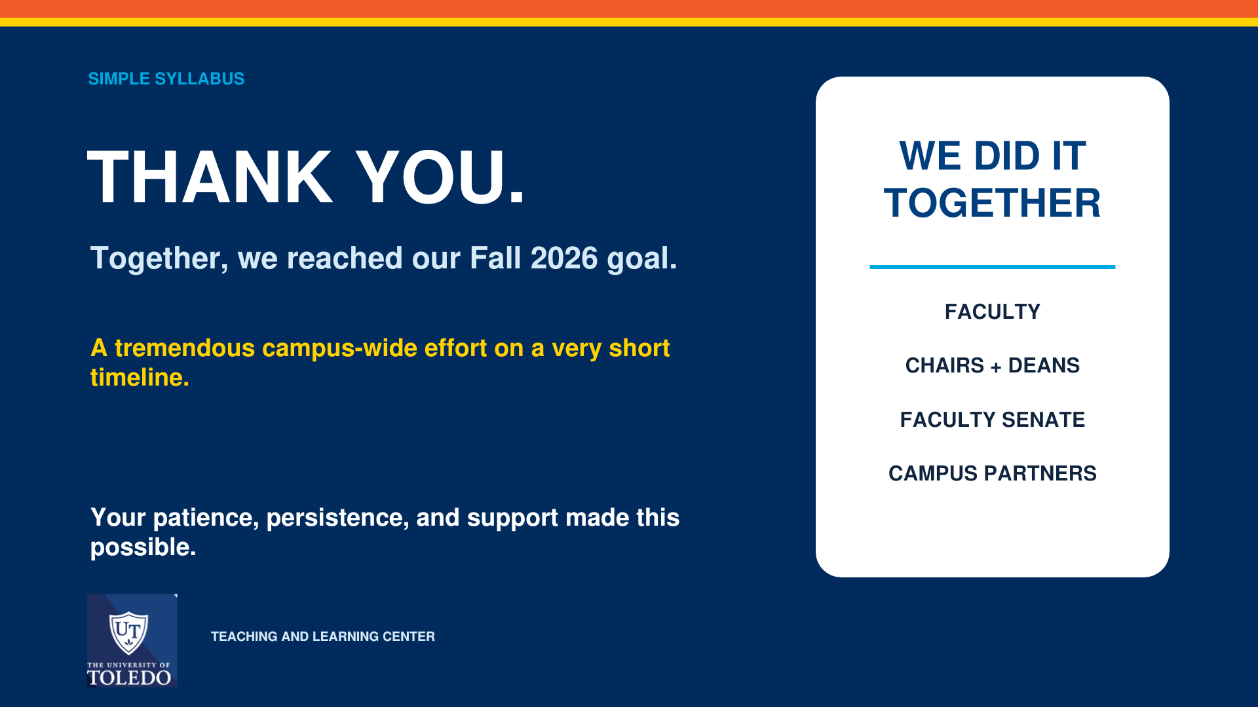

Slide 3

Teaching and Learning Center
NEW NAME
TLC
Same
commitment.
Bigger
aspirations.
TEACHING
TA TRAINING
COMMUNITY
Practical support
Support for student instructors
Faculty development &
partnership
FACULTY SENATE | 09.01.26

Slide 4

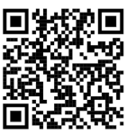
AI +
TEACHING
FALL 2026
Reading Circle
12 participants
Starting September 28th
FALL 2026
AI Teaching Certificate
One connected year
of conversation, practice,
and critical reflection.
Three-week online course with UT Online – Sept. 28 - Oct. 18
Limited participants
NOVEMBER 2026
Faculty Showcase: Teaching and AI
Open to all instructors
November 13th
JANUARY 29, 2027
José Antonio Bowen at UToledo
Interactive faculty workshop • Save the date
ALSO: Online Teaching Toolkit
FACULTY SENATE | 09.01.26

Slide 5
BRING US
YOUR…
TLC is here for you.
CONSULT
One-on-one teaching support
teaching questions
CONNECT
Workshops, conversations, discipline-specific programming
new ideas
course challenges
CREATE
Course design, resources, and teaching toolkits
professional goals
GROW
New Faculty orientation and support, TA training, Support for all career stages
universityteachingcenter@utoledo.edu
THE UNIVERSITY OF TOLEDO • TEACHING AND LEARNING CENTER
FACULTY SENATE | 09.01.26

