Slide 1
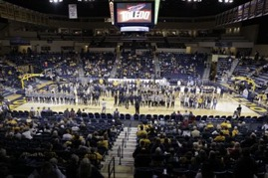
Faculty Athletics Representative Report
April 23, 2019

Slide 4
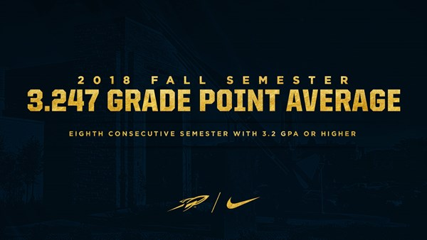
Fall 2018
Second-highest fall term GPA in school history
8th consecutive semester in which UT student athletes have earned a semester GPA above 3.2
20th straight semester of at least a 3.1 GPA

Slide 5
Fall Semester 2018
Thirteen UT varsity sports had a team GPA of 3.0 or higher
Eight had a team GPA of 3.5 or higher

Slide 6
Fall Semester 2018
46 UT student-athletes earned President's List honors (4.0 GPA)
Second only in school history to the 49 Rockets who had perfect GPAs in the spring of 2016.
44% (165 of 375) UT student-athletes earned Dean's List honors (3.50 GPA)

Slide 7
Toledo 2018 Fall Semester Team GPAs
Overall Department GPA: 3.247
Women's Volleyball 3.751 | Women's Swimming & Diving 3.638
Women's Soccer 3.631 | Women's Tennis 3.608
Women's Cross Country 3.532 | Men's Golf 3.528
Softball 3.524 | Women's Golf 3.517
Men's Tennis 3.443 | Women's Indoor/Outdoor Track 3.366
Women's Basketball 3.230 | Baseball 3.082
Men's Basketball 3.081 | Football 2.892

Slide 9
Fall Semester 2018 - 6 UT Student-Athletes Named Mid-American Conference (MAC) Distinguished Scholar Athletes
Football
Bailey Flint, Toledo, Sophomore, 3.769 GPA, Media Communication (Melbourne, Australia)
Cody Thompson, Toledo, Senior, 3.66 GPA; 3.74 Grad GPA, Marketing; Grad. Recreation & Leisure (Huron, Ohio)

Slide 10
Fall Semester 2018 - 6 UT Student-Athletes Named Mid-American Conference (MAC) Distinguished Scholar Athletes
Women's Soccer
Natalie Knauf, Toledo, Senior, 3.94 GPA, Information Systems (Dewitt, Mich.)
Hannah Scafaria, Toledo, Senior, 3.51 GPA, Marketing (Kalamazoo, Mich.)

Slide 11
Fall Semester 2018 - 6 UT Student-Athletes Named Mid-American Conference (MAC) Distinguished Scholar Athletes
Men's Cross Country
Matthew Gibbons, Toledo, Senior, 4.00 GPA, Mechanical Engineering (Oregon, Ohio)

Slide 12
Fall Semester 2018 - 6 UT Student-Athletes Named Mid-American Conference (MAC) Distinguished Scholar Athletes
Women's Cross Country
Athena Welsh, Toledo, Junior, 3.6180 GPA, Marketing (Louisville, Ohio)

Slide 13
MAC WEST CHAMPIONS
Softball – Spring, 2018
Men’s Basketball – Spring, 2019

Slide 14
MORE OUTSTANDING ACCOMPLISHMENTS
Women’s Cross Country
Second-place 2018 MAC Championship Meet
Women’s Golf
Runner-up 2018 MAC Championship Meet
Janelle Noe
Second-team All-America
Smashed her own MAC record by running 4:10.83 in the 1500 meters at the 2018 NCAA Outdoor Championship Meet
Athena Welsh
2018 Cross Country NCAA Championship appearance
Second at the 2018 MAC Championship Meet
2018 Cross Country All-MAC First Team
Claire Steigerwald
2018 Cross Country MAC Freshman of the Year

Slide 15
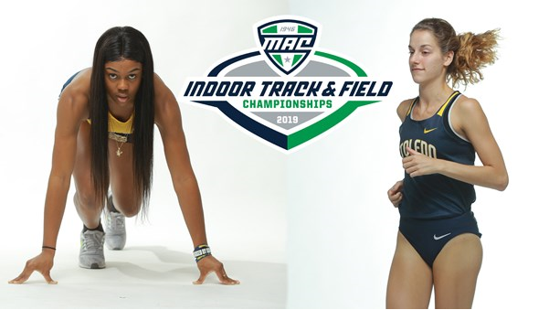
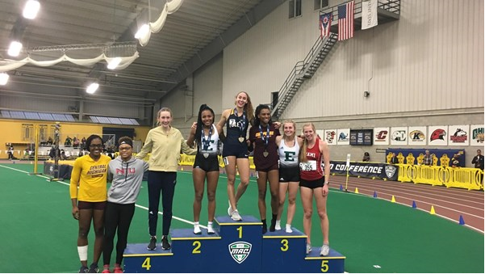
Shanice Williams (60-meter dash), Athena Welsh (5,000-meter run) and Atalia Lima (Pentathlon)
Each finished in first place at the MAC Indoor Championships

Slide 16
MORE OUTSTANDING ACCOMPLISHMENTS
MEN’S BASKETBALL
25-8 record, the second-most wins in school history, and won their second-consecutive MAC West Division title.
Bid to the National Invitation Tournament (NIT)
Fourth post-season berth under head coach Tod Kowalczyk
Jaelan Sanford earned first-team All-MAC honors
Nate Navigato set school and conference records with 309 career three-pointers

Slide 17
MORE OUTSTANDING ACCOMPLISHMENTS
WOMEN’S BASKETBALL
21-12 record
Advanced to the second round of the WNIT
Fourth post-season appearance in the past five years
Coach Tricia Cullop earned her 241st victory as head coach for the Rockets, surpassing Mark Ehlen as Toledo’s all-time leader in coaching victories.
Kaayla McIntrye earned second-team All-MAC honors

Slide 18
MORE OUTSTANDING ACCOMPLISHMENTS
Out of the 62 NCAA Division I “Group of 5” schools, only three had teams make a bowl game in football and earn NCAA or NIT/WNIT berths in basketball -- Houston, Buffalo and Toledo
Vice President and Director of Athletics Mike O’Brien played an important role on the NCAA Men’s Basketball Committee throughout the NCAA Men’s Basketball Tournament in March and April

Slide 19
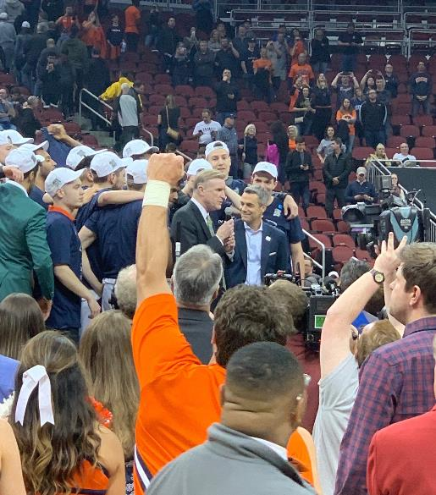
As part of his NCAA Men’s Basketball Committee member duties, Vice President & Athletic Director Mike O’Brien presented the South Regional championship trophy to Virginia

Slide 23
MAC Team Reached Quarterfinals

Slide 24
Reminder

Slide 25
Thank you &
Go Rockets
http://utrockets.com/

