Slide 1
Faculty Athletics Representative Report
February 13, 2018

Slide 2
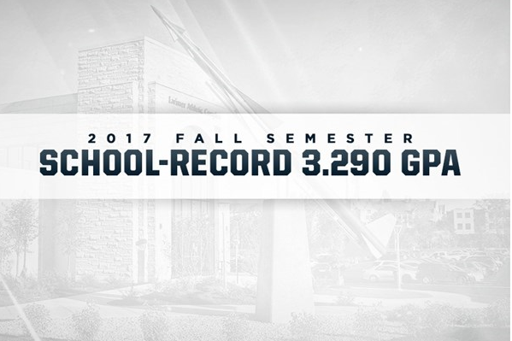
Fall 2017
Highest department semester GPA in school history, eclipsing the previous mark of 3.270 set last spring.
6th consecutive semester in which UT student-athletes have earned a semester GPA above 3.2
18th straight semester of at least a 3.1 GPA

Slide 3
Fall Semester 2017
20 Rockets graduated with their degrees
Individually, 38 student-athletes earned President's List honors with a perfect 4.0 GPA
Nearly 35 percent (130 of 374) earned a spot on the Dean's List by garnering at least a 3.50 GPA
71 percent (268 of 374) achieved a 3.0 grade point average or better

Slide 4
Toledo 2017 Fall Semester Team GPAs
Overall Department GPA: 3.290
Baseball: 3.376 | Women's Basketball: 3.378
Men's Basketball: 2.961 | Women's Cross Country: 3.619
Men's Cross Country: 2.939 | Women's Golf: 3.776
Football: 3.001 | Women's Soccer: 3.538
Men's Golf: 3.553 | Softball: 3.308
Men's Tennis: 3.370 | Women's Swimming & Diving: 3.467
 | Women's Tennis: 3.519
 | Women's Indoor/Outdoor Track: 3.364
 | Women's Volleyball: 3.677

Slide 6
Fall Semester 2017 - 15 UT Student-Athletes Named Mid-American Conference (MAC) Distinguished Scholar Athletes
Women's Soccer
Isa Echeverri, Three-time honoree, Senior, 3.555 GPA, Marketing (Medellin, Colombia)
Chiara Paradiso, Three-time honoree, Senior, 3.937 GPA, Communications (Columbus, Ohio)
Sophie Pohl, First-time honoree, Senior, 3. 794 GPA, Criminal Justice (St. Charles, Ill.)
Regan Price, First-time honoree, Junior, 4.00 GPA, Marketing (Bellefontaine, Ohio)
Hannah Scafaria, First-time honoree, Junior, 4.00 GPA, Administration (Kalamazoo, Mich.)
Christina Williams, First-time honoree, Senior, 3.979 GPA, Finance (Pickerington, Ohio)

Slide 7
Fall Semester 2017 - 15 UT Student-Athletes Named MAC Distinguished Scholar Athletes
Football
Nate Jeppesen, Two-time honoree, Senior, 3.577 GPA (3.668 Graduate GPA), Interdisciplinary Studies (Graduate-Master of Recreation & Leisure Study (Portage, Mich.)
Brad Spelman, Three-time honoree, Senior, 3.7217 GPA (4.0 Graduate GPA), Accounting (Graduate-Master of Business Administration (Hilliard, Ohio)
Brant Weiss, First-time honoree, Senior, 3.512 GPA (3.67 Graduate GPA), Management (Graduate-Master of Business Administration) (Sunbury, Ohio)
Logan Woodside, Two-time honoree, Senior, 3.42 GPA (3.134 Graduate GPA), Marketing (Graduate-Recreation Management) (Frankfort, Ky.)

Slide 8
Fall Semester 2017 - 15 UT Student-Athletes Named MAC Distinguished Scholar Athletes
Women's Cross Country
Stephanie Barlow, Three-time honoree, Senior, 3.754 GPA, Early Childhood Education (San Antonio, Texas)
Janelle Noe, First-time honoree, Senior, 3.845 GPA, Exercise Science (Sylvania, Ohio)
Athena Welsh, First-time honoree, Sophomore, 3.455 GPA, Pre-Business (Louisville, Ohio)

Slide 9
Fall Semester 2017 - 15 UT Student-Athletes Named MAC Distinguished Scholar Athletes
Women's Volleyball
Lauren Bakaitis, Two-time honoree, Senior, 3.965 GPA, Bioengineering (Avon Lake, Ohio)
Annie Beasley, First-time honoree, Senior, 3.731 GPA, Nursing (Indianapolis, Ind.)

Slide 10
2017 MAC CONFERENCE CHAMPIONS
Women’s Basketball – Spring, 2017
Women’s Soccer – Fall, 2017
Football – Fall, 2017

Slide 11
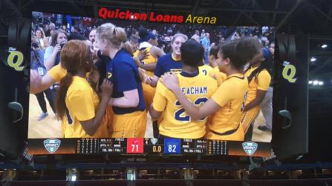

Slide 12
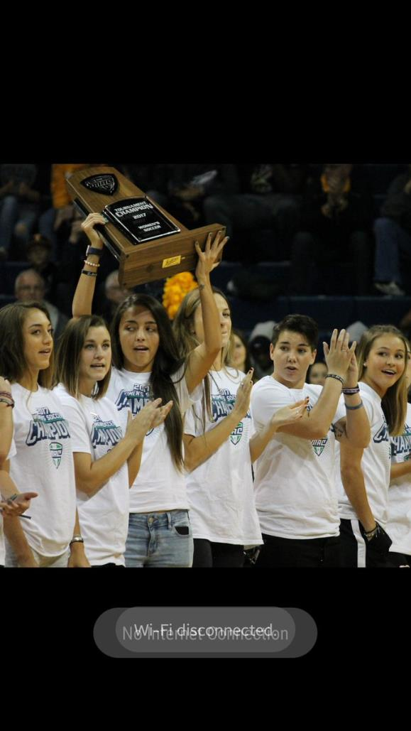
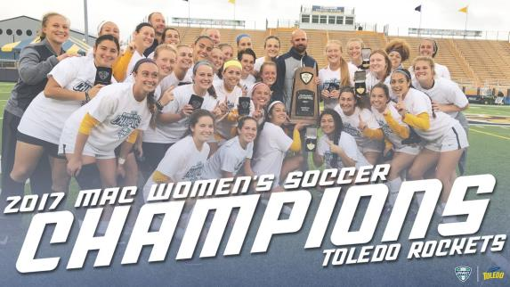

Slide 13
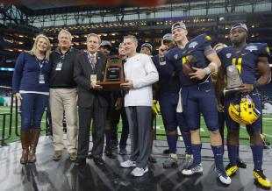
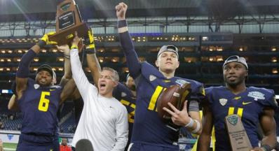

Slide 14
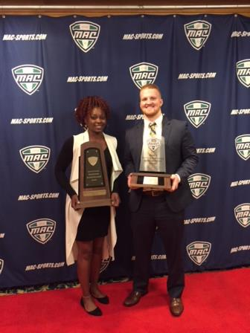
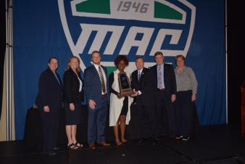
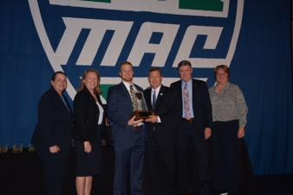

Slide 15
Reminder

Slide 16
Thank you &
Go Rockets
http://utrockets.com/

