Slide 2
Faculty Role in Student Success
Strategies that work
Denise Bartell
Barbara Schneider
October, 2018

Slide 6
Closing the Equity Gaps
Students who are:
The first in the family to go to college
Eligible for Pell grants
Members of underrepresented minorities
Are also less likely to attend college, persist in courses, and graduate in six years.
How do we change that?

Slide 7
Pell Eligible
To be eligible to receive any amount of a Pell grant, students must:
Have a high school diploma, a GED, or an approved home school education.
File a FAFSA—requires parents’ income tax statement
Register with the selective service if male and 18 or older.
Have a valid Social Security number.
Demonstrate financial need—most Pell grants are awarded to students whose families make less than $30,000 annually; some to students with family incomes up to $50,000. Varies.

Slide 8
Degree attainment by Family Income
Our data reflect long-term, national trends
Pell Institute 2017
Notes:
What Does the picture look like nationally?

Slide 9
Pell Coverage
More than 36 percent
of UT’s undergraduates
receive Pell grants.
The Pell Institute
notes that not all
students who would
qualify financially
receive aid because
they do not fulfill
all criteria.

Slide 10
Underrepresented Minorities
Defined by the Office of Diversity and Inclusion as students who identify as African American, Hispanic/Latinx, Native American, or Pacific Islander.
These are communities that share experiences of historical and institutionalized racism in American culture that have material consequences in terms of overall income, access to employment and educational opportunities, and social rewards.
At the University of Toledo, 9.8 percent of our students identify as African American, and 4.8 percent identify as Hispanic/Latinx.

Slide 11
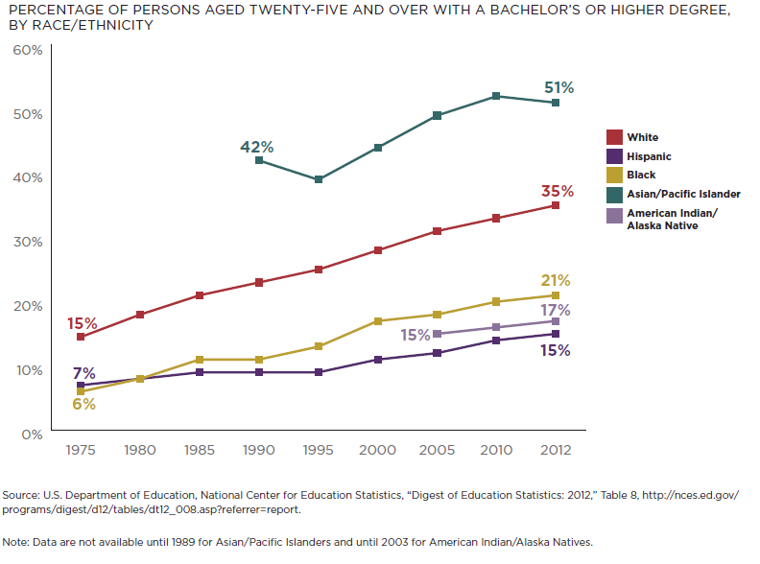
Degree attainment by Race/Ethnicity
Our data reflect long-term, national trends
Notes:
By Race/Ethnicity

Slide 12
Teaching Strategies
Gateway activities
  Open any new activity with an assessment of prior learning
  Allow students to surface prior knowledge, outside experiences that influence approach to topic
  Student discussion of the topic helps learners talk their way into the learning situation, brings their life to bear on the present
  Assists with transfer of knowledge from one context to the next
  Discloses misconceptions that interfere with new knowledge acquisition

Slide 13
Teaching Strategies
Transparent Assignments
Explicitly state learning goals for the assignment
Include both process and product guides
  How do you want them to do it? What should it look like when they are done?
Stage long projects and use formative assessment along the way
Put your evaluation criteria in writing
  Provide the rubric you will use, the peer review guide, or points description

Slide 14
Teaching Strategies
Formative assessment
Teaching---Use peer review sessions and discussions to assess your teaching---what have students learned? What do you need to explain further?

Slide 15
Teaching Strategies: WISE Feedback
Feedback description | Your paper met the basic expectations of the assignment but needs work. Please look over my comments.
High standards | You will see that I give detailed, critical feedback. This course sets the expectation that you will take your writing to a level suitable for college work.
Assurance of student ability | Your past assignments have shown me that you have the skills and motivation to use my feedback to revise and improve your paper.
Feedback description. Describes the nature of the feedback being offered.
Statement of high standards. Emphasizes and explains the high standards used to evaluate the student work and generate the instructional feedback.
Assurance of student ability. The teacher states explicitly that the student has the skills necessary to successfully meet those standards.
Source: https://www.interventioncentral.org/student_motivation_wise_feedback

Slide 16
Teaching Strategies: Basic Needs Statement
“Any student who has difficulty affording groceries or accessing sufficient food to eat every day, or who lacks a safe and stable place to live, and believes this may affect their performance in the course, is urged to contact the Office of the Dean of Students for support (419-530-8852 or rocketresponse@utoledo.edu). Furthermore, please contact me if you are comfortable in doing so. This will enable me to connect you with an array of resources available on campus.
Can include info about textbook lending programs, campus food bank or meal donation program, etc.

Slide 17
Teaching Strategies: Fostering Belonging
Student Panels
Peer Mentors/TA's

Slide 18
Resources
University Teaching Center
Equity
Transparency
High Impact Practices
Teaching for Transfer
Assessment Strategies
Assignment Design
Teaching First Year Students

