Slide 1
Overview of NCFDD Institutional Membership
La Fleur Small, Vice Provost of Academic Administration and Faculty Affairs
Office of the Provost

Slide 2
About the NCFDD
The National Center for Faculty Development & Diversity (NCFDD) is an independent professional development, training, and mentoring community of faculty, postdocs, & graduate students from over 500 colleges and universities.
NCFDD partners with colleges and universities to provide professional development and external mentoring.

Slide 3
NCFDD Institutional Membership
Annual subscription for an unlimited number of users at our institution to access our full suite of online, on-demand trainings and support resources.
Provides external mentoring and professional development training centered on helping faculty, grad students, and postdocs achieve outstanding research & writing productivity while having full and healthy lives off-campus.

Slide 4
Resources:
The Monday Motivator
Our most popular membership resource!
The Monday Motivator is a weekly email that provides tips and strategies to increase productivity and work-life balance by reinforcing the skills and strategies presented in the Core Curriculum.

Slide 5
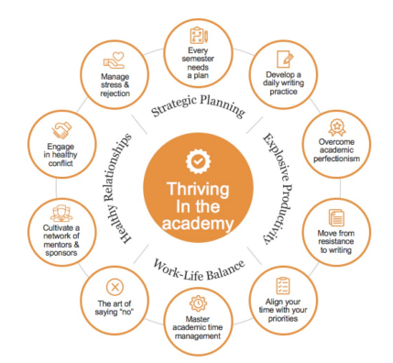
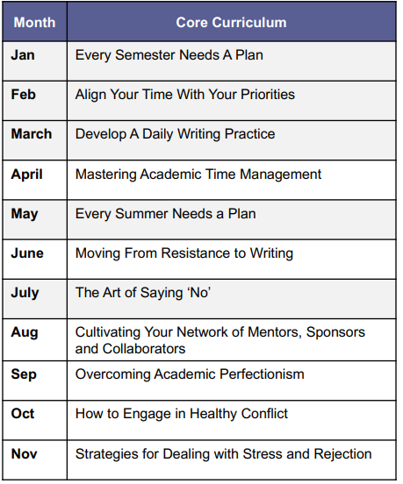
Resources:
Core Curriculum Webinars
Our Core Curriculum webinars teach 10 Key Skills for thriving in academic positions.

Slide 6
Resources: Guest Expert Webinars
NCFDD also hosts Guest Expert Webinars on varied topics such as:
Developing Anti-Oppressive Communities: Supporting Black Students and Mentees
Resting to Rise: Reduce Burn Out, Find Your Joy for Writing and Life, and Create a Just Academia
Moving from Associate to Full Professor
Writing for a Broader Audience: How to Convey Complex Ideas in Clear, Accessible Prose

Slide 7
Resources: Multi-Week Courses
Membership also includes Multi-Week Courses – webinar series’ that run over the course of 3-4 weeks. Example titles include:
From Project to Publication—the Art of Manuscript Revision
Writing Science: How to Write Papers That Get Cited and Proposals That Get Funded
How to Craft and Submit a Winning Book Proposal in Four Weeks
Building a Publishing Pipeline: Concrete Strategies for Increasing Your Writing Productivity ü How to Write an NIH Grant

Slide 8
Resources: 14-Day Writing Challenge
Every semester, members are invited to join a 14-Day Writing Challenge.
It’s an opportunity to experiment with daily writing, online community, and supportive accountability on our WriteNow platform.
Participants can also look forward to a daily dose of encouragement in their inbox from the NCFDD Team.

Slide 9
Additional NCFDD Member Benefits
Access to our Discussion Forums, including monthly writing challenges
Dissertation Success Program for advanced graduate students
Monthly “accountability buddy” matches (peer mentoring)
Access to our continuously growing Webinar Library including hundreds of hours of professional development training
Priority Registration for the Faculty Success Program for sponsoring offices

Slide 10
www.facultydiversity.org/
https://www.utoledo.edu/offices/provost/ncfdd/
The Post-Tenure Pathfinders Program provides a space for recently tenured faculty who are alumni of our FSP program to pause, engage in a discovery process about what’s possible in their next chapter, and build the support network necessary to move powerfully and with intention in that new direction.

