Slide 1
UTOLEDO
STRATEGIC PLANNING UPDATE
Faculty Senate
January 18, 2022

Slide 2
Committee
Anne Fulkerson, AVP for Institutional Research
Jason Huntley, Assoc. Professor of Microbiology & HSC rep. on Faculty Senate
Karen Bjorkman, Provost and EVP for AA; Distinguished University Professor
Jonathan Bossenbroek, Professor of Ecology & Member of Graduate Council
Timothy Brakel, Professor of Music Education & Past-President of Faculty Senate
David Giovannucci, Professor of Neurosciences & Member of University Research Council
Tracey Hidalgo, Assist. Director of Office of International Students and Scholar Services
Doug Huffner, AVP for Risk Management
Chi-Chi Igwe, Undergraduate Studying Biochemistry & Member of Student Government
Birdel F. Jackson, III, National Trustee of the UToledo Board of Trustees
Mark Merrick, Dean of the College of Health and Human Services
James Molnar, Web & Digital Media Specialist for COMLS & past-chair of PSA
Patrick Naranjo, College of Law Student & Member of GSA
Susan Palmer, The University of Toledo Foundation Trustee & Former UToledo Trustee
William Pierce, AVP for Alumni Engagement
Jonathan Rethorn, Engineering College Computing Director
Angie Roach, Director of Scholarships & Financial Aid Systems
Marc Seigar, Dean of NSM
Chris Stesney-Ridenour, UTMC Chief Operating Officer
Jami Taylor, Professor of Political Science & Member of Graduate Council
Valerie S. Walston, Interim VP for Student Affairs
Notes:
21 committee representing and nominated by 17 different constituencies

Slide 3
Committee Charge
Finite number of achievable & actionable goals
Supported by real, identified resources
Capable of being measured for institutional effectiveness
Set goals that are tactical and engage campus community
Focus on achieving current key initiatives & other strategic priorities

Slide 4
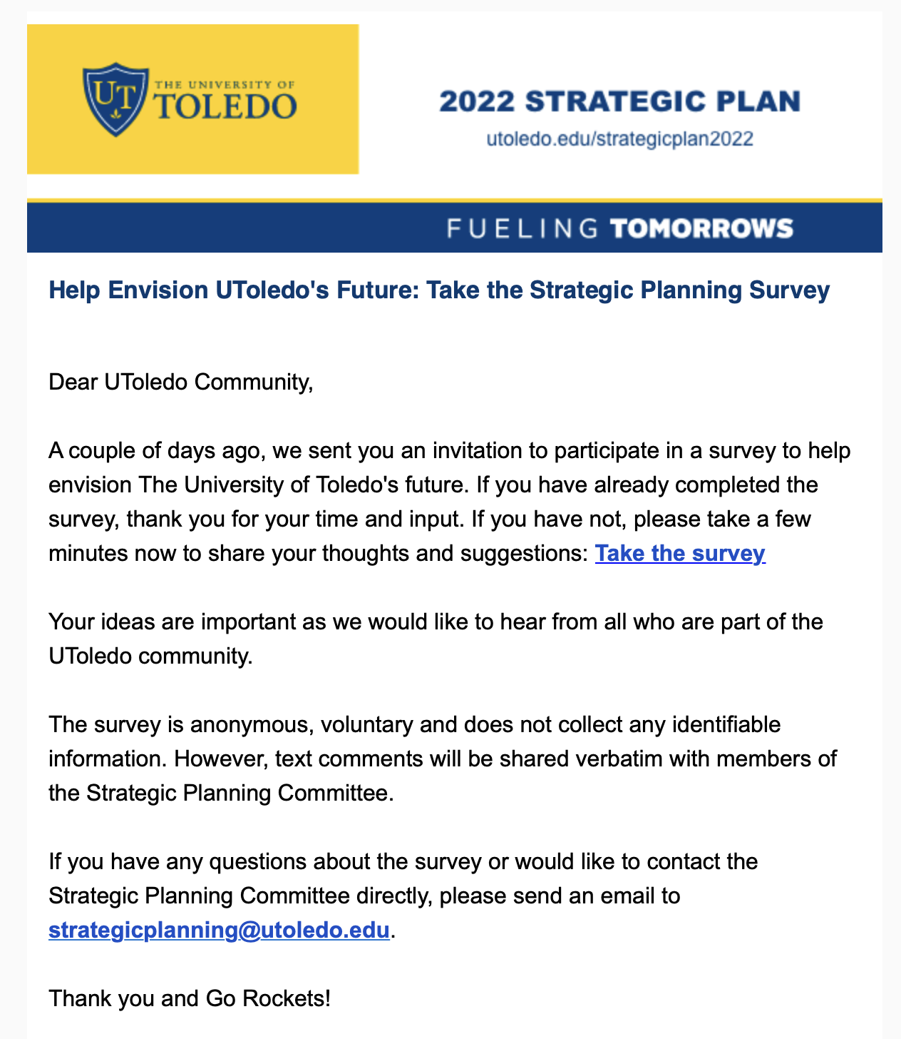
Stakeholder Survey Results

Slide 5
Stakeholder Survey Results
3,628 Total Responses
50% of responses
Unknown Campus
Health Science Campus
Main Campus

Slide 6
Mission
Mission
The University of Toledo is a national, public research university where students obtain a world-class education and become part of a diverse community of leaders committed to improving the human condition in the region and the world.
Notes:
How well does the current MISSION statement describe UToledo's overall purpose as an institution?

Slide 7
Stakeholder Survey Results: Mission
How well does the current MISSION statement describe UToledo's overall purpose as an institution?
All Respondents
2.66
C+

Slide 8
Vision
The University of Toledo will be a nationally ranked, public, research university with internationally recognized expertise and exceptional strength in discovery, teaching, clinical practice and service.

Slide 9
Stakeholder Survey Results: Vision
How well does the current VISION statement describe what UToledo should aspire to be?
All Respondents
2.84
B-
Notes:
How well does the current VISION statement describe what UToledo should aspire to be?

Slide 10
Stakeholder Survey Results: Strengths
Beautiful & compact campus
Diversity & inclusion of student body
Variety of academic programs
Quality programs: Engineering, Law, Business, Nursing, Health, Sciences, Pharmacy
Medical school/hospital
Research opportunities
Faculty & staff (expert & caring)
Size and location (urban setting; close to home)
Affordability
Athletics enhances student experience

Slide 11
Stakeholder Survey Results: Barriers
Parking
Campus dining (healthy options, hours, Rocket Dollars, Honors Academic Village)
Campus life / area around campus
Lack of good public transportation to downtown & shopping
Facilities (Engineering, Palmer, McComas Village, Academic House, Student Union)
Not student-centered
High acceptance rate
Too much emphasis on research rather than teaching

Slide 12
Stakeholder Survey Results: Barriers
Heavy teaching loads
Lack of research and grant support
Not focusing on strengths / trying to do too much
Lack of funding / resources / employees
Low pay
High turnover in leadership
Lack of accountability / complacency
Mediocre athletics
Commuter image
Lack of employee diversity
Notes:
Spending more time on barriers because the suggestions were directly related

Slide 13
Planning Phases & Deliverables
1. January – June 2022 (Phase 1)
Revise mission, vision & values (subcommittee and town halls)
Identify strategic planning themes/pillars for both short-term and long-term planning (subcommittees and town halls)
Identify/prioritize short-term (1-2 year) goals for each theme/pillar
2. July – December 2022 (Phase 2)
Continuing from themes/pillars from Phase 1, expand into Phase 2
Identify/prioritize long-term goals for Phase 2
Delivered in time for budget planning for FY2024
3. January – June 2023
Align with budget; BoT approval
Implement Phase 2 July 2023

Slide 14
SPC Subcommittees
Mission, Vision,
Values
--------------------
Image / Brand
Performance &
Partnerships
Strategic Planning Committee
People
(Students, Faculty, Staff)

Slide 15
Town Halls
Round 1:
Tue Jan 25th MC Students noon Stranahan 131
Wed Jan 26th HSC Faculty noon Health Ed Bldg 105
Wed Jan 26th MC Faculty 4pm Stranahan 131
Tue Feb 1st HSC Staff 9am Health Ed Bldg 105
Tue Feb 1st HSC Students noon Health Ed Bldg 105
Wed Feb 2nd MC Staff 4pm Stranahan 131
Wed Feb 2nd Community 7pm WebEx
UTMC and UTP tbd WebEx
Round 2: March 1st – 3rd

Slide 16
Please attend Town Halls and share opinions
Questions?

