Slide 1
Faculty Senate Committee on Student Affairs: Dining Hall Subcommittee: 7 November, 2023
Sally Harmych, Barry Scheuermann, Sarah Aldrich Renner, Paulette Kilmer
Dr. Deborah Coulter-Harris, Chair

Slide 2
The Faculty Senate Committee on Student Affairs shall act as a liaison between the Faculty, the Student Government, and the Administration on matters of common interest.
These issues directly tie into Enrollment and Retention problems; we brainstormed initial strategies for resolution of these problems. As we research further, more strategies for solutions will become evident

Slide 3
Introduction
Persons in Attendance at 11 October, 2023 meeting: Barry Scheuermann, Sally Harmych, Michael Dennis, Brian Kulpa, Don Bargo
This presentation is to apprise Faculty Senate and the University of Toledo’s Administration on the issues of Dining Halls’ operations and services that Student Government identified and presented to FSCSA; these issues include:
Dining halls need extended hours of operation.
https://dineoncampus.com/utoledo/hours-of-operation

Slide 4
Introduction (SG Issues con’t)
Quality of food should be consistent.
Food labeling should be consistent.
Financial cuts to operational hours hinder purchase of meal plans.
Student Government wants faculty member on its Dining Committee.
Zero positive student reviews for dining halls this year.

Slide 5
Issues Addressed at Meeting
Issue 1: Dining Hall Tour and Student Access
Issue 2: Food Information, Allergy Information, Labeling
Issue 3: Food Quality
(Follow-up Questions and Responses from Mr. Don Bargo)

Slide 6
Issue 1: Dining Halls: Tour and Observations
Toured dining facilities at Student Union:
Facilities were clean and full of students grabbing breakfast.
Options clearly labeled with nutritional information related to allergies included.
Student Union includes: “all you can eat” dining hall, The Eatery, the SU Market and 7 retail locations.

Slide 7
Issue 1: Student Access: Expansion of Dining Hours
Dining availability limited by current financial situation.
Only 2,177 meal plans purchased this academic year (after add/drop); reduces amount of money available -- resulted in Rocket Dining making tough decisions.
Decision: reduced the hours of the 2 “all you can eat locations,” at The Eatery in SU and The Food Hall @ Ottawa East.
Monday-Friday breakfast and lunch are served at The Eatery from 7:30 a.m.-2:30 p.m. On Weekends, The Eatery is closed but Food Hall is open from 9 a.m.- 8 p.m. (Late lunch and dinner are served at The Ottawa food Hall from 2:00-8:30 p.m. ( See Appendix I).

Slide 8
Issue 1: Student Access (Con’t)
Reps from Dining: track card swipes and other transactions to determine busiest areas/ times of day transactions are made: informs decisions on hours of operations of “all you can eat” dining areas.
Retail locations at the Student Union and The Market are open after The Eatery closes:
Food at retail locations available on north campus until 8 p.m.
At Ottawa East: Erbert & Gerberts, open Sunday-Friday 2-10 p.m.; Market @ Ottawa East, open Monday-Friday 2 p.m.-12 a.m. and Saturday and Sunday 2-11 p.m.

Slide 9
Issue 1: Student Access: Use of Dining Cards Off-Campus
We asked about the possibility of allowing students to use their dining plans off campus:
Not receptive to the idea.
Want as much money spent on campus as possible because of the low number of meal plans sold (See Appendix II).

Slide 10
Issue 2: Food Information, Allergy Information, Labeling
We spoke regarding their communications with students about allergy information as students were not sure where to find these foods and/or did not know where to find this information.
We learned that there are a lot of places where this information can be found on the Dining website https://dineoncampus.com/utoledo and the Rocket Dining app.

Slide 11
Issue 2: Food Information, Allergy Information, Labeling
An allergy free station called “The Delicious without Station” is located in the Food Hall @ Ottawa East and serves an entrée, starch, and vegetable that is free from: nuts, peanuts, soy, fish, shellfish, milk, wheat, eggs, gluten, and sesame.
All menu items are stored, prepared, and served at this station to avoid cross contact.
https://dineoncampus.com/utoledo/guide-to-managing-food-allergies

Slide 12
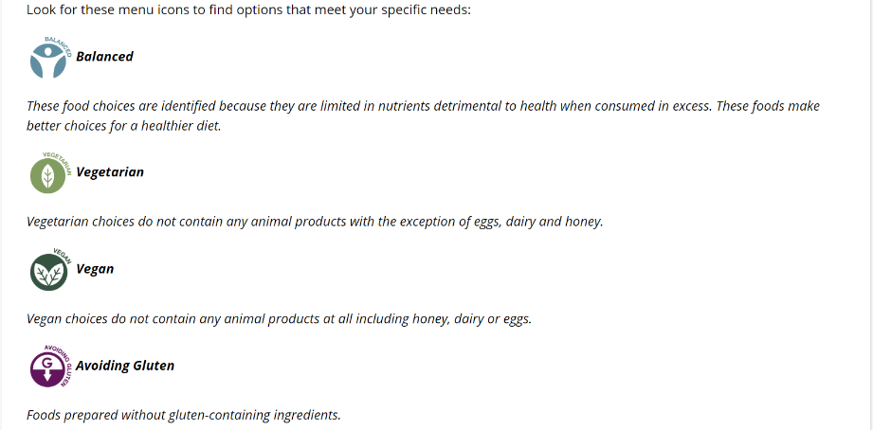
Issue 2: Food Labeling.
All items served in The Eatery at the Student Union and all other items served at the Food Hall @ Ottawa East are clearly marked with the menu symbols below:

Slide 13
Issue 2: Food Information
Full nutritional info on the Rocket Dining Website: https://dineoncampus.com/utoledo/nutrition-information or on the Rocket Dining app.
Students can also look up “What’s on the menu?”: https://dineoncampus.com/utoledo/whats-on-the-menu and on app each day at each location.

Slide 14
Issue 3: Food Quality
Students sent photos students showing moldy food and undercooked chicken.
Dining took corrective actions: additional training was implemented.
In each instance, food was replaced, and issue corrected within a few minutes. T
Number of complaint reports is small considering average of 13,000 meals are served in the dining halls each week.
Want to know about these issues when they happen so they can fix them.

Slide 15
Issue 3: Food Quality
We were assured -- any student complaint will be taken seriously and will be corrected as quickly as possible.
Students encouraged to report issues immediately to the staff; provided various ways to report issue to Dining Services.
Most recent Food Safety by Toledo Lucas County Health Department did not indicate any critical violations related to food quality or preparation.
Staff members routinely checked temperatures while we were visiting dining area in the SU.
Food service areas are cleaned between breakfast and lunch menu changes.

Slide 16
Follow-up Questions/Solutions
1. What is difference between meal swipes and meal exchanges? Are they the same or different?
Response: Meal plans have 3 options: Meal Swipes, Meal Exchanges and Dining Dollars. Meal swipes can be used at either of the All you care to eat (AYCTE), the Eatery or Ottawa East. Meal Exchanges are used in retail locations
2. Is it possible to keep just one or two stations at the Eatery open later to give students that cannot make it there before they close in the afternoon or not enough time between classes to walk to Ottawa a meal swipe option?
Response: Too costly: would require additional staff and increase costs related to food waste; fewer students create a higher than-average food cost due to waste.
retail locations open until 8 p.m. in the Student Union where students can use meal exchanges and dining dollars.

Slide 17
Follow-up Questions/Solutions
3. Is there a QR code the students can use to report issues or ask questions?
Response: Adding QR code would make the process for reporting issues longer. Here are all the options students have for communicating with Rocket Dining:
Text 2 Chat: https://dineoncampus.com/utoledo/text2chat listing of all location numbers Dine on Campus: https://dineoncampus.com/utoledo/feedback
Happy or Not: The Eatery and Ottawa East both have units in the hall at exits.
Social Media:
https://www.instagram.com/rocketdining/?hl=en
https://www.facebook.com/RocketDining/
https://twitter.com/RocketDining?ref_src=twsrc%5Egoogle%7Ctwcamp%5Eserp%7Ctwgr%5Eauthor
Dine on Campus App: https://dineoncampus.com/utoledo One stop shop of information for parents, students and guests.

Slide 18
Follow-up Questions/Solutions
4. You mentioned that sometimes students have difficulty finding different stations or miss them. Could you create a map to the dining hall showing students which direction to go to find each station?
Response: See Dine on Campus App
FIN
(Appendices I and II follow this final slide)

Slide 20
Appendix II
Appendix II. Bar Graph Showing Declines in Purchased Meal Plans
Purchased Meal Plans (Updated)
 |  |  |  |  |  |  |  |  | As of 10/23
 | Fall 2019 | Spr 2020 | Fall 2020 | Spr 2021 | Fall 2021 | Spr 2022 | Fall 2022 | Spr 2022 | Fall 2023
 | 3,123 | 2,750 | 2,329 | 1,814 | 2,294 | 2,002 | 1,947 | 1,655 | 1,878
 | 924 | 893 | 307 | 287 | 346 | 335 | 363 | 388 | 299
 | 4,047 | 3,643 | 2,636 | 2,101 | 2,640 | 2,337 | 2,310 | 2,043 | 2,177

Slide 21
Thank you for Listening!
Questions?

