Slide 1
Faculty Senate ad-hoc Budget Committee
Collin Gilstrap
Associate Professor
Neff Department of Finance

Slide 2
Goals of the Committee
Collect information on how the college budget committees are formed and operated
Suggest common principles to the provost and faculty senate to ensure faculty input is taken into account in college budget decisions

Slide 5
IBB and College Budget Committees

Slide 6
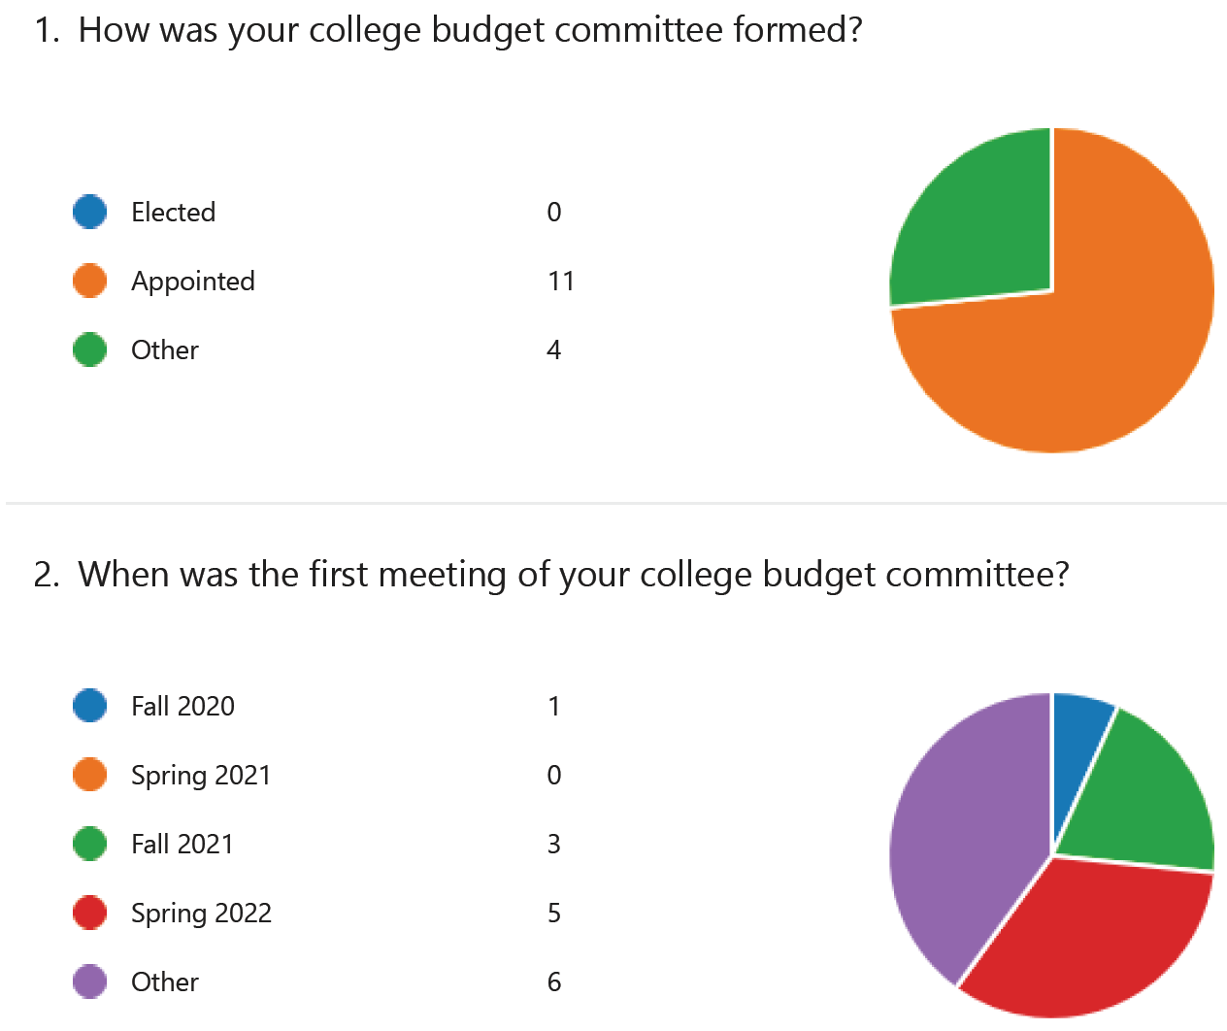

Slide 7
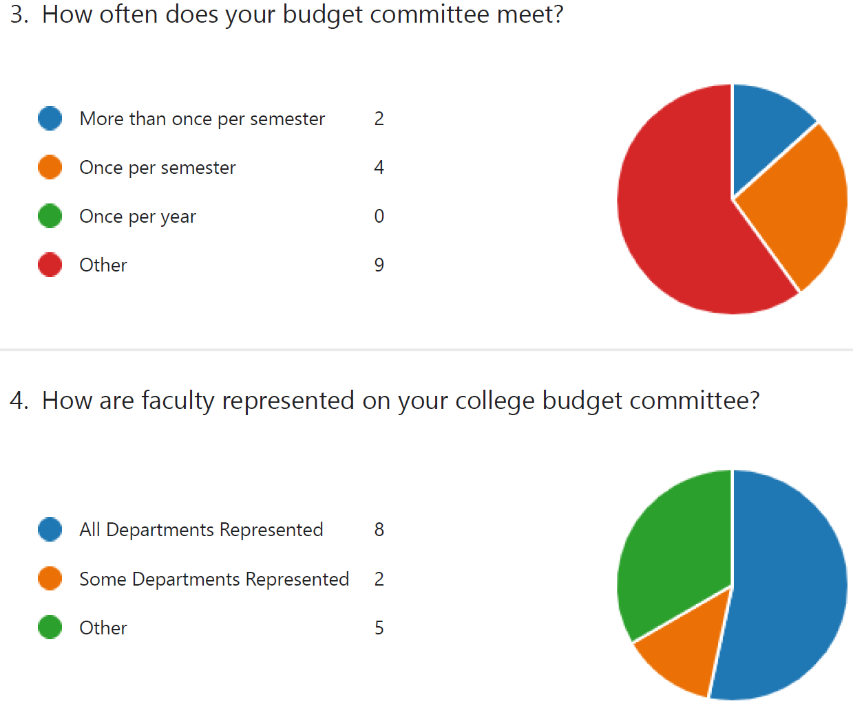

Slide 8
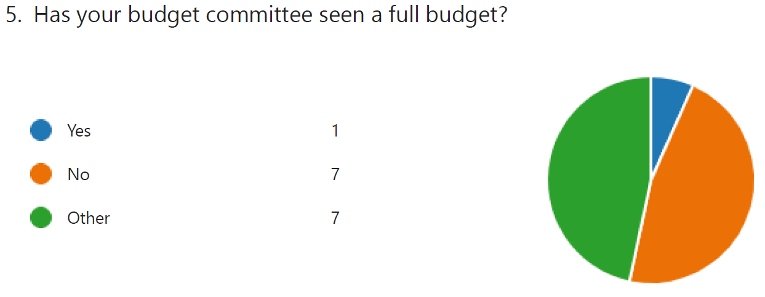
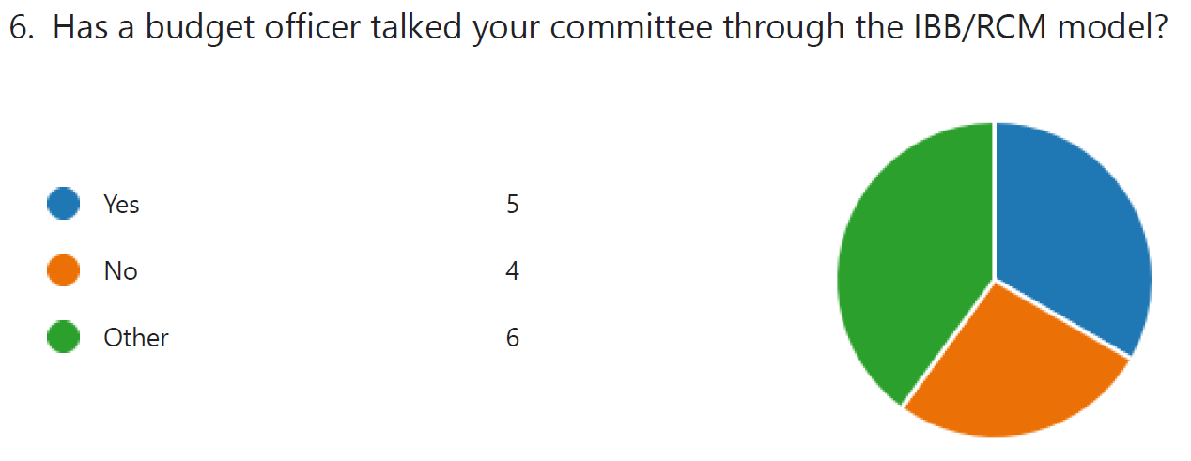

Slide 9
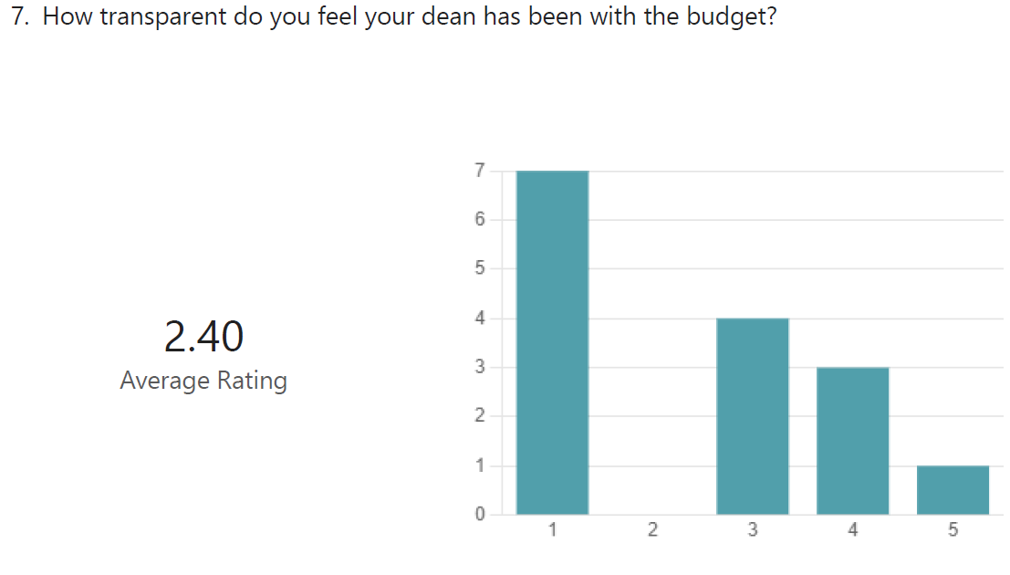

Slide 10
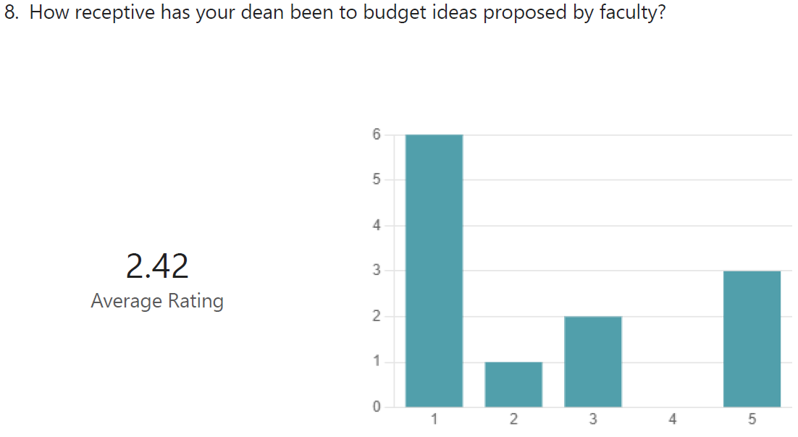

Slide 11
How has this budget impacted your life as a faculty (i.e. teaching/research/service)?

Slide 12
How do your college faculty feel about the radical transparency of the IBB/RCM model?
“Our college has historically presented and discussed budgets at least twice per year with faculty, including having faculty serve on budget committees in preparation of accreditation visits”
“The faculty have requested multiple times to have more transparency in the budgeting process within the college. Implementation of the IBB/RCM model within the budget has never been shared with the faculty”

