Slide 1
Faculty Senate Committee on Student Affairs: Parking Issues Subcommittee: 21 November, 2023
Karen Green, Lucy Duhon,
Deborah Coulter-Harris, Chair

Slide 2
Subcommittee Statement: Our FSCSA Committee has done heroic work responding to student government and other issues for the past 3 years. We have solved many problems, interviewed many underrepresented communities, and even prompted new policies, such as the Policy on Religious Accommodations (#3364-71-30); subcommittees have worked hard the past three years with the Office of Accessibility and Disability Resources to enact changes, worked on COVID related issues, dorm issues, and many, many more. We have always been successful in enacting positive changes. However, our subcommittee on parking issues has failed to negotiate any changes in parking permit and citation fees; we can only relay the information that our 2 meetings produced. We were informed that the enrollment needs to increase beyond the contractually obligated amount as projected in the Concession Agreement (17,419 students in Fall of 2023 with enrollment increasing periodically throughout the 35-year agreement).

Slide 3
Introduction
Persons in Attendance at 11 October, 2023 meeting: Karen Green, Lucy Duhon, Deborah C-H, Michael Dennis, Brian Kulpa.
Persons in attendance at 18 October meeting: Lucy Duhon, Deborah C-H, Brian Kulpa, Sherri Kaspar, Dan Cowgill.
This presentation is to apprise Faculty Senate and the University of Toledo’s Administration on Parking issues that Student Government identified and presented to FSCSA; these issues include:
Cost of permit and violation fees; students left out of decisions.
Ticket forgiveness; create fund for financially insecure students.

Slide 4
Question 1.
Question 1. Is there any possibility annual permit fees can be lowered? “No.” In 2024-2025 student permit fees will be raised $4 (per semester) and faculty permit fees will be raised $14 (for the year).
All current fees cover parking capital expenses/ manage debt.
Michael Dennis and Brian Kulpa stated there is hope: if enrollment increased to 18,000 or above, there may be room then to lower permit and citation fees.
  Rates had not changed between 2011 and 2021 (steady at $125 per semester / $250 per year). Rates were below market and peer rates.
  Student parking permit: $137 per semester / $274 per year

Slide 5
Question 2.
Question 2. How do our permit rates compare to other Ohio universities? As you may observe from the chart below, Toledo is slightly below average regarding the cost of parking permit rates.

Slide 6
Question 3.
Question 3: Could there be no ticketing the first 2 weeks of the semester?
Always possibility to forgive first ticket; no more grace period at start of the term, i.e.“cultural change.”
Willing to forgive ticket if student goes through 30-minute online training.
  Following the concession agreement (CA), first-time forgiveness and the 1-week grace period went away.
  Since ParkUToledo's inception in fall 2021, 61% (students and employees) have received more than one citation.

Slide 7
Question 3. Con’t
Sherri K.: “failure to register” ($61 ticket) is biggest violation (63% of all tickets) followed by “failure to observe:” means violators (not just students) not following rules and instructions posted on signs throughout lots on campus.
  Anyone who has $200 or more in ticket fines will have their car booted. Students tend to be multiple offenders; they receive warning slip first, asking them to contact Parking.
  Sometimes it’s an unknown car or plate that’s in question. (DMV Look-up)

Slide 8
Question 4.
Question 4. Why are people getting ticketed at public events that promote the University of Toledo? Chemistry Department had to cancel “Saturday Morning Science” this year because department has no funds to pay for parking.
All part of concession cost of parking.
  Parking is an option; people can get a permit or drop students off.
  Guests will continue to secure a guest parking permit via the parking portal.https://utoledo.nupark.com/v2/Portal/Login?ReturnUrl=%2Fv2%2Fportal

Slide 9
Question 4. Con’t
  Chemistry Dept. can ask to be the list. But leadership has already decided this list (so may be difficult to change). Perhaps “could share cost with visitors.”
  There are “global days” (freebies for departmental events) (e.g., “football days”). https://www.parkutoledo.com/holidays-and-global-days/?doing_wp_cron=1699367269.4391140937805175781250
  “There is always a cost to parking, even for visitors.”
  Give events@parkutoledo.com as much advance notice as possible regarding parking needs.

Slide 10
Question 5.
Question 5. Are Grad students at UTMC paying more for their permits than student on Main Campus?
All prices are based upon permit types. Medical Student Board negotiated for year permit for their fiscal year ($137 x 3 = $411). Start/ stop dates different than main campus (1 July to 30 June).
Medical permit = $411 (equals same rate annualized as other grad students per term).
Nursing and Pharmacy on MC, grad students pay $137 per semester.

Slide 11
Question 6.
Question 6: Is it true that there were 35,000 tickets (100 per day) issued in 2022? What is the distribution of these tickets over a specific time period?
Yes. Out of 35,000 citations, ParkUtoledo voided 33% via appeals process. (Please see Appendix I. ParkUtoledo Annual Report).
Already 25,000 citations issued for 2023. 30% of these have been forgiven (See Chart 1.) (See Appendix II: Cost of Violations and Non-Ticket Global Holidays).

Slide 12
Question 6. Con’t
63% of all tickets were issued for “failure to register.”
If 2 cars are on 1 permit on campus each car gets a shared permit citation. People can have 4 cars under 1 permit but cannot be on campus at the same time within a 3-hour period.
  Re: shared permits: biggest problem is employees and their college-age kids sharing a vehicle or roommates borrowing vehicles.
  If a car backs in and no plate displayed, ParkUtoledo will waive the first citation if violator reaches out to the ParkUToledo office (via email, phone, appeal, in person).

Slide 13
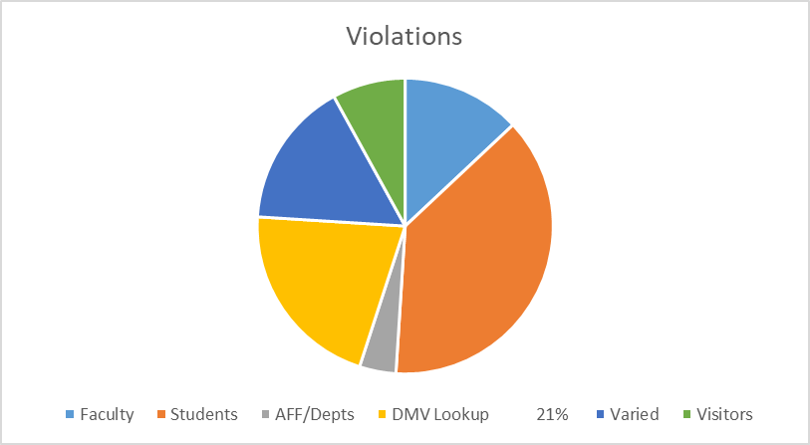
Question 7. (Chart 1)
Question 7. What is the percentage breakdown among students, faculty, staff regarding citations?
Faculty/Staff- 13%
Students- 38%
Affiliates/Departments- 4%
DMV Lookup- 21% **
Varied (Inactive Students, Retirees, Donors)- 16%
Visitors- 8%
**DMV Lookup refers to vehicles parked on campus that are not registered within the ParkUToledo system. In order to issue the citation to the appropriate owner, the DMV Lookup is done to obtain that contact information.

Slide 14
Question 8.
Question 8. People on campus view ParkUtoledo as operating with impunity – no oversight – and view campus community as source of Revenue rather than as consumers of provided services - is this a misconception?
ParkUtoledo is non-profit; UT gets that money. UT gets that money. The budget is very closely monitored and reports are provided to Mike Dennis and Brian Kulpa.
On debt side: ParkUToledo - $7-million improving parking lots over past two years; plans to invest $3-million in upgrades in 2024. All part of concession agreement.

Slide 15
Question 8. Con’t
  Revenue is down because enrollment is down.
    Will probably have to change parking fees to athletic events to bring in more revenue. Currently, ParkUToledo has no impact on athletic parking fees - no athletic fees are passed on to ParkUToledo.
    ParkUToledo operates on calendar year fiscal year; communicates with campus community a lot, e.g., via Rocket Launch, on-campus training/presentations and signage on campus, and via QR Codes for the Park Mobile app on light posts @ parking lot. App uses “Geo Smart” parking system. (See Appendix III. Sherri Kaspar’s Presentation to Faculty Senate: 12 April, 2022)
    Sherri Kaspar & Brian Kulpa agreed: enrollment increases could bring costs down; concession agreement expected 17,419 students in Fall 2023 with enrollment increasing periodically throughout 35-year agreement. Projected decreases in future enrollment may result in annual budget deficits.

Slide 16

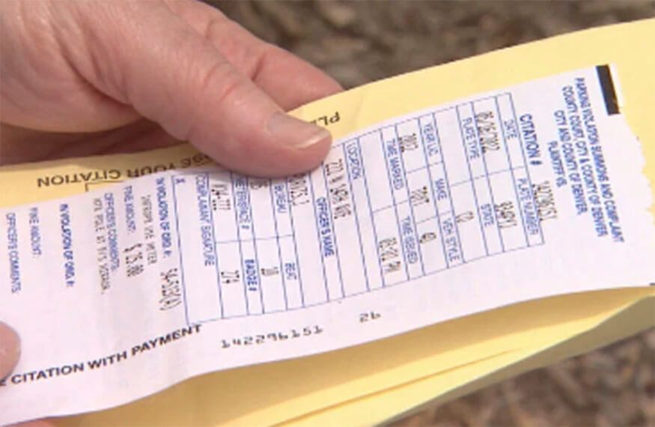
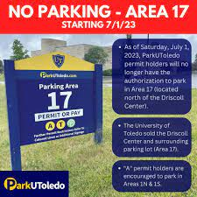
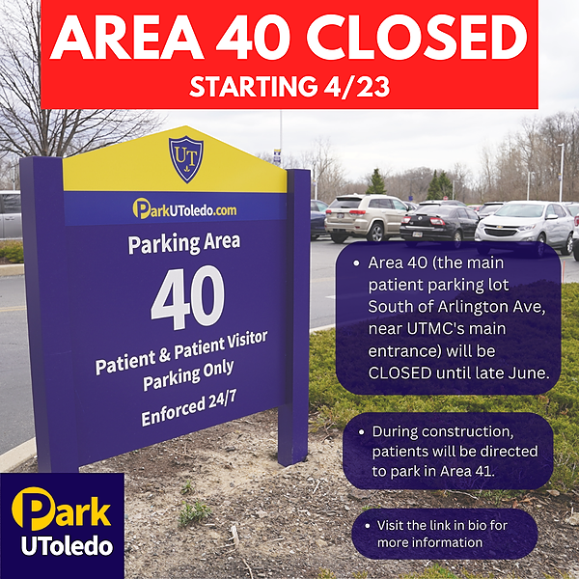
FIN

Slide 17
Appendices
Appendix I. Cost of Violations and Non-Ticket Global Holidays
https://www.parkutoledo.com/citations/
Appendix II. ParkUtoledo Annual Report: Check ParkUToledo’s annual report
ParkUtoledo Annual Report: Check ParkUToledo’s annual report
https://www.parkutoledo.com/wp-content/uploads/parkutoledo_2022_annual_report.pdf
Appendix III. Sherri Kaspar’s Presentation to Faculty Senate: 12 April, 2022
https://www.utoledo.edu/facsenate/docs/Approved%20Faculty%20Senate%20Minutes%20April%2012%202022.pdf

