Slide 1
Faculty Senate Ad Hoc Recruitment and Retention Committee (RRC)
2022 / 2023
April 25, 2023
Final Report

Slide 2
UToledo is facing an existential enrollment crisis
Institutions Making the Right Moves
Fall
Enrollment
(as % of
2015
Numbers)
UToledo
National undergraduate fall enrollment decline slows down
from -3.1% in 2021
to -1.1% in 2022
https://nscresearchcenter.org/stay-informed/
*Data Source: Ohio Department of Higher Education (ODHE) Preliminary Headcount Data
Last Data Point is Based on UToledo’s Fall 2022 Census

Slide 3
Summary of RRC Responsibilities
Review UToledo’s past and present recruitment and retention practices
Benchmark other universities’ student recruitment and retention practices
Identify opportunities to enhance UToledo faculty involvement in the student recruitment and retention process
Define metrics for faculty involvement in student recruitment and retention
Advise University Administrators on the resources needed to enhance collaboration with faculty on recruitment and retention

Slide 4

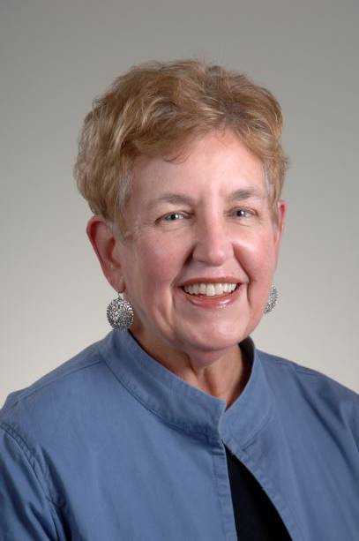
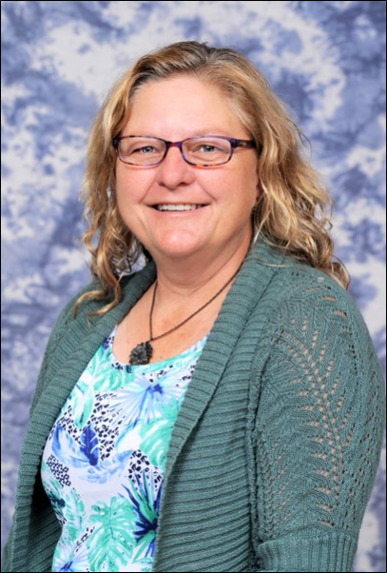
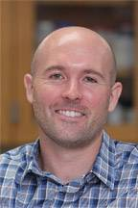
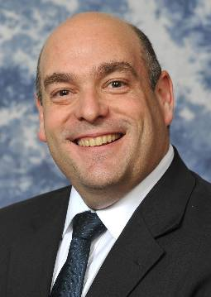
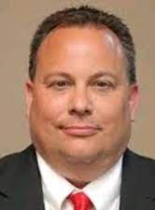
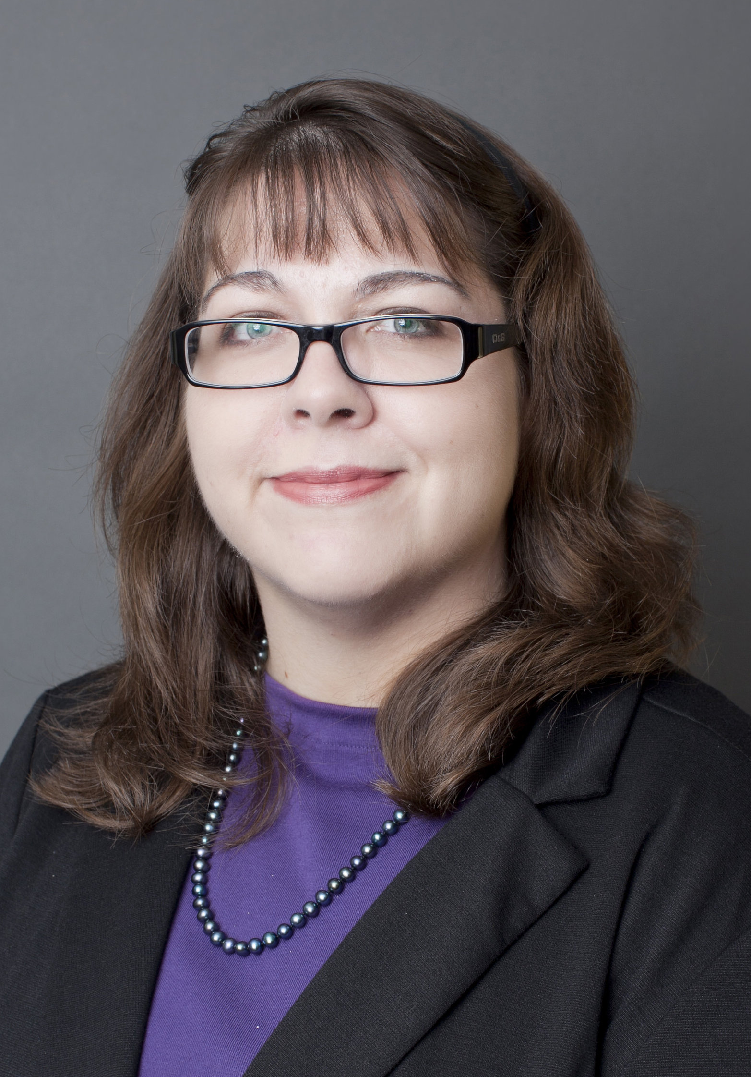
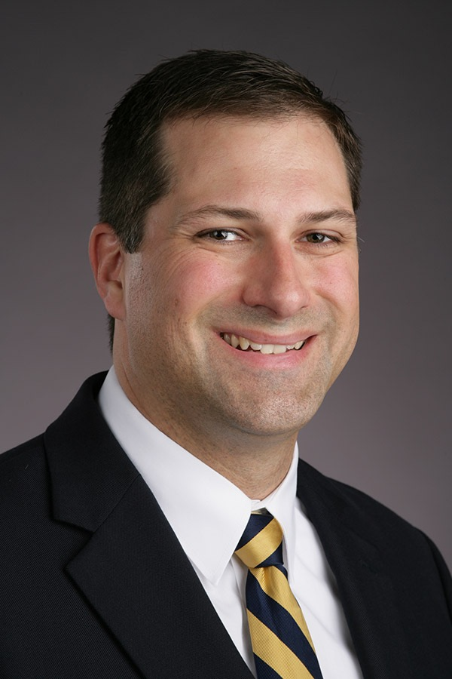
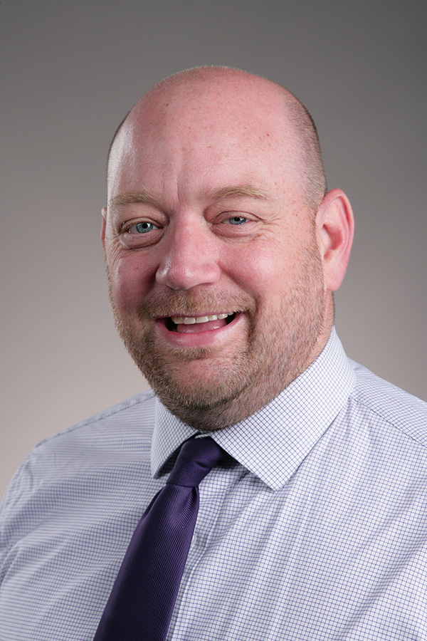
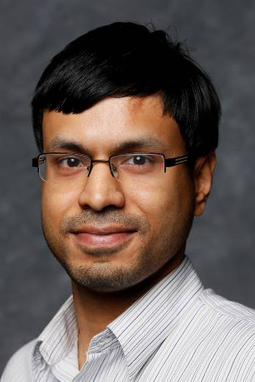
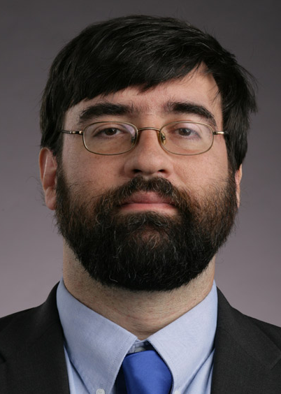

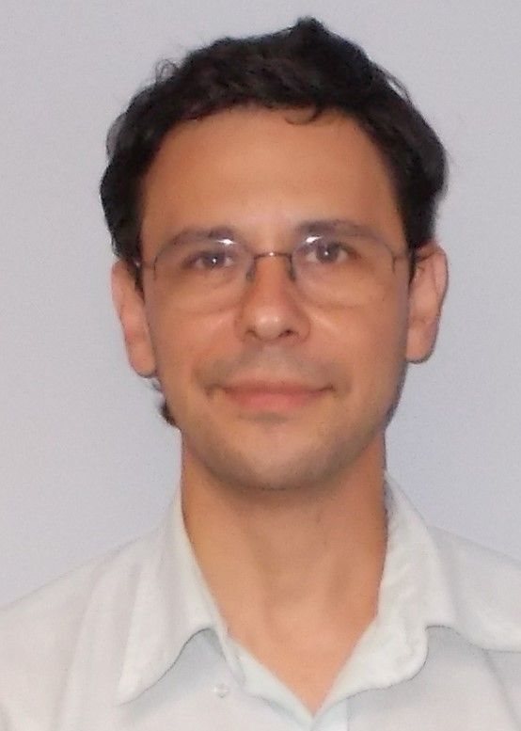
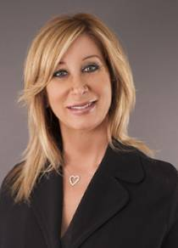
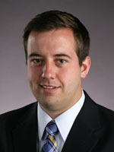
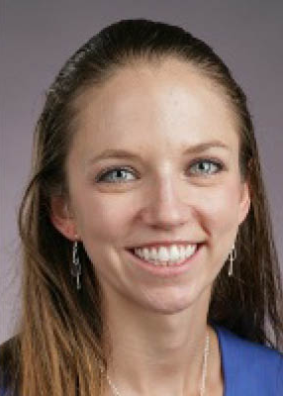
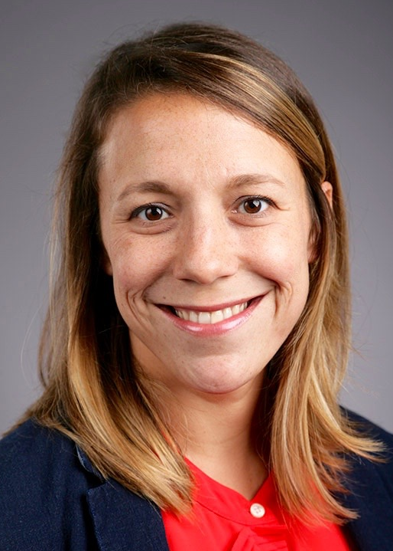

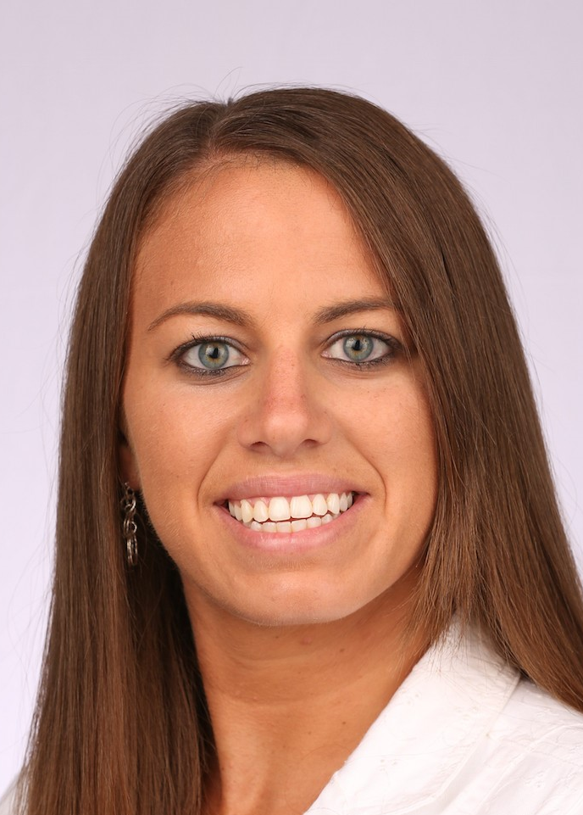

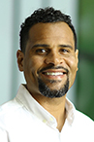
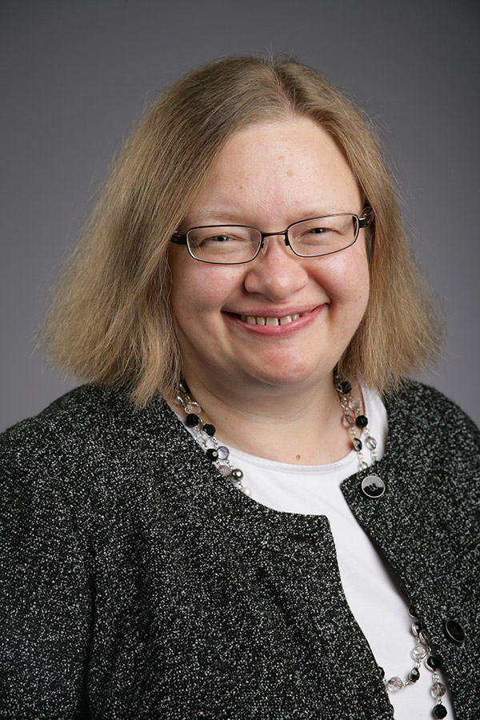
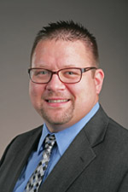
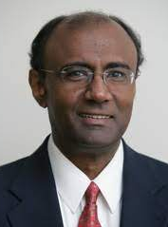
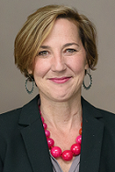
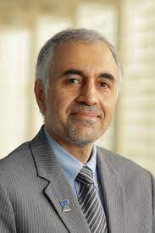

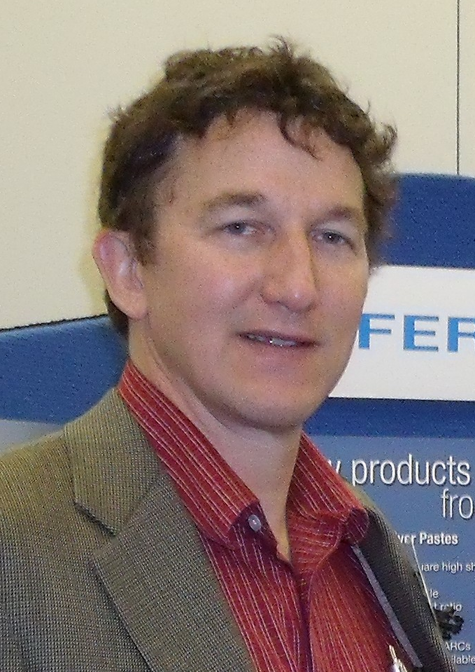
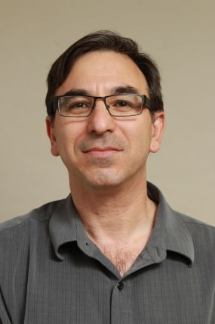
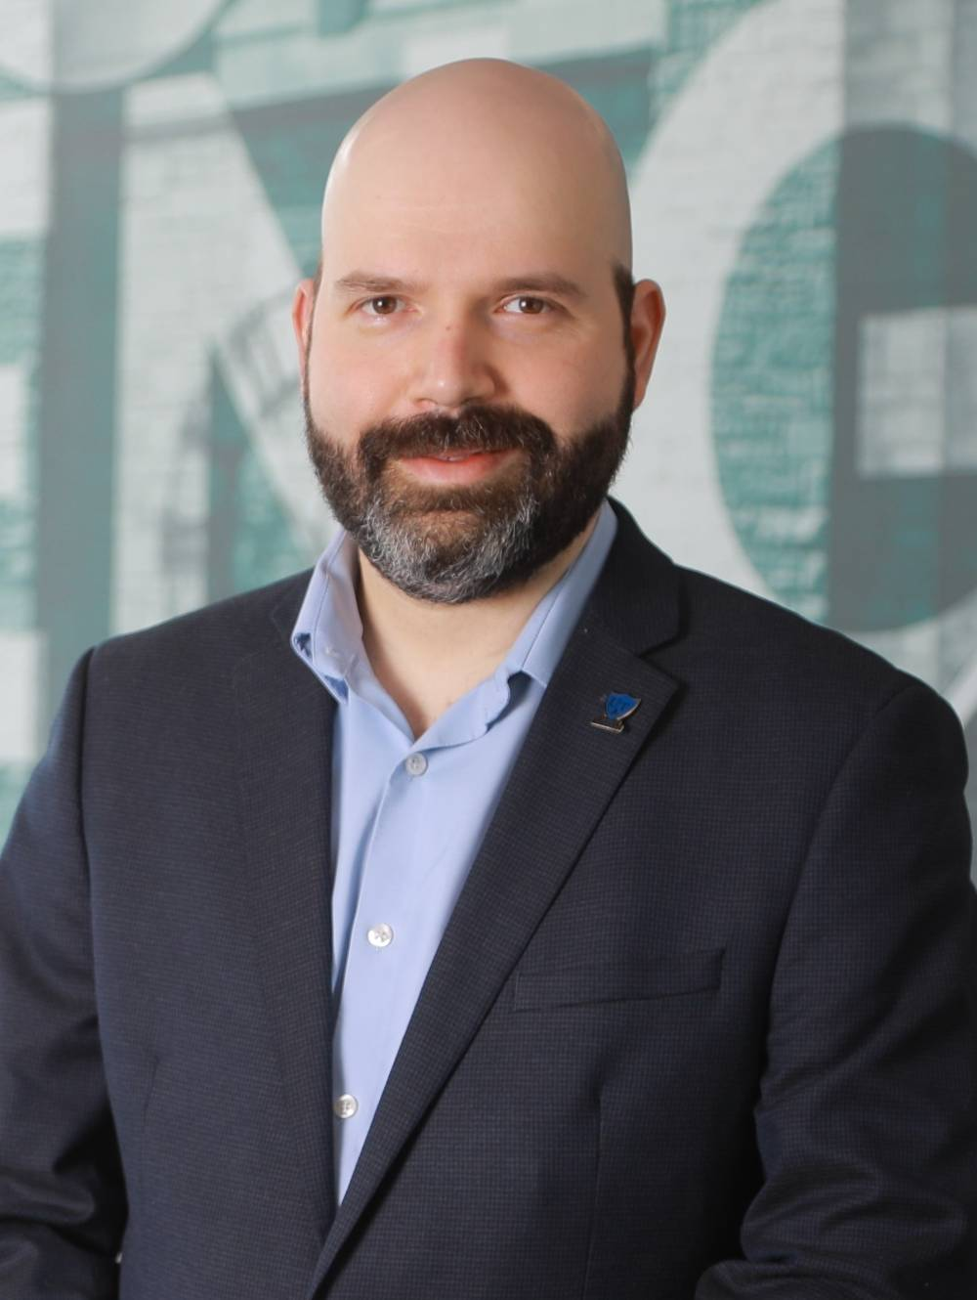
RRC Subcommittee Members
UToledo Recruitment Practices
Peer University Recruitment Practices
Prof. D. McInnis
Humanities
Prof. L. Lewin
Nursing
T. Phares
Bioengineering
Prof. T. McLoughlin
Exercise Sci.
Prof. L. Mata
Eng. Technology
J. Schneiderman
EMS Education
Prof. K. Green
Accounting
Dr. T. Rhodes
Music
Prof. B. Myers
Communication
Prof. A. Ray
Physics
UToledo Retention Practices
Peer University Retention Practices
Prof. S. Wallace
Info. Systems
Prof. J. Desantis
Urology
Prof. A. Spivak
Civil Engineering
Prof. L. Kovach
Education
B. Bosch
Engineering
Prof. S. Robinson
Mathematics
Prof. J. Reynolds
Human Services
Prof. A. Allred
Philosophy
Prof. M. Seegert
Pharmacy
Faculty Engagement
UToledo Value Proposition
Prof. T. Schmitt
Nursing
J.-J. Scott
Upward Bound
Prof. J. Martin
Libraries
Prof. D. Bazett-Jones
Athletic Training
Prof. A. Nadarajah
Bioengineering
Prof. A. Prior
Humanities
Prof. M. Elahinia
MIME
Prof. B. Miner
Dept. of Art
Prof. R. Suliman
Business
Served both in fall and spring semesters
Advisor on
Recruitment
Events
RRC Committee Co-chairs
Prof. M. Heben
Physics
Prof. T. Avidor-Reiss
Biology
Prof. Y. Lapitsky
Chemical Engineering

Slide 5
RRC Timeline
Full RRC Fall semester meetings
September 23: The Recruitment and Retention Committee (RRC) obtained its charge
September 30: Kick-off meeting
October 14: Subcommittees presented their initial plans
November 1: RRC brief report to senate
November 29: RRC preliminary report to senate
Full RRC Spring semester meetings
January 13: Meeting with Dr. Dave Meredith, Vice President for Enrollment Management, and Dr. Adrienne King, Vice President for Marketing and Communications
January 27: UToledo Value Proposition will present their finding to all RRC
February 6: Meeting with Provost Dickson and Angela Paprocki (Chief of Staff for Academic Operations & Associate Vice Provost for Institutional Effectiveness)
February 10: Faculty Engagement will present their finding to all RRC
February 24: Peer University Retention Practices will present their finding to all RRC
March 3: RRC meet Dave Meredith (Vice President for Enrollment Management) & Mary Humphrys (Department of Applied Organizational Technology)
March 10: UToledo Retention Practices will present their finding to all RRC
March 17: Peer University Recruitment Practices will present their finding to all RRC
March 20: Special RRC Meeting on 1:15 Meetings with Dave Garcia
March 31: UToledo Recruitment Practices will present their finding to all RRC
Spring end: RRC final report to senate - Today
There were also many subcommittee meetings throughout the year

Slide 6
Final Findings and Action Items
(For more details see the 34-page final RRC report)

Slide 7
Three strategic areas that need immediate attention
Increasing yield by significantly improving engagement of prospective students after they have made first contact with UToledo, including by mail, face-to-face outreach, and during visits to UToledo
Dramatic improvement in recruitment-related experience by coordinating across various UToledo units and improving communication between administration, faculty, and staff
Reallocation of financial resources toward critical recruitment efforts, including college-based recruiters, campus tours/experience days, university website improvements, and advertisement
These goals should be pursued while
continuing to support policies that enhance retention

Slide 8
Approach: Break down silos and align responsibility with authority
The UToledo must declare solving the enrollment crisis its top priority
To this end, the RRC recommends that one of UToledo’s high-level administrators (e.g., the Provost or Executive Vice President for Enrollment) would have the authority to govern all aspects related to this effort
This administrator will direct all offices related to student recruitment and experience (outside of academics and athletics), including Enrollment Management, Marketing and Communication, Parking and Transportation Services, Dining Services, and others, which often work in silos
  The administrator will coordinate with academics and athletics at a high level
To support their efforts, we propose to form a student, faculty, and staff advisory board that will aid in the continuous improvement of UToledo’s recruitment and retention efforts

Slide 9
UToledo Recruitment Practices
Methods Used:
Review of trends in the numbers of:¹
  Undergraduate applicants
  Admitted students
  Newly enrolled (matriculated) students
  All students enrolled in UToledo (undergraduate and total headcounts)
Discussions on recruitment efforts and recent recruitment (e.g., Experience Day) events with faculty and staff members from diverse UToledo academic units
Review of statewide high school graduation² and public university enrollment³ trends
  Data Sources:
  Banner operational data store (ODS)
  2020 Western Interstate Commission for Higher Ed. report (actual graduate numbers through 2019 and projections thereafter)
  Ohio public university enrollment data from the Ohio Department of Higher Education (ODHE)

Slide 10
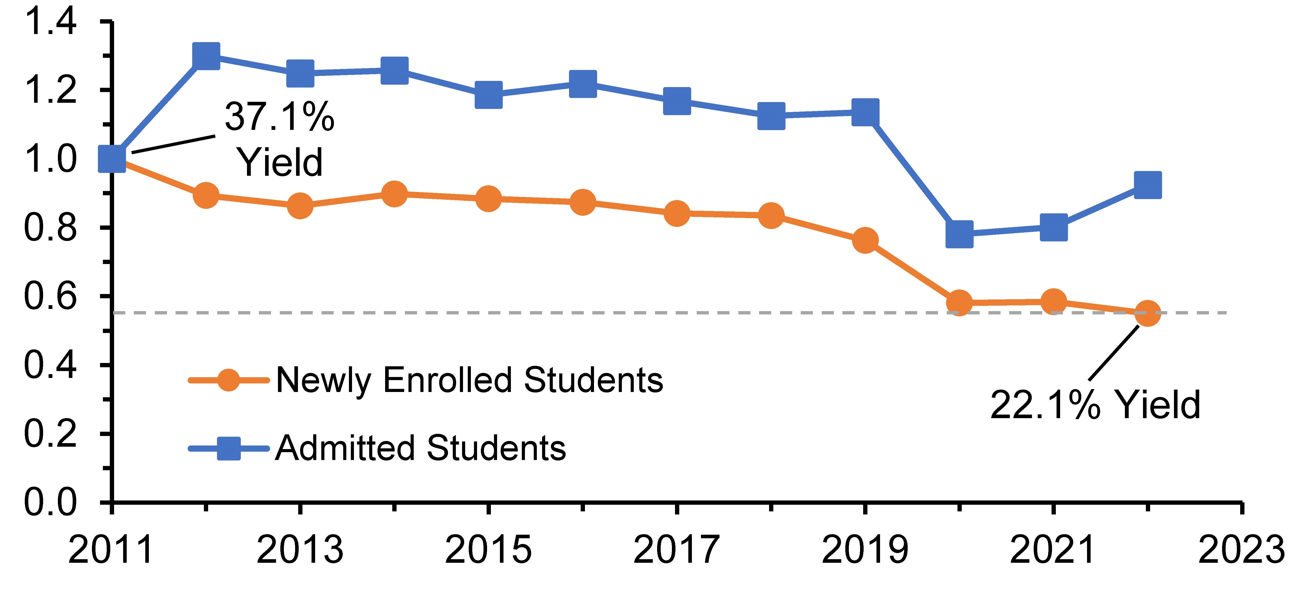
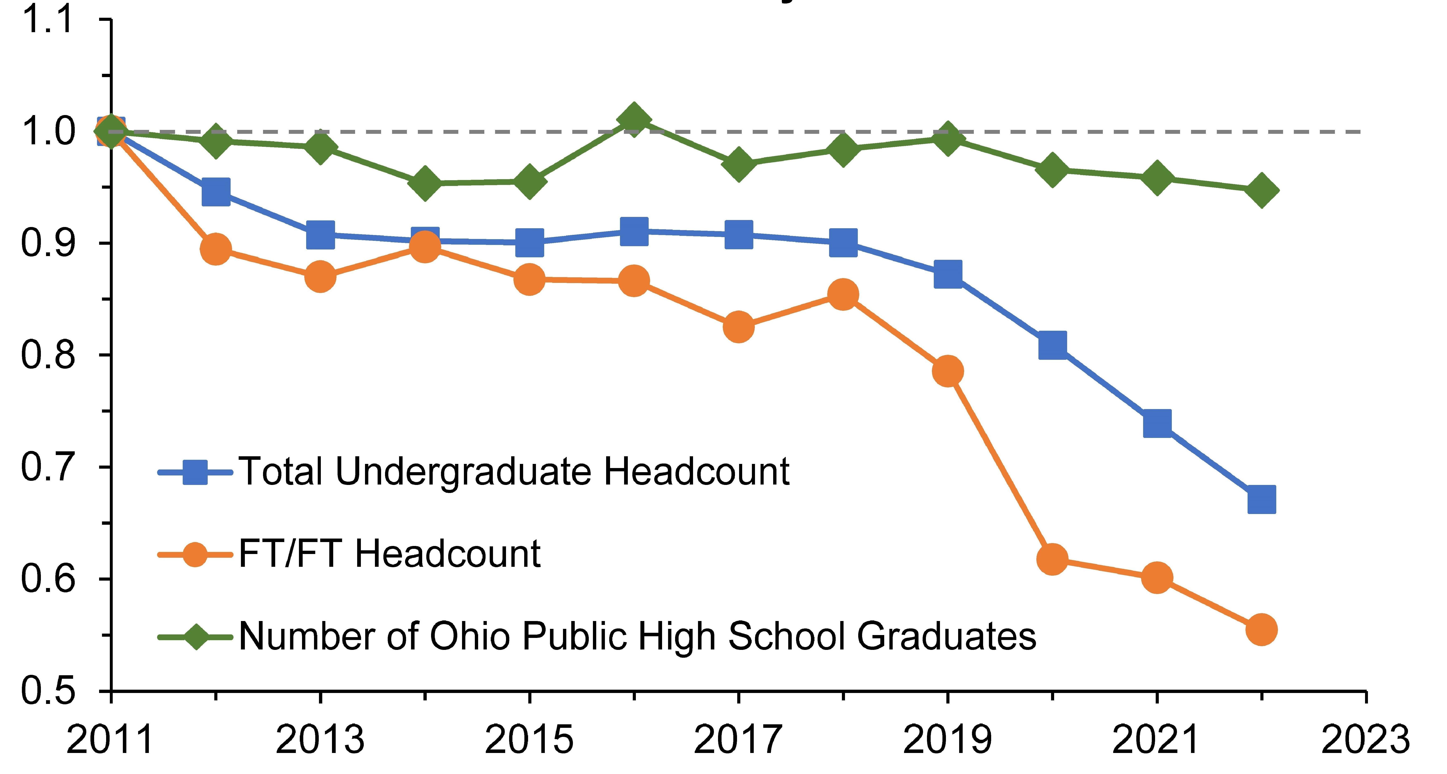
UToledo Recruitment Practices
Key Findings:
Numbers of New Students Joining UToledo Each Fall Have Sharply Declined
UToledo is severely underperforming relative to peers
Between 2011 and 2022, there has been a ~45% decline in newly enrolled students
Normalized # of Students
Data Source: Banner ODS Data
This decline reflects a sharp downturn in the yield of admitted students, which has dropped from ~37% to ~22%
Year
UToledo’s Decline in Enrollment Far Exceeds That in Ohio’s High School Graduates
This decline in new students has decreased the total student headcount from 22,610 to 15,603 (despite the retention rates rising from 62% to 75%)
Normalized # of Students
Crucially, the drop in total undergraduate enrollment and newly enrolled first-time students far exceeds the reduction in Ohio’s high school graduates
First-Time Student Headcount
Year
Data Sources: Institutional Research historical enrollment, retention and graduation rate reports and (for the HS graduate numbers) the Western Interstate Commission for Higher Education (www.knocking.wiche.edu)

Slide 11
UToledo Recruitment Practices
Apparent causes contributing to this decline:
Poor communication between UToledo’s recruitment office and academic units contributing to uncompetitive sales pitches and on-campus recruitment events
Inadequate MarComm support (inconsistent/slow response to requests)
Insufficient engagement/communication with students in the enrollment funnel
Notably, the sharper declines in enrollment correlate with a recruitment strategy change from college-dedicated recruiters to centralized recruiters
Main Conclusion
UToledo must abandon the narrative of the declines in enrollment being caused by shifts in the demographics and focus on making its recruitment strategies more competitive

Slide 12
UToledo Recruitment Practices
Recommendations:
Strengthen communications between Enrollment Services and academic units
Increase faculty/academic unit communication with recruiters to provide them with accurate, up-to-date program information
Employ over-communication/critical redundancies in communication between Enrollment Management and academic programs
Enhance Enrollment Management and MarComm’s responsiveness to inquiries/requests from UToledo’s academic programs/faculty
Increase staffing of UToledo’s recruiting efforts/events
Provide Colleges with dedicated recruiters
Strengthen engagement of high school students by recruiters, interested faculty, and members of student organizations
Strengthen engagement of high school students by recruiters, interested faculty, and members of student organizations
Increase incentives for UToledo tour guides and student recruitment event volunteers
Tailor on-campus visits to demonstrate UToledo’s student-centeredness
Schedule tours at times that increase UToledo student and faculty availability
Provide free parking for all admissions-related visits
Enhance academic program marketing to transfer students and adult learners
Leverage remote/hybrid course formats to increase program appeal to adult learners
Broaden opportunities for professional license renewal-focused continued education
Broaden opportunities for professional license renewal-focused continued education
Offer micro-courses that can be applied toward degree requirements
Develop additional community college affiliations

Slide 13
Peer University Recruitment Practices
Methods Used:
Analyze/compare peer university/competitor websites (overall appearance and numbers of clicks needed to schedule visits)
Reach out to personal connections at other universities
Be a secret shopper and request information from peer universities/competitors (along with UToledo for comparison)
Survey of UToledo faculty with household members looking at colleges (59 total responses)

Slide 14
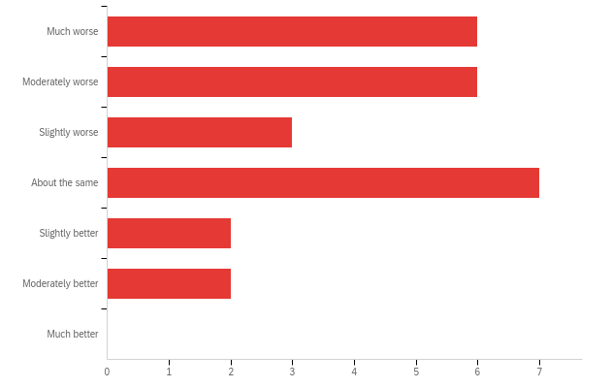
Peer University Recruitment Practices
Key Findings:
UToledo’s Campus Tours Compared to Other Universities
UToledo uses many of the same recruiting tactics as peer institutions but is uncompetitive in their execution
Much worse
Moderately worse
Slightly worse
About the same
Specific areas of concern include:
Slightly better
Moderately better
Uncompetitive quality of campus tours
Much better
0 1 2 3 4 5 6 7
Slow and impersonal communication with students in the enrollment funnel
Number of Responses
Relatively few campus visit opportunities
Lackluster website relative to nearby institutions (e.g., BGSU and EMU)
Weak branding of UToledo’s academic programs

Slide 15
Peer University Recruitment Practices
Recommendations:
Increase competitiveness of UToledo’s advertising efforts
Strengthen branding/advertisement of individual UToledo programs
Enhance advertisement of student activities and the overall college experience in the City and University of Toledo
Regularly update marketing materials/stop distributing outdated handouts
Add short videos to UToledo’s website with information on and highlights of campus life
Increase outreach to high school students in Northwest Ohio/Southeast Michigan, including prospective college credit plus (CCP) students
Increase competitiveness of UToledo’s campus visits
Add a greater personal touch to campus visits (e.g., engage visitors one-on-one rather than showing them UToledo commercials)
Ensure that campus tours are staffed with excited personnel who are knowledgeable about dorms, financial aid, etc.
Provide free parking for all admissions-related visits
Improve communication with students in the enrollment funnel
Increase quantity/consistency of communication with prospective and admitted applicants
Modernize communication modalities to include texting and personalized videos

Slide 16
Peer University Recruitment Practices
Recommendations:
Increase competitiveness of UToledo’s advertising efforts
Strengthen branding/advertisement of individual UToledo programs
Enhance advertisement of student activities and the overall college experience in the City and University of Toledo
Main Conclusion
Regularly update marketing materials/stop distributing outdated handouts
UToledo should increase engagement and communication consistency with high school students and improve its campus visit programs and website
Add short videos to UToledo’s website with information on and highlights of campus life
Increase outreach to high school students in Northwest Ohio/Southeast Michigan, including prospective college credit plus (CCP) students
Increase competitiveness of UToledo’s campus visits
Add a greater personal touch to campus visits (e.g., engage visitors one-on-one rather than showing them UToledo commercials)
Ensure that campus tours are staffed with excited personnel who are knowledgeable about dorms, financial aid, etc.
Provide free parking for all admissions-related visits
Improve communication with students in the enrollment funnel
Increase quantity/consistency of communication with prospective and admitted applicants
Modernize communication modalities to include texting and personalized videos

Slide 17
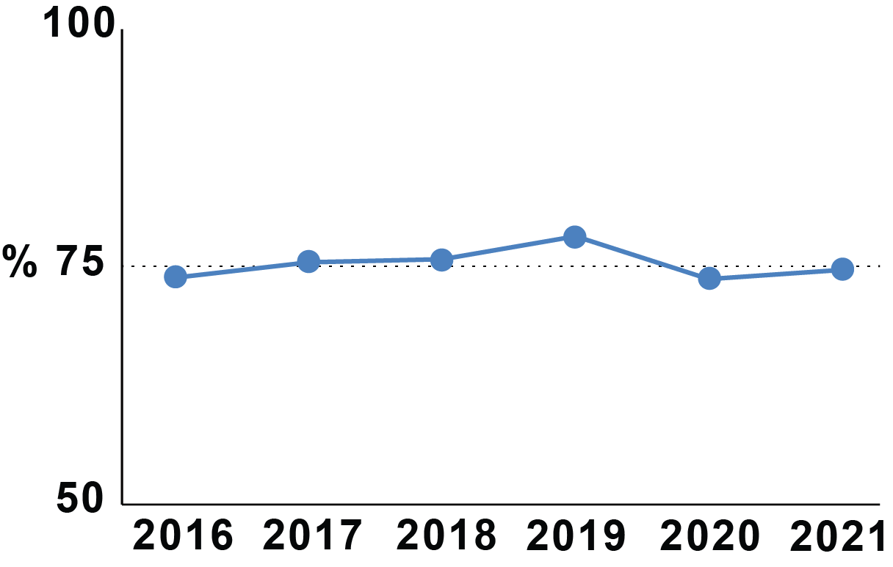
  UToledo’s Retention Practices
Data collection:
Data collection:
Source: Ohio Department of Higher Education (ODHE) data on first- to second-year retention of first-time, full-time, degree-seeking freshmen
Discussion with Deans’ Offices and other stakeholders identified more than 40 issues
Key Findings:
Key Findings:
Primary Issues
Many unretained students are:
  Improperly prepared for STEM gateway classes
  Lack of college-level writing skills
  Unable to continue paying for tuition, fees, or room & board
  Lack of sense of belonging
Secondary Issues
  Insufficient parking
  Inadequate dorm conditions
  Limited dining options
UToledo's first year retention rates for 2016 – 2021 ranges between 73-78%
Plateau
Insufficient Parking: Sample Social Media Posts:
"25 minutes of trying to find a parking spot …looks like I’m skipping today"
"Is it even possible for me to come to class today? Like is there anywhere to park on campus?"

Slide 18
  UToledo’s Retention Practices Continued
Recommendations:
Remediation
Provide programs more control on classes out of the major
Review and update remediation classes and programs
Policies and procedures need to be student-centered
Inform faculty/staff about retention issues
Modify placement exams to reflect the student's skills
Place students in the proper level-based performance in introductory courses
Provide more help and tutoring for select STEM classes
Retention issues should be the responsibility of all university stakeholders, not only faculty
Increase student sense of belonging
1. Expand student mentor/ambassador programs (beyond the first year)
2. More student programming, including activities during the weekend to combat isolation
3. More success coaches and advisors to handle the high number of at-risk students
4. More support for student groups to help create much-needed student communities
Financial needs, dorms, and dining
1. Better assessments for identifying students with financial needs
2. More oversight on the dorms and fixing dorm issues promptly
3. More dining options. More hours and more places to eat
Parking
1. Provide more information about parking issues
2. Better alternative than towing students’ car (paying $150 to the tow lot)

Slide 19
  UToledo’s Retention Practices Continued
Recommendations:
Remediation
Provide programs more control on classes out of the major
Review and update remediation classes and programs
Policies and procedures need to be student-centered
Inform faculty/staff about retention issues
Modify placement exams to reflect the student's skills
Place students in the proper level-based performance in introductory courses
Provide more help and tutoring for select STEM classes
Retention issues should be the responsibility of all university stakeholders, not only faculty
Increase student sense of belonging
1. Expand student mentor/ambassador programs (beyond the first year)
2. More success coaches and advisors to handle the high number of at-risk students
3. More student programming, including activities during the weekend to combat isolation
4. More support for student groups to help create much-needed student communities
Financial needs, dorms, and dining
1. Better assessments for identifying students with financial needs
2. More oversight on the dorms and fixing dorm issues promptly
3. More dining options. More hours and more places to eat
Parking
1. Provide more information about parking issues
2. Better alternative than towing students’ car (paying $150 to the tow lot)
Main Conclusion
UToledo student retention can be improved by providing students with (1) better preparation for STEM gateway classes and college-level writing, (2) an increased sense of belonging, and (3) more help with overcoming financial barriers

Slide 20
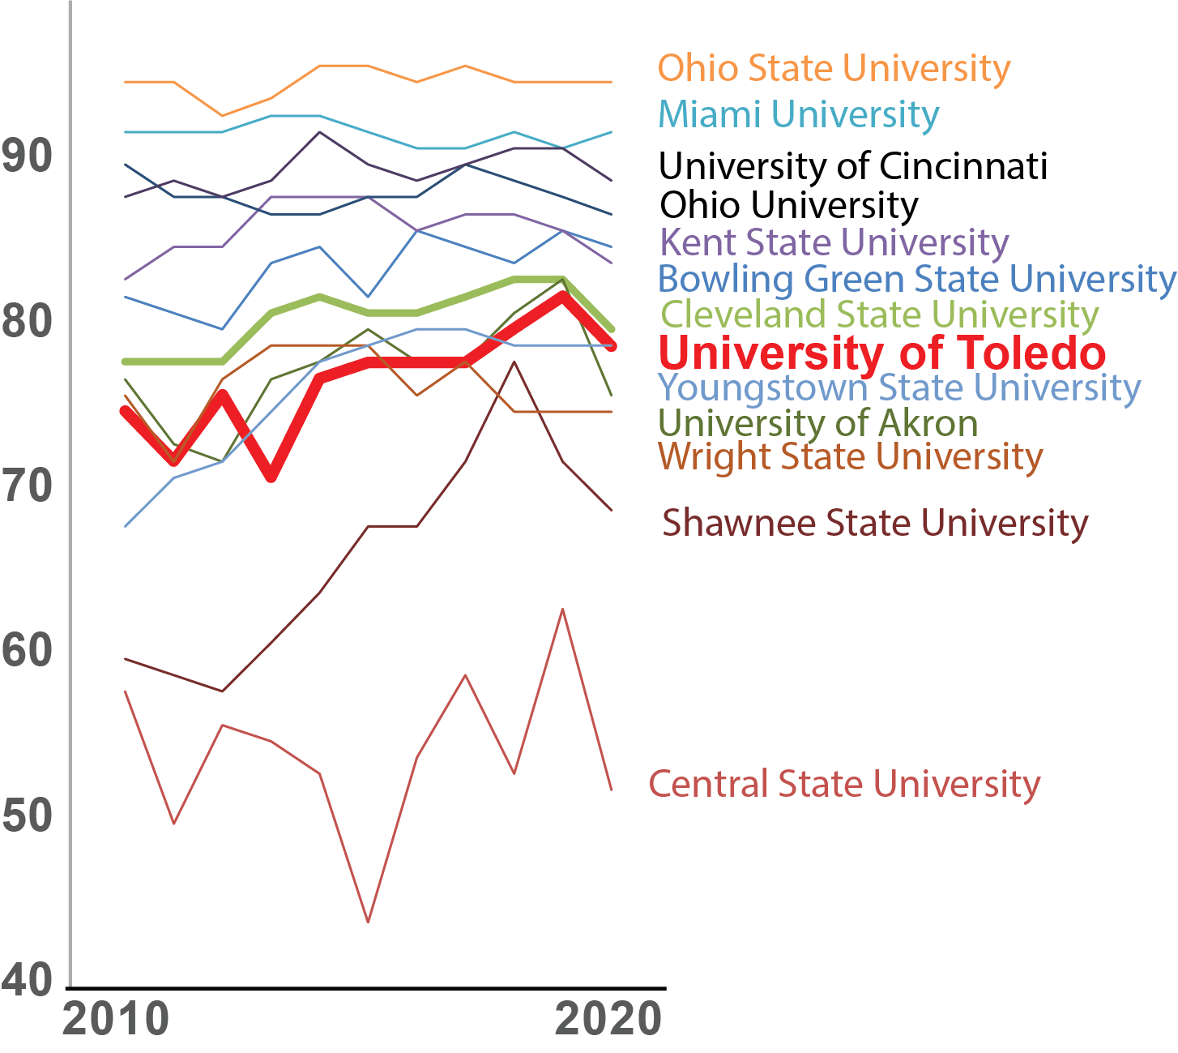
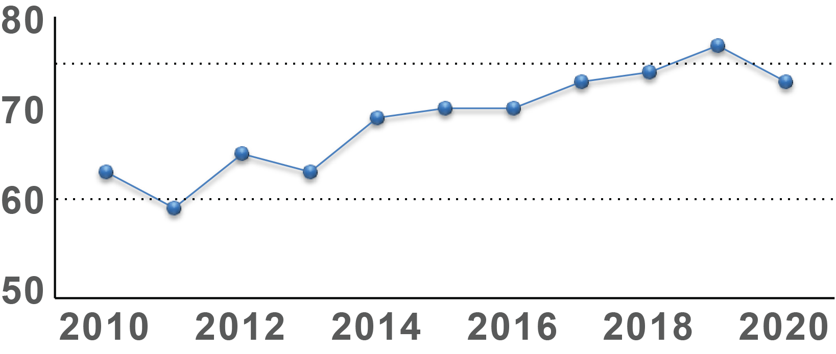
  Peer University Retention Practices
Data collection:
Key Findings:
Source: Ohio Department of Higher Education (ODHE) data on first- to second-year retention of first-time, full-time, degree-seeking freshmen
UToledo’s retention rate is:
Comparable to institutions with similar acceptance rates
Below average compared to all 4-year Ohio institutions
Toledo's persistence rates
for 2010 – 2020
increased by ~15% but plateau in the last 5 years around 75%
Plateau

Slide 21
  Peer University Retention Practices
Data collection:
A survey to 23 peer institutions inquired about best practices for improving retention and ways to increase the faculty role and interest in this area
  Received 6 responses from faculty across 5 institutions
Recommendations:
Raise the debt threshold that prevent students from enrolling
UToledo should apply retention efforts across all colleges with college-specific adaptations
College administration should work with faculty to design faculty-specific, intentional activities to promote retention
Provide each college with retention specialists to work with departments and faculty
Create the ability for colleges to flag and connect with students that have dropped most or all courses within a semester.
Increase faculty responsiveness and personal attention to students.
Create more opportunities for students and faculty to learn from each other and engage with one another inside and outside of the classroom.
Provide Undergraduate to Graduate research opportunities.
Creating a portal to match students to lab openings.
Creating short-term research opportunities to increase “graduate-like” research.
Create incentives and promotion for students to utilize the tutoring center.
Create incentives and promotion for students to utilize success coaches.
Create opportunities to drop down to a preceding foundational course to improve skills when difficulty within coursework is identified early in the semester
Faculty and staff contributing to these efforts should be compensated and/or their efforts outlined in workload to demonstrate the value of their time and work and encourage more participation.

Slide 22
  Peer University Retention Practices
Data collection:
A survey to 23 peer institutions inquired about best practices for improving retention and ways to increase the faculty role and interest in this area
  Received 6 responses from faculty across 5 institutions
Recommendations:
Main Conclusion
Raise the debt threshold that prevent students from enrolling
UToledo should apply retention efforts across all colleges with college-specific adaptations
College administration should work with faculty to design faculty-specific, intentional activities to promote retention
Provide each college with retention specialists to work with departments and faculty
Create the ability for colleges to flag and connect with students that have dropped most or all courses within a semester.
Increase faculty responsiveness and personal attention to students.
Create more opportunities for students and faculty to learn from each other and engage with one another inside and outside of the classroom.
Provide Undergraduate to Graduate research opportunities.
Creating a portal to match students to lab openings.
Creating short-term research opportunities to increase “graduate-like” research.
Create incentives and promotion for students to utilize the tutoring center.
Create incentives and promotion for students to utilize success coaches.
Create opportunities to drop down to a preceding foundational course to improve skills when difficulty within coursework is identified early in the semester
Faculty and staff contributing to these efforts should be compensated and/or their efforts outlined in workload to demonstrate the value of their time and work and encourage more participation.
UToledo’s administration, faculty, and staff can significantly improve student retention by having more open cross-campus dialogue and a collective sense of urgency.

Slide 23
Faculty Engagement
Data collection:
UToledo member survey inquired about their willingness to participate in recruitment and retention activities, and their informedness about and invitedness to partake in these activities
A total of 159 faculty members and 5 staff members responded to the survey
63 individuals indicated their willingness to participate in focus groups and 7 faculty participated in them
Key findings from survey:
Over 80% of faculty indicate that they are willing to participate in recruitment activities and over 90% of faculty indicate that they are willing to participate in retention activities
Only 52% of faculty agree that they are informed about recruitment activities and only 54% of faculty agree that they are informed about retention activities
Only 65% of faculty agree that they have been invited or encouraged to participate in recruitment or retention activities

Slide 24
Faculty Engagement
Key findings from focus groups:
Many faculty are interested in participating in both recruitment and retention activities as they understand they play a role in these endeavors
Faculty feel like they could be better informed
  Limited communication from event organizers
  This limited communication often happens last minute (creates frustration)
  Faculty do not know whom to ask or where to obtain information about these opportunities
Many faculty indicate that they have never been asked to participate or told that they were important to these efforts
Key recommendations:
Each College should have 2 positions to coordinate recruitment and retention-related efforts
  A College Recruiter (a staff position)
  A Recruitment & Retention Coordinator (a designated faculty member)
  Both will work together to coordinate recruitment events and communicate with administrators and faculty about enrolment-related opportunities
Improve availability of resources for faculty on retention improvement

Slide 25
Faculty Engagement
Key findings from focus groups:
Many faculty are interested in participating in both recruitment and retention activities as they understand they play a role in these endeavors
Faculty feel like they could be better informed
  Limited communication from event organizers
  This limited communication often happens last minute (creates frustration)
  Faculty do not know whom to ask or where to obtain information about these opportunities
Many faculty indicate that they have never been asked to participate or told that they were important to these efforts
Main Conclusion
Many faculty/staff members are willing to and interested in participating in recruitment and retention activities, but many feel uninformed and do not feel invited to partake in these efforts; interested faculty members may be redeployed toward recruitment and retention initiatives.
Key recommendations:
Each College should have 2 positions to coordinate recruitment and retention-related efforts
  A College Recruiter (a staff position)
  A Recruitment & Retention Coordinator (a designated faculty member)
  Both will work together to coordinate recruitment events and communicate with administrators and faculty about enrolment-related opportunities
Improve availability of resources for faculty on retention improvement

Slide 26
UToledo’s Value Proposition
Data collection:
Wide-ranging discussions with faculty and deans from all the UToledo colleges about our core advantages
Recommendations:
Implementing a hybrid recruitment effort, both University-level and College-specific with a unified value proposition message
Use a University-wide and College-specific value proposition called the PPP Plan, based on three values: Practical, Partnership, and Place
The plan should be distributed to faculty and recruiters for use and continued improvement

Slide 27
UToledo’s Triple Value Proposition (PPP)
Practical: We are a university that emphasizes the practical side of education, with a strong emphasis on hands-on learning in every major, but also emphasizing the need for creativity
Partnership: We believe education is a partnership between faculty and students, with strong mentorship and high expectations
Place: We are an urban institution that is strongly engaged with the community, the Greater Toledo Area and Northwest Ohio & Southeast Michigan, but also open to, and interacting with the rest of Ohio, the country, and the world. This is reflected in the majors we offer, our emphasis on internships, and our commitment to diversity
Four colleges developed
college-specific value propositions:
- College of Engineering
- Neff College of Business and Innovation
- College of Arts and Letters
- College of Pharmacy

Slide 28
UToledo’s Triple Value Proposition (PPP)
Practical: We are a university that emphasizes the practical side of education, with a strong emphasis on hands-on learning in every major, but also emphasizing the need for creativity
Partnership: We believe education is a partnership between faculty and students, with strong mentorship and high expectations
Place: We are an urban institution that is strongly engaged with the community, the Greater Toledo Area and Northwest Ohio & Southeast Michigan, but also open to, and interacting with the rest of Ohio, the country, and the world. This is reflected in the majors we offer, our emphasis on internships, and our commitment to diversity
Main Conclusion
UToledo should adopt university- and college-wide PPP value proposition plans and implement a hybrid recruitment strategy (blending centralized/university-level and college-level approaches).
Four colleges developed
college-specific value propositions:
- College of Engineering
- Neff College of Business and Innovation
- College of Arts and Letters
- College of Pharmacy

Slide 29
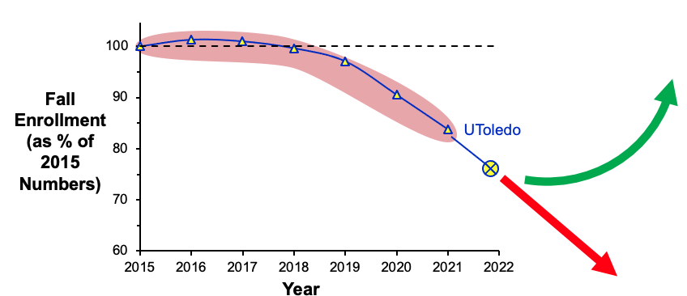
Summary of Findings
UToledo’s losses in undergraduate student enrollment are primarily caused by a sharp reduction in yield of enrolling students
UToledo recruitment is underperforming relative to peers; reduction correlates with UToledo’s currently uncompetitive recruitment practices
To reverse these trends, the RRC’s final recommendations are to:
Strengthen communications between Enrollment Services and academic units
Improve staffing of UToledo’s recruiting efforts/events
Tailor on-campus visits to demonstrate UToledo’s student-centeredness
Appoint a
senior administrator
and a student and faculty
advisory board
to oversee these efforts

Slide 30
Recommendation to Next Year’s Senate
Reconstitute the RRC during AY 2023/2024 to follow up with and assist the administration with adapting this year’s RRC recommendations

Slide 31
Subcommittees’ Main Conclusions
Questions?
UToledo must abandon the narrative of the declines in enrollment being caused by shifts in the demographics and focus on making its recruitment strategies more competitive
UToledo should increase engagement and communication consistency with high school students and improve its campus visit programs and website
UToledo student retention can be improved by providing students with (1) better preparation for STEM gateway classes and college-level writing, (2) an increased sense of belonging, and (3) more help with overcoming financial barriers
With a more open cross-campus dialogue and a collective sense of urgency, UToledo’s administration, faculty, and staff can significantly improve student retention
Faculty/staff members are willing to and interested in participating in recruitment and retention activities, but many feel uninformed and/or do not feel invited to partake in these efforts; interested faculty members may be redeployed toward recruitment and retention initiatives
UToledo should adopt university- and college-wide PPP value proposition plans and implement a hybrid recruitment strategy (blending centralized/university-level and college-level approaches)

Slide 32
End

