Slide 1
Faculty Senate Ad Hoc Recruitment and Retention Committee (RRC)
2023 / 2024
August 29, 2023
Brief Update

Slide 2
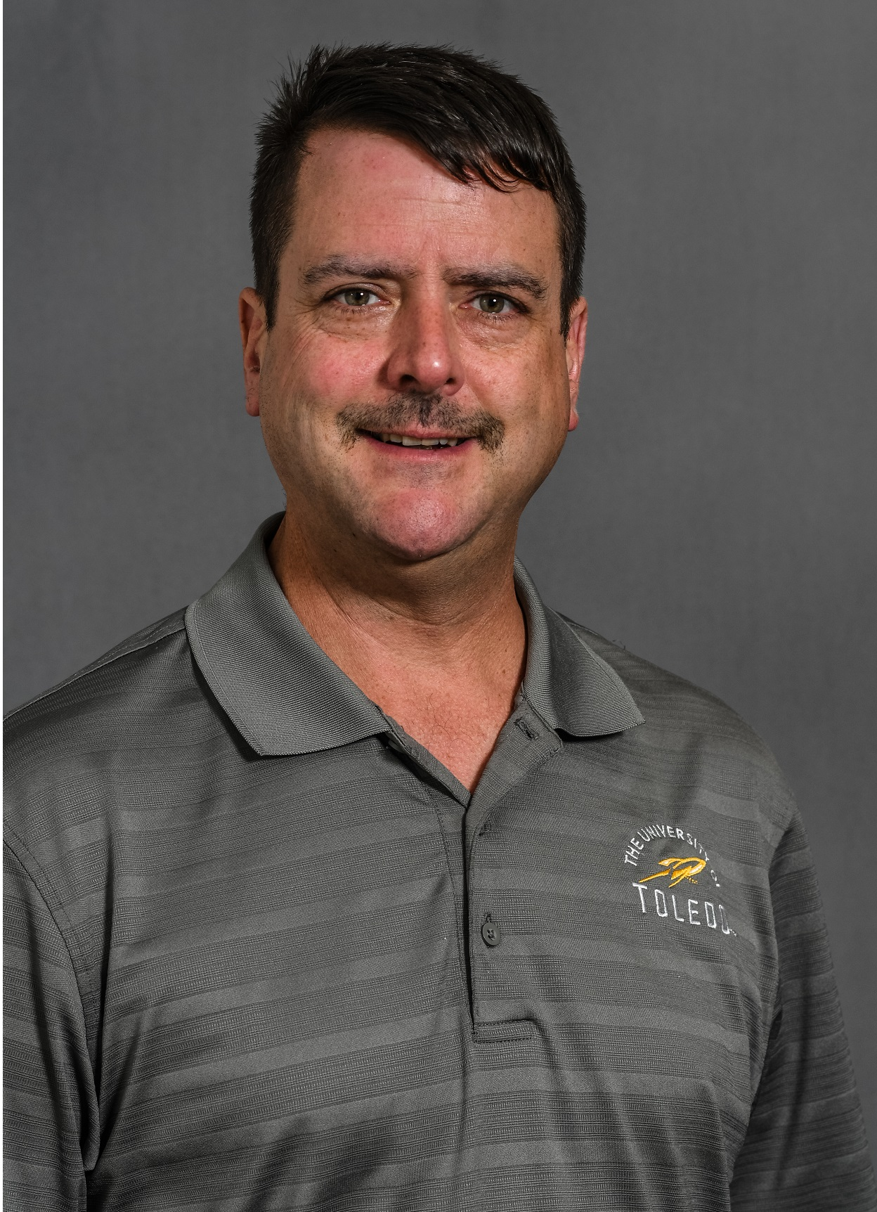
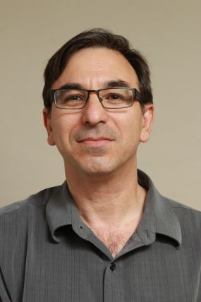
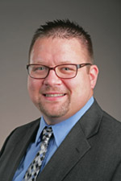
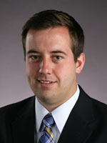
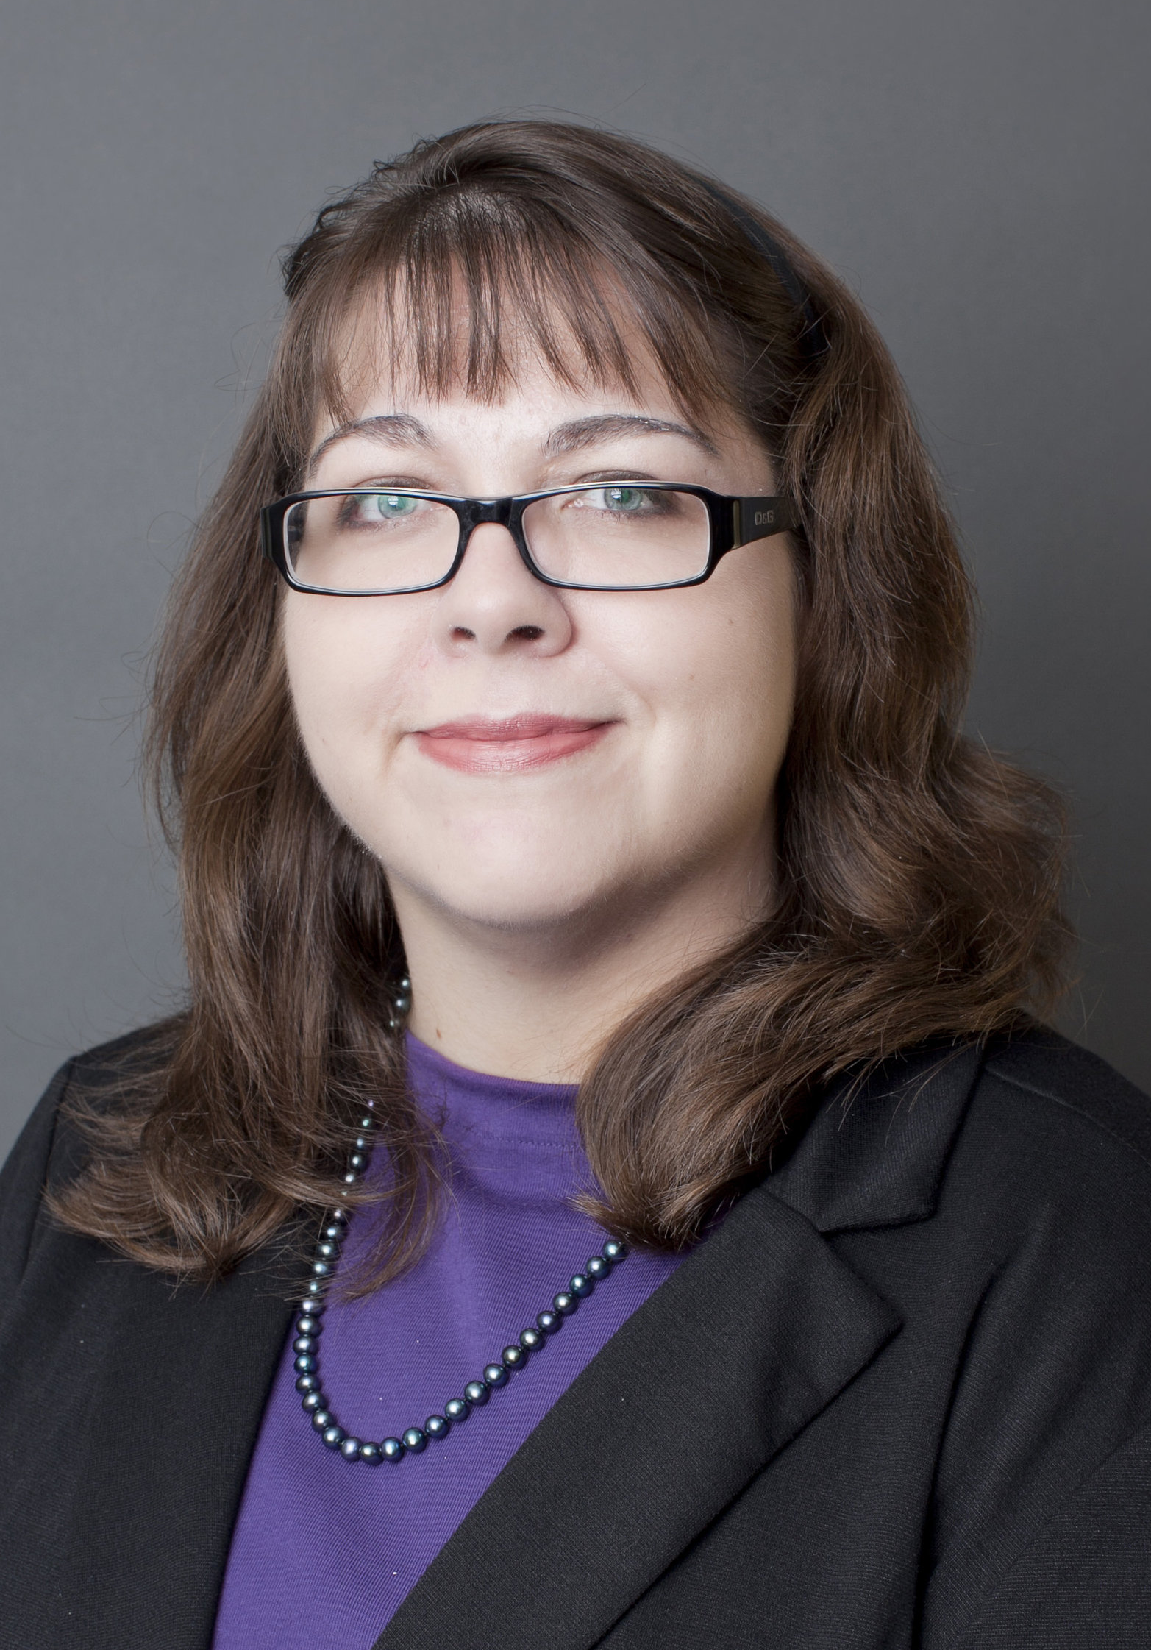
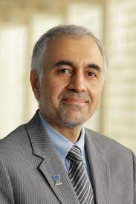
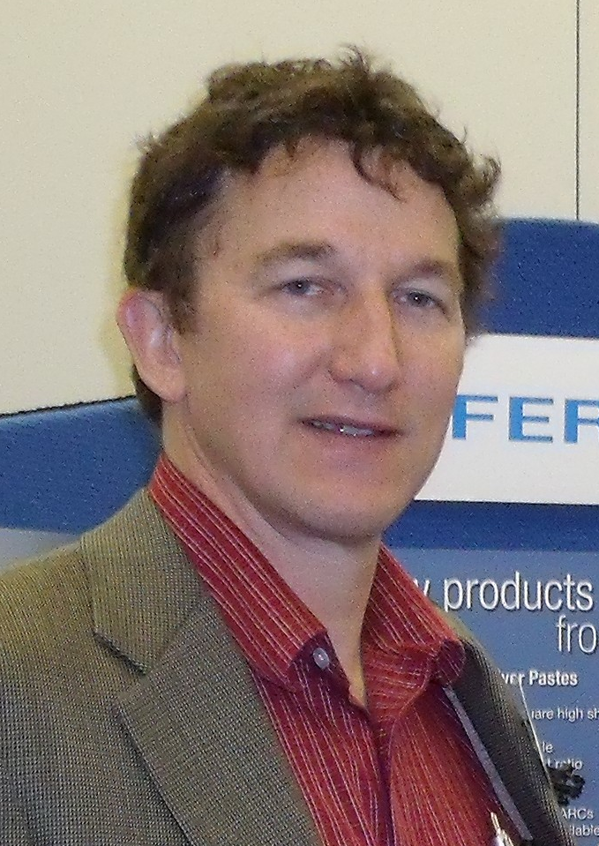
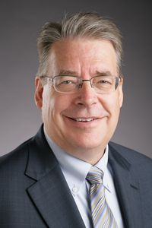
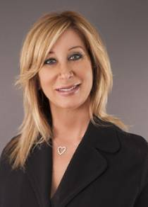
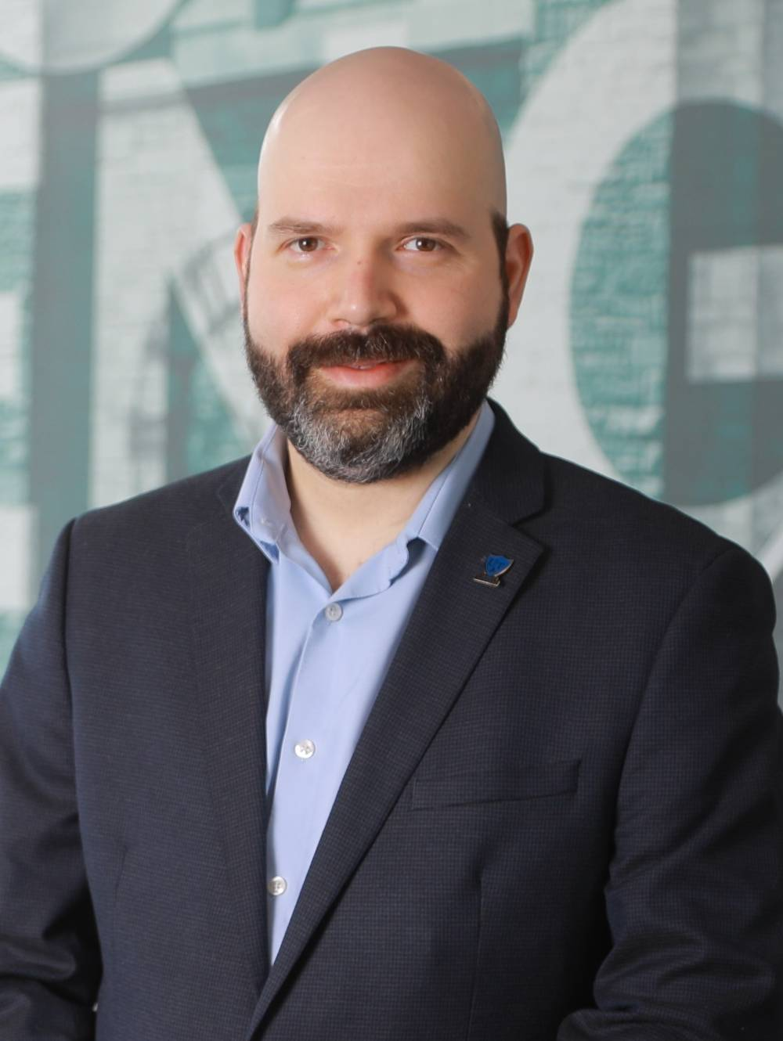
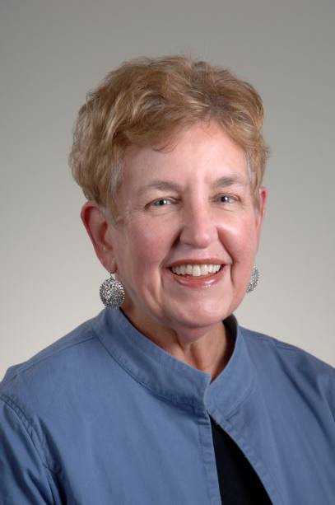
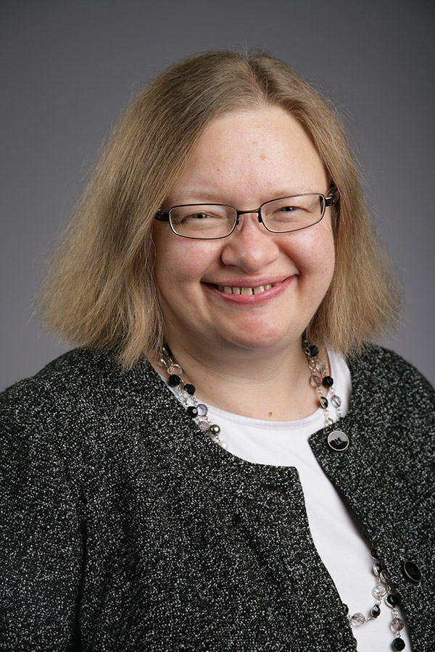

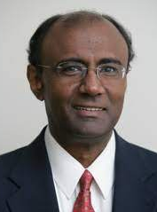
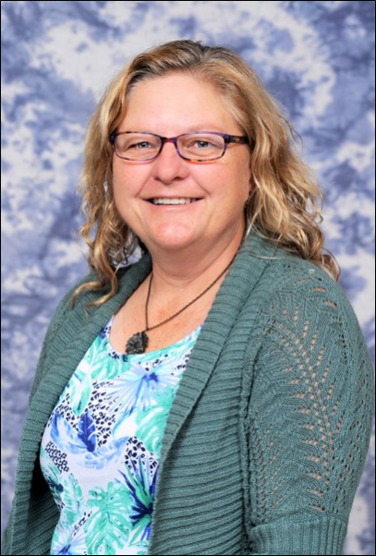
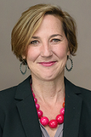
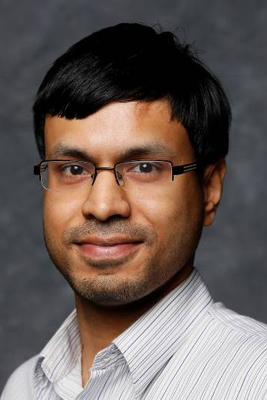
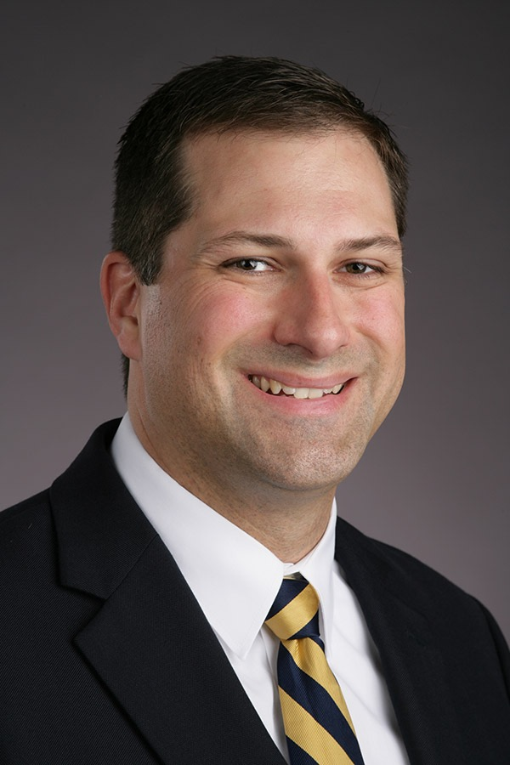
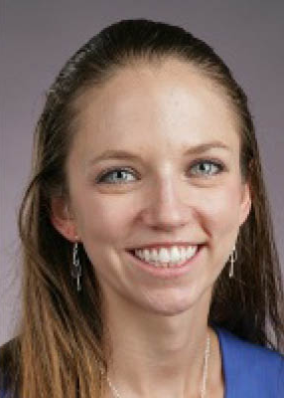
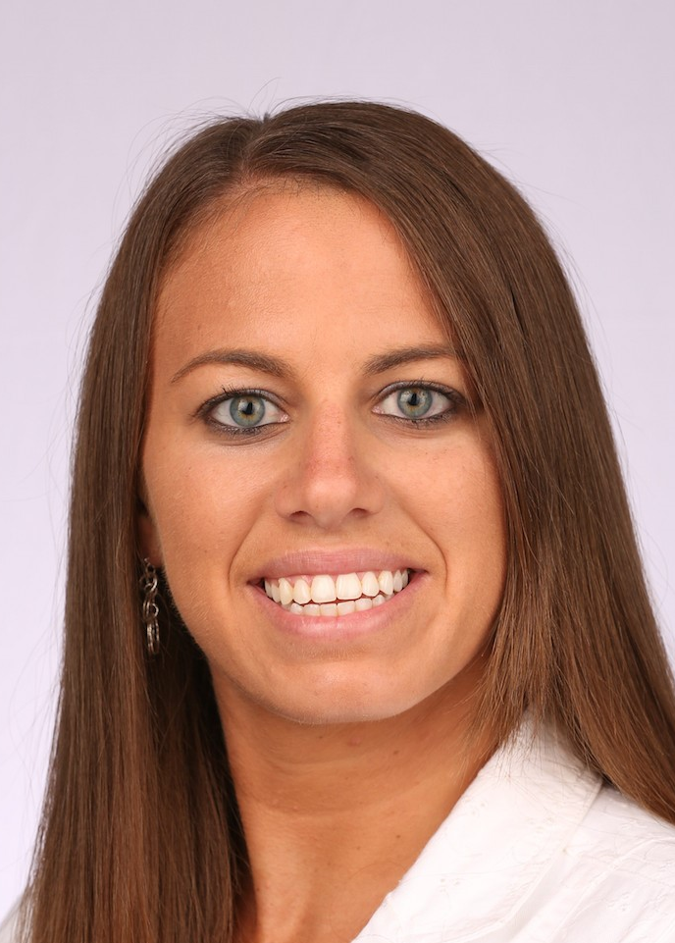
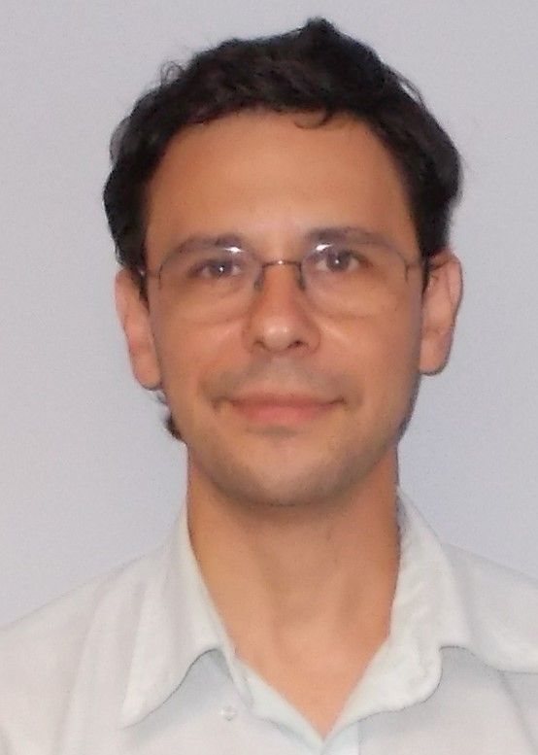
2023 – 2024 RRC (22 Members)
Prof. F. Ahrens
Info. Operations & Tech. Management
Prof. T. Avidor-Reiss
Biology
Prof. D. Bazett-Jones
Athletic Training
B. Bosch
Engineering
Prof. K. Green
Accounting
Prof. M. Elahinia
MIME
Prof. M. Heben
Physics
Prof. G. Insch
Management
Prof. L. Kovach
Education
Prof. Y. Lapitsky
Chemical Engineering
Prof. L. Lewin
Nursing
Prof. J. Martin
Libraries
Prof. B. Miner
Dept. of Art
Prof. A. Nadarajah
Bioengineering
T. Phares
Bioengineering
Prof. A. Prior
Humanities
Prof. A. Ray
Physics
Dr. T. Rhodes
Music
Prof. S. Robinson
Mathematics
Prof. M. Seegert
Pharmacy
Prof. A. Spivak
Civil Engineering
Prof. R. Suliman
Business

Slide 3
AY 2023/2024 Plans
Reconstitute the RRC and follow up with and assist the administration with adopting the RRC recommendations

Slide 4
RRC Subcommittees
Institutional Organization for Enhanced Recruitment
  Faculty and administrator roles, communication channels between academic units and administrative offices, etc.
Recruitment Events
  On and off campus; ensuring appropriate staffing (e.g., college recruiters and student tour guides), visits to schools and college fairs, campus visits/1:15 meetings
New Program, Incentive, and Relationship Development
  Provide new offerings to attract more/non-traditional students, strategically waving application fees, establishing pipelines with community colleges
Retention
Advertising and Value Proposition

Slide 5
UToledo administration provided responses to all (~60) major recommendations in the AY 22/23 report
The responses were divided into three types:
  Things the UToledo administration is already doing (and the responsible party)
  Things the UToledo administration is considering or planning on doing (and the responsible party)
  Things that don't fit UToledo and why

Slide 6
RRC Timeline
August 25: RRC Co-Chairs meet with President Postel to discuss the Administration’s plans to implement AY 22/23 RRC report
August 29: RRC update to Senate
September 5: RRC kick-off meeting
End of Fall: RRC’s preliminary AY ‘23 – 24 report to Senate
End of Spring: RRC’s final AY ‘23 – 24 report to Senate

Slide 7
The short answers were provided by:
President, Board of Trustees (BOT), and Senior Leadership Team (SLT) information
  President Postel (gregory.postel@utoledo.edu)
  Diane Miller (diane.miller2@utoledo.edu)
Academic Affairs information:
  Risa Dickson (risa.dickson@utoledo.edu)
  Angela Paprocki (angela.paprocki@utoledo.edu)
Enrollment Management and Financial Aid information
  Dave Meredith (david.meredith@utoledo.edu)
Marketing and Communications information
  Meghan Cunningham (meghan.cunningham@utoledo.edu)
Finance information (also Park UToledo)
  Matt Schroeder (matt.schroeder@utoledo.edu)
  Mike Dennis (michael.dennis5@utoledo.edu)
Student Affairs information
  Sammy Spann (sammy.spann@utoledo.edu)
  Sara Clark (sara.clark2@utoledo.edu)

Slide 8
Examples: Things the UToledo Administration is already doing
RRC recommendation: “UToledo must declare solving the enrollment crisis its top priority”
Administration’s response: “The Board of Trustees, the President, and the Strategic Plan have all asserted that this is a top priority”
In the discussion with President Postel, it became evident that one of the qualifications expected of the new provost is handling the enrollment crisis

Slide 9
Examples: Things the UToledo Administration is considering or planning
RRC recommendation: “A high-level UToledo administrator (e.g., the Provost or the Executive Vice President for Enrollment) should be granted the authority to govern all aspects related to the enrollment crisis…”
Administration’s response: “President and SLT, While we are considering a different way to organize some of these areas, to make it more streamlined, it would not be appropriate for all of these areas to report to one person…”
In the discussion with President Postel, it became evident that the provost’s new job description was broadened and included enrollment management

Slide 10
Examples:
Things that don't fit UToledo and why
RRC recommendation: “Provide each College with dedicated recruiters with detailed, program-specific knowledge”
Administration’s response: “EM unsure how this would work logistically or financially if nine colleges employed recruiters and had to pay for travel expenses to cover the area we need to grow enrollment. Will all nine visit Chicago, Cincinnati, Detroit etc. in addition to NW Ohio? This seems very inefficient”

Slide 11
This Semester’s Plan
Using President Postel’s response as the starting point, RCC members will meet with administrators (from the level of Deans and Vice Presidents and up) to discuss the implementation of the RRC's recommendations
In doing so, we will be looking to learn:
Which of the recommendations have been implemented, how were they implemented, what were the outcomes, and how further progress can be made
Which of the recommendations do the UToledo administrators plan to implement, how do they plan to implement them, and how can they be improved
Which recommendations do they disagree with and whether their disagreement is well-founded
Identify implementation barriers that the faculty and staff can help overcome and provide a plan to do so
Based on this feedback, we will refine our recommendations, continue to advise the administration of their implementation, and prepare a report on what the Administration did in response to last year's RRC recommendations
We believe that, collectively, these activities will stimulate the Administration toward further action on last year's findings, ultimately helping UToledo to solve its enrollment crisis

Slide 12
Questions

Slide 13
END

