Slide 1
University Assessment Committee Update
Shery Milz, PhD. and Alana Malik, PhD.
Graduate Council
April 16, 2024

Slide 2
Agenda
Review the Assessment Process Timeline
Discuss 2022-2023 Findings and Recommendations
Future Action Steps
Introduce Curriculum Mapping in CIM

Slide 3
3

Slide 4
Findings
Overview
Declined Reports
Results by Institutional Student Learning Outcome

Slide 5
Overview of Graduate-Level Program Reports
171 Graduate/Professional Programs and Post-Baccalaureate Certificates
44 Post-Baccalaureate Certificates
127 Graduate/Professional Programs
82 (48%) Complete
9 Multi-Year
73 One-Year
83 (49%) Declined
6 (1%) Incomplete

Slide 6
34 Declined Post-Baccalaureate Certificates
College
Rationale
1 College of Medicine and Life Sciences
3 College of Engineering
4 Judith Herb College of Education
5 College of Health and Human Services
10 Neff College of Business and Innovation
11 College of Arts and Letters
3 New
6 Not submitted by department
25 Insufficient enrollment

Slide 7
42 Declined Graduate and Professional Programs
College
Rationale
College of Law
1 Neff College of Business and Innovation
College of Engineering
5 College of Arts and Letters
5 College of Natural Science and Mathematics
College of Pharmacy and Pharmaceutical Sciences
7 College of Health and Human Services
8 College of Medicine and Life Sciences
8 Judith Herb College of Education
New
10 Enrollment suspended
13 Not submitted by department
17 Insufficient enrollment

Slide 8
Institutional Student Learning Outcomes Results
Presented by outcome, not program
Some programs report on more outcomes than others
HHS, EN, COMLS

Slide 9
Specialized Knowledge
Type of Assessment
Stoplight Indicator

Slide 10
Broad Integrative Knowledge
Type of Assessment
Stoplight Indicator

Slide 11
Civic and Global Learning
Type of Assessment
Stoplight Indicator

Slide 12
Intellectual Skills
Type of Assessment
Stoplight Indicator

Slide 13
Applied and Collaborative Learning
Type of Assessment
Stoplight Indicator

Slide 14
Strengths
Liaison Evaluation Report
Use of Direct Measures
Identifying Program Learning Outcomes to be assessed
Describing how results are shared with faculty and how they provide input about curricular improvements
Dean Meetings
Liaisons
External Accreditation
Faculty Engagement
Dean Support

Slide 15
Challenges
Liaison Evaluation Report
Results and conclusions
Assessment instruments and rubrics are clearly described or attached to report
Dean Meetings
Support/Resources
Budget
Faculty time/resources
Department Chair workload
Change to college leadership/structure
Vague Student Learning Outcomes/Metrics; Over-mapping to Institutional Student Learning Outcomes
Certificates

Slide 16
Recommendations

Slide 17
Recommendations
Liaisons continue to work with individual programs to align program learning outcomes with institutional student learning outcomes, to update curriculum mapping at the course level, and to adjust assessment plans as needed;
Establish a distinction between certificates with intentional matriculation to be included in the assessment process, versus certificate credentials awarded towards the end of a major degree program (excluded from the assessment process);
Align program concentration learning outcomes and curriculum mapping within an established major, and eliminate annual assessment reporting requirements for individual concentrations within a major. Concentrations will be assessed adequately within the major’s program review cycle.

Slide 18
Future Action Steps
Curriculum Mapping in CIM

Slide 19
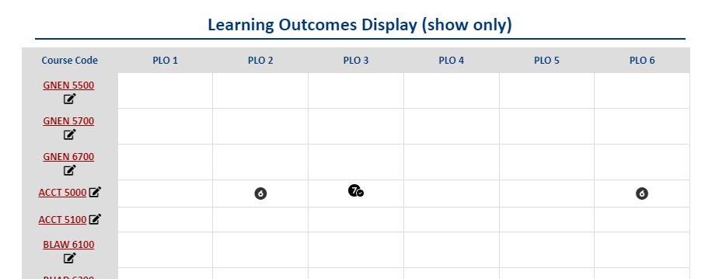
Program CIM Display
Aligning Courses to Program Outcomes

Slide 20
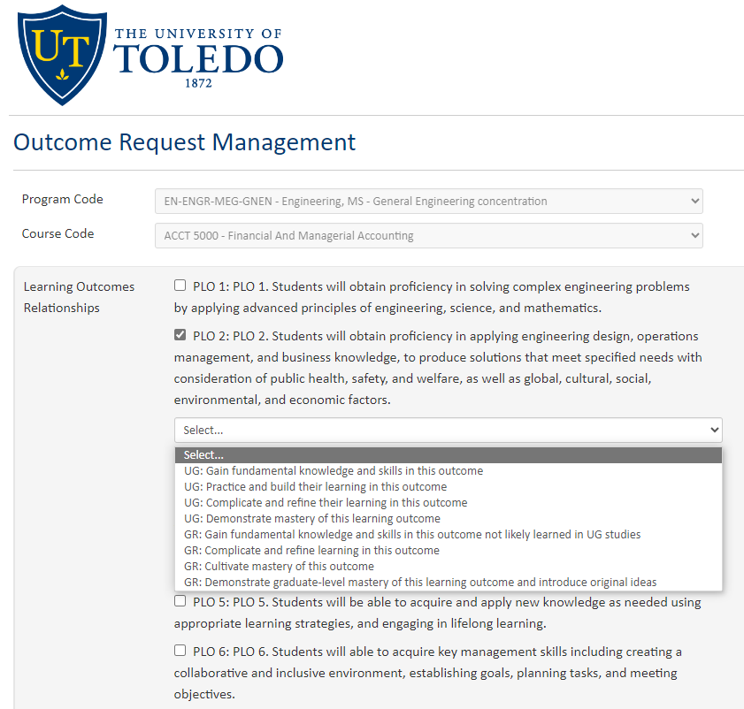
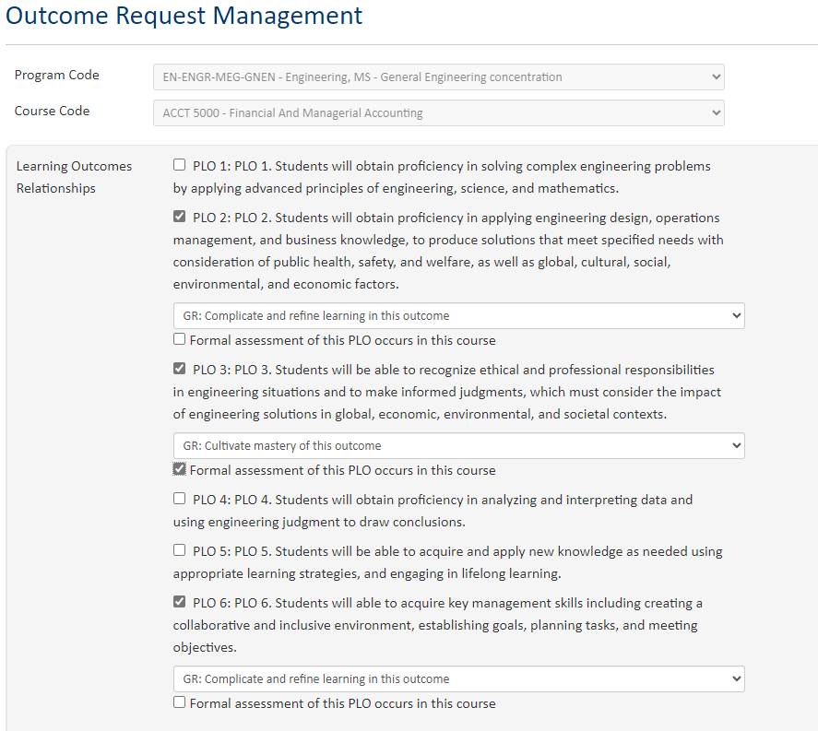
New Mapping Features

Slide 21
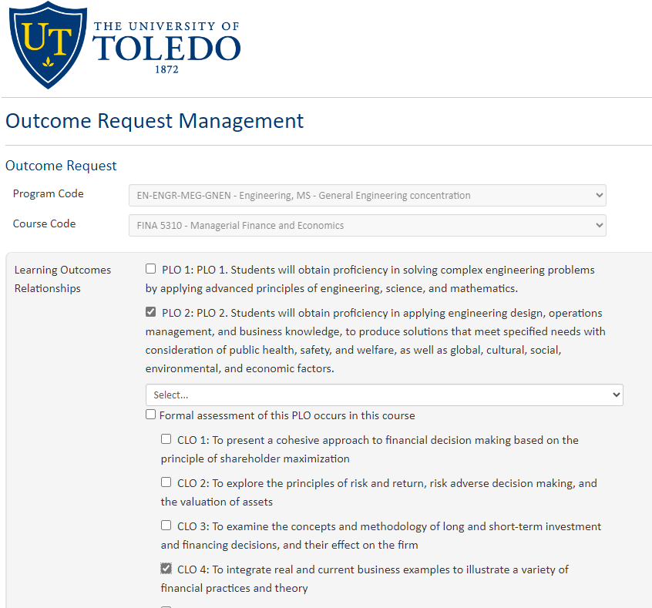
New Mapping Features
Aligning Course Learning Outcomes to Program Outcomes

Slide 22
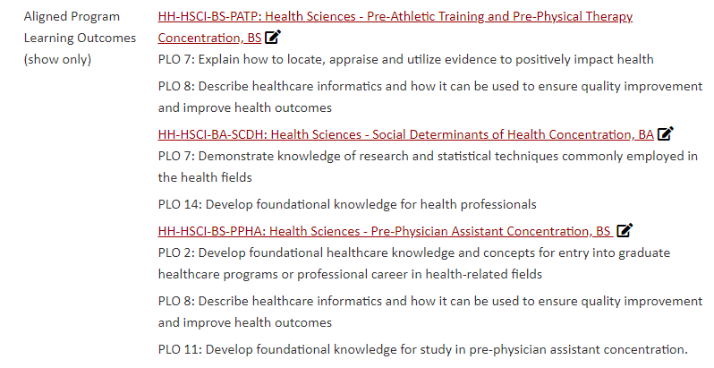
Course CIM Display
Alignment of Individual Courses with Academic Programs

Slide 23
Opportunities
Encourage
Encourage dialogue between faculty from different departments
Identify
Identify gaps in understanding of how individual courses contribute to major programs
Facilitate
Facilitate cohesive curriculum design
Help
Help reviewers of curriculum in CIM visualize program design

Slide 24
Questions

Slide 25
Evaluation Report Rubric Criteria Definitions
Actions taken: The connection between assessment results and program changes is clear.
Assessment Method Plan Changes: Actions Taken: Identified actions taken and/or next steps for changes to the assessment methods/plans.
Assessment Method Plan Changes: Target Completion Dates: Identified target completion dates of action steps.
Describes how the results have been shared with program faculty/staff and they have provided input about curriculum improvements.: Results shared with faculty; faculty input gathered
Direct measures of students learning used: Learning outcomes are assessed using direct measures of student learning (e.g., projects, papers, exams, a prescribed formalized test, or other program requirements, e.g., portfolio), although indirect measures also may be used to supplement.
Embedded assessments (Curricular only): Most or all of the direct assessment data being collected are embedded as a requirement for a course.
Expectations for Student Achievement: Results are described in terms of how well the students performed compared to target levels of achievement. They are reported in terms of the proportion of students that did not meet, met, or exceeded expected levels of competency.
Learning Outcomes Changes: Actions Taken: Identified actions taken and/or next steps for changes to the learning outcome(s).
Learning Outcomes Changes: Target Completion Dates: Identified target completion dates of action steps.
PLOs Assessed: Identifies specific program Learning Outcomes that were assessed this year.
Results & Program Changes: Actions Taken: Identified actions taken and/or next steps for changes to the program.
Results & Program Changes: Person/Groups Responsible: Identified person or group(s) responsible for each action step.
Results & Program Changes: Target Completion Dates: Identified target completion dates of action steps.
Results and Conclusions: Results are clearly and concisely described, with respect to the Learning Outcomes identified above. Includes tables, charts, or other visuals to highlight key findings, as appropriate.
Results Description-clear description: Results (both quantitative and qualitative) are clearly described, with respect to the Student Learning Outcomes assessed and compare results to past trends, as appropriate. Includes tables, charts, or other visuals to highlight key findings, as appropriate.
Results Description-decision-making: Results/findings are described in a way that makes it clear how they provide the basis for program decision making.
Results Description-methods evaluated: Assessment methods are evaluated and the strengths and weaknesses of the assessment methods used were discussed.
Rubrics, measures attached or described: Assessment instruments and rubrics are clearly described or attached to the report.
Who was assessed: The student sample (i.e., number of students, class level, and data collection) were described.

