Slide 2
Office of Undergraduate Research
Proposal Preparation Workshop
Dr. Jonathan Bossenbroek
Director - OUR
January 29

Slide 3
Contact Information
Dr. Jonathan Bossenbroek
Director OUR
undergraduate.research@utoledo.edu
MacKinnon Hall 2000
419-530-2983
http://www.utoledo.edu/honors/undergradresearch/

Slide 4
OURUT Research Programs
Academic Year Research Program: AYRP
First Year Summer Research Experience: FYSRE
Research Travel Grant Program: Travel
Undergraduate Summer Research & Creative Activity Program: USRCAP

Slide 5
OURUT Research Programs
Academic Year Research Program: AYRP
First Year Summer Research Experience: FYSRE
Research Travel Grant Program: Travel
Undergraduate Summer Research & Creative Activity Program: USRCAP
UT-City of Toledo Internship Program: Toledo Talent Keeps Toledo Great (TTKTG)
Work-Study Research Program: WSRP
Notes:
Today’s workshop will focus on these two programs as they are targeted towards students working with a mentor on a project over summer.

Slide 6
USR&CAP and FYSRE
The Undergraduate Summer Research and Creative Activity Program (USRCAP) and First Year Summer Research Experience: (FYSRE) are the main summer research programs and are open to all UT undergraduate students in all areas of research and/or creative activity at UT. These are competitive program that support research & scholarship by undergraduate students under the direction of a faculty member.

Slide 7
Undergraduate Research
Top 8 Characteristics of success at Google (in order of importance)
being a good coach
communicating and listening well
possessing insights into others (including others different values and points of view)
having empathy toward and being supportive of one’s colleagues
being a good critical thinker and problem solver
being able to make connections across complex ideas
STEM expertise.

Slide 8
Undergraduate Research
Top 8 Characteristics of success at Google
being a good coach
communicating and listening well
possessing insights into others (including others different values and points of view)
having empathy toward and being supportive of one’s colleagues
being a good critical thinker and problem solver
being able to make connections across complex ideas
STEM expertise.

Slide 9
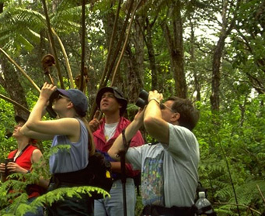
Follow your passion

Slide 10
Follow your passion
What do you call a passion without a plan?

Slide 11
Follow your passion
What do you call a passion without a plan?
A HOBBY!

Slide 12
Follow your passion
What do you call a passion with a plan?

Slide 13
Follow your passion
What do you call a passion with a plan?
Research and Scholarship

Slide 14
Steps to getting involved research and creative activities:
Step 1: Find a mentor
Step 2: Develop an idea
Step 3: Develop a proposal
Step 4: Apply for funding
Step 5: Plan your project
Step 6: Present your work

Slide 15
Step 1: Finding a mentor
Talk to your professors – Faculty members across campus are involved with research, scholarship and creative activities. Some faculty regularly have undergraduates as volunteers or paid technicians in their labs, which is a great place to start.

Slide 16
Step 2: Develop an idea
Research and scholarship begin with ideas and questions. Your mentor can help you develop an idea. These ideas can be closely tied with the activities already being conducted by a faculty member or graduate student, or start a new direction for you and the faculty mentor.

Slide 17
Step 3: Develop a proposal
A proposal lays the groundwork and defines the boundaries and scope of a project.
Most importantly a proposal is the stage of research that forces clarity of the question and objectives and ensures that the means to address these issues is feasible in a timely manner.

Slide 18
Step 4: Apply for funding
The Office of Undergraduate Research funds research and creative activities primarily focused on summer research.

Slide 19
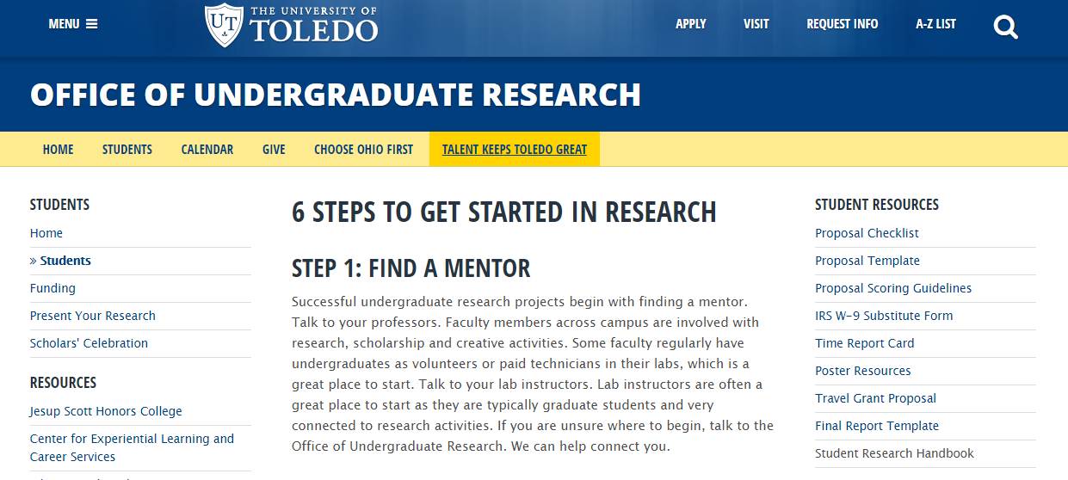
OUR-UT Resources

Slide 20
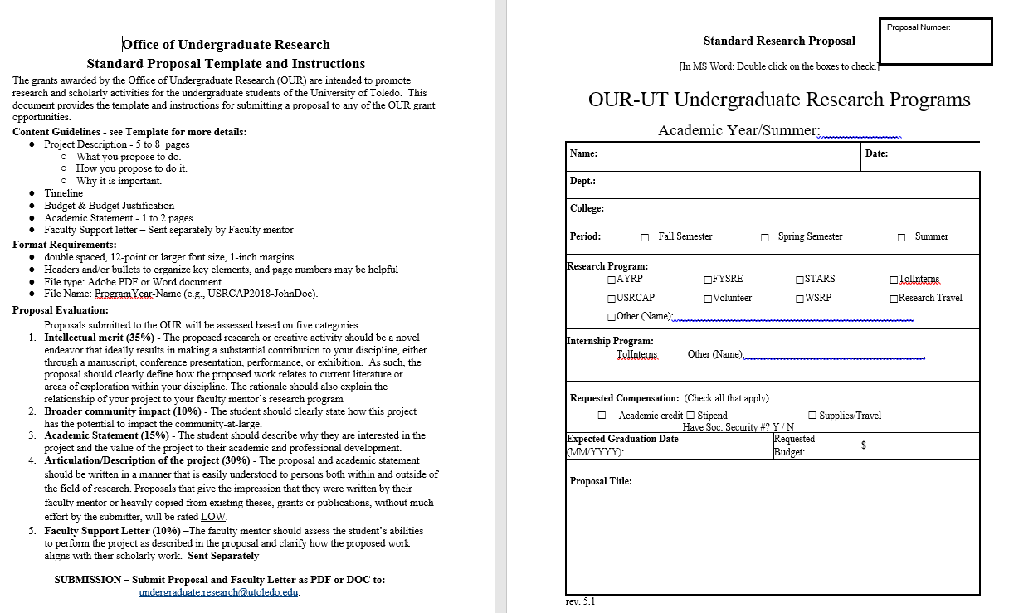
OUR-UT Proposal Template

Slide 21
Content Guidelines
Project Description - 5 to 8 pages
What you propose to do.
How you propose to do it.
Why it is important.
Timeline
Budget & Budget Justification
Academic Statement - 1 to 2 pages
Formatting – See Template for Instructions

Slide 22
Project Description
Two areas of the Project Description
Intellectual Merit (Introduction, Objective/Hypotheses, Methods, Expected Results)
Broader Community Impact

Slide 23
Project Description
Focus on your Question, Objective, Goal or Hypothesis.
There needs to be a focal idea that your proposal is built upon.
Define this first!

Slide 24
Project Description
Intellectual Merit (Introduction, Objective/Hypotheses, Methods)
Focal Idea is the HEART of this Section
It is the first thing you should think about.
But doesn’t come first in the proposal.

Slide 25
Project Description
Intellectual Merit (Introduction, Objective/Hypotheses, Methods)
Introduction
background, literature review, or sources of inspiration.
Explain the relationship of your project to your faculty mentor’s research program
Basically, the argument for why your Focal Idea is important
Focal Idea is the HEART of this Section

Slide 26
Project Description
Intellectual Merit (Introduction, Objective/Hypotheses, Methods)
Your introduction should have background, literature review, or sources of inspiration.
Focal Idea is the HEART of this Section
Describe your methods
How will you answer or address your idea/question?
Written for those outside your discipline

Slide 27
Project Description
Intellectual Merit (Introduction, Objective/Hypotheses, Methods)
Your introduction should have background, literature review, or sources of inspiration.
Focal Idea is the HEART of this Section
Describe your methods
Expected results
Including how the project results will be disseminated

Slide 28
Project Description
Intellectual Merit (Introduction, Objective/Hypotheses, Methods)
Broader Community Impact
How does this project have the potential to impact the community-at-large?
This is your opportunity to explain the significance of the research to a layperson and should be free of jargon or overly technical language.

Slide 29
Project Description
Intellectual Merit (Introduction, Objective/Hypotheses, Methods)
Broader Community Impact
References
Style of references is your choice
Proper citations are a necessary component to ETHICAL conduct of research.
Not counted in the proposal page limit.

Slide 30
Content Guidelines
Project Description - 5 to 8 pages
What you propose to do.
How you propose to do it.
Why it is important.
Timeline
Budget & Budget Justification
Academic Statement - 1 to 2 pages

Slide 31
Timeline
Describe the various steps or milestones you plan on taking to work on your project.
For a summer project, describe how you perceive the project will progress during the ten weeks.
Research and scholarship often diverge from an expected path, but planning a timeline helps you in making progress on your project.
Helps the reviewers judge if the work is achievable in the allotted time.

Slide 32
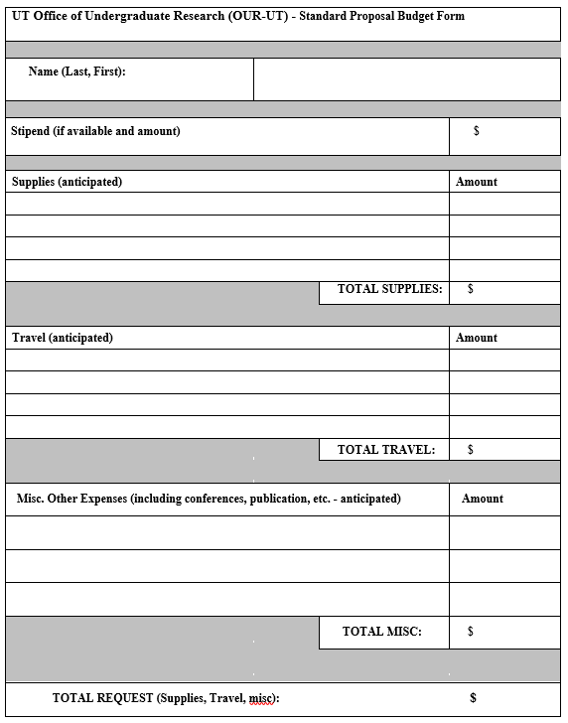
Budget

Slide 33
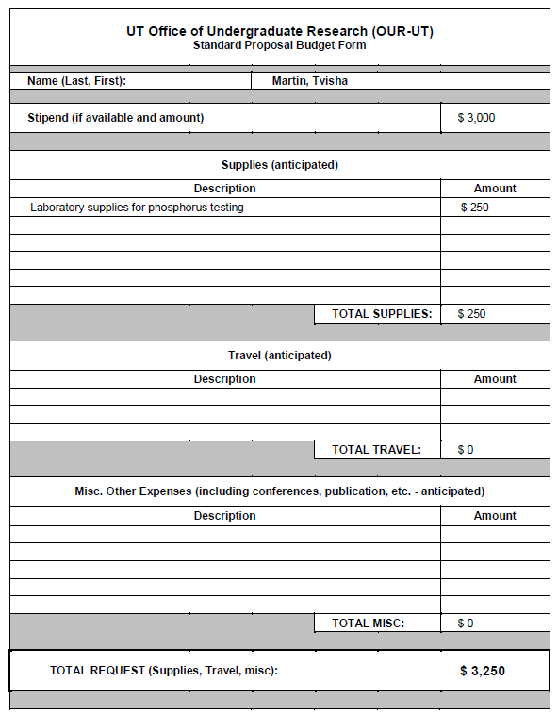
Example:

Slide 34
Budget Justification
Clearly state why the budget items are being requested and needed for the project to be successful.

Slide 35
Academic Statement
Why you are eager to spend ten weeks of your life conducting *THIS* project
Explain how what you propose to do will fit into your professional career aspirations.
Not just because it will add a line to your resume!

Slide 36
Writing Advice
Write in your own voice!
Be clear about your Focal Idea, Question, Objective, etc.
The rest of the proposal hinges on this idea!
Clearly describe:
What you propose to do.
How you propose to do it.
Why it is important.

Slide 37
Writing Advice
Have other students and your mentor review your proposal.
Edit, edit, edit! (did I say edit?)
MEET the DEADLINE!

Slide 38
Proposal Evaluation
Intellectual merit (35%)
Broader Impact (10%)
Academic Statement (15%)
Articulation/Description of the project (30%)
Faculty support letter (10%)

Slide 39
Proposal Evaluation
Intellectual merit (35%) - The intellectual merit of the project should be evaluated on two primary factors: 1) The rationale for the project should be founded in the literature or a clear description of the inspiration or connection to scholarly work. The rationale should also contain a clear description of how this work is related to the mentor’s research program. 2) The result of the project should be of high quality with the potential to be a manuscript, conference presentation, performance, or exhibition.
5 The rationale and potential for a high quality result are both strong.
4 Either the rationale or potential result is not of a quality expected for publication or exhibition without additional work.
3 The rationale has limited connection to recent scholarship and/or the potential result is likely to only make a limited contribution to the field.
2 The rationale is inconsistent or contains errors and/or the results are likely to have little potential to make a tangible contribution to the field.
1 The rationale contains serious errors and the results are likely to have little/no potential to make any contribution to the field.

Slide 40
Proposal Evaluation
Broader community impact (10%) - The student should clearly state how this project has the potential to impact the community-at-large.
5 Has potential to make a substantial contribution to the community-at-large.
4 Has potential to make a contribution to the community-at-large.
3 Has potential to make a limited contribution to the community-at-large.
2 Has little potential to make a contribution to the community-at-large or contains errors.
1 Has very little/no potential to make any contribution to the community-at-large or contains serious errors.

Slide 41
Proposal Evaluation
Academic and professional development (15%) - The student should describe why they are interested in the project and the value of the project to their academic and professional development.
5 Student provides an excellent description of their interest in the project and why it will fit into the student’s career aspirations and their academic program.
4 Student provides a good description of their interest in the project and why it will fit into the student’s career aspirations and their academic program.
3 Student provides a satisfactory description of their interest in the project and why it will fit into the student’s career aspirations and their academic program.
2 Student provides a poor description of their interest in the project and why it will fit into the student’s career aspirations and their academic program.
1 Student provides an unacceptable description of their interest in the project and why it will fit into the student’s career aspirations and their academic program.

Slide 42
Proposal Evaluation
Articulation/Description of the project (30%) - The proposal and academic statement should be written in a manner that is easily understood to persons both within and outside of the field of research. Proposals that give the impression that they were written by their faculty mentor or heavily copied from existing theses, grants or publications, without much effort by the submitter, will be rated LOW.
5 Project and statement are easily understood to persons both within and outside of the field.
4 Project and statement are understood to persons both within and outside of the field with some effort.
3 Project and statement are written for persons within the field but difficult for persons outside the field to comprehend.
2 Project and statement are difficult to understand for persons both inside and outside the field.
1 Project and statement are nebulous and/or difficult to understand for persons both inside and outside the field.

Slide 43
Proposal Evaluation
Faculty support letter (10%) - The faculty mentor should assess the student’s abilities to perform the project as described in the proposal and clarify how the proposed work aligns with their scholarly work.
5 Faculty support letter describes the student’s ability to perform the project in the proposed time frame as excellent.
4 Faculty support letter describes the student’s ability to perform the project as above average.
3 Faculty support letter describes the student’s ability to perform the project as sufficient.
2 Faculty support letter describes the student’s ability to perform the project as minimal.
1 Faculty support letter describes the student’s ability to perform the project as poor.

Slide 44
Dates for summer proposals
End of January - Proposal Workshops
3rd Tuesday of February - Proposals due!
3rd Tuesday of February – Letters due!
April – Offers of Acceptance sent out.
April - Paperwork
May/June/July – Conduct project
At times, an extension will be granted for proposals. Be on the lookout!

Slide 45
Steps to getting involved research:
Step 1: Find a mentor
Step 2: Develop an idea
Step 3: Develop a proposal
Step 4: Apply for funding
Step 5: Plan your project
Step 6: Present your work

Slide 46
Step 5: Plan your project
When your project gets funded create a research plan that can be accomplished in the time frame of the grant.
Part of this should be complete through the proposal process.

Slide 47
Step 6: Present your work
Late November – Scholar’s Celebration
Hosted by Carlson Library
NW Ohio Undergraduate Research Symposium
2021 - ??
Anytime – OUR-UT helps support travel to present at conferences

Slide 48
Here to help! Contact Information
Dr. Jonathan Bossenbroek
Director OUR
undergraduate.research@utoledo.edu
MacKinnon Hall 2000
419-530-2983
http://www.utoledo.edu/honors/undergradresearch/

