Slide 1
Understanding Lake Erie and
Its History
Dr. Jeffrey M. Reutter
Director, Ohio Sea Grant College Program

Slide 2
One of the Most Important Lakes in the World
Dead lake image of 60s and 70s.
Poster child for pollution problems in this country.
But, most heavily utilized of any of the Great Lakes.
Shared by 4 states and 2 countries.
Best example of ecosystem recovery in world.

Slide 3
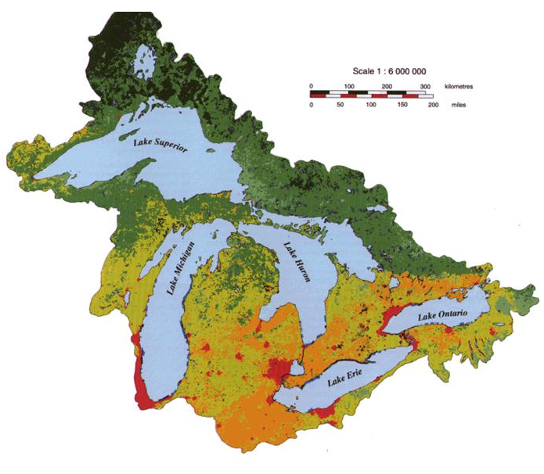
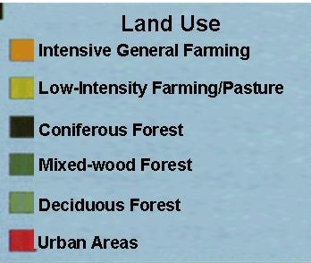
Great Lakes Land Use
Image: Ohio Sea Grant
Notes:
http://www.epa.gov/glnpo/atlas/images/big07.gif

Slide 4
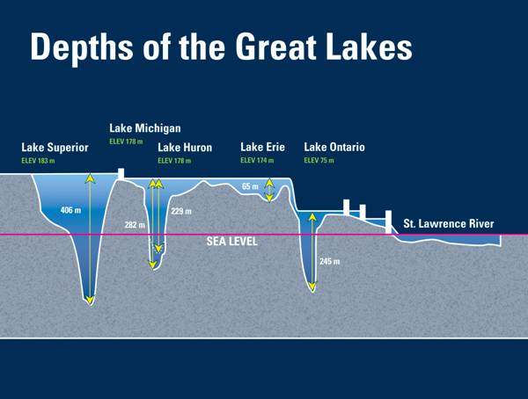
Photo: Ohio Sea Grant

Slide 5
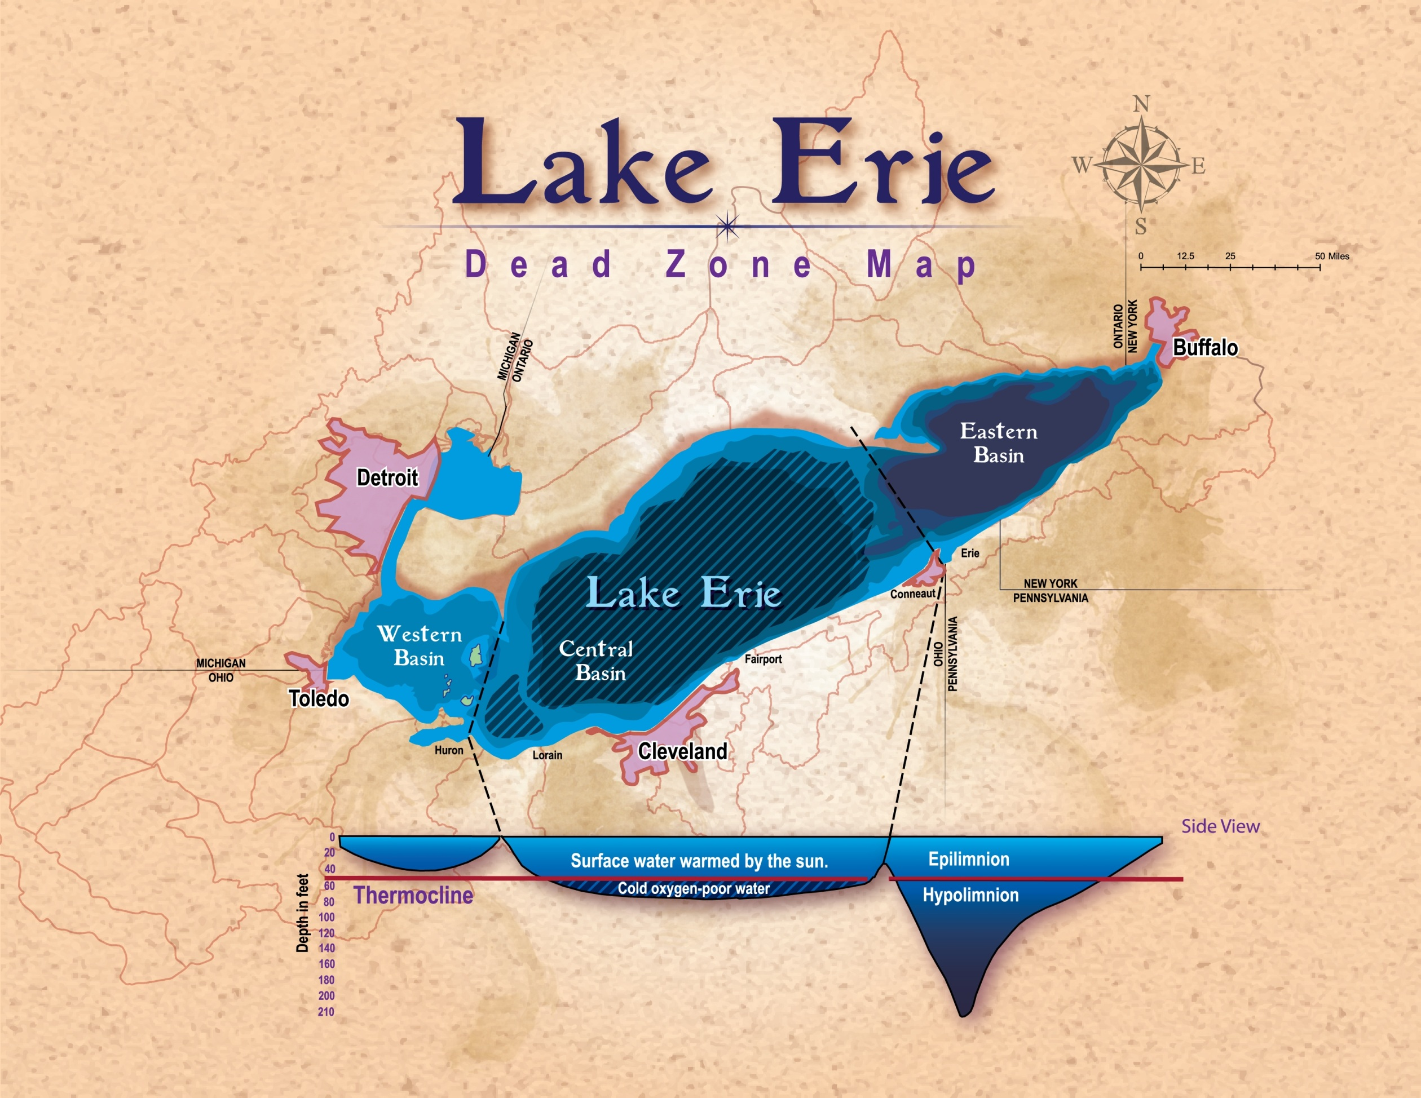
Photo: Ohio Sea Grant

Slide 6
Major Land Uses in
The Great Lakes

Slide 7
Because of Land Use,
Lake Erie Gets:
More sediment
More nutrients (fertilizers and sewage)
More pesticides
(The above 3 items are exacerbated by storms, which will be more frequent and severe due to climate change.)
And Lake Erie is still biologically the most productive of the Great Lakes—And always will be!!

Slide 8
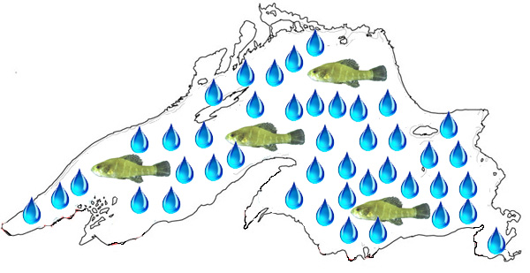
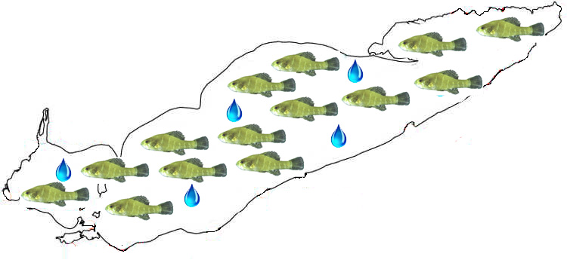
50:2 Rule
(Not exact, but instructive)
Lake Superior: 50% of the water and 2% of the fish
Lake Erie:
2% of the water and 50% of the fish

Slide 9
80:10:10 Rule
80% of water from upper lakes
10% from Lake Erie tributaries
10% direct precipitation

Slide 10
Lake Erie Stats
Drinking water for 11 million people
Over 20 power plants
Power production is greatest water use
300 marinas in Ohio alone
Walleye Capital of the World
40% of all Great Lakes charter boats
Ohio’s charter boat industry in largest in North America
$1.5 billion sport fishery
One of top 10 sport fishing locations in the world
The most valuable freshwater commercial fishery in the world
Coastal county tourism value is over $10 billion

Slide 11
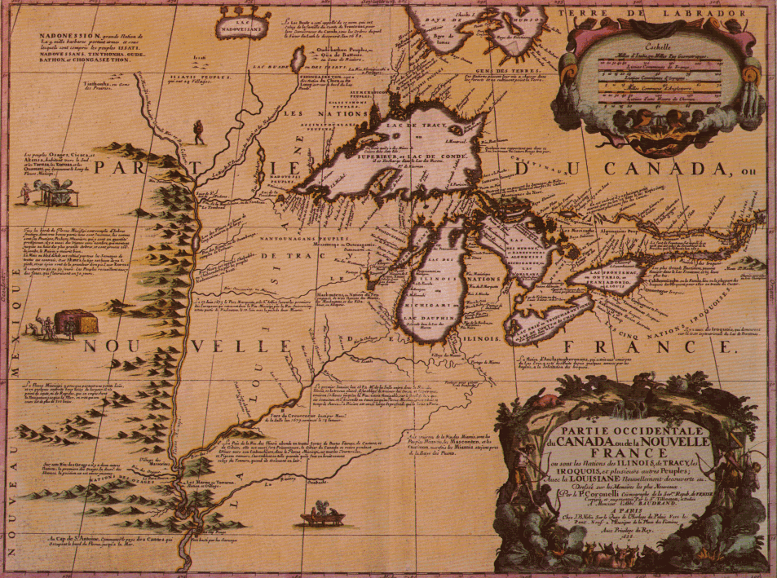
Historical Trends:
The Lake Erie Ecosystem
1969—Cuyahoga River burns
Getting worse annually to 1970
Stable 1970-75
Improving 1975-1995
1995+ Getting worse
Photo: Ohio Sea Grant

Slide 12
Lake Erie’s Biggest Problems/Issues
Sedimentation
Phosphorus and nutrient loading
Harmful algal blooms
Aquatic invasive species
Dead Zone
Climate Change—Makes the others worse
Coastal Economic Development

Slide 13
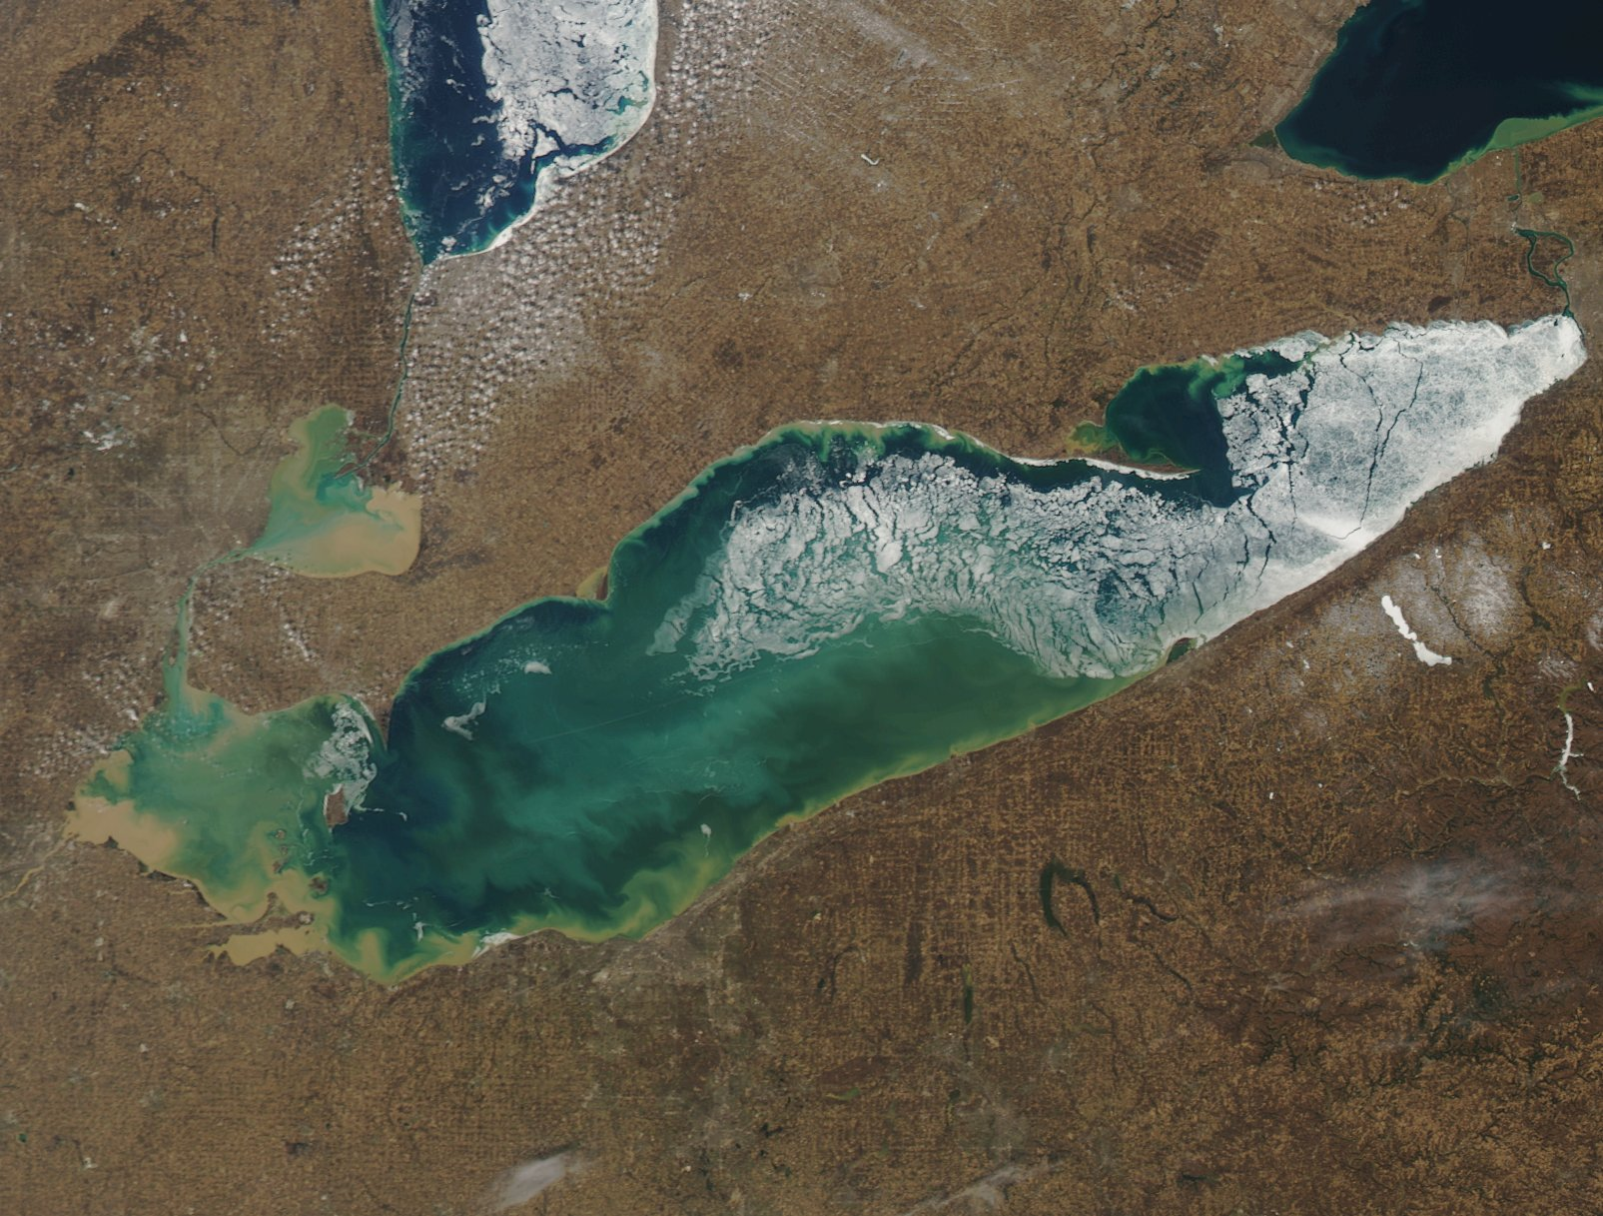
Sedimentation
Photo: NOAA Satellite Image

Slide 14
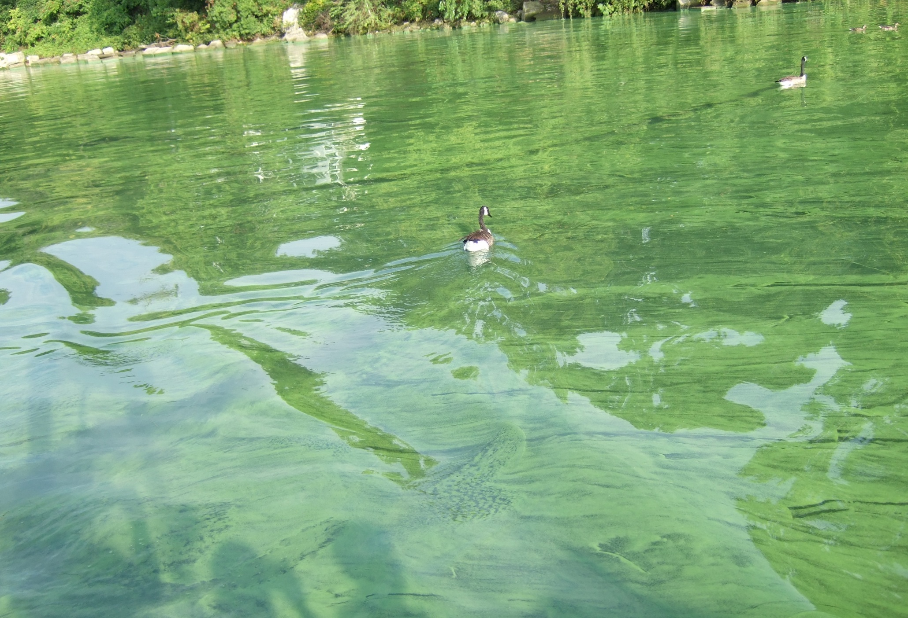
Nutrients: Nitrogen, Phosphorus, Potassium—
N:P:K
Stone Lab
September 11, 2011
Photo: Jeff Reutter

Slide 15
Nutrients: Problem or Benefit?
On our lawns, they make our grass grow
In water, they make algae and plants grow
Lake Erie is most productive Great Lake because: shallowest, warmest, and most nutrients.
But it is possible to have too much of a good thing.
Too much algae, wrong kinds of algae

Slide 16
Why does Lake Erie get most nutrients?
The most agriculture in its basin
Few forests
Wetlands gone
Large human population—water treatment, septic tanks, sewage treatment (or lack thereof)

Slide 17
What brought about the rebirth?
Phosphorus reductions from point sources (29,000 metric tons to 11,000); and agriculture helped!

Slide 18
Why are we targeting phosphorus?
Normally limiting nutrient in freshwater systems
P reduction is best strategy ecologically and economically
Reducing both P and N would help

Slide 19
Are we sure phosphorus reductions will solve the problem?
It worked in the 70s and 80s and turned Lake Erie into the “Walleye Capital of the World”
Approximately a 2/3 reduction in total P loading (29,000 tons to 11,000)

Slide 20
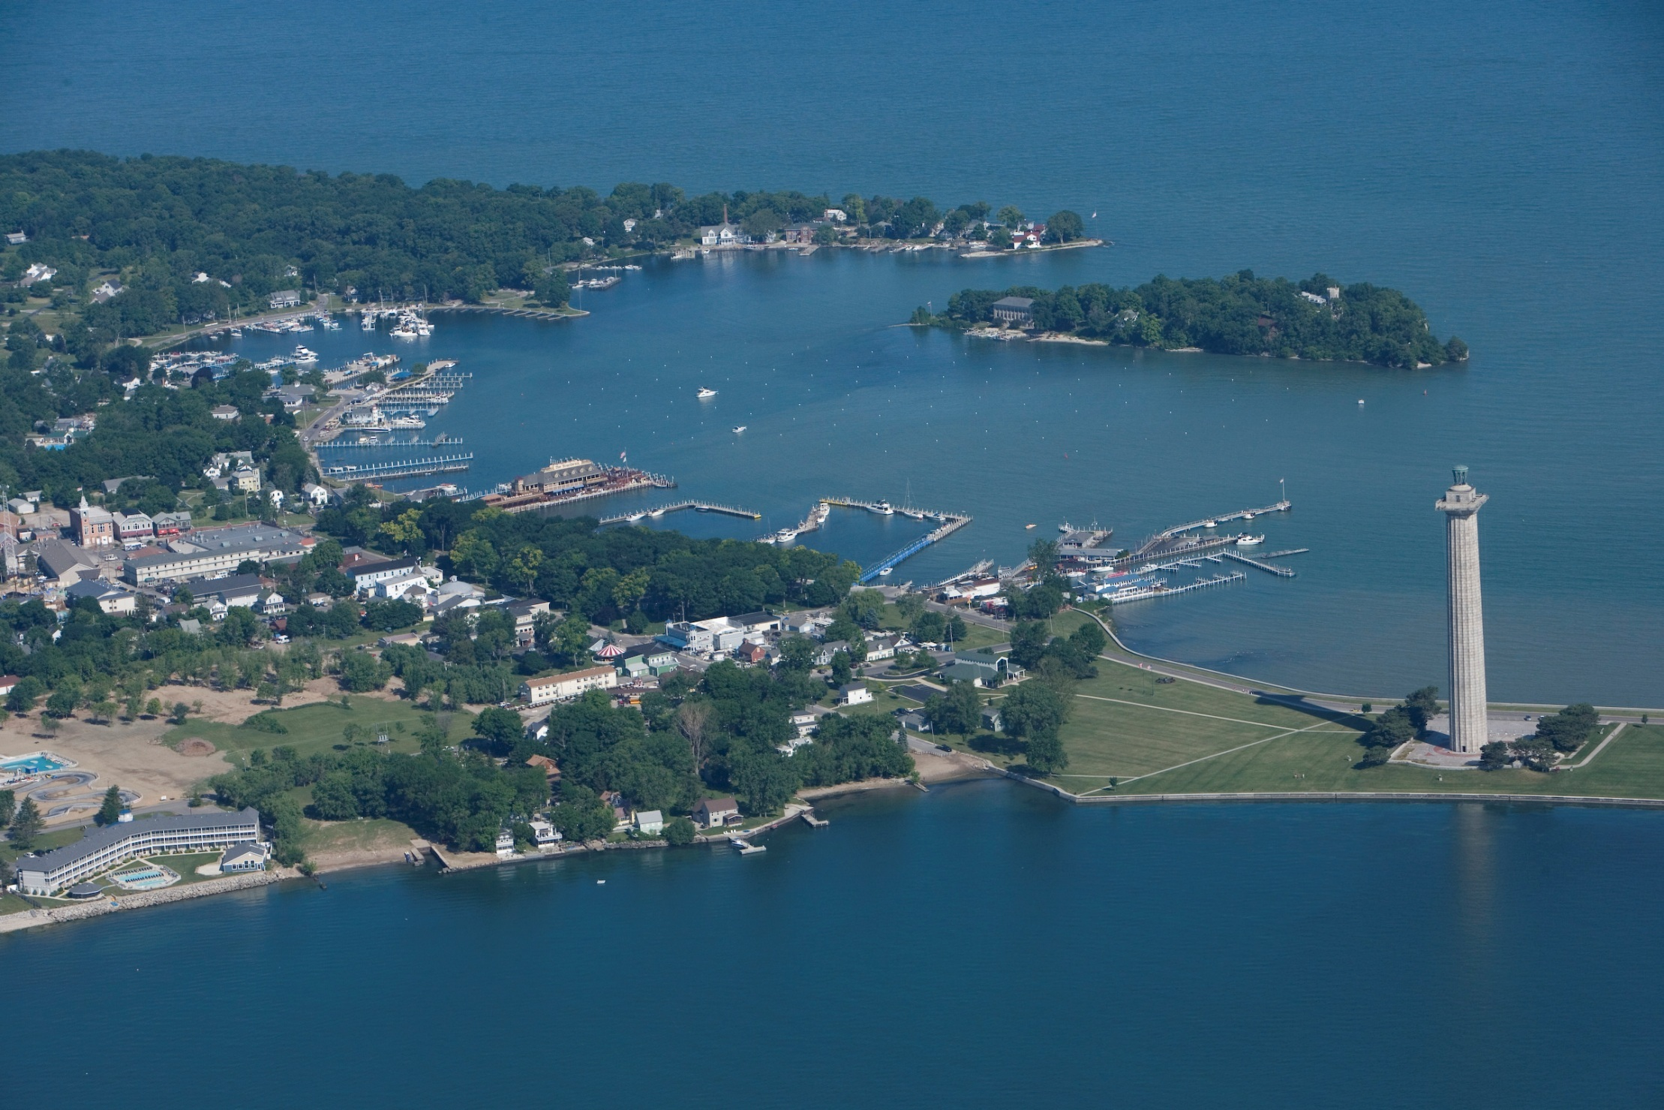

Slide 21
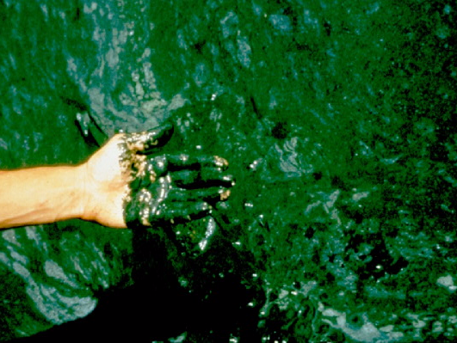
Blue-green Algae Bloom circa 1971, Lake Erie
Photo: Forsythe and Reutter

Slide 22
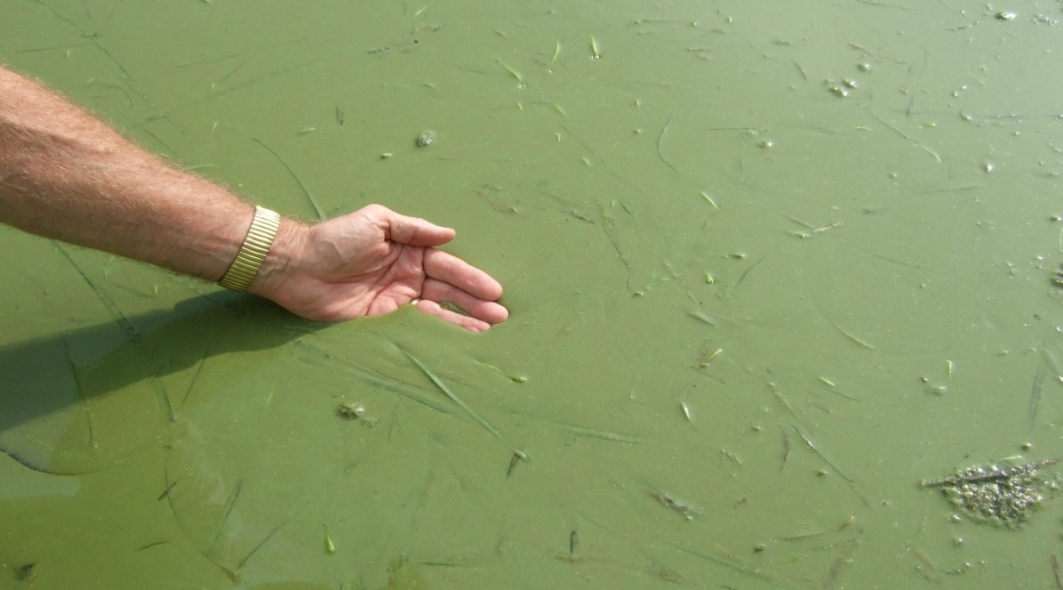
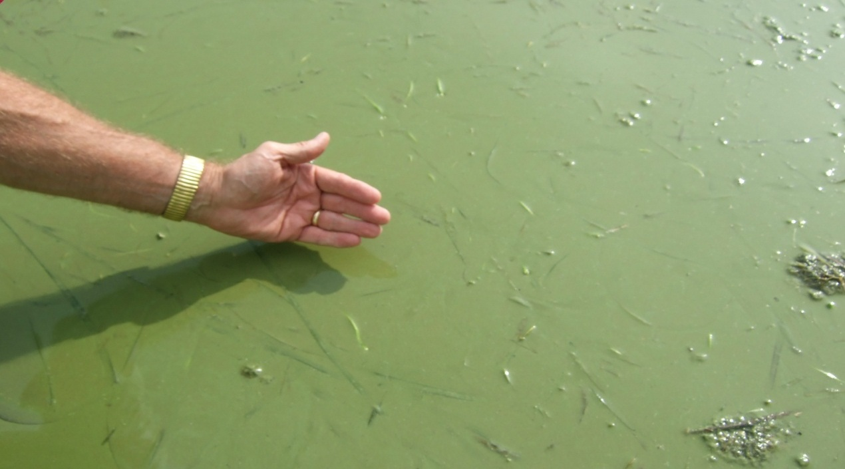
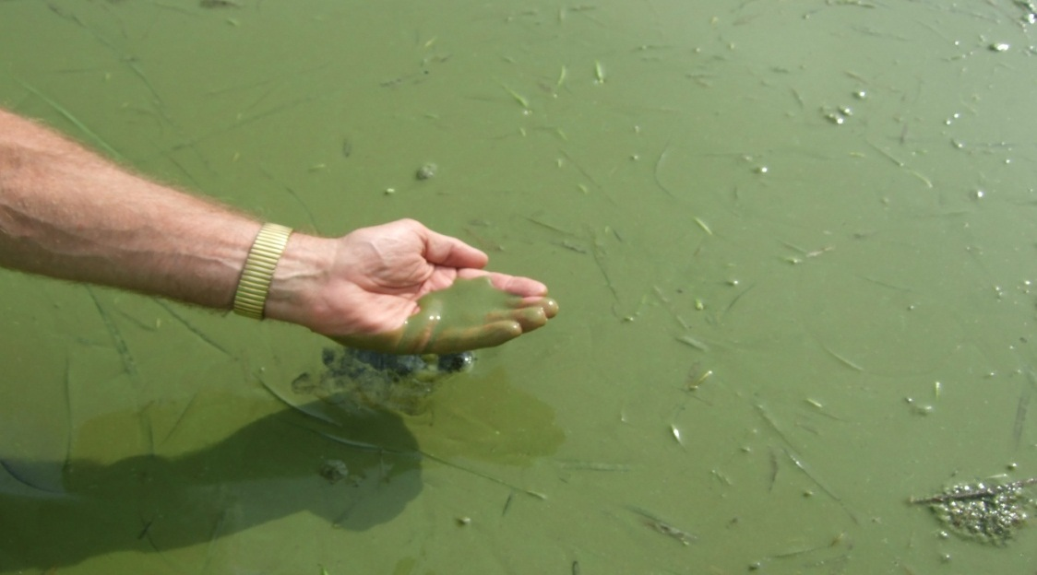
Microcystis, Stone Lab, 8/10/10
Photos: Jeff Reutter

Slide 23
What Are We Doing To Address Lake Erie Problems
Dr. Jeffrey M. Reutter
Director, Ohio Sea Grant College Program

Slide 24
Actions
Research: OSU/Sea Grant/Stone Lab, UT Lake Erie Center, Heidelberg U.
Ohio Phosphorus Task Force
  Report
Millennium Synthesis Team Funded by Ohio Lake Erie Commission and GLNPO
  Report: 14 June 2011
Reutter Presentations: IJC, USEPA, OEPA, ODNR, ODW, ODA, ODH, OSU Extension, NRCS Director, Ohio Legislature, Ohio Congressional Delegation, certified crop advisors, coastal mayors and county commissioners, sewage and water treatment plant operators, charter captains, tourism leaders, science writers, general public, National Sea Grant College Program, farmers, State Directors of Agriculture 13 states, TNC, OEC, Lake Erie LaMP, Joyce Foundation, Stone Lab students, and more
Agriculture Nutrients and Water Quality Work Group: ODA, OEPA, ODNR—Report to Governor Kasich
US Secretary of Agriculture Briefing, 16 March 2012

Slide 25
Lake Erie Millennium Network Synthesis Team
Jeff Reutter
Jan Ciborowski
Steve Davis
Joe DePinto
Darren Bade
David Baker
Tom Bridgeman
David Culver
Elizabeth Dayton
Doug Kane
Jack Kramer
Robert Mullen
Christopher Pennuto
Interdisciplinary discussions were very valuable and beneficial to the report and individual team members.
Should try to keep the team together to address identified research needs and to aid managers in developing strategies to address the problem.

Slide 26
Final Report: June 14, 2011
Preliminary presentations for managers: February 10, 2010 and March 28, 2011
9 hours of conference calls since end of March
10 pages of summary, findings, and implications
  23 Findings
  28 Implications
18 research recommendations
An appendix with some items needing additional discussion

Slide 27
Phosphorus Sources
1960s and 70s—primarily point sources (2/3)
Today loading is coming primarily from agriculture (2/3) but other sources include:
  Sewage treatment plants and CSOs
  Lawn fertilizer runoff
  Water treatment plants
  Septic tanks

Slide 28
Impacts of Increased Phosphorus Concentrations
HABs—If P concentrations are high (regardless of the source, Ag, sewage, etc.) and water is warm, we will have a HAB (nitrogen concentration will likely determine which of the 6-7 species bloom)
Nuisance Algae Blooms
  Cladophora—Whole lake problem. An attached form.
Dead Zone in Central Basin

Slide 29
HAB Requirements
Warm water (summer problem but now finding them in Maumee River as early as April)
High phosphorus levels
Zebra/quagga mussels (not required but remove competition)

Slide 30
Microcystin Concentrations
1 ppb WHO drinking water limit
20 ppb WHO swimming limit
60 ppb highest level for Lake Erie till this year
84 ppb highest level for Grand Lake St. Marys till last year
2000+ Grand Lake St. Marys 2010
1200 Lake Erie Maumee Bay area 2011

Slide 31
Are HABs only a Lake Erie and Ohio Problem?
Global problem
Serious problem in US and Canada
Common species in Lake Erie is Microcystis sp.
Dominant form in Grand Lake St. Marys in 2010 was Aphanizomenon sp., the same species that bloomed in Lake Erie in the 60s and 70s

Slide 32
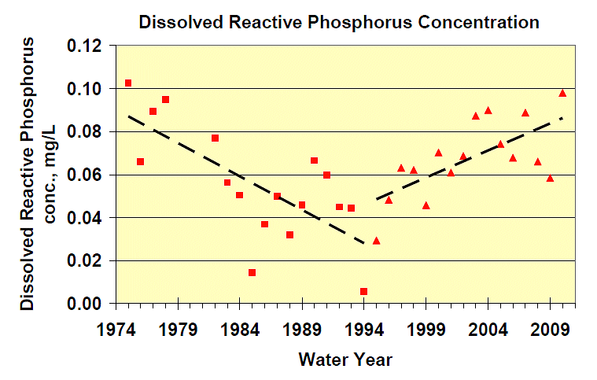

Slide 33
Target Load Reduction
To solve the harmful algal bloom problem (HAB) and reduce the size and duration of the dead zone in the Central Basin of Lake Erie, the overall annual load of soluble reactive or dissolved phosphorus to Lake Erie should be reduced by 2/3.
All sources should reduce by 2/3!!

Slide 34
Dissolved Reactive Phosphorus Spring Loads

Slide 35
Nutrient Loading
Majority of loading occurs during storm events
90% of loading occurs 10% of time

Slide 36
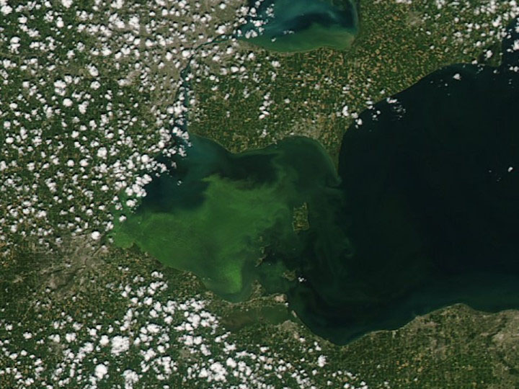
August 11 2011
1330 cfs
Photo: NOAA Satellite Image

Slide 37
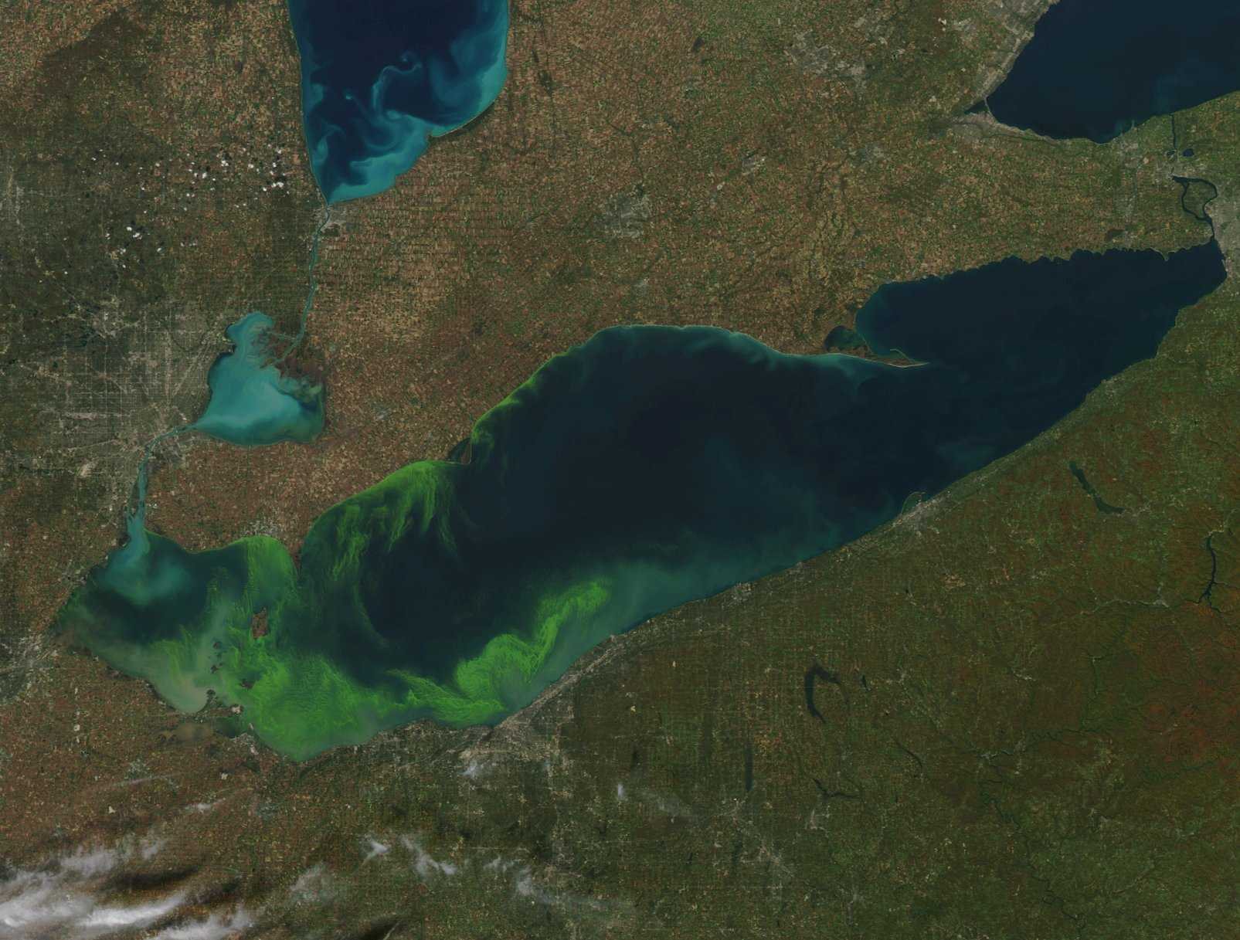
October 9, 2011
Photo: NOAA Satellite Image

Slide 38
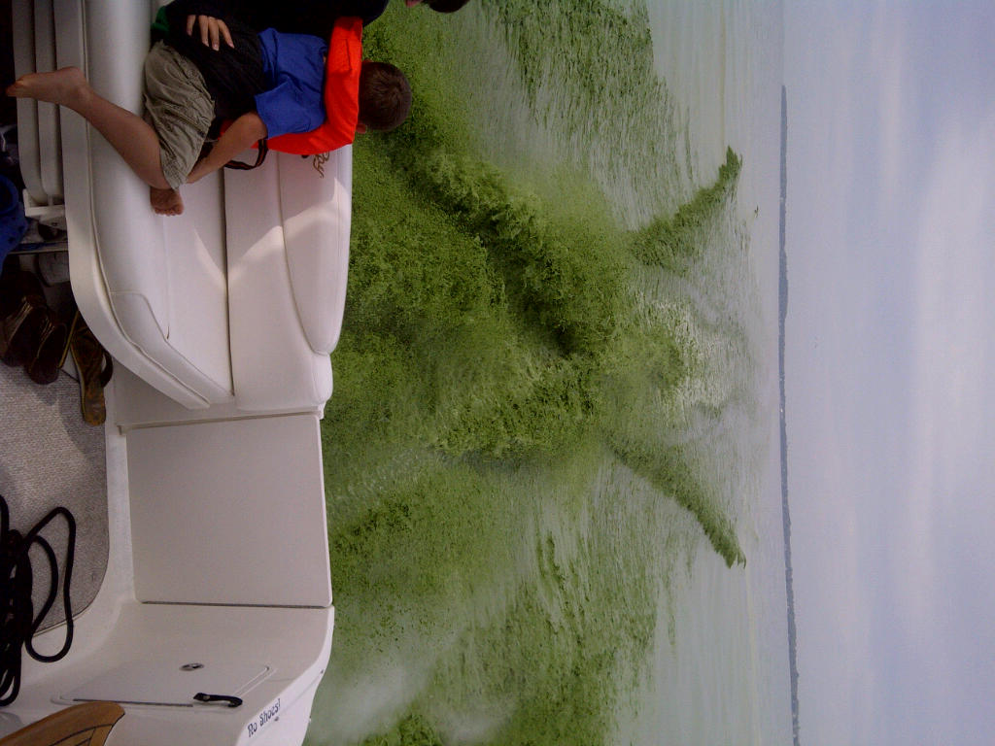
Microcystis near Marblehead
October 9, 2011
Photo: Richard Kraus, United States Geological Survey

Slide 39
HABs:
Western Basin Problem but Contribute to
Oxygen Demand in the Central Basin, i.e. the Dead Zone

Slide 40
Dead Zone:
Central Basin Problem

Slide 41
Lake Erie Cross Section
Image: Ohio Sea Grant

Slide 42
Possible Agriculture Action Areas
Eliminate fall and winter application of fertilizer and manure.
Eliminate broadcast application and incorporate the fertilizer into soil.
Soil testing of all fields to determine if we are missing some real problem spots and to prevent application of too much.
Do not apply P at levels above agronomic needs recommended by OSU.
Use appropriate fertilizer, e.g., don’t apply nitrogen in fall/winter
Do not apply fertilizer when rain is forecast to occur within 48 hours.
Place a moratorium on the addition of more tiles to remove water from agricultural fields. It appears that over 50% of the dissolved phosphorus leaving fields is going through the tiles—POINT SOURCES
Consider reducing the size of farms falling under CAFO regulations so more of the unregulated operations are regulated.
Improve recommendations made by soil testing laboratories regarding amount of P to be added (30% of Ohio fields have too much P already)

Slide 43
What other levers can we turn?
Lawn Care Recommendations
Encourage Scott's and all lawn care fertilizer sellers and their applicators to meet the zero P goal set by Scott's on 1 January 2012 rather than 1 January 2013.
Sewage Treatment Plant Recommendations
Cut allowable discharge levels of P in half.
Expedite actions to eliminate CSOs.
Water Treatment Plant Recommendations
Water treatment plant operators should stop using ortho-P as a corrosion reduction strategy.
Septic Tanks
Assure that all septic tanks are connected and working properly.

Slide 44
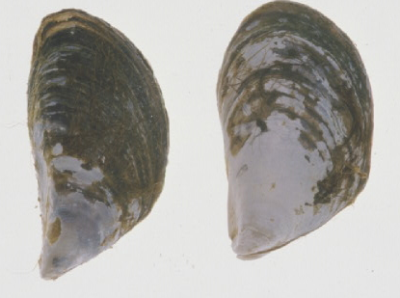
Zebra Mussel vs Quagga Mussel
Photo: Ohio Sea Grant

Slide 45
Climate change is making these problems worse!
Warm water favors HABs
Warm water increases oxygen depletion rates
More severe storms will resuspend more sediment and increase erosion and nutrient loading
  Critically important point—with no changes in Ag practices, warmer weather and increased frequency of severe storms could increase negative impact of existing practices.
Lake levels—uncertain/probably down

Slide 46
Maumee Storm Runoff Statistics
(1960-2010)
Statistically significant increases:
  Number of storm runoff events per year (67% increase)
  Number of spring runoff events (40%)
  Number of winter runoff events (47%)
  Annual storm discharge (53%)
  Summer storm discharge (27%)
Other seasonal comparisons show increases but they are not significant
Rapid increases 1960-1970, slower increases since
Source: Dr. Peter Richards, Heidelberg University

Slide 47
Expected Time for Recovery
Because Lake Erie is the smallest of the Great Lakes by volume, the retention time for water in the Lake is very short compared to the other 4 lakes—Western Basin retention time is 20-50 days. Therefore, if reduced loading targets are reached, recovery will be almost immediate.

Slide 48
For more information:
Dr. Jeff Reutter, Director
Ohio Sea Grant and Stone Lab
Ohio State Univ.
1314 Kinnear Rd.
Col, OH 43212
614-292-8949
Reutter.1@osu.edu
ohioseagrant.osu.edu
Stone Laboratory
Ohio State Univ.
Box 119
Put-in-Bay, OH 43456
614-247-6500

Slide 49
What Can You Do?
Donate to Friends of Stone Lab and Ohio Sea Grant
Make your voice heard
Reduce you own P contribution
Reduce water and energy consumption
Reduce runoff from your property
  Me—2 rain barrels and 3 low-flow toilets
  Stone Lab—low-flow toilets, shower heads, solar power, solar thermal hot water, high efficiency furnace, better insulation, new windows

