Slide 1
Reducing Nutrients in the Urban Environment
Katie Rousseau
Clean Water Program
American Rivers

Slide 2
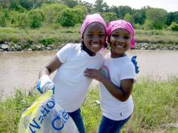
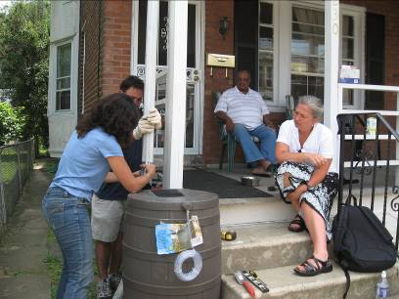
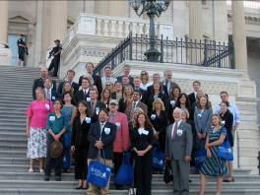
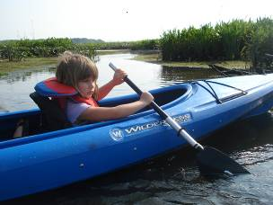
American Rivers
Founded in 1973 to protect and restore America’s rivers
65,000 members and supporters nationwide

Slide 3
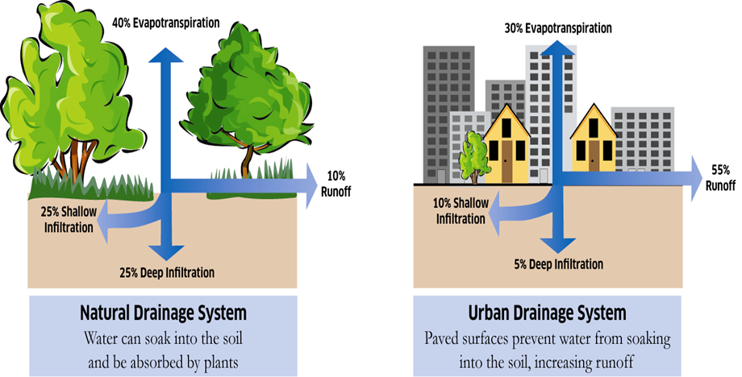
Drainage Systems

Slide 4
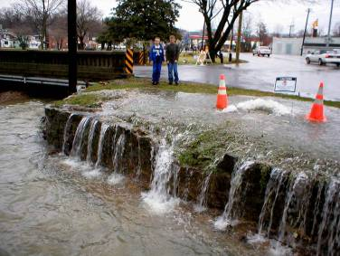
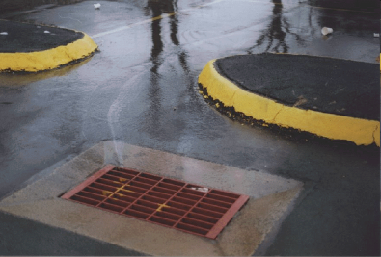
Contributors to the Problem
Most cities across the country have an average of 45% of impervious surface. Studies show that water quality becomes degraded when total impervious surface exceeds 10%.
Impervious Surfaces
Combined Sewer Overflows

Slide 5
Stormwater Management Objectives
The objective of BMPs is to minimize the adverse effects of development by mimicking, as closely as possible, the runoff characteristics of the site in its undeveloped state.
These characteristics include:
  Moderation of runoff peak flows and volumes to minimize downstream erosion and damage to in-stream aquatic habitat.
  Removal of pollutants such as sediment, nutrients, pathological bacteria and heavy metals.
  Infiltration of rainfall to replenish the water table and provide stable base flow to streams.

Slide 6
Best Management Practices
Selecting the right BMP
  Different BMPs are better suited for different aspects of stormwater treatment and control
    Sediment removal
    Nutrient removal
    Volume control
  Site characteristics
    Slope, soils, size, and development density
Are there specific requirements?
  1 inch storm
  85% storm

Slide 7
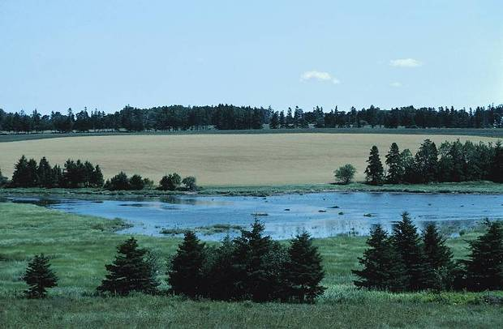
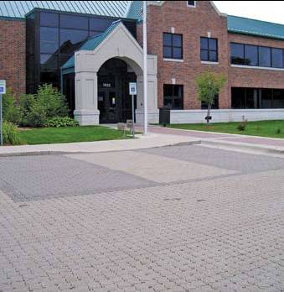
Nonstructural Controls
Protect Natural Features and
Sensitive Areas
Minimize Impervious Surfaces

Slide 8
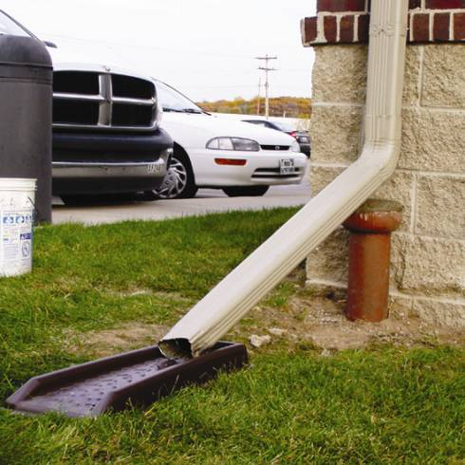
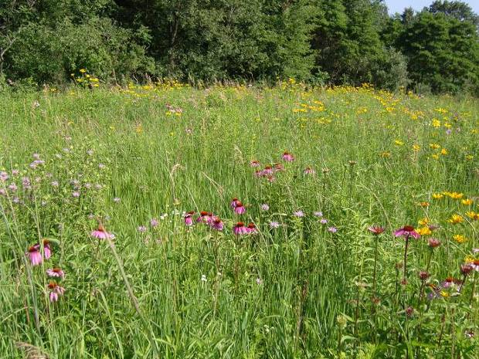
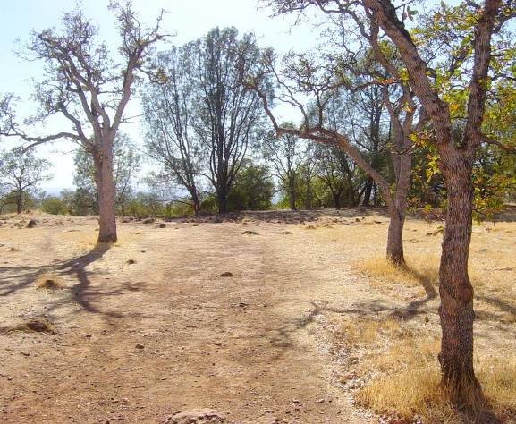
Nonstructural Controls
Stormwater Disconnection
Conservation Landscaping Techniques
Minimize Soil Compaction

Slide 9
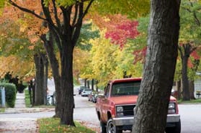
Tree Canopy
A 2007 study of Washington, DC found that use of urban trees and green roofs for stormwater management would keep 1.2 billion gallons of runoff out of the water infrastructure system. This equals a 10% reduction in untreated discharge entering local rivers and would reduce the frequency of combined sewer overflows by almost 7 percent. At the minimum, this would keep an estimated 120 pounds of copper, 180 pounds of lead, 340 pounds of phosphorous, and 530,000 pounds of total solids among other pollutants out of local waterways every year.

Slide 10
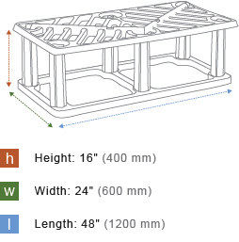
Silva Cells
Rigid, stackable structures of glass and polysyrene compound with galvanized steel tube frames.
Models predict a 10 percent reduction in peak stormwater flows as a result of Silva cell installation, and research indicates that the filtration offered by the soil within the cells will potentially remove more than 80 percent of phosphorus, 60 percent of nitrogen, and more than 90 percent of lead, copper, zinc, and iron.

Slide 11
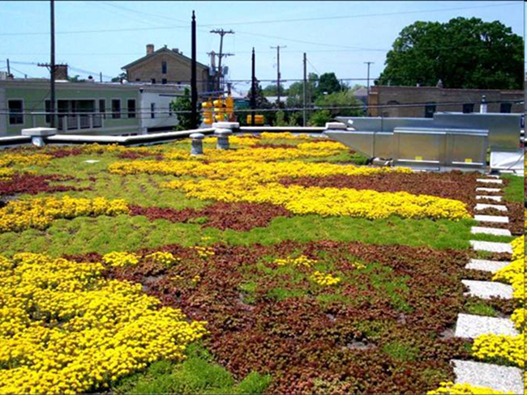
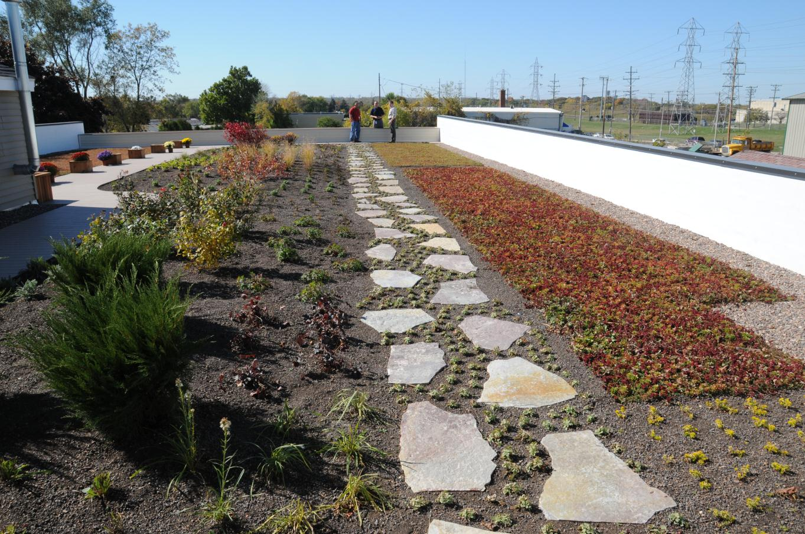
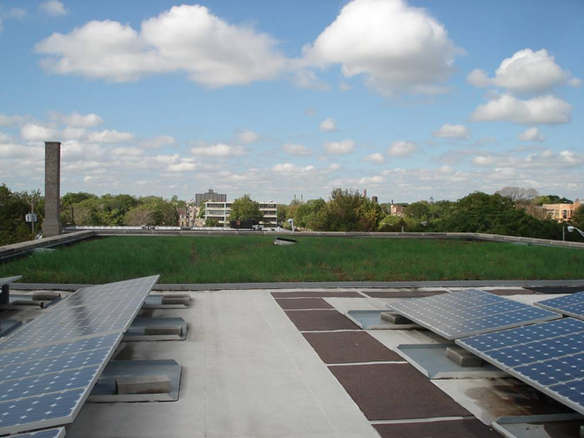
Green Roofs
Peak flow reduction
Compost balance

Slide 12
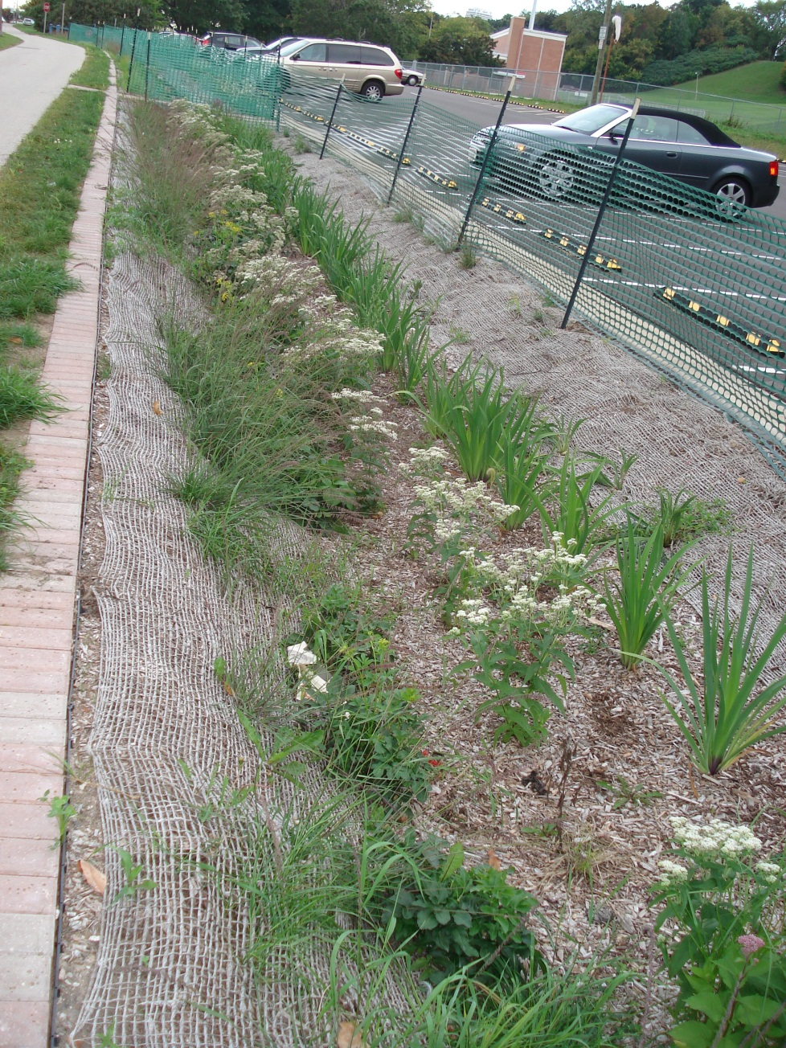
Bioretention
Performance
Pollutant removal rates
  Sediment and bacteria (90%)
  Phosphorus (negative to 70%)*
  Nitrogen (35 to 65%)
  Metals (Zn, Cu, Pb) (65% or more)
  * Depends on soil-P levels in media

Slide 13
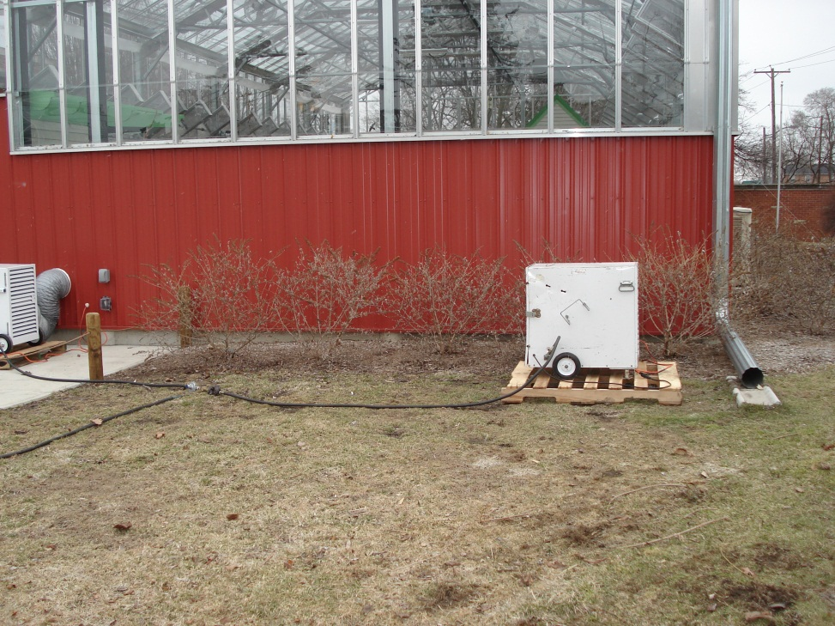
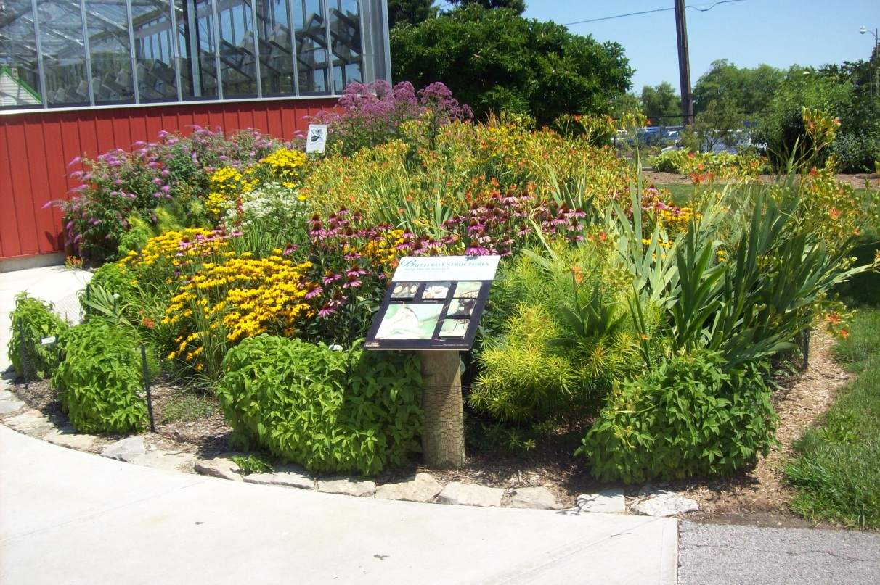
Rain Gardens
Toledo Zoo

Slide 14
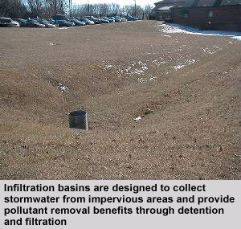
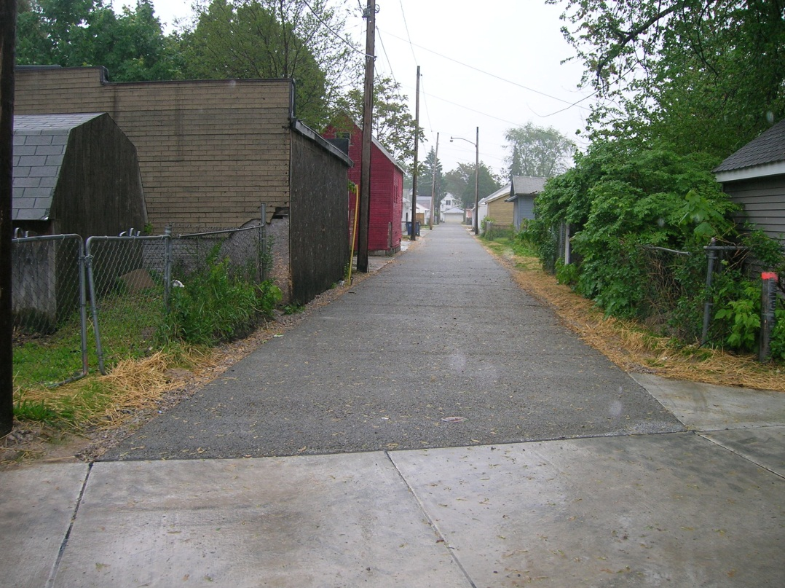
Infiltration
Performance
Pollutant removal rates
  Sediment and bacteria (90%)
  Phosphorus (65%)
  Nitrogen (35 to 50%)
  Metals (Zn, Cu, Pb) (65% or more)
  Great for temperature and runoff reductions
  *Limited or zero removal of soluble metals, chlorides and nutrients

Slide 15
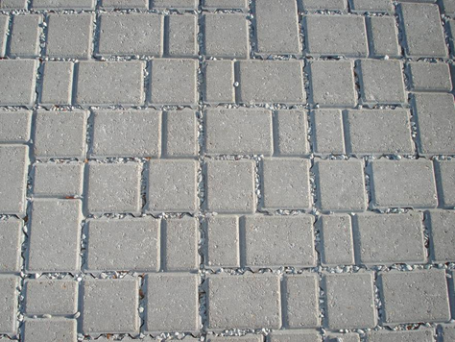
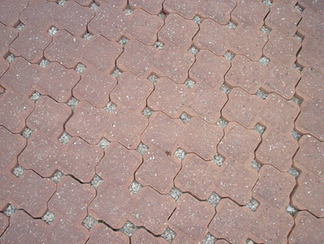
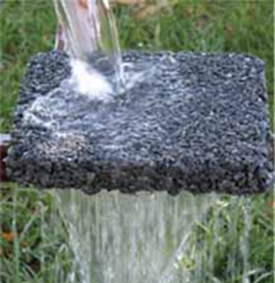
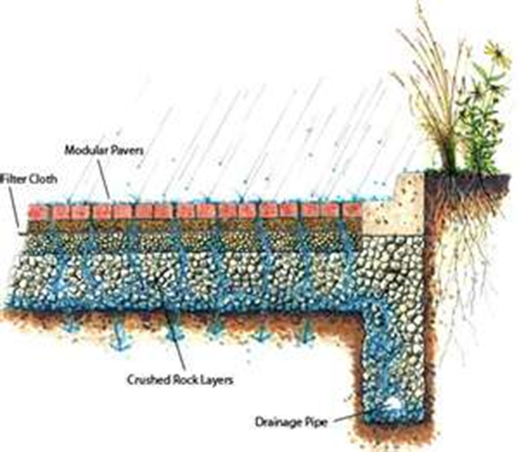
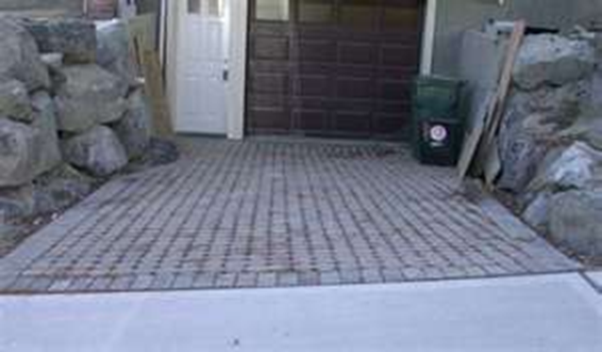

Slide 16
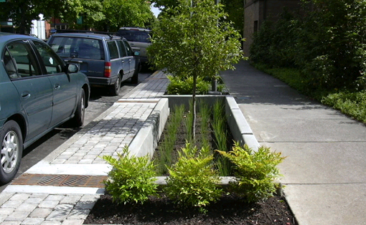
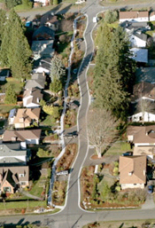
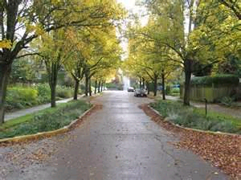
Green Streets

Slide 17
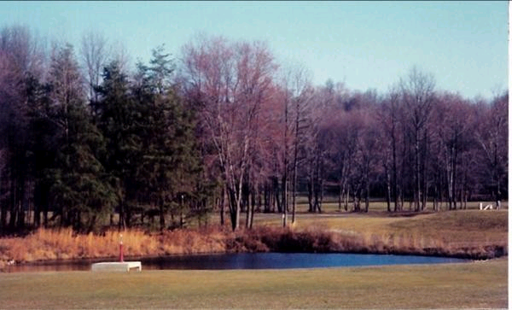
Wet Ponds
The primary functions of a wet pond are to detain stormwater and facilitate pollutant removal through settling and biological uptake.
Performance
Pollutant removal rates
  Sediment and bacteria (75%)
  Phosphorus (65%)
  Nitrogen (30%)
  Metals (Zn, Cu) (65% )
  *Ice cover, geese, and poor geometry limit performance

Slide 18

Lawn Care
Mow High: Longer grass is stronger grass; it grows deeper roots and better absorbs and filters rainfall.
Return clippings: Mulching recycles organic matter and nutrients back into the soil where microbes and earthworms thrive. Rich soil helps absorb and filter rainfall, reducing erosion and runoff.
Use the right fertilizer: For mature lawns, choose a fertilizer that is low in phosphorus or phosphorus-free.
Clean up: Keep grass clippings and fertilizer off sidewalks, roadways and other hard surfaces and out of our waterways.

Slide 19
Thank you
Katie Rousseau
American Rivers
419-936-3759
krousseau@americanrivers.org
www.americanrivers.org

