Slide 1
Abuse and Neglect of Older Adults with Disabilities

Slide 2
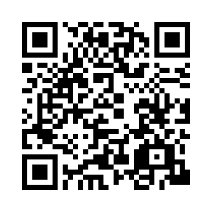
Please scan the QR code or use the anonymous link to complete a brief demographic questionnaire.
https://ohio.qualtrics.com/jfe/form/SV_6h50DHeXKNxJCRM

Slide 3
Acknowledgements
The Medicaid Care Experience Simulation (MCarES) is funded by the Ohio Department of Medicaid and administered by the Ohio Colleges of Medicine Government Resource Center.
The views expressed in this virtual reality simulation are solely those of the creators and do not represent the views of the state of Ohio or federal Medicaid programs.

Slide 4
Partners

Slide 5
The following virtual reality simulation contains content
that some people may find triggering. If you believe that you will find the material triggering, you may choose not to participate, or you can withdraw at any time.
Section 4743.10: Medical Practitioner Conscience Clause
“A medical practitioner, health care institution, or health care payer has the freedom to decline to perform, participate in, or pay for any health care service which violates the practitioner’s, institution’s, or payer’s conscience as informed by the moral, ethical, or religious beliefs or principles held by the practitioner, institution, or payer.”
Law signed on July 1, 2021 and made effective on September 30, 2021.

Slide 6
Objectives
Define disability and elder abuse and neglect.
Identify risk factors for elder abuse and neglect.
Explain the association between disability and elder abuse and neglect.
List approaches to intervene in cases of suspected elder abuse and neglect.

Slide 7
Disability in Ohio
Ohio law defines disability as:
“a physical or mental impairment that substantially limits one or more major life activities, including the functions of caring for oneself, performing manual tasks, walking, seeing, hearing, speaking, breathing, learning, and working; a record of a physical or mental impairment; or being regarded as having a physical or mental impairment.”
Disability can be the result of multiple health conditions being present that decrease a person's ability to independently perform activities of daily living.

Slide 8
Disability Amongst Older Adults in Ohio
42.6% of Ohioans over age 65 years have a disability.
Mobility disability
Cognitive disability
Hearing disability
Independent living disability
Vision disability
Self-care disability
Centers for Disease Control and Prevention, National Center on Birth Defects and Developmental Disabilities, Division of Human Development and Disability. Disability and Health Data System

Slide 9
Barriers to Adequate Health Care in People with Disabilities
Lack of accessible and affordable transportation.
Inaccessible health care facilities.
Lack of accessible exam and diagnostic equipment (e.g., adjustable height exam tables).
Communication barriers, especially for Deaf patients and patients with cognitive disabilities.

Slide 10
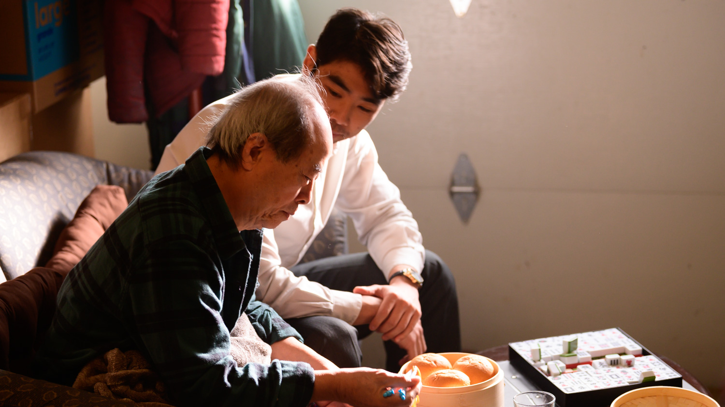
Meet Mr. Chen and His Family Mr. Chen is 80-year-old with type 2 diabetes, hearing disability, mobility disability, and potential cognitive disability. He is living with his son James’ family.

Slide 11
Episode 1 James Takes Mr. Chen to a Doctor’s Appointment

Slide 12
Experiences and Attitudes toward Disability
Persons with disability experience more negative interactions with the healthcare system.
Less likely to be receive cancer screenings or STI screenings, dental cleanings, Pap tests, cholesterol tests, and tetanus shots
A 2021 survey of physicians found negative biases against persons with disability:
82% of physicians reported persons with disability live lower quality lives that people without disabilities when disability was the only factor considered.
Pharr & Bungam, 2012; Iezzoni et al., 2021.

Slide 13
Disability Training
Only 52% of medical schools incorporate disability training into their curriculum.
Of the medical schools with disability included in their curriculum, only 10% integrate content developed by people with disabilities.
Both medical students and physicians want more training for how to care for patients with disabilities.
Seidel & Scott, 2017; Bruder et al., 2012

Slide 14
Episode 2: The Stress of Caregiving Tension Mounts in the Family

Slide 15
Disability & Elder Abuse
Disability is one of the most prominent risk factors for becoming a victim or perpetrator of elder abuse or neglect.
1 to 2 million older adults in the US are mistreated by a loved one or caregiver.
*It is estimated that persons 65 years and older will comprise 20% of the US population by 2030; this will likely increase the prevalence of abuse.

Slide 16
Care Associated with Disability can Increase Caregiver Stress
On average, family caregivers for older persons devote 40.5 hours/week in addition to other responsibilities.
27% of caregivers report financial stress through lost wages and additional medical expenses.
*Providers should consider abuse and neglect in both home-based and institutional-based care settings (e.g., assisted living, nursing homes).

Slide 17
The Stress of Caregiving
In 2020, 1 in 6 Americans (42 million adults) report providing care to someone age ≥ 50 years.
53% of caregivers are providing care to someone ≥ 75 years and 25% are caring for someone ≥ 85 years.
21% of caregivers say that caregiving made their health worse.
61% caregivers of adults ≥ 50 years are women and 39% are men.

Slide 18
Warning Signs of Elder Abuse and Neglect
Injuries
Dehydration
Weight loss
Unkempt appearance
Caregiver control
Refusing to allow older adult to be alone with clinician
Interrupting the older adult during visit
Little or no community involvement with community/senior services
Frequent exacerbations of chronic conditions
Unexpected declining health

Slide 19
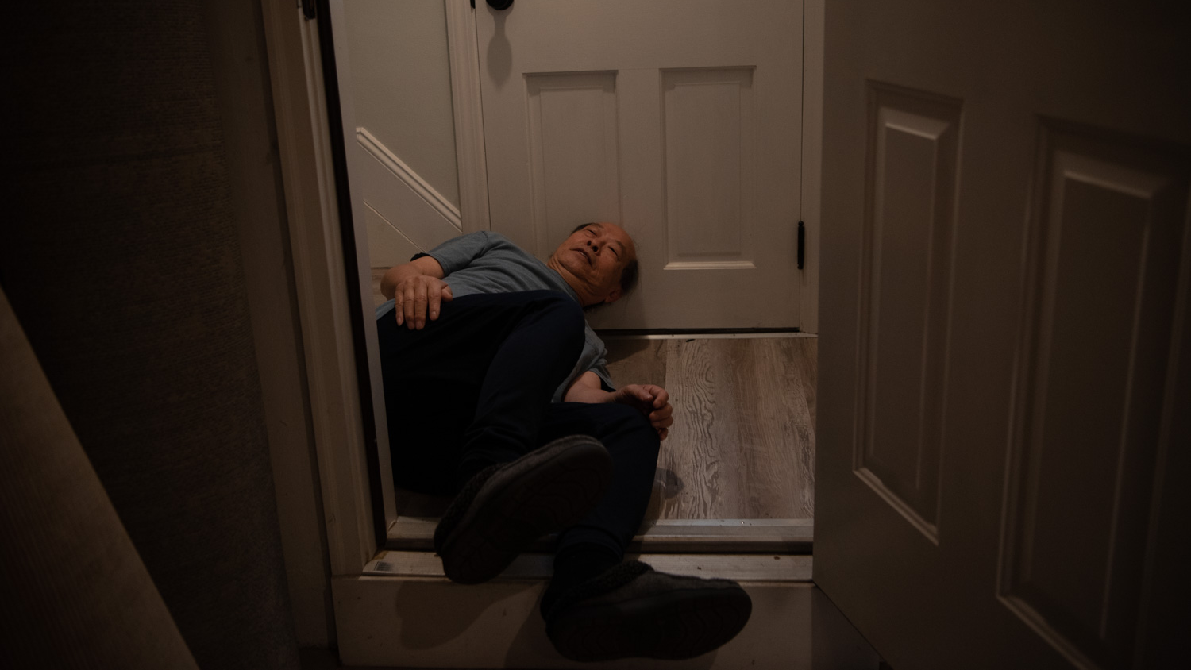
Episode 3: Recognizing Elder Abuse A Visit to Urgent Care

Slide 20
Recognizing Elder Abuse
Physical abuse includes bodily harm by hitting, pushing, slapping, restraining, or locking in a room.
Emotional / Psychological abuse can include hurtful language, threatening, repeatedly ignoring, or isolating from loved ones.
Neglect manifests by inattention to physical, emotional, and social needs (e.g., withholding food, water, medications, hygiene)
Sexual abuse involves a caregiver forcing an older adult to watch or be part of sexual acts.
Financial abuse includes forging checks, diverting Social Security benefits, using credit cards without permission, and theft.

Slide 21
Look for the Signs
Physical Abuse
Fractures, bruises (note ages, patterns, distribution), burns, head injuries, facial injuries
Emotional Abuse
Isolated / withdrawn, submissive, hesitant to talk, anxious, angry, depressed, fearful
Financial Abuse
Reported missing money, lack of access to own bank records, gifts of money in exchange for companionship
Sexual Abuse
Unexplained sexually transmitted infection (STI), genital bruising, bleeding, or irritation, inappropriate relationships between caregiver and elder

Slide 22
Look for the Signs
Neglect
Pressure ulcers, poor hygiene, bed confinement
Evidence of poor medication access / adherence (A1C elevation)
Missing / broken medical aids such as glasses, walker, dentures, or hearing aids (batteries)
Lack of follow-up with providers (e.g, audiologist)
Evidence of unclean/unsafe living conditions (e.g., pest infestations, soiled clothing, lack of heating/cooling)

Slide 23
Adult Abuse in Ohio (2019-2020)
33,783 reports (32,072 for adults aged 60 years and older)
17,022 validated reports / offered protective services
11,324 agreed to receive protective services

Slide 24
Perpetrator characteristics / risk factors:
Inadequate coping
Social isolation
Burnout
Low self-esteem
High perceived stress
Substance use disorders / dependence
Past traumatic experience
Women higher risk, but not discriminatory

Slide 25
Situational characteristics / risk factors:
Both institutional and home care
Dementia / cognitive impairment
Communication impairment
Limited mobility
Age ≥ 75 years
Women higher risk, but not discriminatory
Shared living arrangement other than spouse

Slide 26
Which of the Following Signs in the Simulations Suggest Abuse and/or Neglect?
Multiple missed visits with primary care doctor.
Mr. Chen does not need refills on his prescriptions at the primary care appointment.
James and Heather interrupt at key moments during appointments.
Mr. Chen has elevated A1C.
In the Urgent Care, it is noted that there is a variety of bruising and injuries.
Mr. Chen is dehydrated in the Emergency Department.
All the above

Slide 27
Which of the Following Signs in the Simulations Suggest Abuse and/or Neglect?
Multiple missed visits with primary care doctor.
Mr. Chen does not need refills on his prescriptions at the primary care appointment.
James and Heather interrupt at key moments during appointments.
Mr. Chen has elevated A1C.
In the Urgent Care, it is noted that there is a variety of bruising and injuries.
Mr. Chen is dehydrated in the Emergency Department.
All the above ✔

Slide 28
Episode 4: Tools of the Abuser Heading to the ED

Slide 29
Tool of the Abuser
Control | Isolation | Dependency | Shame
Threat of institutionalization Threat of abandonment Threat of reprisal Guilt Payback Manipulation | Isolation from people Isolation from pleasure Isolation from sensory input (hearing, vision) (Not the same as privacy) | Abuser leverages and fosters dependency as a means of control: Shopping Transportation Meal preparation Managing finances | The abuser may create shame surrounding: Cognitive impairment Physical disability Being dependent Being revealed Perceived fault Perceived diminished self-worth

Slide 30
Which Tools of Abuse do you Observe in the Simulation?
Control
Isolation
Dependency
Shame
All the above

Slide 31
Which Tools of Abuse do you Observe in the Simulation?
Control
Isolation
Dependency
Shame
All the above ✔

Slide 32
Delirium, dementia, and depression
are all common and difficult to tease apart. Mr. Chen has exhibited some symptoms of delirium, depression, and dementia.
The following charts help differentiate between delirium and dementia and depression and dementia.

Slide 33
Differentiating Delirium vs. Dementia
Feature | Delirium | Dementia
Onset | Onset often acute, at night | Insidious
Course | Fluctuating with lucid intervals during day; worse at night | Generally stable over course of day
Duration | Hours to weeks | Months to years
Awareness | Reduced | Clear
Alertness | Abnormally low or high | Usually normal
Attention | Hypoalert or hyperalert, distractable; fluctuates over course of day | Usually normal
Orientation | Usually impaired for time, tendency to mistake unfamiliar for familiar place and persons | Often impaired
Memory | Immediate and recent impairment | Recent and remote impairment
Thinking | Disorganized | Impoverished
Perception | Illusions and hallucinations (usually visual) relatively common | Usually normal
Speech | Incoherent, hesitant, slow or rapid | Difficulty in finding words
Sleep-wake cycle | Always disrupted | Often fragmented sleep
Physical illness or drug toxicity | Either or both present | Often absent, especially in Alzheimer’s disease

Slide 34
Differentiating Depression vs. Dementia
Depression in Older Adults | Dementia
Onset of cognitive decline is rapid | Onset of cognitive decline is slow
Preoccupation about cognitive deficits | Lack of concern or denial about cognitive deficits
Difficulty concentrating | Difficulty with short-term memory
Knowledge of correct date, time, and location | Confusion and disorientation
Psychomotor slowing with rapid onset (language, body movements) | Impaired psychomotor skills with gradual onset (writing, speaking, facial masking)
Acute loss of interest or pleasure in activities | Gradual loss of interest or pleasure in activities
Acute changes in sleeping patterns | Gradual disruption of the sleep-wake cycle due to changes in the brain
Acute decrease in energy | Normal energy levels
Acute changes in appetite leading to weight loss or gain | Gradual changes in weight status over the course of months to years
Rapid onset of agitation, predominantly worse in the morning but may persist throughout the day | Gradual increase in agitation, predominantly worse in the late afternoon/evening (sundowning)
Suicidal ideation or self-harming behaviors | Less likely to express suicidal ideation

Slide 35
For Mr. Chen, what is the most critical diagnosis that needs immediate attention?
Delirium
Depression
Dementia

Slide 36
For Mr. Chen, what is the most critical diagnosis that needs immediate attention?
Delirium ✔
Depression
Dementia
Mr. Chen may have all three conditions, but the delirium needs to be addressed first. He can then be assessed for the other conditions.

Slide 37
Episode 5: Improving Care for Mr. Chen We have the opportunity to take part in a conversation with Dr. Brooks about where she may have missed an opportunity to intervene during Mr. Chen’s trip to the ER.

Slide 38
Mistaking Signs and Symptoms of Elder Abuse and Neglect
Reports of frequent falls or being “accident prone”
Bruising pattern on face, neck, lateral arms, and posterior torso, especially if > 5 cm, is more common in older adults who suffer physical abuse than accidental injury.
Unexplained injuries and frequent emergency department visits.
Bruising in various stages of healing can be indicative of physical abuse or mistaken as bruising from anticoagulant and antiplatelet therapies or thin skin due to aging.
Fractures in various stages of healing can be attributed to osteoporosis and not evaluated as possible elder abuse.
Not taking medications/following treatment plan or not attending appointments
May be attributed to cognitive deficits, but it could be due to lack of access to medications, provider, or lack of caregiver knowledge in following the medication plan.

Slide 39
Mistaking Signs and Symptoms of Elder Abuse and Neglect
Weight loss
May be attributed to chronic disease(s), physical or cognitive deficits, or dehydration.
Polypharmacy or toxic levels of certain over-the-counter or prescription medications can lead to decreased appetite and weight loss (e.g., elevated digoxin level, amiodarone toxicity, donepezil).
Isolation during the COVID-19 pandemic decreased visits to providers, which may have increased the risk for undetected weight loss.
Providers should assess person’s access to meals and fluids, ability to feed self and swallow, and the caregiver’s understanding of nutritional requirements.
Include dietitian, occupational therapist, and speech language pathologist.

Slide 40
Identify which of the following are examples of misidentification by the healthcare provider of a sign of elder abuse or neglect.
Dr. Burnham notes elevated A1C level, multiple missed appointments, and lack of an updated medication list, and does not address these with James or Mr. Chen.
Dr. Burnham notes James’ comment about his dad’s confusion and does not make a referral to a neurologist for a diagnostic evaluation.
Dr. Brooks reviews the chart and directly questions Mr. Chen and notices his glances at James. She then asks all her questions to James.
Dr. Brooks notes Mr. Chen’s fall history and bruises but does not believe there is sufficient suspicion to call Adult Protective Services.
All of the above

Slide 41
Identify which of the following are examples of misidentification by the healthcare provider of a sign of elder abuse or neglect.
Dr. Burnham notes elevated A1C level, multiple missed appointments, and lack of an updated medication list, and does not address these with James or Mr. Chen.
Dr. Burnham notes James’ comment about his dad’s confusion and does not make a referral to a neurologist for a diagnostic evaluation.
Dr. Brooks reviews the chart and directly questions Mr. Chen and notices his glances at James. She then asks all her questions to James.
Dr. Brooks notes Mr. Chen’s fall history and bruises but does not believe there is sufficient suspicion to call Adult Protective Services.
All of the above ✔

Slide 42
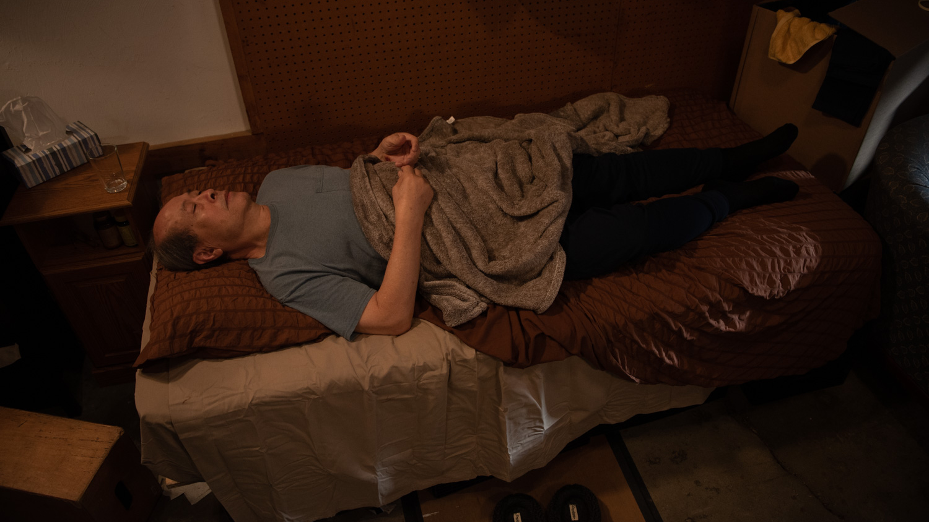
Episode 6: Connecting to Social Services Let’s revisit Mr. Chen’s visit to the ED.

Slide 43
Reporting Abuse
In Ohio, medical professionals are mandated to report suspected elder abuse, neglect, or exploitation (Section 5101.63 of Ohio Revised Code).
Ways to Report Suspected Abuse/Neglect/Exploitation:
If the person is in immediate danger, call local law enforcement.
If the person is 60 years or over and living in the community:
Adult Protective Services: 1-855-OHIO-APS
Your county’s department of Job and Family Services
Ohio Adult Protective Services Online Referral Tool
If the person has a developmental disability:
Developmental Disabilities Abuse/Neglect Hotline: 1-866-313-6733 (M-F 8-4:30)
If the person lives in a healthcare facility and suspected abuse is by another resident or staff member:
Ohio Department of Health Hotline: 1-800-342-0553
If the person lives in a mental health facility:
Adult Protective Services (APS) for facilities with 3 to 16 residents:1-855-OHIO-APS
For all other facilities:1-877-275-6364

Slide 44
Which resource is appropriate for making a report about Mr. Chen’s situation?
Adult Protective Services
Developmental Disabilities Abuse/Neglect Hotline
Ohio Department of Health Hotline

Slide 45
Which resource is appropriate for making a report about Mr. Chen’s situation?
Adult Protective Services ✔
Developmental Disabilities Abuse/Neglect Hotline
Ohio Department of Health Hotline

Slide 46
Making A Report
Reports of suspected abuse or neglect can be made anonymously.
You do not need to have evidence of abuse or neglect to provide a report.
There are no consequences for making a report that is not validated later – but there are consequences for failing to make a report as a mandated reporter.
Notes:
Will be modified to a downloadable flyer/brochure

Slide 47
What Happens When a Report is Made?
APS determines if an investigation needs to be opened.
The investigation:
Must be completed within 30 days.
Must attempt to interview older adult and provide written notice/explanation in language the person can understand.
Can interview other agencies, professionals, including the reporter.
Can request medical reports.
Must determine if the report can be validated.
If validated, APS develops a case plan that is reevaluated every 90 days.
Older adults can choose to accept or refuse assistance from APS.
If older adult does not appear to have capacity to make that decision,
APS can file a petition to override.

Slide 48
In conclusion

Slide 49
Do Not Miss the Opportunity to Help
You may be the one to make the difference. Missed diagnoses are either those you do not think about or those you do not know about.
Think about it:
Include elder abuse and neglect in differential diagnosis.
Know about it:
Learn the signs and symptoms – some are very subtle and easily confused for other pathology.
Act on it:
Be a patient advocate by reporting and following through.
Healthcare professionals are mandated reporters in Ohio. It is your professional obligation to report on suspected cases of elder abuse.
You do not need to be certain; you only need a suspicion to report.

Slide 50
It is Too Easy to Miss Opportunities
“It was probably just a fall.”
“It’s so hard to tell if this is abuse or neglect.”
“I don’t want to get it wrong.”
“I don’t want to accuse anyone.”
“I don’t have time to get into it. _____ will handle it.”
Social work
The inpatient team
The primary care provider
“They’re still probably better off than in a nursing home.”

Slide 51
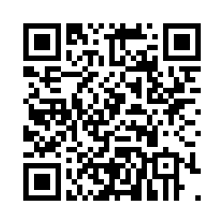
Please scan the QR code or the anonymous link to complete a brief post-VR simulation questionnaire.
https://ohio.qualtrics.com/jfe/form/SV_dnafceFLvK4chPE

Slide 52
References
Adult Protective Services Laws and Regulations. APS Ohio Revised Codes and Ohio Administrative Codes. Adapted by HIS of Ohio Human Services Training System; Understanding Elder Abuse: A Guide for Medical Professionals. Ohio Department of Job and Family Services.
Brozowski K, Hall DR. Aging and risk: physical and sexual abuse of elders in Canada. J Interpers Violence. 2010;25(7):1183-1199. doi:10.1177/0886260509340546.
Colón-Emeric CS, Whitson HE, Pavon J, Hoenig H. Functional decline in older adults. Am Fam Physician. 2013;88(6):388-394. PMCID: PMC3955056
Conde-Sala JL, Turró-Garriga O, Calvó-Perxas L, et al. Three-year trajectories of caregiver burden in Alzheimer's disease. J Alzheimers Dis. 2014;42(2):623-633. doi:10.3233/JAD-140360.
Connors MH, Seeher K, Teixeira-Pinto A, et al. Dementia and caregiver burden: a three-year longitudinal study. Int J Geriatr Psychiatry. 2020;35(2):250-258. doi:10.1002/gps.5244.
Godkin MA, Wolf RS, Pillemer KA. A case-comparison analysis of elder abuse and neglect. Int J Aging Hum Dev. 1989;28(3):207-225. doi:10.2190/WW91-L3ND-AWY3-R042.
Hawes C. Elder Abuse in Residential Long-Term Care Settings: What Is Known and What Information Is Needed? In: National Research Council (US) Panel to Review Risk and Prevalence of Elder Abuse and Neglect; Bonnie RJ, Wallace RB, editors. Elder Mistreatment: Abuse, Neglect, and Exploitation in an Aging America. Washington (DC): National Academies Press (US); 2003. 14. Available from: https://www.ncbi.nlm.nih.gov/books/NBK98786/.
Lachs MS, Rosen T. Elder Mistreatment. In: Halter JB, Ouslander JG, Studenski S, High KP, Asthana S, Supiano MA, Ritchie C. eds. Hazzard's Geriatric Medicine and Gerontology, 7th edition. McGraw Hill; 2017.

Slide 53
References
Family Caregiver Alliance. Caregiver Statistics: Demographics. https://www.caregiver.org/resource/caregiver-statistics-demographics/. Published 2016. Accessed February 28, 2022.
Centers for Disease Control and Prevention. Caregiving. https://www.cdc.gov/aging/caregiving/index.htm. Reviewed November 25, 2019. Accessed February 28, 2022.
Ohio Department of Job and Family Services. Interdisciplinary Teams and Memorandum of Understanding 101 [Training Transcript]: Understanding Elder Abuse: A Guide for Medical Professionals.
Laumann EO, Leitsch SA, Waite LJ. Elder mistreatment in the United States: prevalence estimates from a nationally representative study. J Gerontol B Psychol Sci Soc Sci. 2008;63(4):S248-S254. doi:10.1093/geronb/63.4.s248.
Li-Korotky HS. Age-related hearing loss: quality of care for quality of life. Gerontologist. 2012;52(2):265-271. doi:10.1093/geront/gnr159.
Lachs MS, Williams C, O'Brien S, et al. Risk factors for reported elder abuse and neglect: a nine-year observational cohort study. Gerontologist. 1997;37(4):469-474. doi:10.1093/geront/37.4.469.
National Alliance for Caregiving and AARP. Caregiving in the U.S. 2020. https://doi.org/10.26419/ ppi.00103.001; https://www.caregiving.org/caregiving-in-the-us-2020/. Published 2021. Accessed February 28, 2022.
National Institute on Aging. Spotting the Signs of Elder Abuse. https://www.nia.nih.gov/health/infographics/spotting-signs-elder-abuse#:~:text=Seems%20depressed%2C%20confused%2C%20or%20withdrawn,needed%20care%20for%20medical%20problems. Reviewed 2020. Accessed February 28, 2022.

Slide 54
References
National Institute on Aging. Types of Abuse. https://www.nia.nih.gov/health/elder-abuse#types. Reviewed July 29, 2020. Accessed February 28, 2022.
National Institute on Aging. What Are Signs of Abuse? https://www.nia.nih.gov/health/elder-abuse#signs. Reviewed July 29, 2020. Accessed February 28, 2022.
Ohio Colleges of Medicine Government Resource Center, Ohio Developmental Disabilities Council. Transportation Challenges for Ohioans with Disabilities. https://ddc.ohio.gov/Portals/0/transportation-challenges-7-17.pdf. Published July 2017. Accessed February 28, 2022.
Peterson JC, Burnes DP, Caccamise PL, et al. Financial exploitation of older adults: a population-based prevalence study. J Gen Intern Med. 2014;29(12):1615-1623. doi:10.1007/s11606-014-2946-2.
Iezzoni LI, Rao SR, Ressalam J, et al. Physicians' perceptions of people with disability and their health care. Health Aff (Millwood). 2021;40(2):297-306. doi:10.1377/hlthaff.2020.01452.
Pinquart M, Sörensen S. Spouses, adult children, and children-in-law as caregivers of older adults: a meta-analytic comparison. Psychol Aging. 2011;26(1):1-14. doi:10.1037/a0021863.
Rosen T, Stern ME, Elman A, Mulcare MR. Identifying and Initiating Intervention for Elder Abuse and Neglect in the Emergency Department. Clin Geriatr Med. 2018;34(3):435-451. doi:10.1016/j.cger.2018.04.007.
Lachs MS, Pillemer KA. Elder Abuse. N Engl J Med. 2015;373(20):1947-1956. doi:10.1056/NEJMra1404688.
Han SD, Mosqueda L. Elder Abuse in the COVID-19 Era. J Am Geriatr Soc. 2020;68(7):1386-1387. doi:10.1111/jgs.16496.

Slide 55
References
Lachs MS, Pillemer KA. Elder Abuse. N Engl J Med. 2015;373(20):1947-1956. doi:10.1056/NEJMra1404688.
Han SD, Mosqueda L. Elder Abuse in the COVID-19 Era. J Am Geriatr Soc. 2020;68(7):1386-1387. doi:10.1111/jgs.16496.
Sirey JA, Halkett A, Chambers S, et al. PROTECT: A Pilot Program to Integrate Mental Health Treatment Into Elder Abuse Services for Older Women. J Elder Abuse Negl. 2015;27(4-5):438-453. doi:10.1080/08946566.2015.1088422.
The United States Department of Health and Human Services, Office of Disease Prevention and Health Promotion. Injury and Violence Prevention. https://www.healthypeople.gov/2020/topics-objectives/topic/injury-and-violence-prevention. Updated February 6, 2022. Accessed February 28, 2022.
Thorpe L. Depression versus dementia: how do we assess. Canadian Review of Alzheimer's Disease and Other Dementias. 2009 Sep;12(3):17-212.
Ohio Department of Job and Family Services. Understanding Elder Abuse: A Guide for Medical Professionals. http://nursing.ohio.gov/wp-content/uploads/2019/08/OhioBoardUnderstandingAbuse1_5.0.pdf. Reviewed September 2018. Accessed February 28, 2022.
Whalen Smith CN, Robinson AC, Brown C, Jiang F, Ashmead R, Disman P, Howard K. Transportation Accessibility for Ohioans with Disabilities: A Follow-Up to the 2017 Report “Transportation Challenges for Ohioans with Disabilities.” The Ohio Colleges of Medicine Government Resource Center, Columbus, OH. December 2021.

