Slide 1
Maternal, Infant, Child Health and Intimate Partner Violence

Slide 2
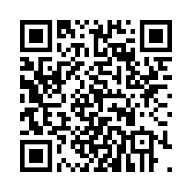
IPV PRE-SURVEY
Please scan the QR code to complete a brief demographic questionnaire.

Slide 3
Acknowledgements
The Medicaid Care Experience Simulation (MCarES) is funded by the Ohio Department of Medicaid and administered by the Ohio Colleges of Medicine Government Resource Center.
The views expressed in this virtual reality simulation are solely those of the creators and do not represent the views of the state of Ohio or federal Medicaid programs.

Slide 4
Partners

Slide 5
The following virtual reality simulation contains content
that some people may find triggering. If you believe that you will find the material triggering, you may choose not to participate, or you can withdraw at any time.
Section 4743.10: Medical Practitioner Conscience Clause
“A medical practitioner, health care institution, or health care payer has the freedom to decline to perform, participate in, or pay for any health care service which violates the practitioner’s, institution’s, or payer’s conscience as informed by the moral, ethical, or religious beliefs or principles held by the practitioner, institution, or payer.”
Law signed on July 1, 2021 and made effective on September 30, 2021.

Slide 6
Objectives
Describe the association between intimate partner violence and maternal and infant morbidity and mortality.
Define intimate partner violence.
List 3 signs and symptoms of intimate partner violence.
Describe the role of social support in intimate partner violence and psychological resilience.

Slide 7
Maternal, Infant, and Child (MIC) Health
Maternal health refers to the health of a woman during pregnancy, childbirth, and the postpartum period.
Improving the health and well-being of mothers, infants, and children is critical to preventing future health problems and achieving public health goals.
Maternal, infant, and child health outcomes are influenced by social determinants of health (e.g., income, employment, educational level, nutrition, housing).

Slide 8
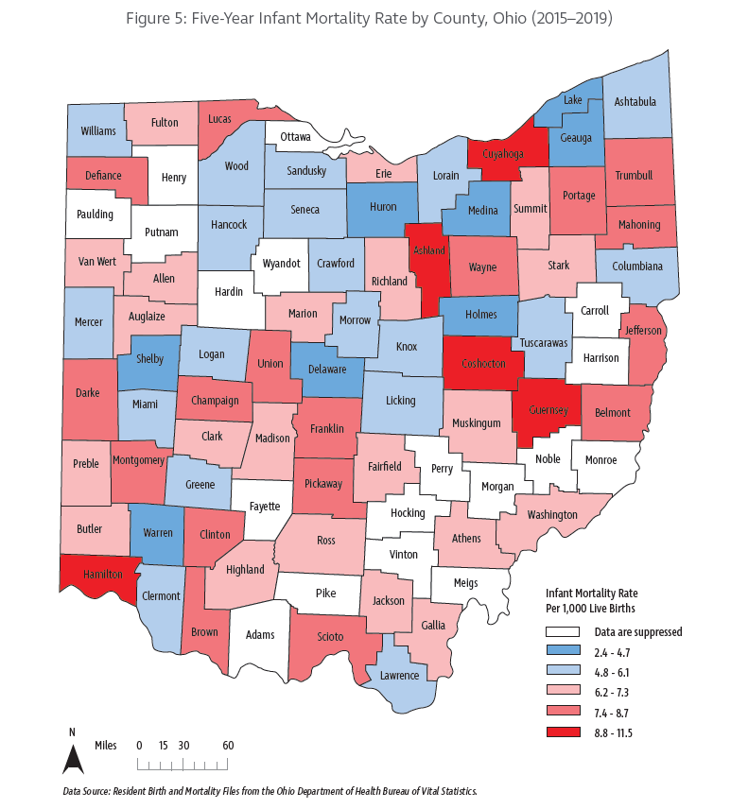
Maternal, Infant, and Child (MIC) Health in Ohio
In Ohio, racial and geographic disparities exist in infant mortality rates.
Ohio ranks 45th in the nation with an infant mortality 7.4 (infant deaths per 1,000 live births).
Leading causes of pregnancy-related death in Ohio:
-Cardiovascular and coronary conditions, 14%
-Infections, 13%
-Hemorrhage, 12%
-Mental health conditions, 11%
-Pre-eclampsia and eclampsia, 10%
-Cardiomyopathy, 9%
-Thromboembolism, 9%
-Amniotic fluid embolism, 4%,
-Other (homicide, unintentional injury, malignancies), 18%

Slide 9
Intimate Partner Violence
Intimate Partner Violence (IPV) is a behavior within a current or previous relationship leading to physical, psychological, or sexual harm to those in the relationship. Behaviors include:
Acts of physical violence (e.g., slapping, pushing, choking)
Sexual violence (e.g., unwanted sexual contact, forced sexual intercourse)
Emotional (psychological) abuse (e.g., insulting, belittling, threats of harm or to take away children)
Stalking (i.e., ongoing harassing or threatening behaviors that are unwanted and cause fear)
Controlling behaviors: (e.g., isolating a person from family and friends, monitoring their movements, restricting access to employment)

Slide 10
IPV Has Severe Consequences
Physical and mental health costs
Musculoskeletal injuries, disability and pain
Increased risk of cardiovascular and gastrointestinal diseases
Post-traumatic stress syndrome
Anxiety spectrum disorders
Depression / Major Depressive Disorder
Relationship costs
Loss of connection with family, friends
Economic costs
Impact on work performance
A woman who has experienced IPV is estimated to lose $103,767 over a lifetime

Slide 11
IPV Has Severe Consequences
IPV can take many forms up to and including homicide.
Pregnant and postpartum women are at increased risk of being assaulted and killed by a partner.
Homicide is the leading cause of death for women during pregnancy and the postpartum period in the United States.
One half of female homicide victims in the U.S. are the result of physical abuse from a male partner.

Slide 12
Who Experiences IPV?
Epidemiologic data demonstrate that IPV can impact anyone.
IPV occurs in any community regardless of:
Gender
Socioeconomic status
Age
Race
Religion
Nationality
Sexual and gender minorities and individuals with disabilities are at increased risk of experiencing IPV.

Slide 13
Prevalence of IPV
In Ohio alone, 38% of women and 33% of men have experienced intimate partner physical violence, intimate partner rape, and/or intimate partner stalking.
Across the U.S., domestic violence hotlines receive more than 20,000 phone calls each day.
Only a third of those who are injured by intimate partners receive medical attention for those injuries.

Slide 14
Meet Ana Luisa
Ana Luisa is 29 years old.
She thought she had found the perfect partner.
However, with each incidence of abuse, she is starting to think about what options exist to seek safety for herself and her son.
Health care professionals are uniquely positioned to empower and connect her to resources.

Slide 15
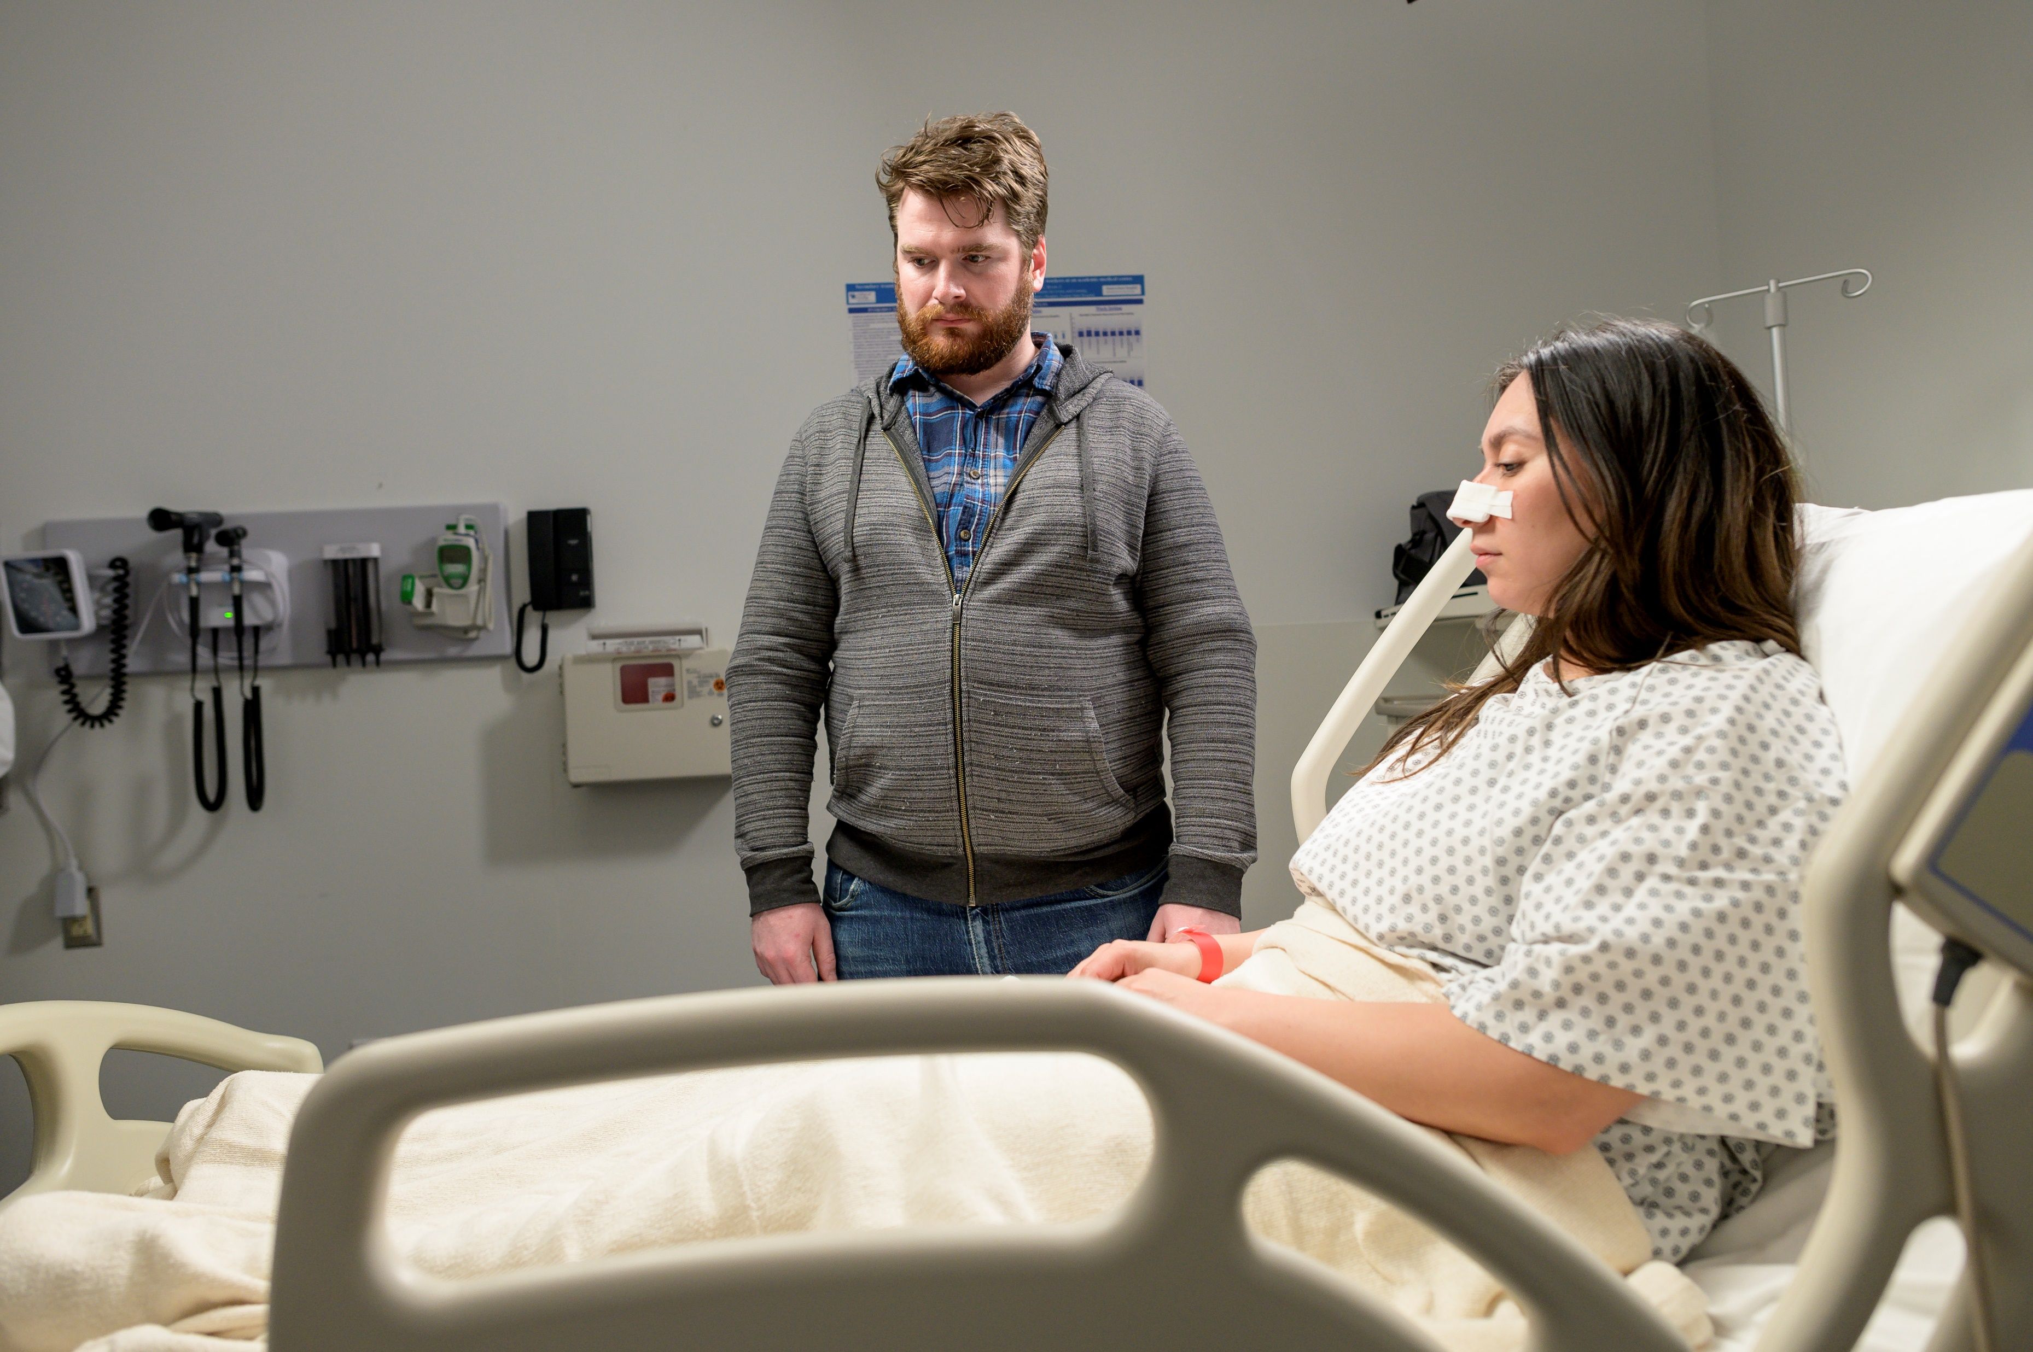
Episode 1: Ana Luisa’s Injury
https://youtu.be/gux4kZwbCgY

Slide 16
Recognize IPV
History Patterns
Frequent use of medical services, EDs, Urgent Care clinics
Frequent missed appointments with variable explanations
“Clumsy”, “Accident prone”, “Uncoordinated”
Multiple somatic concerns including frequent headaches / abdominal pain
2x more likely to report frequent headaches
3x more likely to report concurrent multisystem symptoms
Repeated reproductive system issues – STI’s, painful intercourse
2x more likely to have STIs
1.5x more likely to have unplanned pregnancies, abortions, or use emergency contraception
Increased incidence of psychiatric illness and substance abuse
2x more likely to show signs of anxiety
2x more likely to use drugs, especially related to sexual IPV
3x more likely to shows signs of depression

Slide 17
Recognize IPV
Behavior Patterns
Withdrawn posture
Poor eye contact
Hesitation before answering questions / Defers to partner (abuser)
No emotion <-> tearful
Defensive disposition
Untrusting demeanor

Slide 18
Recognize IPV
Physical Signs
Bruises or other injuries in various stages of healing
Injuries that don’t match reported history
Bruises / abrasions on neck (strangulation)
Defensive injuries (arm bruises resulting from blocked strikes)
Multiple / repeated injuries
Patterned injuries (object strikes, finger / grab marks, fingernail marks)
Injuries in hidden areas (thighs, upper arms, back, abdomen, ribs)

Slide 19
Recognize IPV
Partner’s / Abuser’s Behavior
Speaks for patient / interrupts
Insists on staying close to the patient
Attempts to control time spent with the physician / provider
Displays jealousy or possessiveness
Displays intimidating body language (can be subtle)
May use threatening or abusive language
Holds insurance cards, wallet, driver’s license, keys, and money
Insists on being only emergency contact

Slide 20
What did you observe in the simulation that could indicate IPV?
A. Ana Luisa’s unplanned pregnancy
B. Bruises of various colors on Ana Luisa’s arms
C. Ana Luisa’s lack of eye contact
D. Ana Luisa’s injury does not match the cause given
E. All of the above

Slide 21
What did you observe in the simulation that could indicate IPV?
A. Ana Luisa’s unplanned pregnancy
B. Bruises of various colors on Ana Luisa’s arms
C. Ana Luisa’s lack of eye contact
D. Ana Luisa’s injury does not match the cause given
E. All of the above ✔

Slide 22
Which flags for potential interpersonal violence do you note in Jax’s behavior?
A. Jax stays close to Ana Luisa and never leaves her side.
B. Jax communicates with nurse on behalf of Ana Luisa.
C. Jax does not let Ana Luisa speak to her son or sister-in-law on the phone.
D. Jax controls the time the nurse spends with Ana Luisa.
E. All of the above

Slide 23
Which flags for potential interpersonal violence do you note in Jax’s behavior?
A. Jax stays close to Ana Luisa and never leaves her side.
B. Jax communicates with nurse on behalf of Ana Luisa.
C. Jax does not let Ana Luisa speak to her son or sister-in-law on the phone.
D. Jax controls the time the nurse spends with Ana Luisa.
E. All of the above ✔

Slide 24
Episode 2:
The Impact of IPV on Children
https://youtu.be/Y7op_VOa5OY

Slide 25
Adverse Childhood Experiences
Six percent of children are exposed to IPV annually.
Exposure to IPV and other adverse childhood experiences are linked to:
Poor academic achievement and school attendance problems
Depression and anxiety
Behavioral problems
Aggression
Experiencing peer bullying
Increased substance use in later life, and
A higher chance of suffering physical, emotional, and sexual abuse.

Slide 26
What might be true for Elias later in life due to his exposure to Intimate Partner Violence?
A. He may experience depression and anxiety.
B. He will be more likely to use drugs and alcohol.
C. He is more likely to become an abuser.
D. He could experience abuse in a relationship.
E. All of the above

Slide 27
What might be true for Elias later in life due to his exposure to Intimate Partner Violence?
A. He may experience depression and anxiety.
B. He will be more likely to use drugs and alcohol.
C. He is more likely to become an abuser.
D. He could experience abuse in a relationship.
E. All of the above ✔

Slide 28
Episode 3: Social-Ecological Model of Violence
https://youtu.be/8zuQ1L0wA7k

Slide 29
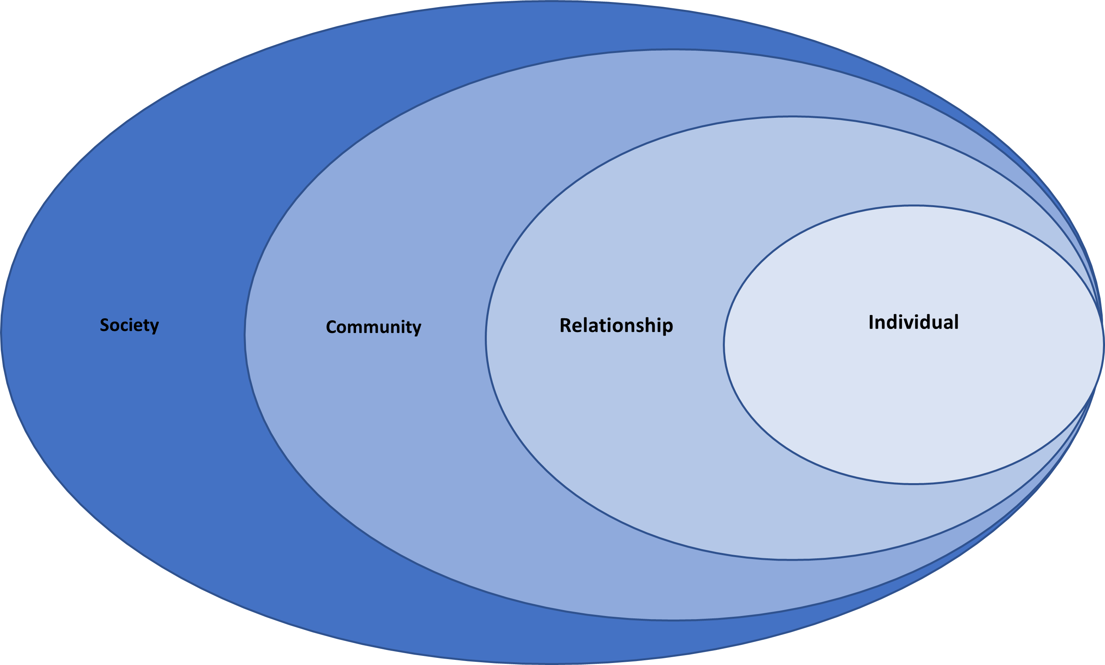
The Social-Ecological Model of Violence
IPV is the result of interactions amongst individuals and as products of communities and societies.
Society
Community
Relationship
Individual
Notes:
NOTES on each level:
Individual
Identifies biological and personal history factors; such as age, education, income, substance use, or history of abuse, that increase the likelihood of becoming a victim or perpetrator of violence.
Relationship
Examines close relationships that may increase the risk of experiencing violence as a victim or perpetrator. A person’s closest social circle-peers, partners and family members-influences their behavior and contributes to their range of experience.
Community
Explores the settings, such as schools, workplaces, and neighborhoods, in which social relationships occur and seeks to identify the characteristics of these settings that are associated with becoming victims or perpetrators of violence.
Societal
Looks at the broad societal factors, such as health, economic, educational and social policies, that help create a climate in which violence is encouraged or inhibited and help to maintain economic or social inequalities between groups in society.

Slide 30
What individual, relationship, community, and societal factors are at play in this simulation?
Notes:
Examples answers:
Jax experienced abuse as a child.
Ana Luisa’s in-laws brush violent behavior under the rug.
The Hills are respected and influential and local systems such as health care and policing tolerate their behavior.
Social norms reinforce violent behavior and encourage people to “look the other way” or blame the victim.

Slide 31
The following virtual reality episode contains a scene depicting IPV. If you wish to skip it starts at minute 4:30 when Jax closes the door and lasts through the end of the episode.

Slide 32
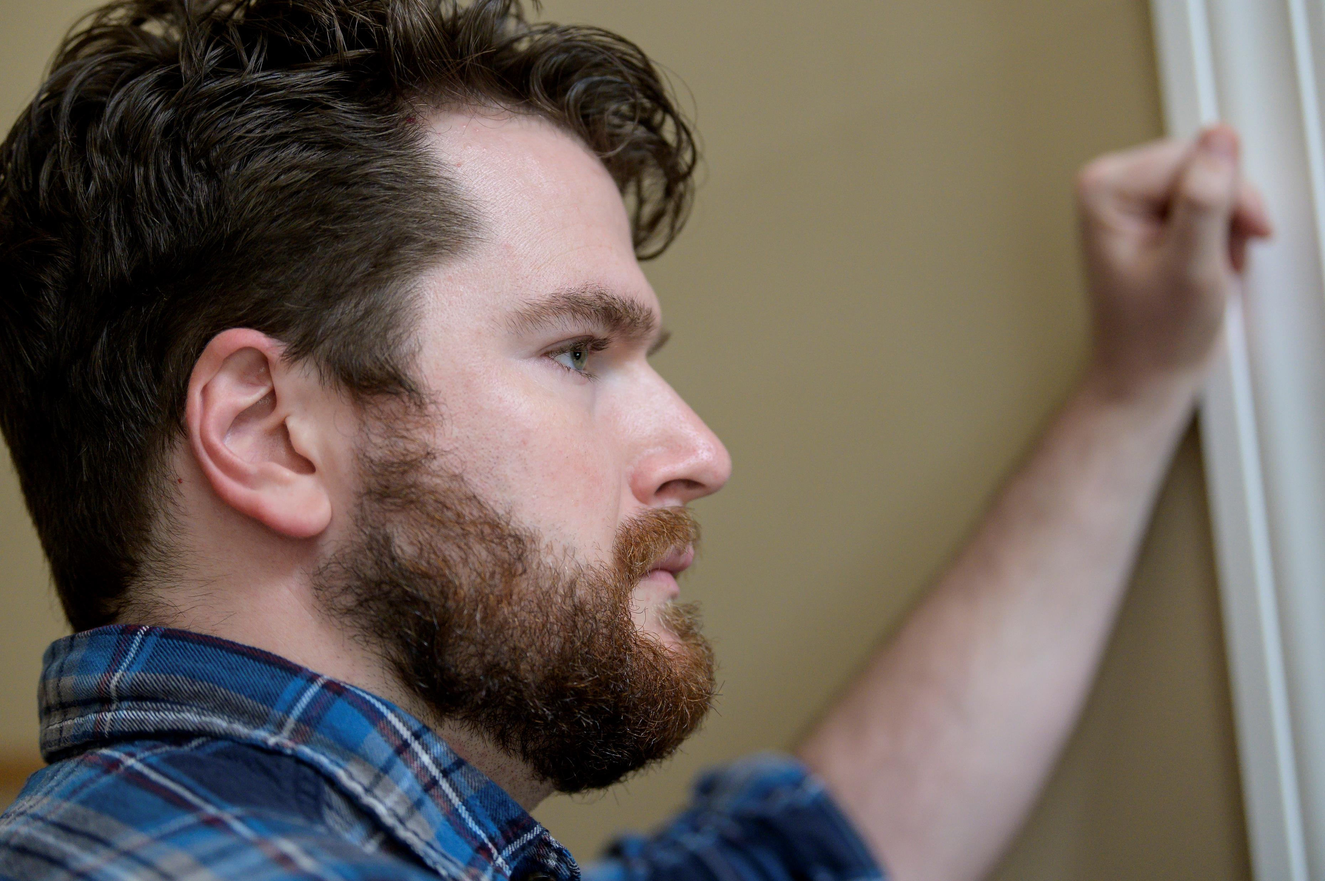
Episode 4:
The Tools of Abuse
https://youtu.be/7xtYUlIVs-Y

Slide 33
Coercive Control in a Relationship
IPV often takes place in the context of coercive control - a systematic pattern of power and control of one partner over the other.
Three things that help us understand when coercive control is present:
The intent and motivation to control,
The individual on the receiving end perceives the behavior as negative, and
The perpetrator is able to make a credible threat.

Slide 34
Recognize the Tools of Abuse
The abuser may use several methods to exert coercive control and instill fear and compliance in an intimate partner.
Isolation
Intimidation
Emotional / psychological manipulation
Threats against partner, self, friends, family
Stalking
Tracking by cell phone or another device
Deprivation of needs
Financial control
Sexual abuse
Physical assault

Slide 35
Episode 5: Motivational
Interviewing
https://youtu.be/sOLPnBw9hwY

Slide 36
Approaching Someone Experiencing IPV
The Substance Abuse and Mental Health Services Administration (SAMHSA) has outlined the following six principles of trauma-informed care:
Ensuring safety
Being trustworthy
Offering peer support
Collaborating with the patient
Empowering the patient by giving them choice
Appreciating and respecting the cultural background of the patient
Notes:
It is critical to build trust with someone who has experienced IPV. It's important that providers avoid having patients retell the story, which could re-traumatize the patient.

Slide 37
Motivational Interviewing (MI)
Motivational interviewing (MI) is a non-judgmental communication style that addresses an individual’s ambivalence or mixed feelings about a behavior.
Ambivalence is resolved by being heard and understood rather than persuasion to change a behavior.
The tenets of Trauma Informed Care can be incorporated into MI techniques.

Slide 38
Key Steps in Motivational Interviewing (MI)
Begin a conversation to elicit motivation for change:
Express empathy
Roll with resistance and engage the person in the process of problem solving
Develop discrepancy between their behavior and personal goals
Support self-efficacy so they believe change is possible -------------------------------------------------------------------------------------
Use ‘OARS’ skills: open questions, affirmations, reflections, summaries
Develop and reinforce ‘change talk’
Help your patient/client develop an action plan

Slide 39
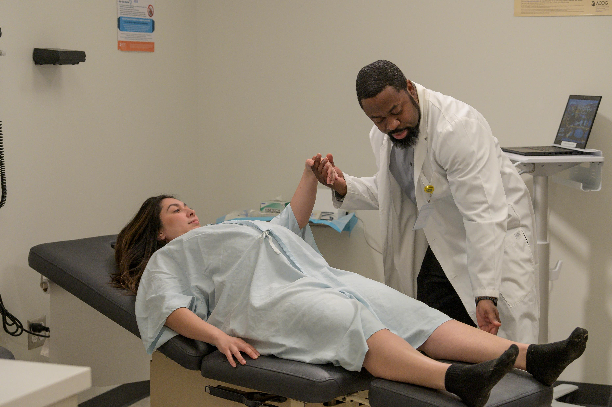
Episode 6: Supporting Someone Experiencing Intimate Partner Violence
https://youtu.be/B6ldITuK7pQ

Slide 40
Use Motivational Interviewing
Screening
Step 1: Ensure physical and emotional Safety with a welcoming space, security barriers, posting patient rights.
Step 2: Demonstrate Trustworthiness by being transparent, consistent, and setting interpersonal boundaries. Ask reflective and open-ended questions.
Clinician: [Name], how have you and your partner been doing since we last talked?
Patient: Okay, I guess.
Optional: So, things with you and partner have been going okay. [Reflection] Tell me more about that. [Open-ended question]

Slide 41
Use Motivational Interviewing
Brief Intervention
Step 3: Express Concern
Clinician: I’m concerned about your well-being and the health of your baby.
Step 4: Ask for Permission (Collaboration & Mutuality)
Clinician: If it’s all right with you, I’d like to talk about the impact of stress on the baby
Patient: Sure, I’m okay with that.
Step 5: Medicalize the Concern
Clinician: High levels of stress can cause health problems for you and your baby. It can increase the chances of having a premature or low-birthweight baby.
Step 6: Solicit Mutual Concern
Clinician: Does this concern you as well?
Patient : Well, yes it does.

Slide 42
Use Motivational Interviewing
Brief Intervention (cont’)
Step 7: Collaborate with patient (Offer Peer Support. Appreciate and respect Cultural, Historical, and Gender Issues)
Clinician: Would it be okay if we discuss this for a few minutes today? I can connect you with other individuals who have been in your situation and can help support you during this difficult time.
Patient: Yes, that would be fine.
Step 8: Assess Importance and Elicit Change Talk (Empowerment, Voice, and Choice)
Clinician: On a scale from 0 to 10, how important would you say it is for you to change the situation that you are in?
Patient: 7
Clinician: This is very important to you. What would it take to go from a 7 to a 9 or 10?

Slide 43
Patients Who Are Not Ready to Leave
People who experience IPV may not be ready to leave due to:
Fear of retaliation
Fear of relationship loss
Fear of harm to child or loss of custody
Fear of leaving a pet
Lack of financial resources
Lack of secure housing
Cultural / religious beliefs
Individual reasons

Slide 44
Patients Who Are Not Ready to Leave
There are ways to support individuals experiencing IPV, even if they are not ready to leave.
Encourage self-care and a safety plan
Those who experience IPV and are not ready to leave can think about ways to care for themselves and work with an advocate to have safety considerations in place.
Build trust
Once trust has been established, and with the patient’s consent, providers can ask: do you have a trusted friend who you can call for support? Have you thought about where you would go if you ever decide to leave?
Maintain an open door
Let them know they are not alone and can reach out for help when ready.

Slide 45
You May Be the One to Make a Difference
Making the diagnosis may save a life – “Missed diagnoses are either those you don’t know about or those you don’t think about.”
Know the signs of IPV
Actively look for the signs of IPV
Recognize the signs of IPV
Build trust, empower, and communicate effectively with your patient
Work with your team
Avoid pitfalls
“That’s not my job. The social worker should take care of that.”
“I wish I could do more. I’m so busy. I don’t have time to get into all of that.”
“It won’t make a difference anyway.”

Slide 46
Create an Environment of Support
Educate. Place posters or brochures in exam rooms and restrooms.
Screen. Use screening tools for IPV in women of reproductive age as recommended by the U.S. Preventive Services Task Force.
HITS – Hurt, Insult, Threaten, Scream
UVPSP – Universal Violence Prevention Screening Protocol
PVS – Partner Violence Screen
Connect. Develop a referral process to mental health, social services, and local and national IPV advocacy organizations.

Slide 47
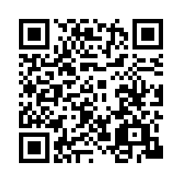
IPV POST-SURVEY
Please scan the QR code to complete a brief post-VR simulation questionnaire.

Slide 48
Key Resources
National Domestic Violence Hotline Call 1-800-799-7233 and TTY 1-800-787-3224.
Love is Respect National Teen Dating Abuse Helpline Call 1-866-331-9474 or TTY 1-866-331-8453
Rape, Abuse & Incest National Network’s (RAINN) National Sexual Assault Hotline Call 800-656-HOPE (4673) to be connected with a trained staff member from a sexual assault service provider in your area.
National Resource Center on Domestic Violence
Resources for Violence Prevention and Healing

Slide 49
References
Abramsky, T., Watts, C. H., Garcia-Moreno, C., Devries, K., Kiss, L., Ellsberg, M., ... & Heise, L. (2011). What factors are associated with recent intimate partner violence? Findings from the WHO multi-country study on women's health and domestic violence. BMC public health, 11(1), 1-17. https://doi.org/10.1186/1471-2458-11-109
Baylor College of Medicine. Practical Guidelines on Handling Abuse Issues in Clinical Settings (n.d.). Retrieved October 27, 2021 from https://www.bcm.edu/research/research-centers/center-for-research-on-women-with-disabilities/a-to-z-directory/violence/guidelines-for-professionals/practical-guidelines-on-handling-abuse-issues-in-clinical-settings.
Black, M.C., Basile, K.C., Breiding, M.J., Smith, S.G., Walters, M.L., Merrick, M.T., Chen, J., & Stevens, M.R. (2011). The National Intimate Partner and Sexual Violence Survey (NISVS): 2010 Summary Report. Atlanta, GA: National Center for Injury Prevention and Control, Centers for Disease Control and Prevention.
Boden, J. M., Fergusson, D. M., & Horwood, L. J. (2012). Alcohol misuse and violent behavior: findings from a 30-year longitudinal study. Drug and alcohol dependence, 122(1-2), 135-141. https://doi.org/10.1016/j.drugalcdep.2011.09.023
Caldwell, J. E., Swan, S. C., & Woodbrown, V. D. (2012). Gender differences in intimate partner violence outcomes. Psychology of violence, 2(1), 42. https://doi.org/10.1037/a0026296
Camacho, K., Ehrensaft, M. K., & Cohen, P. (2012). Exposure to intimate partner violence, peer relations, and risk for internalizing behaviors: A prospective longitudinal study. Journal of Interpersonal Violence, 27(1), 125-141.https://doi.org/ 10.1177/0886260511416474
Centers for Disease Control National Center for Health Statistics (2020). Infant Mortality Rates by State [Data Set]. Retrieved April 19, 2022 from https://www.cdc.gov/nchs/pressroom/sosmap/infant_mortality_rates/infant_mortality.htm
Choo, E. K., & Houry, D. E. (2015). Managing intimate partner violence in the emergency department. Annals of emergency medicine, 65(4), 447-451. https://doi.org/10.1016/j.annemergmed.2014.11.004
Curry, S. J., Krist, A. H., Owens, D. K., Barry, M. J., Caughey, A. B., Davidson, K. W., ... & US Preventive Services Task Force. (2018). Screening for intimate partner violence, elder abuse, and abuse of vulnerable adults: US Preventive Services Task Force final recommendation statement. Jama, 320(16), 1678-1687. https://doi.org/10.1001/jama.2018.14741
Dahlberg, L. L. (2002). Violence: a global public health problem In Krug EG, Dahlberg LL, Mercy JA, Zwi AB, & Lozano R (Eds.), World report on violence and health (pp. 1–21). Geneva, Switzerland: World Health Organization.
Decker, M., Littleton, H. L., & Edwards, K. M. (2018). An updated review of the literature on LGBTQ+ intimate partner violence. Current Sexual Health Reports, 10(4), 265-272.. https://doi.org/10.1007/s11930-018-0173-2
Desmarais, S. L., Pritchard, A., Lowder, E. M., & Janssen, P. A. (2014). Intimate partner abuse before and during pregnancy as risk factors for postpartum mental health problems. BMC pregnancy and childbirth, 14(1), 1-12. https://doi.org/10.1186/1471-2393-14-132
Emery, C. R. (2009). Stay for the children? Husband violence, marital stability, and children's behavior problems. Journal of Marriage and Family, 71(4), 905-916. https://doi.org/10.1111/j.1741-3737.2009.00643.x

Slide 50
References
Garcia-Moreno, C., Jansen, H. A. F. M., Ellsberg, M., Heise, L., & Watts, C. (2005). WHO multi-country study on Women's health and domestic violence against women: initial results on prevalence. Health Outcomes and Women's Responses. Geneva: World Health Organization.
Hahn, J. W., McCormick, M. C., Silverman, J. G., Robinson, E. B., & Koenen, K. C. (2014). Examining the impact of disability status on intimate partner violence victimization in a population sample. Journal of interpersonal violence, 29(17), 3063-3085. https://doi.org/10.1177%2F0886260514534527
Hamberger, L. K., Larsen, S. E., & Lehrner, A. (2017). Coercive control in intimate partner violence. Aggression and Violent Behavior, 37, 1-11. https://doi.org/10.1016/j.avb.2017.08.003
Hamby, S. L., Finkelhor, D., Turner, H., & Ormrod, R. (2011). Children’s exposure to intimate partner violence and other family violence: Nationally representative rates among US youth. OJJDP Juvenile Justice Bulletin–NCJ 232272, 1-12. Washington, DC: US Government Printing Office.
Heise L, Garcia Moreno C (2002). Violence by intimate partners. In: Krug EG et al., eds., The world report on violence and health. Geneva, World Health Organization, 2002:87– 121. https://doi.org/10.1016/S0140-6736(02)11133-0
Heise, L., Ellsberg, M., & Gottemoeller, M. (1999). Ending violence against women. Population reports, 27(4), 1-1.
Holt, S., Buckley, H., & Whelan, S. (2008). The impact of exposure to domestic violence on children and young people: A review of the literature. Child abuse & neglect, 32(8), 797-810.https:// doi.org/ 10.1016/j.chiabu.2008.02.004
Hong, J. S., Zhang, S., Burlaka, V., Yoshihama, M., Yan, Y., & Voisin, D. R. (2021). From Exposure to Violence between Mother and Her Intimate Partner to Suicidality Experienced by Urban Adolescents in Chicago’s Southside. International journal of environmental research and public health, 18(15), 7870.https://doi.org/ 10.3390/ijerph18157870
Kiesel, L. R., Piescher, K. N., & Edleson, J. L. (2016). The relationship between child maltreatment, intimate partner violence exposure, and academic performance. Journal of Public Child Welfare, 10(4), 434-456.https://doi.org/ 10.1080/15548732.2016.1209150
Kwako, L. E., Glass, N., Campbell, J., Melvin, K. C., Barr, T., & Gill, J. M. (2011). Traumatic brain injury in intimate partner violence: A critical review of outcomes and mechanisms. Trauma, Violence, & Abuse, 12(3), 115-126. https://doi.org/10.1177/1524838011404251
Lacey, K. K., McPherson, M. D., Samuel, P. S., Powell Sears, K., & Head, D. (2013). The impact of different types of intimate partner violence on the mental and physical health of women in different ethnic groups. Journal of interpersonal violence, 28(2), 359-385. https://doi.org/10.1177/0886260512454743
Machado, A., Hines, D., & Douglas, E. M. (2020). Machado, A., Hines, D., & Douglas, E. M. (2020). Male victims of female-perpetrated partner violence: A qualitative analysis of men’s experiences, the impact of violence, and perceptions of their worth. Psychology of Men & Masculinities, 21(4), 612.https://doi.org/10.1037/men0000285
Madruga, C. S., Viana, M. C., Abdalla, R. R., Caetano, R., & Laranjeira, R. (2017). Pathways from witnessing parental violence during childhood to involvement in intimate partner violence in adult life: The roles of depression and substance use. Drug and alcohol review, 36(1), 107-114.https:// doi.org/ 10.1111/dar.12514

Slide 51
References
McDonald, R., Jouriles, E. N., Ramisetty-Mikler, S., Caetano, R., & Green, C. E. (2006). Estimating the number of American children living in partner-violent families. Journal of family psychology, 20(1), 137.https:// doi.org/ 10.1037/0893-3200.20.1.137
Miller, W. R., & Rollnick, S. (2012). Motivational interviewing: Helping people change. Guilford press.
National Center for Injury Prevention and Control, Division of Violence Prevention (n.d.). The social-ecological model: A framework for violence prevention. Centers for Disease Control and Prevention. Retrieved February 8, 2022, from https://www.cdc.gov/violenceprevention/about/social-ecologicalmodel.html
National Coalition Against Domestic Violence (2020). Domestic violence. Retrieved from https://assets.speakcdn.com/assets/2497/domestic_violence-2020080709350855.pdf?1596811079991.
National Coalition Against Domestic Violence (2021). Domestic violence in Ohio. Retrieved April 19, 2022 from https://ncadv.org/state-by-state
National Coalition Against Domestic Violence (n.d.). Why do Victims Stay? Retrieved April 19, 2022 from https://www.ncadv.org/why-do-victims-stay
Nicholson, J. V., Chen, Y., & Huang, C. C. (2018). Children's exposure to intimate partner violence and peer bullying victimization. Children and Youth Services Review, 91, 439-446. https://doi.org/10.1016/j.childyouth.2018.06.034
Niolon, P. H., & Centers for Disease Control and Prevention. (2017). Preventing intimate partner violence across the lifespan: A technical package of programs, policies, and practices. Government Printing Office.
Ohio Department of Health (n.d.). Ohio Pregnancy-Associated Mortality Review Program Fact Sheet. Retrieved April 19, 2022 from: https://odh.ohio.gov/know-our-programs/pregnancy-associated-mortality-review/media/pamr-fact-sheet.
Ohio Domestic Violence Network. (2012). Ohio Domestic Violence Protocol for Health Care Providers: Standards of Care. Columbus, OH: Ohio Domestic Violence Network.
O'Neil, A., & Scovelle, A. J. (2018). Intimate partner violence perpetration and cardiovascular risk: a systematic review. Preventive medicine reports, 10, 15-19. https://doi.org/10.1016/j.pmedr.2018.01.006
Panuzio, J., Taft, C. T., Black, D. A., Koenen, K. C., & Murphy, C. M. (2007). Relationship abuse and victims’ posttraumatic stress disorder symptoms: Associations with child behavior problems. Journal of Family Violence, 22(4), 177-185.https://doi.org/10.1007/s10896-007-9069-z
Penti, B., Tran, H., Timmons, J., Rothman, E. F., & Wilkinson, J. (2017). Physicians' experiences with male patients who perpetrate intimate partner violence. The Journal of the American Board of Family Medicine, 30(2), 239-247. https://doi.org/10.3122/jabfm.2017.02.160258
Peterson, C., Kearns, M. C., McIntosh, W. L., Estefan, L. F., Nicolaidis, C., McCollister, K. E., ... & Florence, C. (2018). Lifetime economic burden of intimate partner violence among US adults. American journal of preventive medicine, 55(4), 433-444. https://doi.org/10.1016/j.amepre.2018.04.049

Slide 52
References
Roberts, A. L., Gilman, S. E., Fitzmaurice, G., Decker, M. R., & Koenen, K. C. (2010). Witness of intimate partner violence in childhood and perpetration of intimate partner violence in adulthood. Epidemiology (Cambridge, Mass.), 21(6), 809. https://doi.org/10.1097/EDE.0b013e3181f39f03
Roberts, A. L., McLaughlin, K. A., Conron, K. J., & Koenen, K. C. (2011). Adulthood stressors, history of childhood adversity, and risk of perpetration of intimate partner violence. American journal of preventive medicine, 40(2), 128-138. https://doi.org/10.1016/j.amepre.2010.10.016
Rollnick, S., & Miller, W. R. (1995). What is motivational interviewing?. Behavioural and cognitive Psychotherapy, 23(4), 325-334.
Sharps, P. W., Campbell, J., Campbell, D., Gary, F., & Webster, D. (2001). The role of alcohol use in intimate partner femicide. American Journal on Addictions, 10(2), 122-135. https://doi.org/10.1080/105504901750227787
Sheridan, D. J., & Nash, K. R. (2007). Acute injury patterns of intimate partner violence victims. Trauma, Violence, & Abuse, 8(3), 281-289. https://doi.org/10.1177/1524838007303504
Smith, P. H., Homish, G. G., Leonard, K. E., & Cornelius, J. R. (2012). Intimate partner violence and specific substance use disorders: findings from the National Epidemiologic Survey on Alcohol and Related Conditions. Psychology of Addictive Behaviors, 26(2), 236. https://doi.org/10.1037/a0024855
Smith, S. G., Chen, J., Basile, K. C., Gilbert, L .K., Merrick, M. T., Patel, N., Walling, M., & Jain, A. (2017). The national intimate partner and sexual violence survey (NISVS): 2010-2012 state report. National Center for Injury Prevention and Control, Centers for Disease Control and Prevention.
Stylianou, A. M., & Ebright, E. (2021). Providing coordinated, immediate, trauma-focused, and interdisciplinary responses to children exposed to severe intimate partner violence: assessing feasibility of a collaborative model. Journal of interpersonal violence, 36(5-6), NP2773-NP2799.https://doi.org/10.1177/0886260518769359
Substance Abuse and Mental Health Services Administration (2014). SAMHSA’s Concept of Trauma and Guidance for a Trauma-Informed Approach. HHS Publication No. (SMA) 14-4884. Rockville, MD: Substance Abuse and Mental Health Services Administration.
Truman, J. L., & Morgan, R. E. (2014). Nonfatal domestic violence. Washington, DC: US Department of Justice, Bureau of Justice Statistics. Retrieved from http://www.bjs.gov/content/pub/pdf/ndv0312.pdf
Vatnar, S. K., & Bjørkly, S. (2011). Victim of and witness to violence: an interactional perspective on mothers' perceptions of children exposed to intimate partner violence. Violence and Victims, 26(6), 830-52. DOI: 10.1891/0886-6708.26.6.830
Vicard-Olagne, M., Pereira, B., Rougé, L., Cabaillot, A., Vorilhon, P., Lazimi, G., & Laporte, C. (2022). Signs and symptoms of intimate partner violence in women attending primary care in Europe, North America and Australia: a systematic review and meta-analysis. Family practice, 39(1), 190-199. https://doi.org/10.1093/fampra/cmab097
Wallace, M., Gillispie-Bell, V., Cruz, K., Davis, K., & Vilda, D. (2021). Homicide During Pregnancy and the Postpartum Period in the United States, 2018–2019. Obstetrics & Gynecology, 138(5), 762-769. https://doi.org/10.1097/AOG.0000000000004567
World Health Organization (2012). Understanding and addressing violence against women. Retrieved from https://www.who.int/reproductivehealth/publications/violence/en/

