Slide 1
Curriculum Mapping in CIM
Keys to our Institutional Curriculum Mapping Process

Slide 2
Our Rationale for Curriculum Mapping In CIM
Encourage
Encourage dialogue between faculty from different departments
Identify
Identify gaps in understanding of how individual courses contribute to major programs
Facilitate
Facilitate cohesive curriculum design
Help
Help reviewers of curriculum in CIM visualize program design

Slide 3
Before Mapping: Course Considerations
Are your courses set up in CIM correctly?

Slide 4
Course Learning Outcomes
Are all of the Course Learning Outcomes entered into CIM?
Is each Course Learning Outcome entered as an individual row?

Slide 5
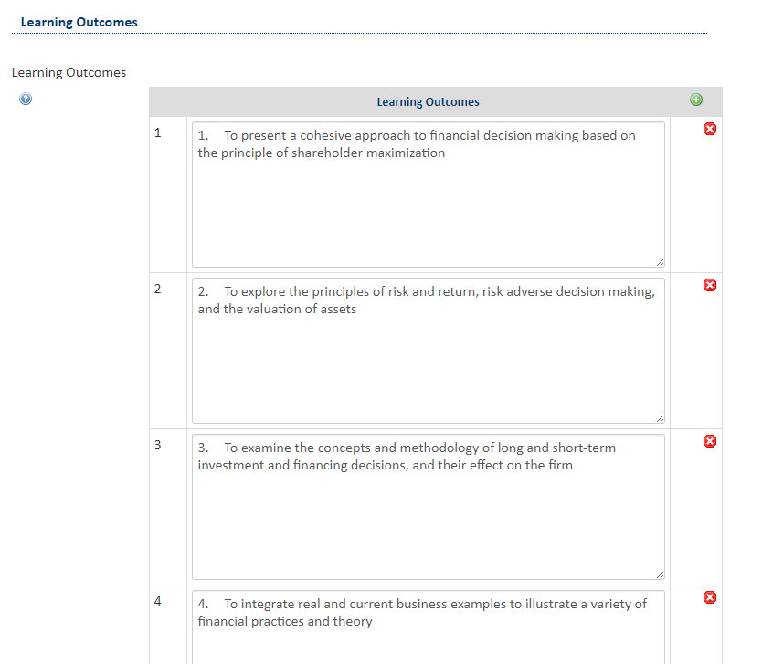
Click the green “+” circle to add Course Learning Outcomes
Course Learning Outcomes in CIM

Slide 6
Before Mapping: Program Considerations
Is your program information set up in CIM correctly?

Slide 7
Program Learning Outcomes
Are all Program Learning Outcomes entered into CIM?
Is each Program Learning Outcome entered as an individual row?
Is each Program Learning Outcome Aligned With at Least One Institutional Student Learning Outcome?

Slide 8
Aligning Program Learning Outcomes and Institutional Student Learning Outcomes in CIM
Click the green “+” circle to add a Course Learning Outcome; Click the yellow pencil to edit each outcome and add the ISLO alignment(s)

Slide 9
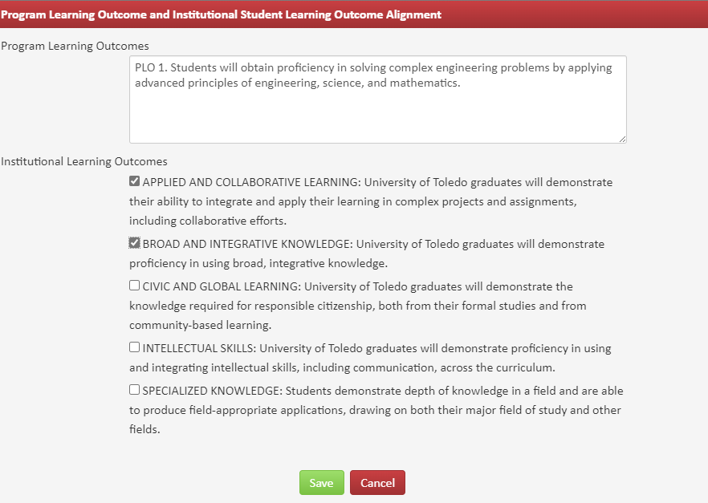
Entering Course Learning Outcomes in CIM
Currently, these alignments are listed in the Program’s Assessment Plan.

Slide 10
Required Courses for the Program
Are all required courses for the program listed in CIM?
Are they listed under the “Requirements” heading in CIM?

Slide 11
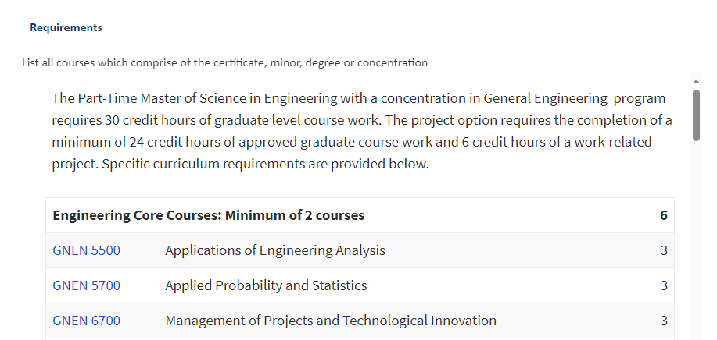

Slide 12
Curriculum Mapping in CIM
How to enter program curriculum mapping data into CIM

Slide 13
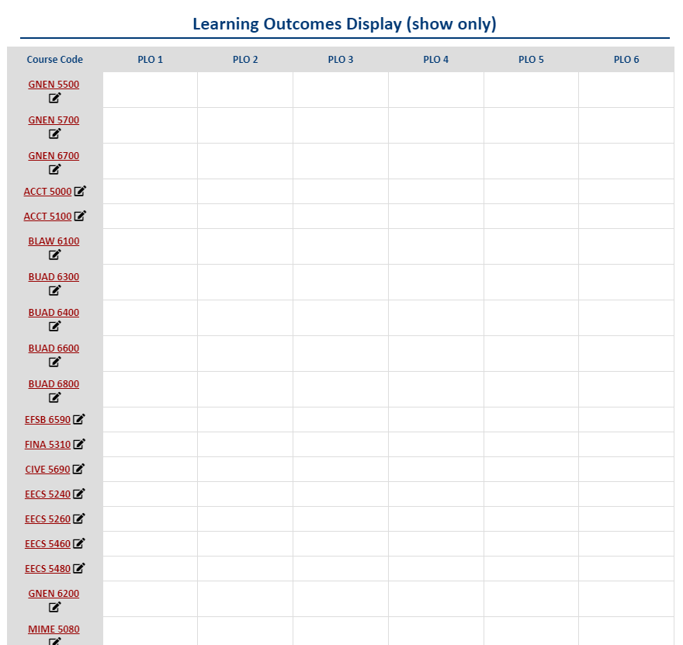
Once the required courses are listed correctly in CIM, the Curriculum Map template automatically displays within the program workflow.

Slide 14
Mapping Course Learning Outcomes to Program Learning Outcomes
Click the pencil to map the Course to the Program Learning Outcomes for Each Required Course

Slide 15
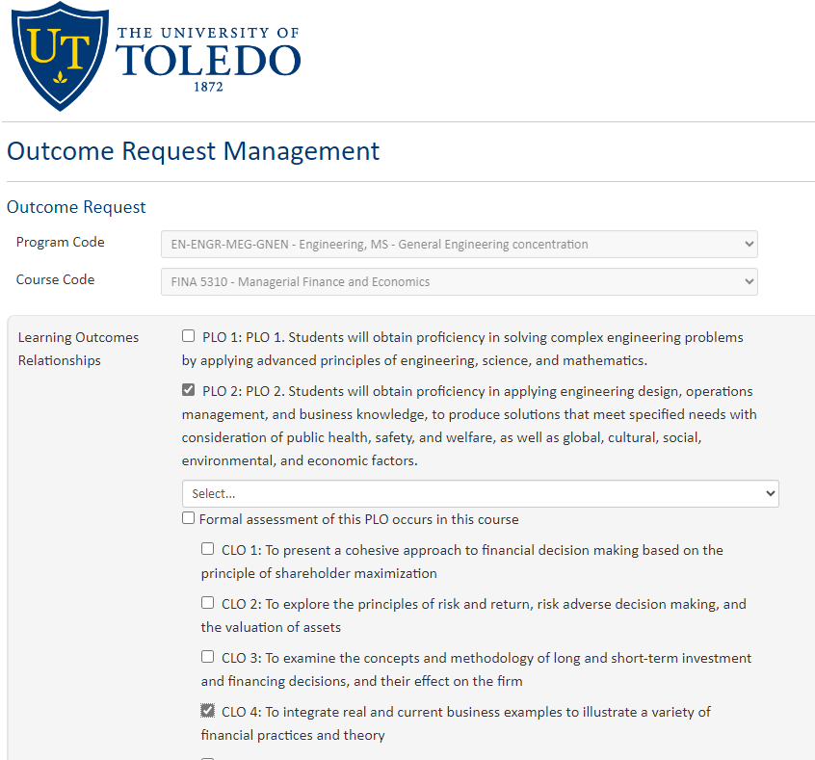
A new window opens, listing the Program Learning Outcomes.
Trouble Shooting:
If the list of course outcomes does not appear, check the learning outcomes listed under the Course in CIM.
The mapping feature is linked to the Program information in CIM.
Step 1.
Select a Program learning outcome from the list to open a new dropdown list of course outcomes.
Step 2.
Select the aligned course learning outcome(s).

Slide 16
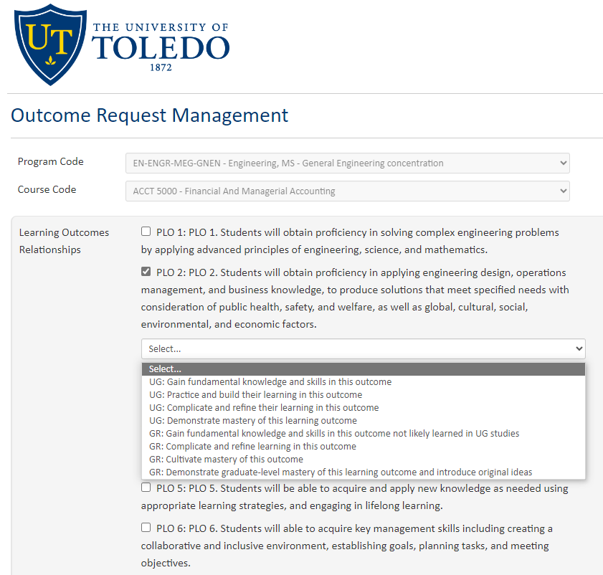
Step 3:
Select the appropriate level of learning, relative to the program outcome selected, expected in this course.
UG = Undergraduate
GR = Graduate/Professional

Slide 17
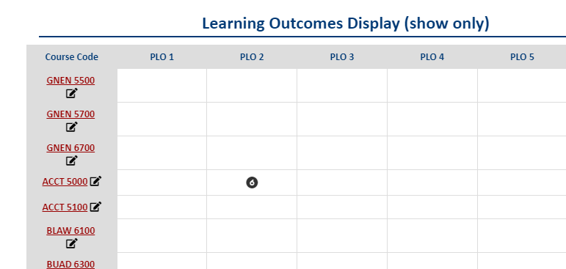
The level of learning indicated in step 3 appears as a number in the curriculum map.

Slide 18
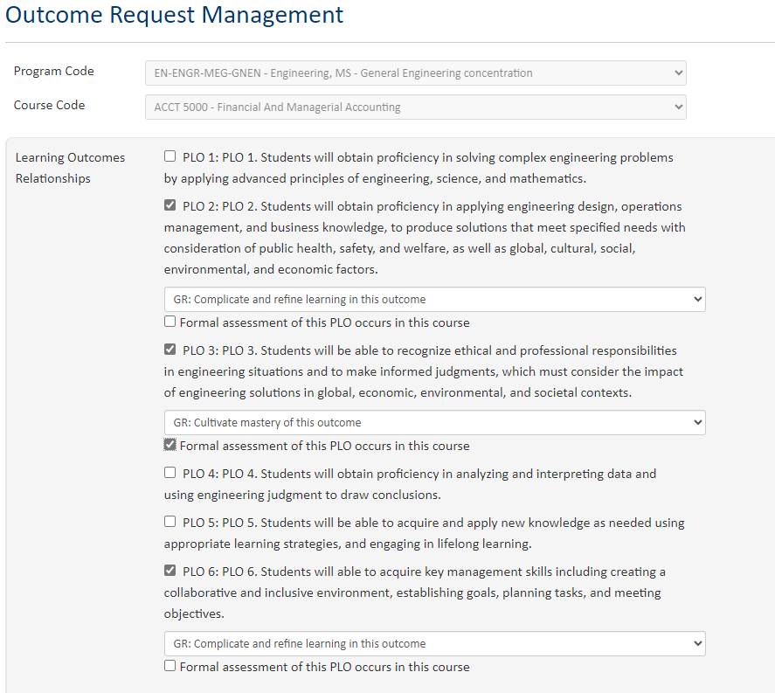
Step 4.
Indicate if a program learning outcome is formally assessed in this course.

Slide 19
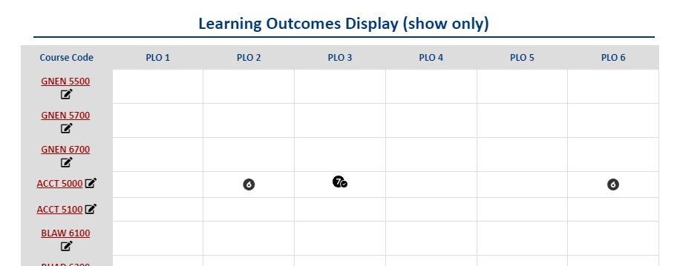
The formal assessment of a PLO indicated in step 4 appears as a checkmark in the curriculum map.

Slide 20
Repeat Steps 1-4 for each required course in the Program

Slide 21
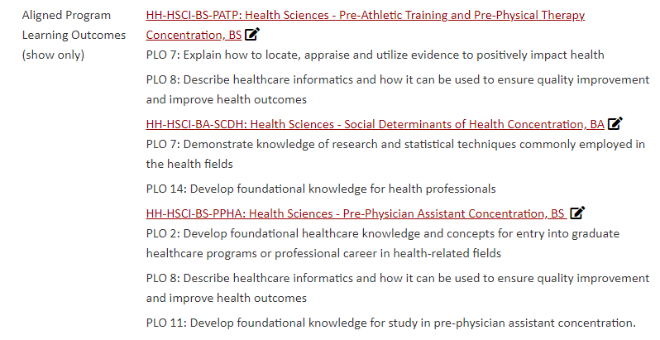
Once the Program Curriculum Map is complete, the alignments between each program and an individual course display under the course listing in CIM.

Slide 22
Filling in Gaps Linking Curriculum Design to Assessment
Important items not included in the conversion of curriculum mapping to CIM:
Course mapping of individual assignments to program-level assessment
Checkmark in CIM indicating formal assessment within a course should have a corresponding item(s) in the program assessment plan
Mapping and assessment of Co-Curricular learning should remain part of the assessment plan
Program-level assessment measures, administered outside the scope of an individual course, should remain part of the assessment plan

Slide 23
Questions or Need Assistance?
Alana Malik
Alana.malik@utoledo.edu
419-530-2026
Cathy Zimmer
Cathy.zimmer@utoledo.edu
419-530-3202

