Slide 1
The University of Toledo
Student Health Insurance Plan - 2013

Slide 2
Student Health Insurance Plan
Who is required to have Student Health Insurance:
All Students registered for (6) or more on-campus credit hours per term
International Students registered for (1) or more on-campus credit hours per term
Medical Students registered for (1) or more on-campus credit hours per term

Slide 3
Enroll/Waive Deadlines
Fall Deadline: September 30, 2013
Spring/Summer Deadline: January 31, 2014
Online Waiver system – Access through www.myut.utoledo.edu
Should have current insurance policy information to input
University of Toledo may audit waiver submissions

Slide 4
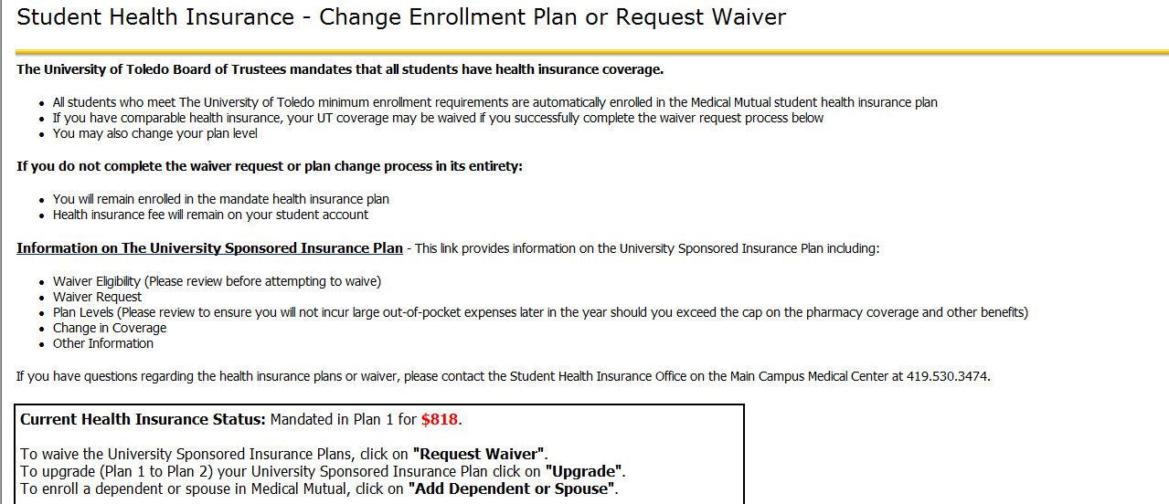
Student Insurance PLAN

Slide 5
Student Insurance PLAN (cont.)

Slide 6
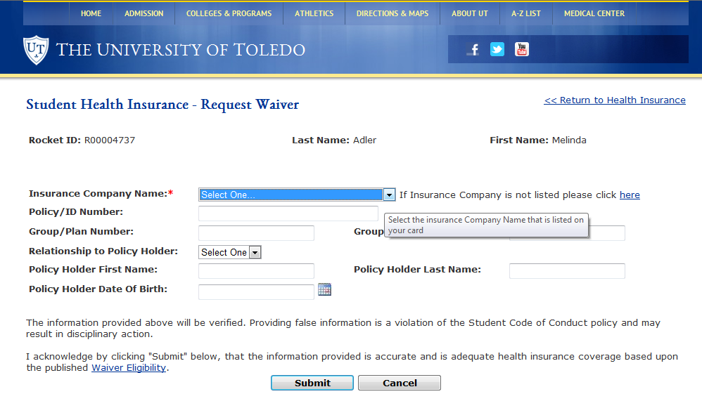
Student Insurance PLAN (cont.)

Slide 7
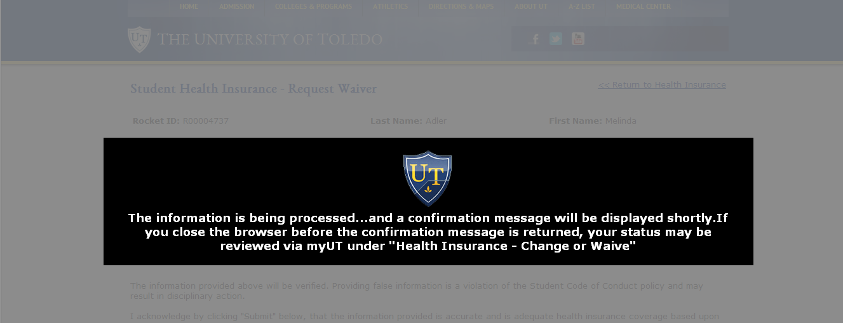
Student Insurance PLAN (Cont.)

Slide 8
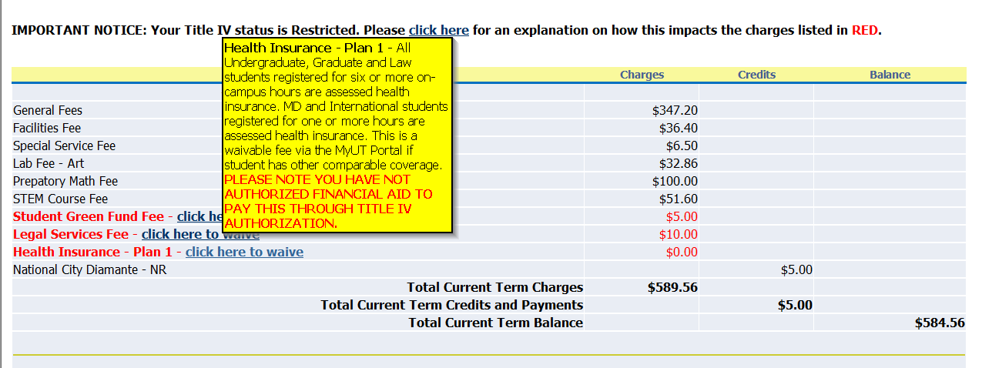
Student Insurance PLAN

Slide 9
enrollment Process
If you are an eligible student you will be automatically enrolled in Plan 1
Fee will be added to your Student Account
If you would like to enroll in Plan 2, you may select to do this on website
For more information visit the website: Student.MedMutual.com
If you are not a full-time student , you may enroll on this website
If you have a dependent to enroll, you may enroll on this website
You will receive an email confirmation and an invoice

Slide 10
Where to go for Services
LEVEL 1 Benefits -
University of Toledo Medical Center Hospital
University of Toledo Physicians
Student Medical Center – Main Campus
Student Health and Wellness Center – Health Science Campus – Ruppert Health Center Lower Level, Suite 003
UT Pharmacy – Health Science Campus
LEVEL 2 Benefits –
Medical Mutual’s SuperMed Network

Slide 11
Benefits at A Glance
Plan Benefits Plan 1 Plan 2
Benefit Period Maximum $500,000 $500,000
Pharmacy Maximum Combined Medical and Prescription
Mental Health Maximums
Outpatient 30 visits per benefit period
Inpatient 30 days per benefit period

Slide 12
Benefits at a Glance
Annual Deductible Plan 1 Plan 2
At SHC, UTMC, UTP $100 NONE
MMO Network Provider $300 NONE
Non-Network Provider $500 Individual $250 Individual
$1,000 Family $500 Family

Slide 13
Benefits at a Glance
Office Visit and Emergency Room * Plan 1 Plan 2
At SHC, UTMC, UTP 100% 100%
Network Provider 80% after $10 Copay 100% after $15 Copay
Non-Network Provider 60% 70%
Emergency Room $100 copay $50 Copay
*Deductible applies to services unless a copay is listed.

Slide 14
Benefits at A Glance
Preventive Services * Plan 1 Plan 2
At SHC, UTMC, UTP 100% 100%
Network Provider 80% 100%
Non-Network Provider 60% 70%
*In accordance with state and federal law. Certain services are subject to deductible.

Slide 15
Benefits at a Glance
Inpatient Hospitalization* Plan 1 Plan 2
X-ray and Lab*
At SHC, UTMC, UTP 100% 100%
Network Provider 80% 100%
Non-Network Provider 60% 70%
*Deductible applies to services unless a copay is listed.

Slide 16
Benefits At A GLANCE
Prescription Drug* Plan 1 Plan 2
UT Pharmacy (100% after Copay)
Generic $5 $5
Formulary Brand $25 $25
Non-formulary Brand $60 $60
Participating Retail Pharmacy $10 $10
Formulary Brand $25 + 20% $25 + 20%
Non-formulary Brand $60 + 20% $60 + 20%
*Prescription drug reflects a 30-day supply

Slide 17
Who To Call/Contact
Main Campus Medical Center - Visit http://utoledo.edu/healthservices/student/index.html
Or Call 419-530-3451 or
Main Campus Insurance Management Office
Call 419-530-3474
Medical Mutual’s Customer Service
Call 800- 272-6967
Health Science Campus - Visit
www.utoledo.edu/healthservices/hsc/index.html
Or Call 419-383-3777

